Slide 1
“Dan Uggla: History's Most Unlikely Hitting Streak?”
Presenter: David Firstman / Casey Stengel Chapter
SABR 51 – July 2023

Slide 2
INTRODUCTION

Slide 3
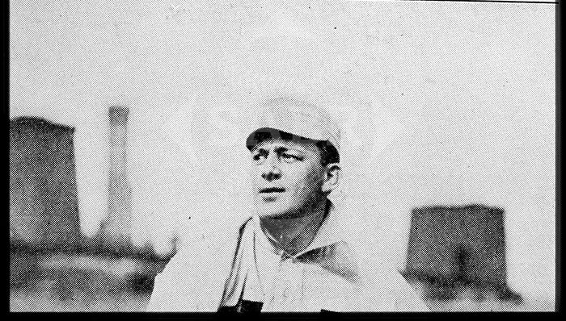

Slide 5
Why are long hitting streaks so difficult to achieve?

Slide 6
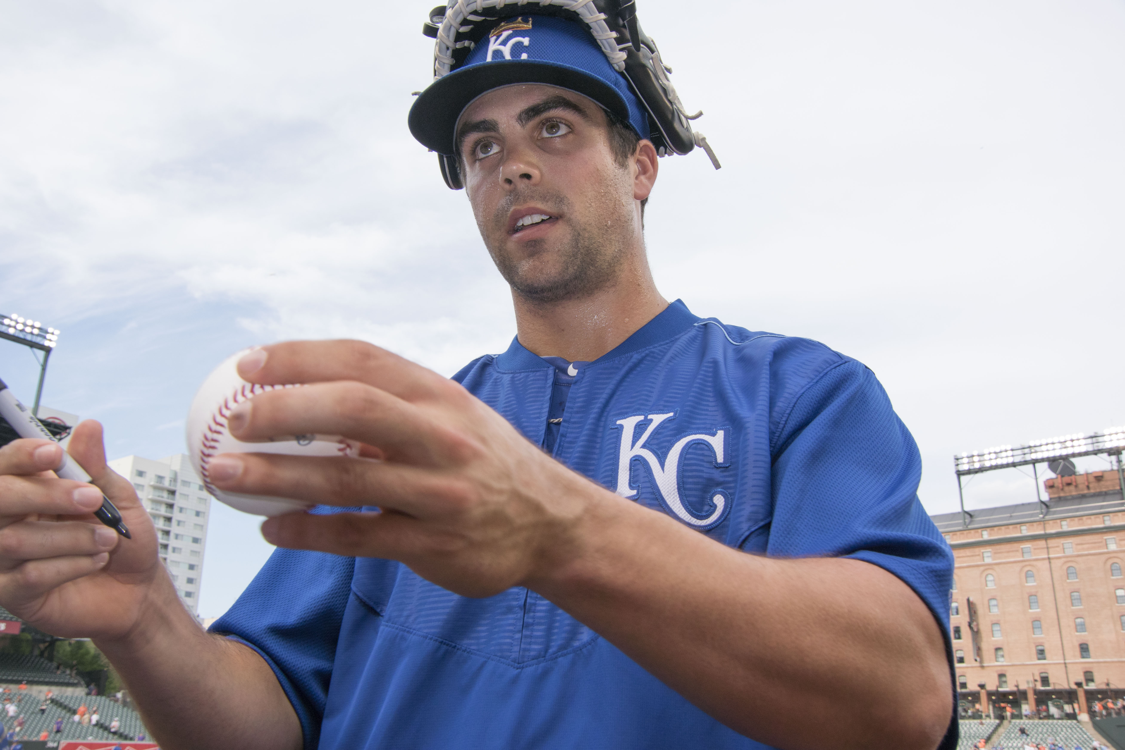

Slide 7
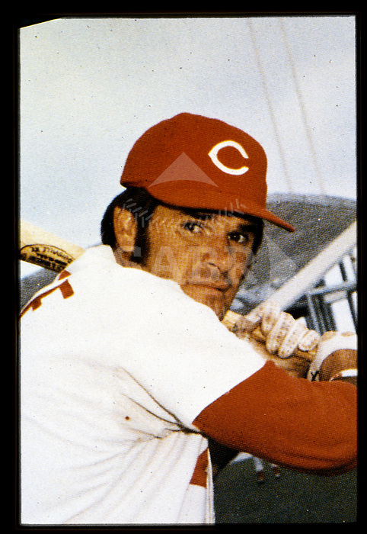

Slide 8
Pete Rose’s Four Components for a Long Hitting Streak

Slide 9
The ability to hit for contact

Slide 10
In the 47 streaks lasting 30 or more games since 1900, batters struck out or walked in 16% of all plate appearances, compared to a 22% average across the Majors.
More balls in play = more opportunities for hits.

Slide 11
2. Enough speed to leg out a weak hit or bunt

Slide 12
Lefties make up nearly 1/3 of all batters who have stepped to the plate. However, they make up roughly 47% of the 30+-game hit streaks.

Slide 13
3. A knack for hitting to all fields

Slide 14
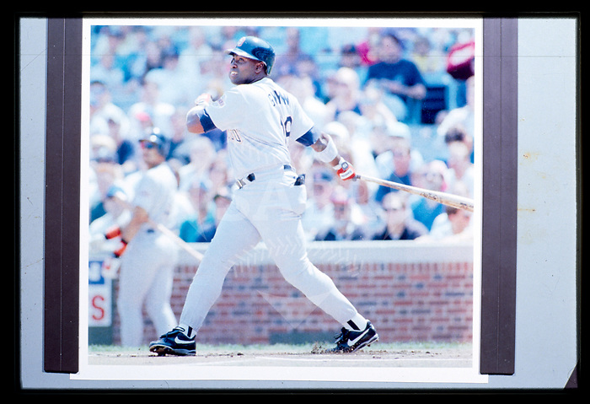

Slide 15
Batted Ball Direction 1988-2022
PULLED | 29%
MIDDLE | 53%
OPPOSITE | 18%

Slide 16
4. A heavy dose of luck

Slide 17
Of the 47 streaks since 1900, batters had a career composite .321 BABIP at the start of their streak. Their composite BABIP during their streak was .417.

Slide 18
Longest hit streaks of legendary batsmen:
Ted Williams: 23 games
Tony Gwynn: 25 games
Ichiro Suzuki: 27 games
(7 streaks of 20-29 games)
Wade Boggs: 28 games

Slide 19
Assumption: .300 hitter gets 4 at-bats each game
Odds he gets at least one hit in a game: roughly 3/4 (76% chance)
Odds of getting at least one hit in two consecutive games: 76% * 76% = 58% chance
Odds of getting at least one hit in 30 consecutive games: 76%^30 = or .03% or
1 in 3,764.

Slide 20
CAREER BA PRIOR TO STREAK (1900-PRESENT)
.250s | 2
.260s | 6
.270s | 3
.280s | 7
.290s | 7
.300s | 4
.310s | 5
.320s | 3
.330s | 2
.340s | 5
.350s | 2
.360s | 1

Slide 21
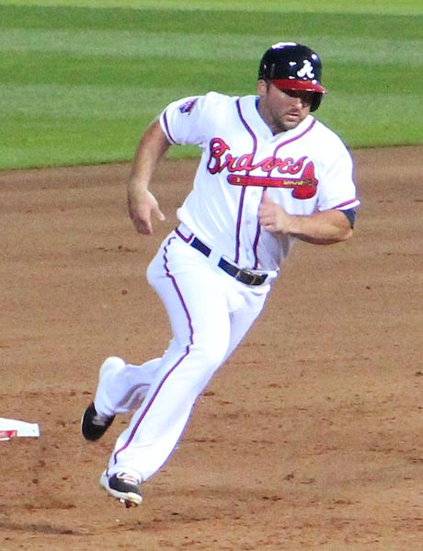

Slide 22
A Tale of Three Ugglas – Before the Streak
Date | G | PA | H | 2B | 3B | HR | RBI | BB | SO | BA | OBP | SLG | OPS | BABIP
3/31-7/4 | 86 | 348 | 55 | 11 | 1 | 12 | 29 | 27 | 77 | .173 | .241 | .327 | .568 | .187

Slide 24
NL BATTING LEADERS - 7/5/2011 MORNING
RK | Name | AVG
1 | Jose Reyes | .354
2 | Hunter Pence | .325
3 | Matt Kemp | .324
4 | Ryan Braun | .320
5 | Todd Helton | .319
\|/ | \|/ | \|/
73 | Kelly Johnson | .216
74 | John Buck | .211
75 | Dan Uggla | .173

Slide 25
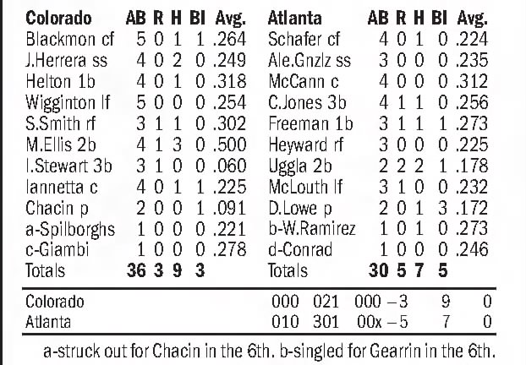
Game 1 – July 5

Slide 26
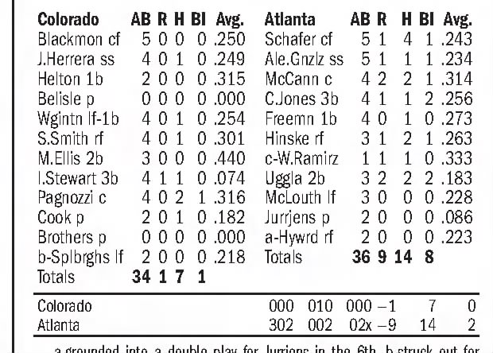
Game 2 – July 6

Slide 27
Games 3 thru 10
Date | Opp | PA | AB | H | 2B | 3B | HR | BA
7-Jul | COL | 5 | 4 | 1 | 1 | 0 | 0 | .183
8-Jul | PHI | 4 | 4 | 1 | 0 | 0 | 0 | .184
9-Jul | PHI | 5 | 5 | 1 | 0 | 0 | 1 | .185
10-Jul | PHI | 4 | 4 | 1 | 1 | 0 | 0 | .185
15-Jul | WSN | 5 | 5 | 1 | 1 | 0 | 0 | .186
16-Jul | WSN | 4 | 2 | 1 | 0 | 0 | 0 | .187
17-Jul | WSN | 4 | 3 | 1 | 0 | 0 | 0 | .189
18-Jul | COL | 5 | 5 | 1 | 0 | 0 | 0 | .189

Slide 28
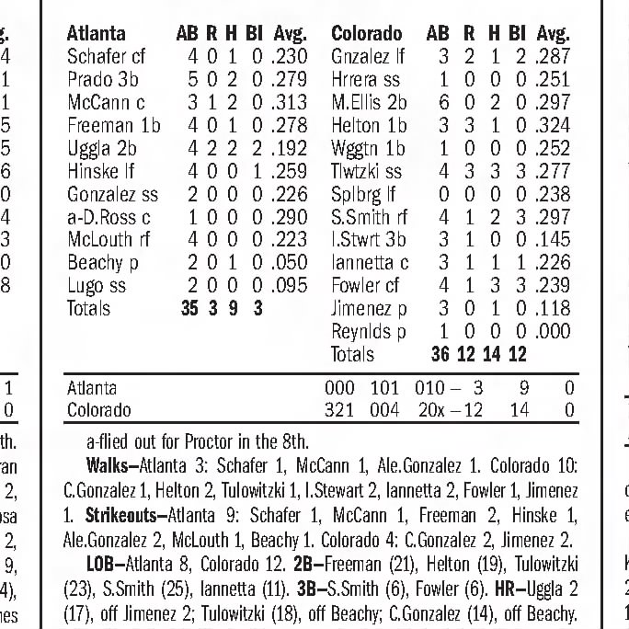
Game 11 – July 19

Slide 29
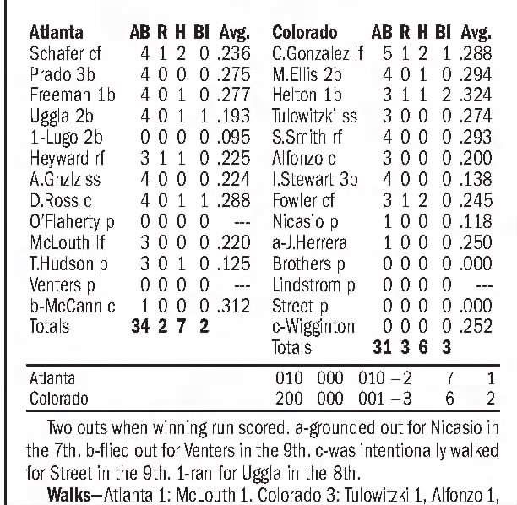
Game 12 – July 20

Slide 31
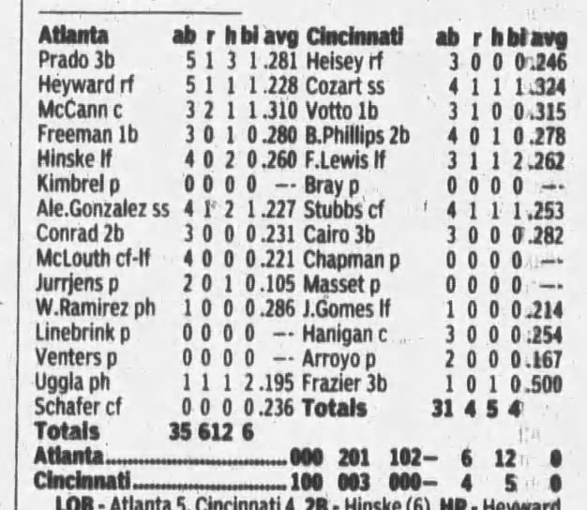
Game 13 – July 22

Slide 32
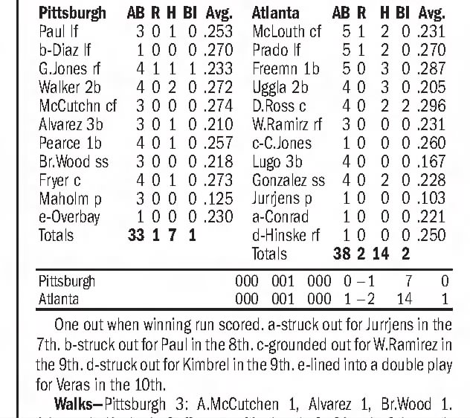
Game 18 – July 27

Slide 34
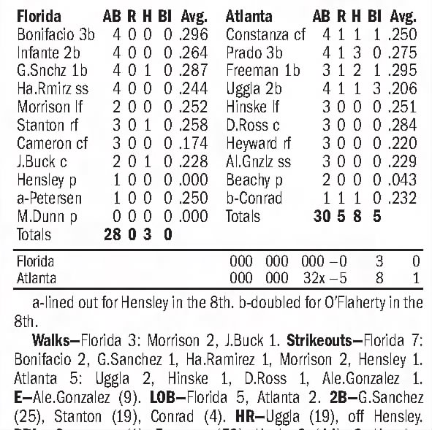
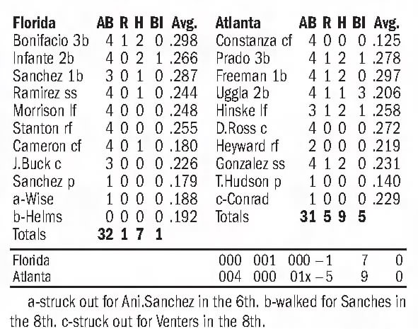
Game 20 – July 29
Game 21 – July 30

Slide 35
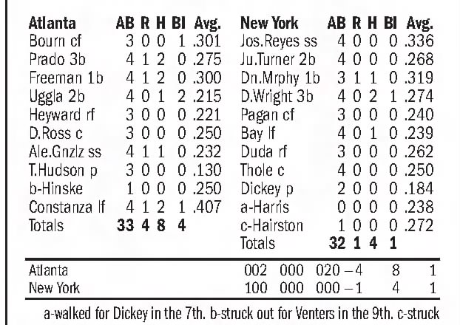
Game 26 – August 5

Slide 36
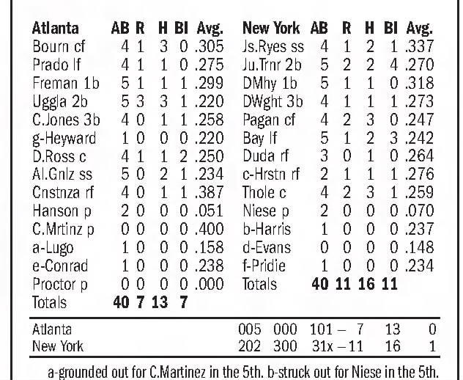
Game 27 – August 6

Slide 37
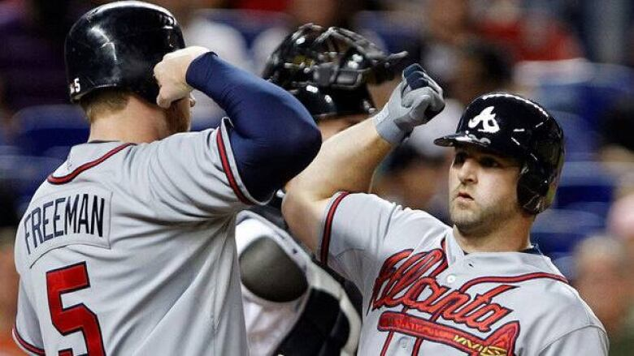

Slide 38
Uggla’s Average Goes Up in Record 27 Straight Games
GAME | DATE | YTD AVG | change |  | GAME | DATE | YTD AVG | change
0 | 4-Jul | .1730 | ----- |  | 15 | 24-Jul | .1973 | .00111
1 | 5-Jul | .1781 | .00517 |  | 16 | 25-Jul | .1979 | .00056
2 | 6-Jul | .1827 | .00454 |  | 17 | 26-Jul | .1990 | .00109
3 | 7-Jul | .1835 | .00082 |  | 18 | 27-Jul | .2047 | .00571
4 | 8-Jul | .1843 | .00080 |  | 19 | 28-Jul | .2051 | .00046
5 | 9-Jul | .1845 | .00023 |  | 20 | 29-Jul | .2056 | .00046
6 | 10-Jul | .1853 | .00077 |  | 21 | 30-Jul | .2060 | .00045
7 | 15-Jul | .1855 | .00021 |  | 22 | 31-Jul | .2065 | .00044
8 | 16-Jul | .1873 | .00181 |  | 23 | 1-Aug | .2118 | .00535
9 | 17-Jul | .1886 | .00125 |  | 24 | 2-Aug | .2122 | .00037
10 | 18-Jul | .1887 | .00016 |  | 25 | 3-Aug | .2150 | .00278
11 | 19-Jul | .1922 | .00347 |  | 26 | 5-Aug | .2153 | .00034
12 | 20-Jul | .1928 | .00064 |  | 27 | 6-Aug | .2199 | .00455
13 | 22-Jul | .1951 | .00222 |  | 28 | 7-Aug | .2196 | (.00023)
14 | 23-Jul | .1962 | .00113

Slide 39
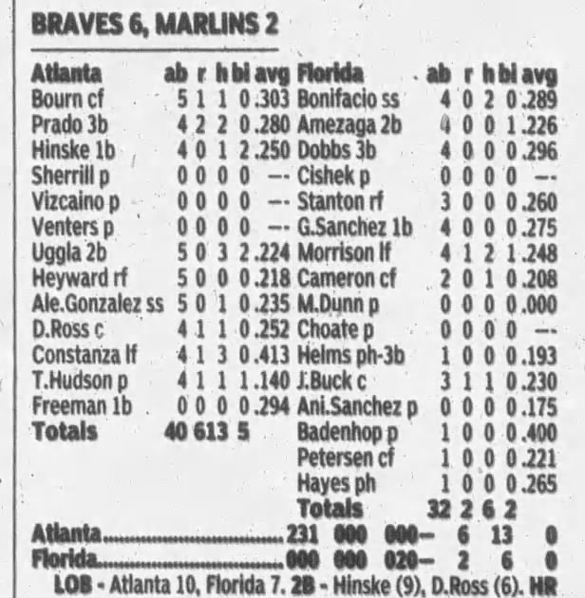
Game 31 – August 10

Slide 40
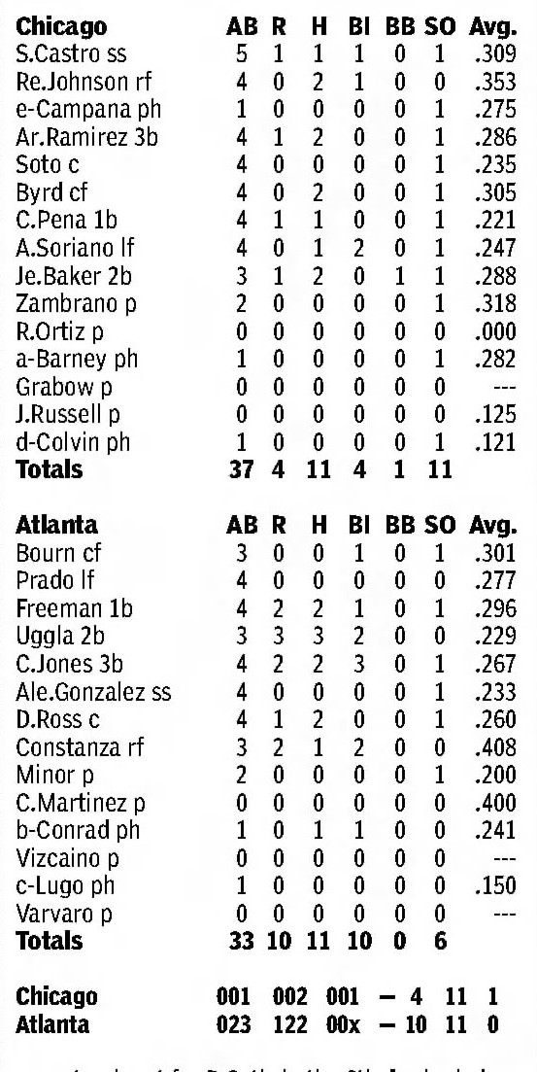
Game 32 – August 12

Slide 41
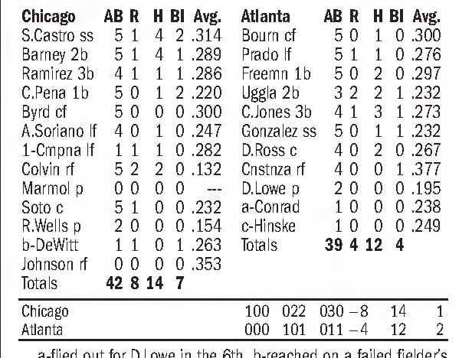
Game 33 – August 13

Slide 44
A Tale of Three Ugglas – During the Streak
Date | G | PA | H | 2B | 3B | HR | RBI | BB | SO | BA | OBP | SLG | OPS | BABIP
7/5-8/13 | 33 | 146 | 49 | 5 | 0 | 15 | 32 | 12 | 27 | .377 | .438 | .762 | 1.200 | .382

Slide 45
A Tale of Three Ugglas – After the Streak
Date | G | PA | H | 2B | 3B | HR | RBI | BB | SO | BA | OBP | SLG | OPS | BABIP
8/14-9/28 | 42 | 178 | 36 | 6 | 0 | 9 | 21 | 23 | 52 | .237 | .343 | .454 | .797 | .294

Slide 46
Summary of Uggla’s Anomalous
Hit Streak
Homers made up 30% of hits (highest all-time)
Strikeouts made up 18.5% of plate appearances (3rd-highest all-time)
.377 batting average (9th-lowest all-time)
Started at .173 and ended at .232 (both lowest all-time)
Ended season at .233 (lowest all-time)
Next longest streak 12 games (3rd-lowest all-time)

Slide 47
Data/photos culled from, and other thanks go out to:
Baseball Reference
SABR Rucker Archive
Associated Press
Trent McCotter
Fangraphs

