Slide 1
Changes In Minor League Umpire Tendencies With The Challenge and Automatic Ball-Strikes Systems
Jonah Soos, Dr. Jeremy Losak, & Dr. Jason Maddox

Slide 2
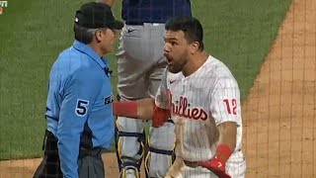
April 24th 2022: Schwarber Bat Slam

Slide 3
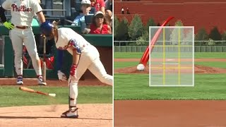
April 13th 2023: Alec Bohm’s Blow Up

Slide 4
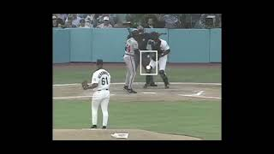
1997 NLCS: “The Eric Gregg Game”

Slide 5
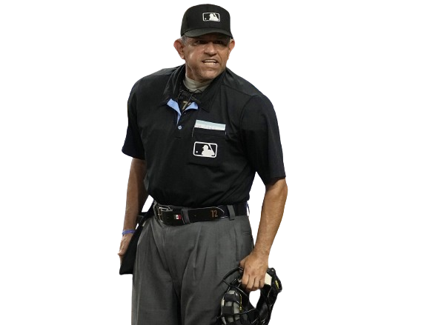
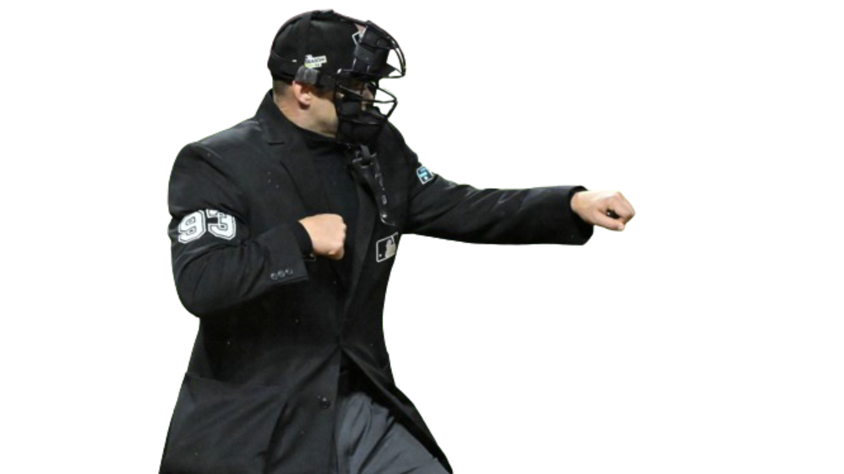
Responding to Scrutiny
Sparked discourse amongst the community about the effect of umpires on the game of baseball.
Lead MLB to test two new alternatives in recent MiLB seasons
Automatic Ball-Strike (ABS) System
Challenge System
Notes:
Do we want to credit this to “social media”? Saying “Effects of Social Media” implies the change is being driven by arguments on social. And I’m not inclined to state that.

Slide 6
History of Automated Strike Zones
ABS First Tested at the Atlantic League (AA) All-Star Game. Used for 2nd half and in Arizona Fall League (AFL).
ABS Used in 11 Triple-A Ballparks. Low-A, and for final month of Triple-A, tested the challenge system. Further used in AFL
KBO announced they would fully utilize the ABS system to ensure fairness.
2019
2022
2024
2021
2023
Revamped ABS used in Low-A Southeast (now Florida State League), first full season test. Used in AFL.
All 30 Triple-A Ballparks fully adapt the ABS and Challenge Systems.

Slide 7
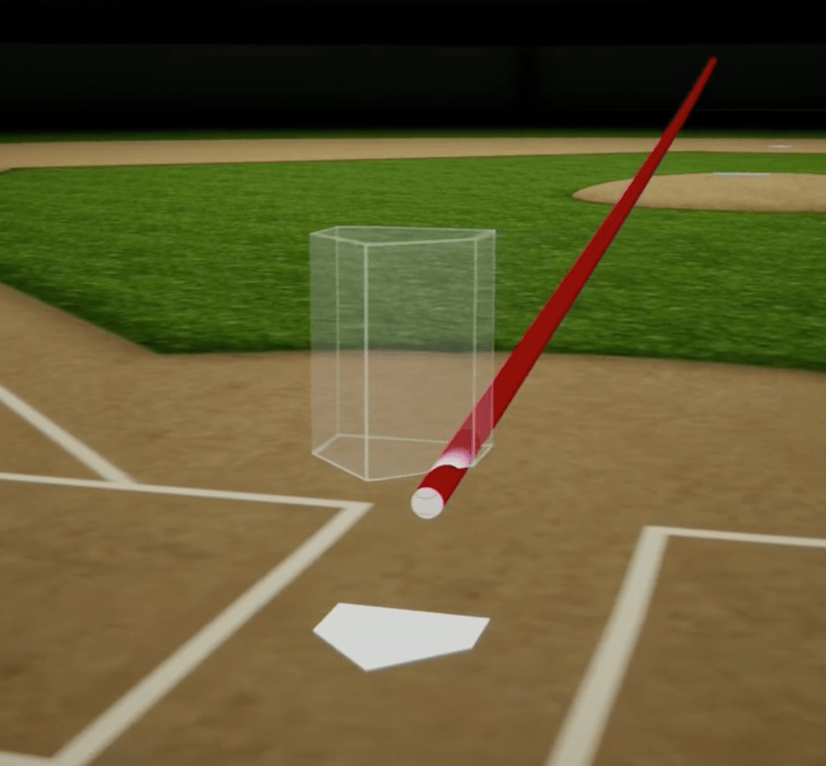
The Automatic Ball-Strike (ABS) System
Uses Hawk-Eye 3D Tracking system to determining whether a ball touches any area of the strike zone.
Negates any umpire variability – every call is automated
Received criticism and multiple adjustments for being too pitcher/batter friendly

Slide 8
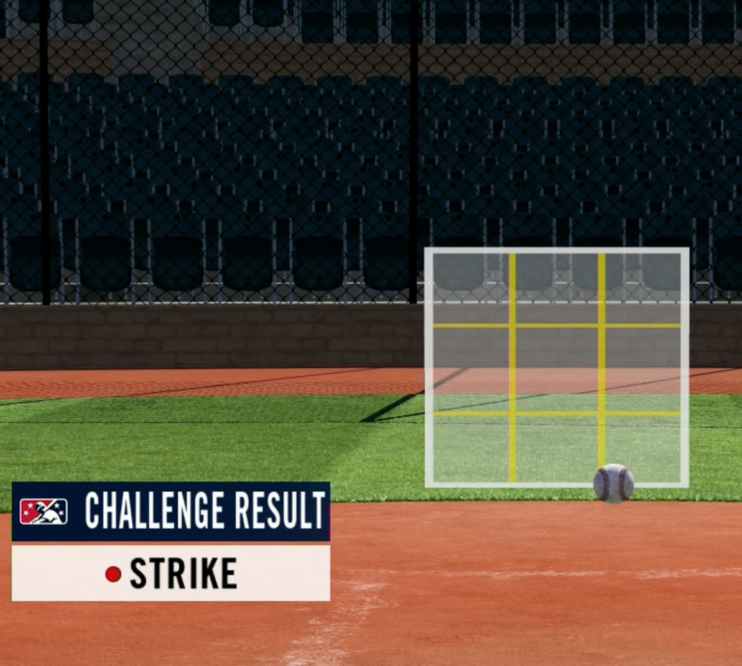
The ABS-Challenge System
Uses same Hawkeye Technology to determine balls and strikes
Batter, Catcher, or Pitcher can initiate a challenge after the pitch
Teams get unlimited challenges, until they reach 3 unsuccessful attempts
Maintains umpire variability

Slide 9
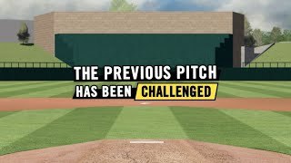
How a Challenge Works

Slide 10
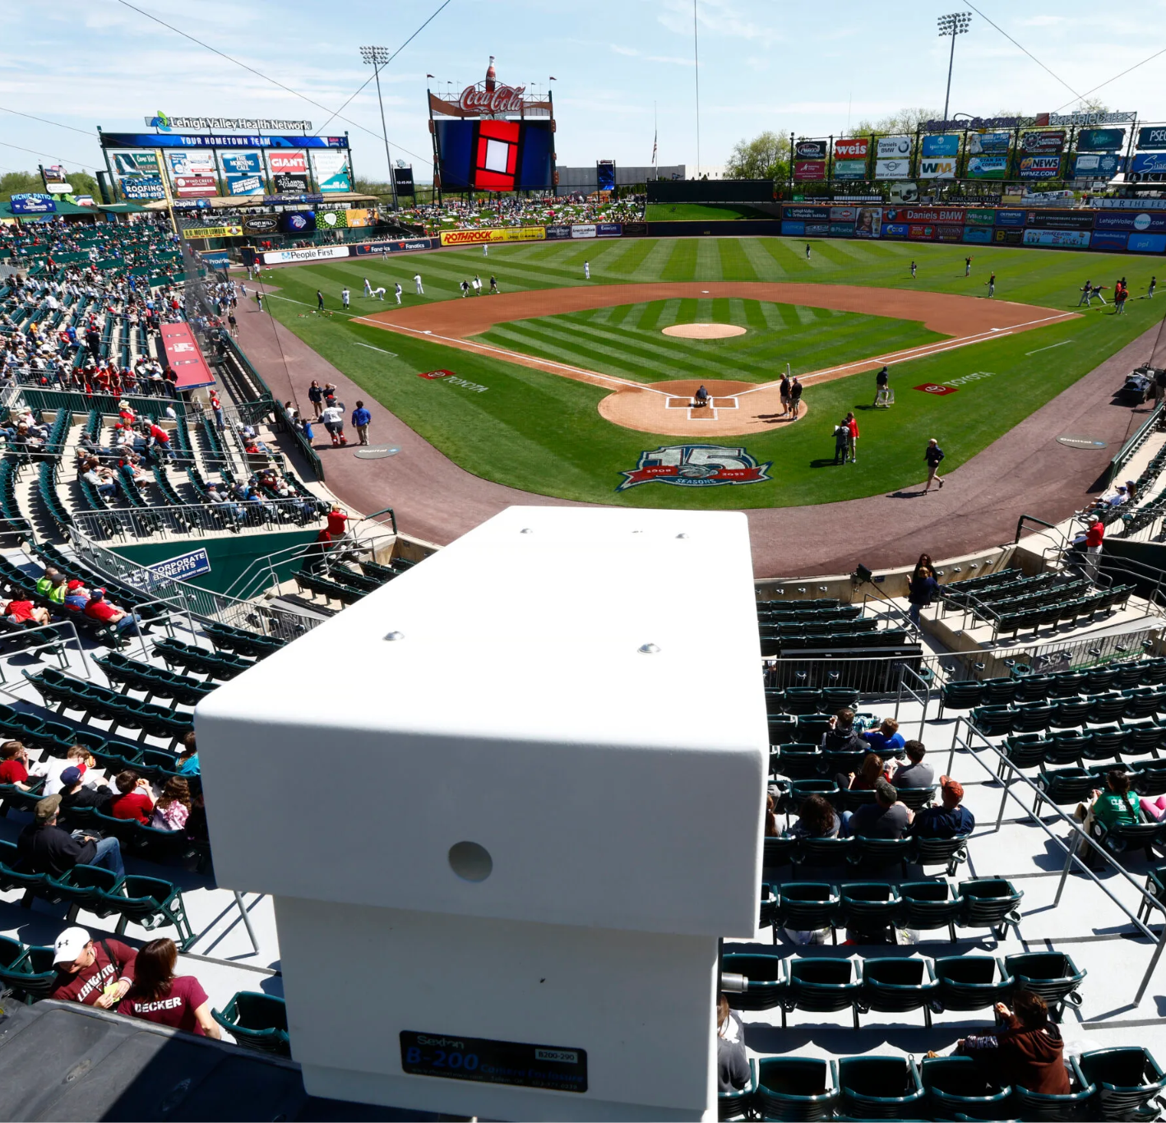
Area of Focus
Utilized the 2023 Triple-A season as our focus group for umpire systems
First full season to use both the ABS and Challenge Systems interchangeably
Higher caliber of play & umpires can allow for results to be more translatable

Slide 11
Goal: Analyze umpire accuracy and tendency shifts under the two new systems.
Question: Do umpires change their strike calling tendencies with the ABS and challenge systems?

Slide 12
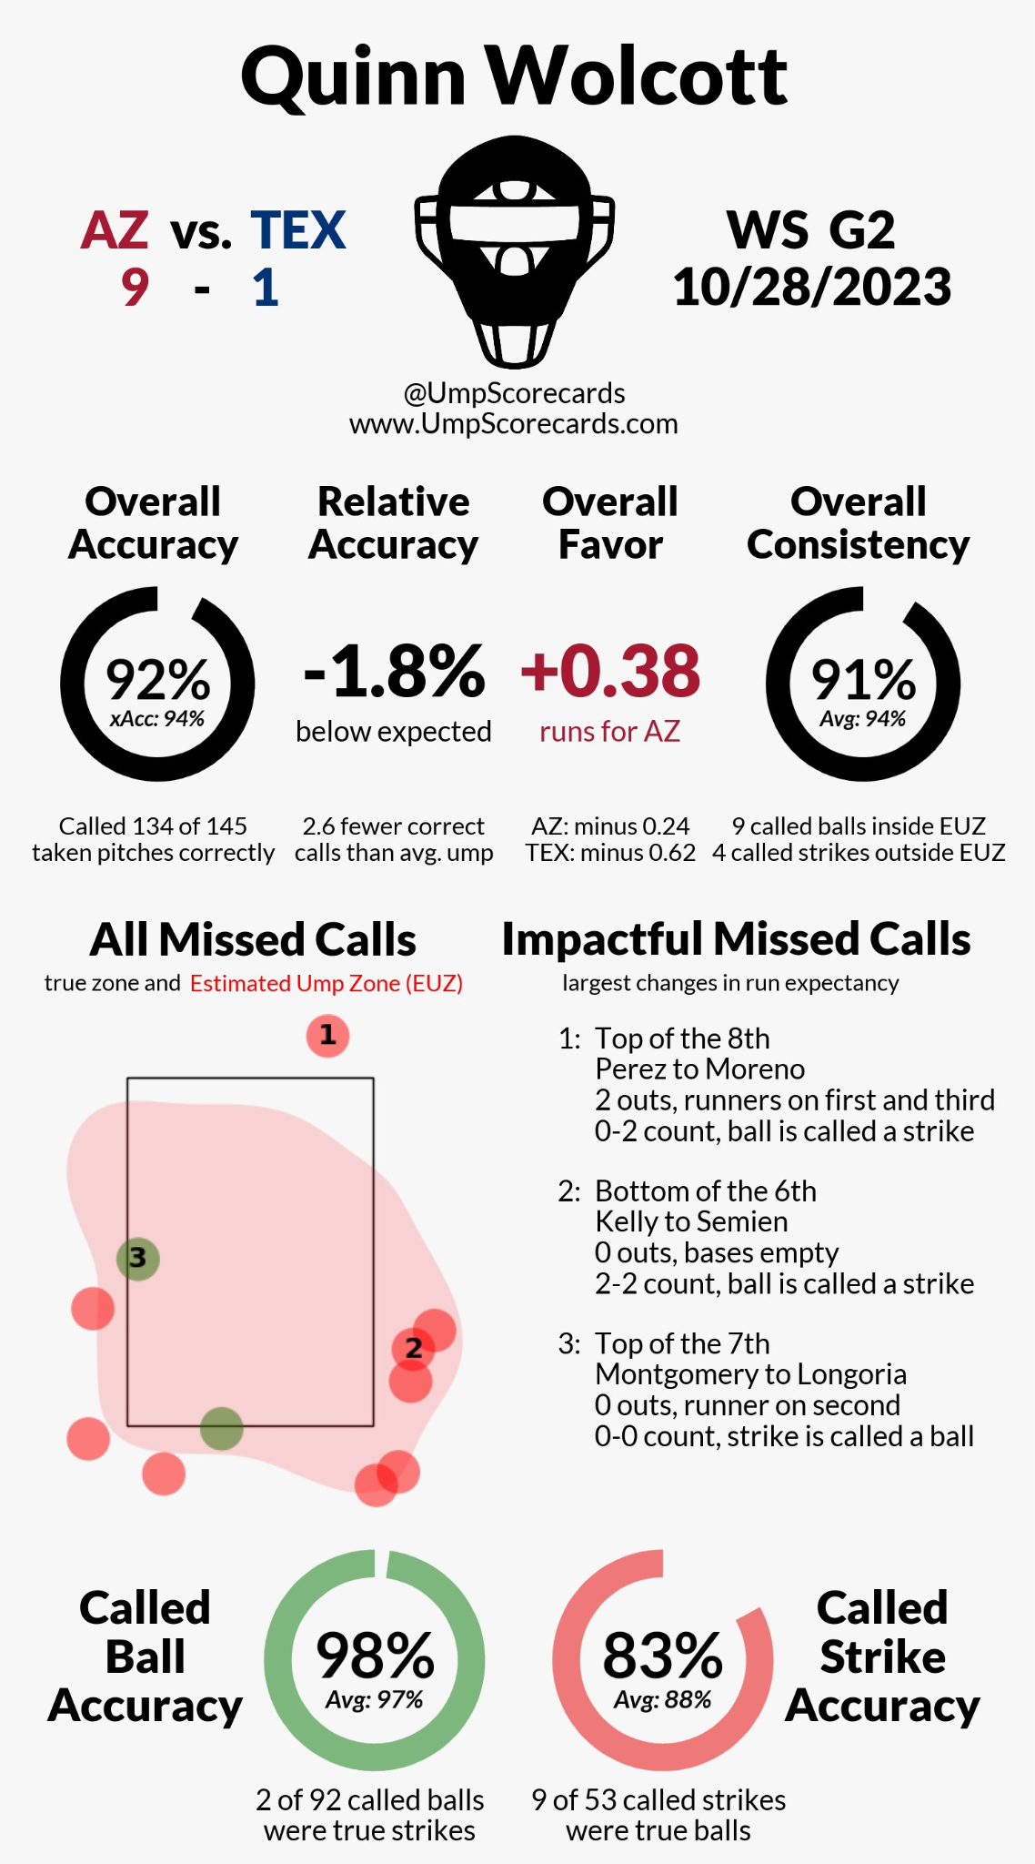
What We Know About Umpires
More scrutiny of umpires with increased access to data
Umpire scorecard
Thorough review of umpire behaviors
Umpire pitch calling has positively progressed as strike-zone technology improves (Mills, 2016)
Expediting skill development
Especially prominent in younger umpires
Umpires impacted by external social pressures
“Heckling” umpires (Guérette et al., 2024)

Slide 13
Test Groups
ABS System
Challenge System
Game 1
Game 2
Game 3
Game 4
Game 5
Game 6
2 Groups: ABS and Challenge
In September, raised the bottom of the strike zone to account for player feedback
Used International League Games pre April 25th as our control group.
ABS Inactive
ABS Active
IL
PCL

Slide 14
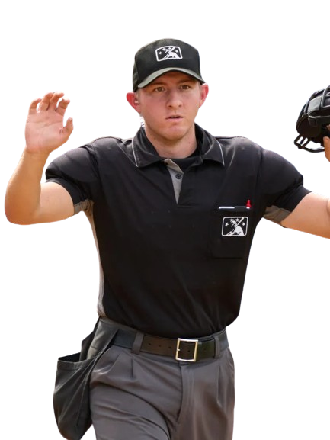
Available Data
Collected Pitch-By-Pitch data for the 2023 Triple-A Season.
First season with access to PITCHf/x data
Binary Indicator for an Incorrect Call by the Umpire
Determined through a predefined 2D strike zone
Looked specifically at 3-0, 0-2, and 3-2 counts in analysis.

Slide 15
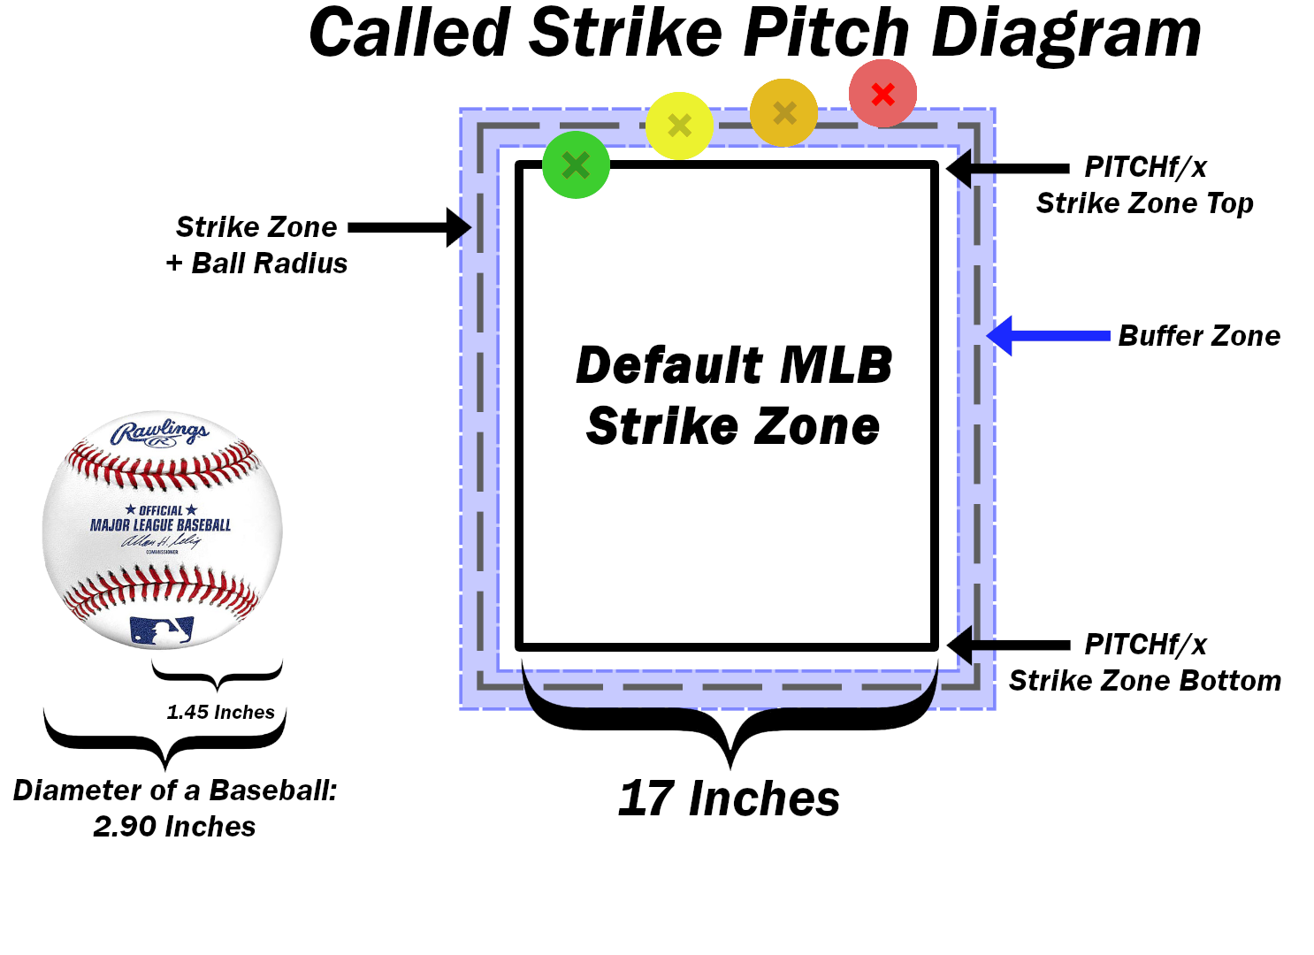
Defining the Strike Zone
Classified our 2D strike zone with different parameters
Strike Zone Edge: One ball radius from the defined MLB Strike
Zone
Buffer Zone: Half Ball Radius zone on
both sides of the
Strike Zone Edge

Slide 16
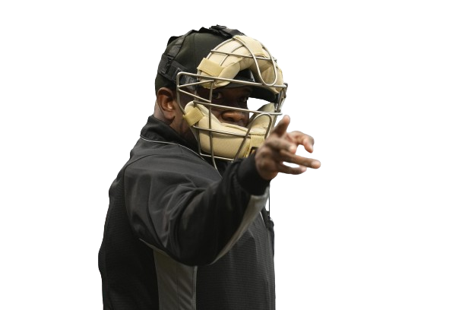
Modeling Methodology
Limit the data to non-swing pitches.
Model predicted probability of the umpire making the correct call
Effects of ball/strike system using average predictions.
Attempted logistic regression, but too many complex interactions.

Slide 17
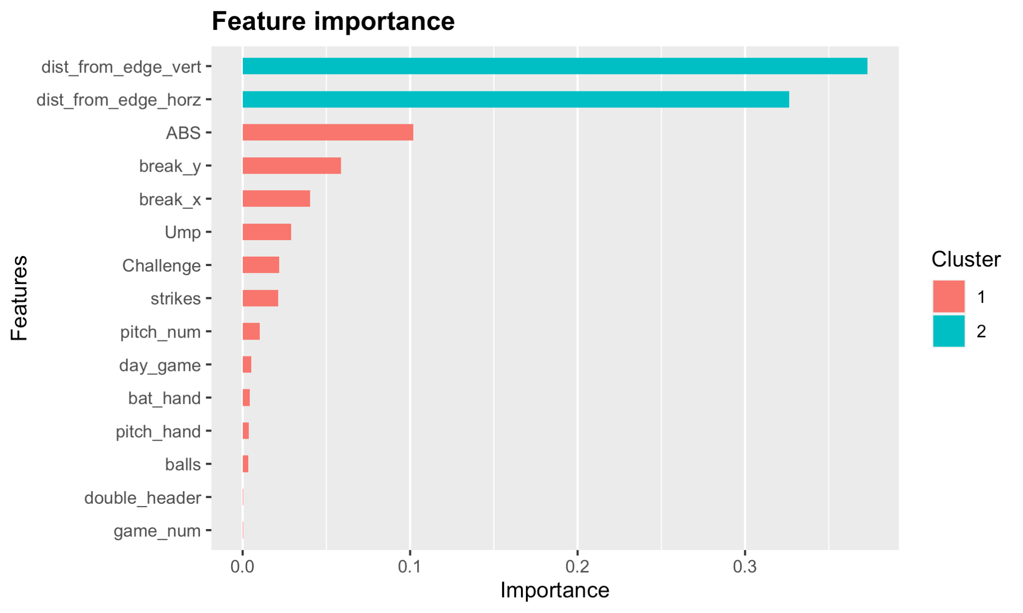
Modeling Methodology
Fit an xgboost model to predict probability of an incorrect call by umpire.
Tuned parameters:
max tree depth: 8
eta: 1/700
trees: 3360
100 bootstrap sample models ran to approximate standard errors of incorrect call probability.

Slide 18
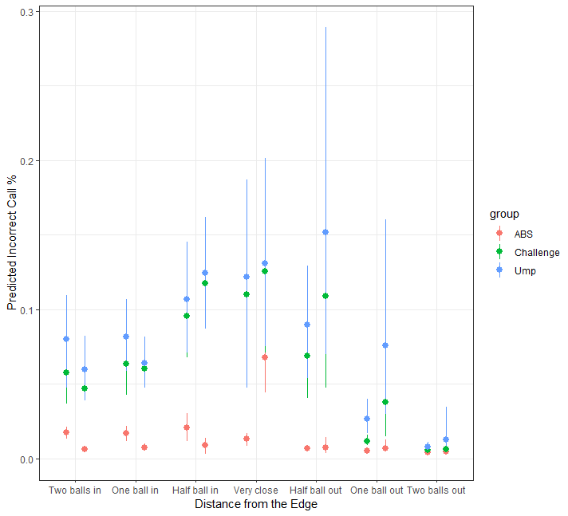
Results: ABS Accuracy
Predicted Inaccuracy in the ABS system is nearly 0
Should not be exactly zero – limitation of a 2D strike zone
Most notable jump is Very Close vertically
Distance Horizontally
Distance Vertically

Slide 19
Results: General Umpire Accuracy
Some evidence that Umpires are more accurate in the Challenge system over the control group.
General trend, some instances of statistical significance
Sample Size of control group make it difficult to draw definitive conclusions

Slide 20
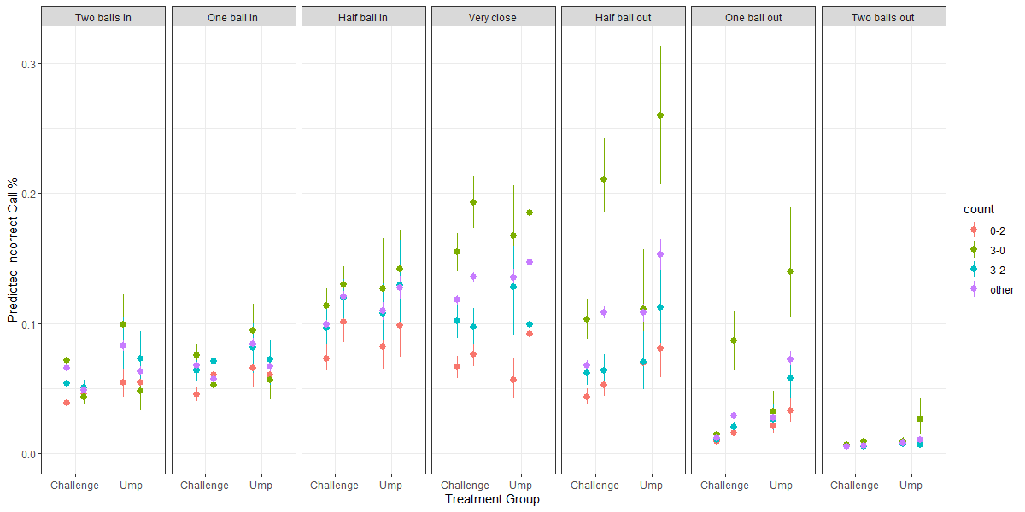
Results: General Umpire Accuracy

Slide 21
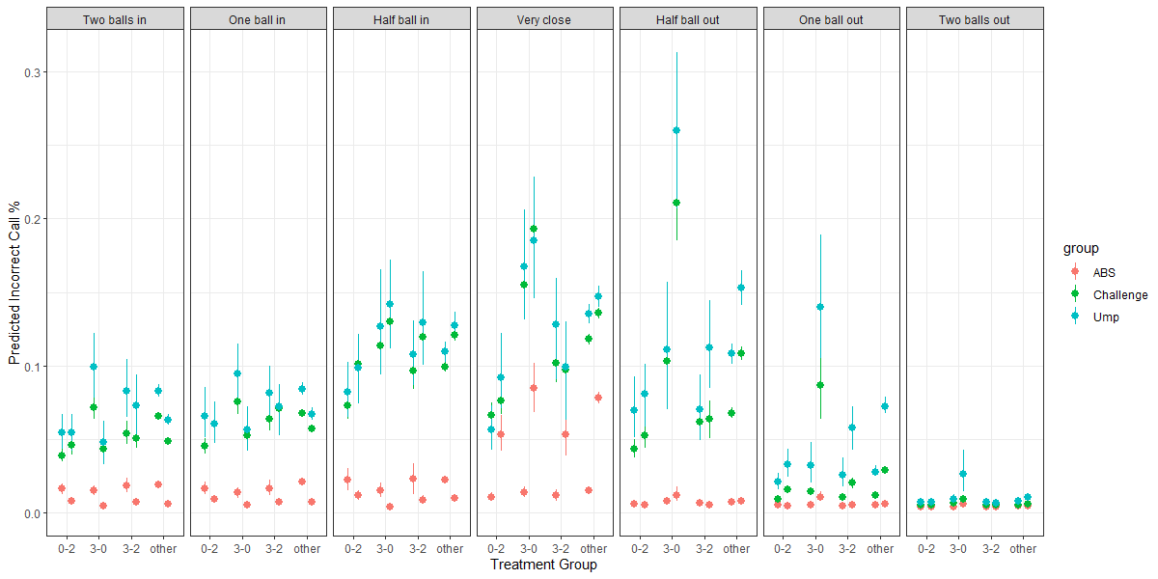
Results: General Umpire Accuracy
Statistical
Significance

Slide 22
Results: Accuracy Based on Count
Least Accurate
Most Accurate

Slide 23
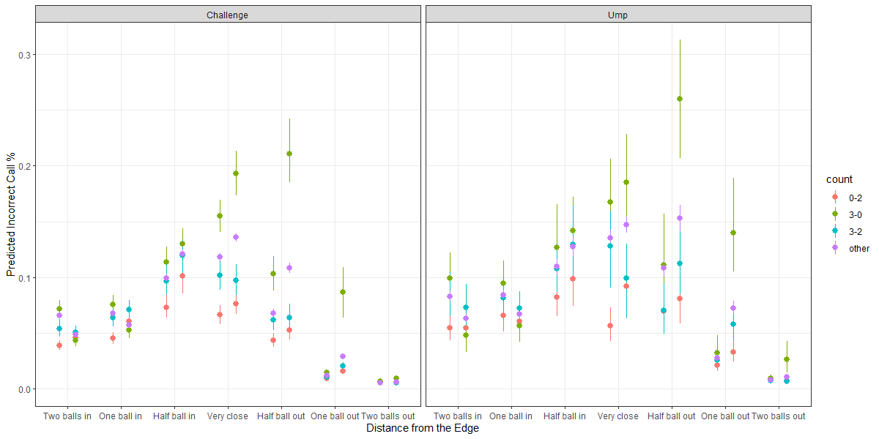
Results: Accuracy Based on Count
Other:
2nd in Inaccuracy
3-2:
Close to
0-2

Slide 24
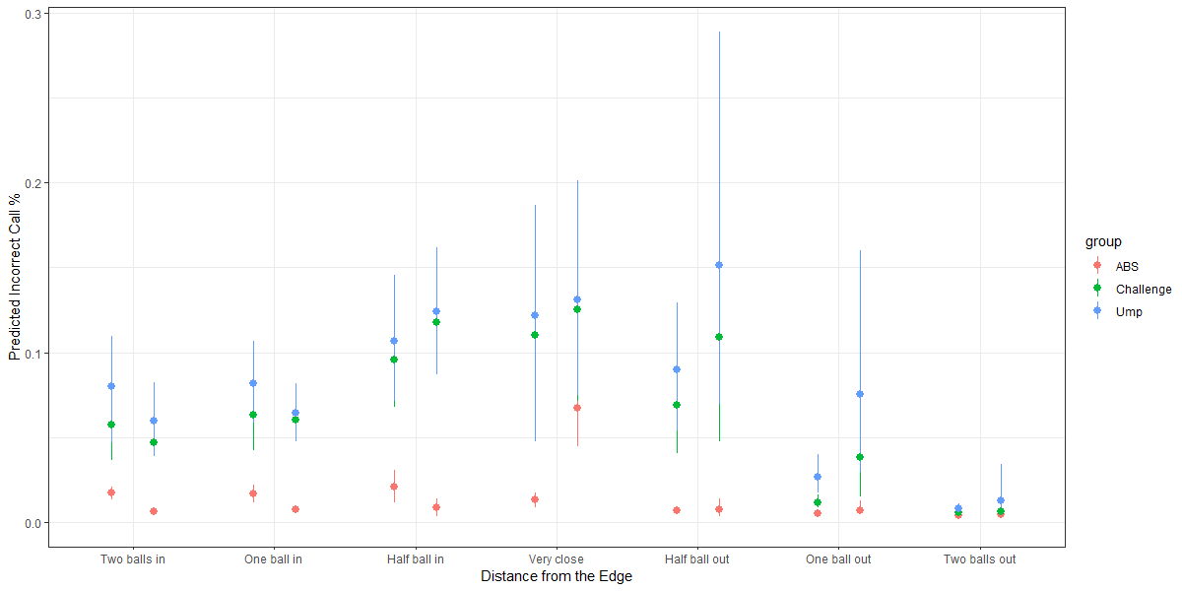
Results: Shrinking the Strike-Zone
Marginal Differences
Considerable Accuracy Differences

Slide 25
Results: Shrinking the Strike-Zone

Slide 26
Results: Accuracy in High Leverage
Statistical Significance

Slide 27
Results: Accuracy in High Leverage
Largest Challenge %, low overturn rate

Slide 28
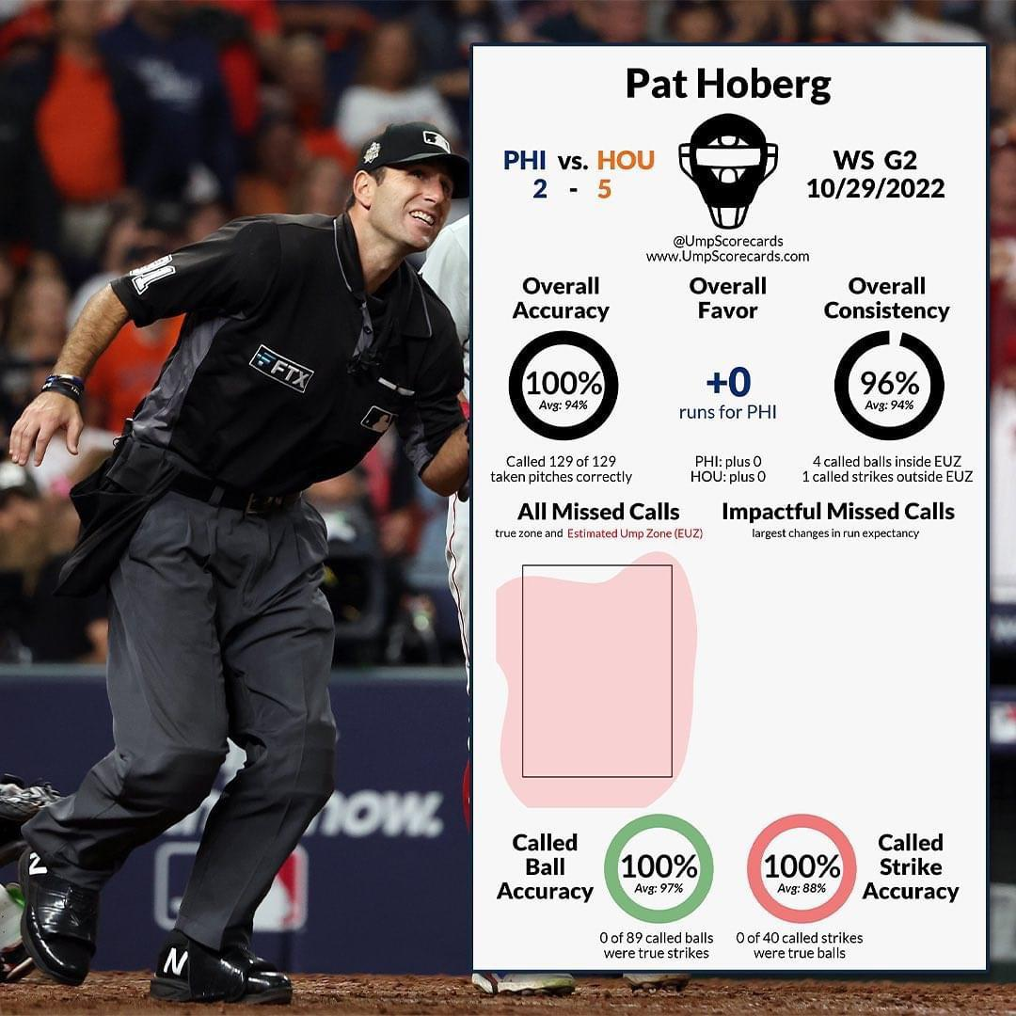
Conclusions
Umpires trended to be more accurate under observation within the challenge system
Found some statistical significance
Found evidence Umpires adapted strike zones to account for inaccuracies in 3-0 counts.
Umpires tended to be more accurate in high leverage situations.
Batters and Pitchers challenged unsuccessfully

Slide 29
Thank You
Jonah Soos
@jonahsoos24
jasoos@syr.edu
Jeremy Losak
@JeremyLosak
jmlosak@syr.edu
Jason Maddox
@jasontmaddox
jtmaddox@syr.edu

