Slide 1
Miles Wolff and the Rebirth of Independent Baseball
SABR51, Chicago
July 7, 2023

Slide 2
Who is Miles Wolff?
Born in Baltimore and moved to Greensboro at an early age.
Fell in love with minor league baseball.
Graduated from Johns Hopkins in 1965 with a B.A. in History.
Received Master’s degree from UVA.
Served as a US Naval officer from 1967 to 1970.
Hired by Atlanta Braves G.M. Paul Richards and Farm Director Eddie Robinson to take control of their Savannah club.
Several minor league jobs followed.
Miles was convinced that he needed to own his own team.

Slide 3
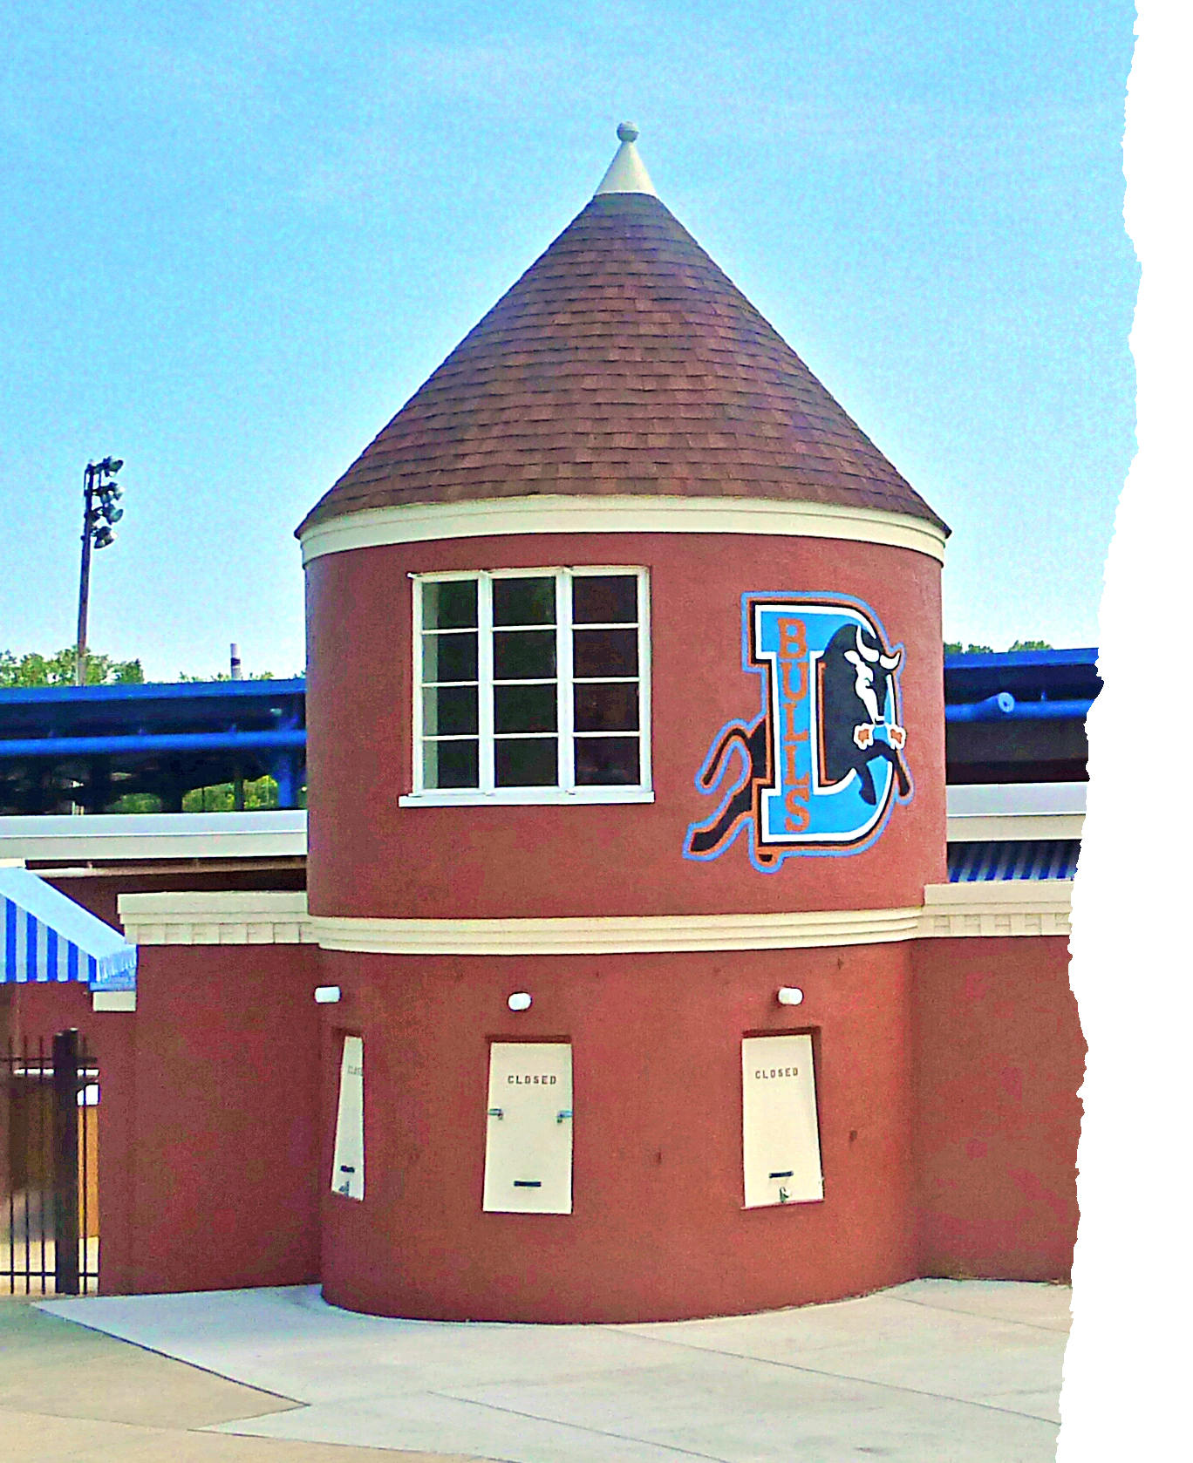
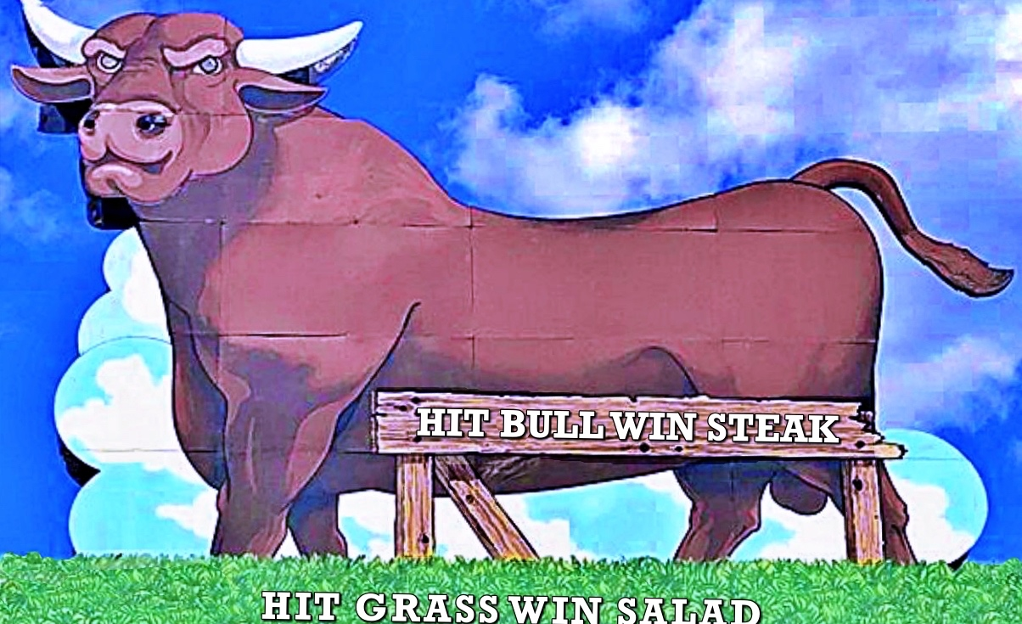
Miles and the Durham Bulls
Purchased Durham franchise for $2,417.⁰⁰
Played in the old Durham Athletic Park.
Began play in 1981 with over 4,000 attending on opening day.
And then there was the movie, Bull Durham …
While owning Durham, Miles also pursues a franchise in Burlington, NC.
He acquires interests in Asheville, Utica, and Butte teams.
Miles sells the Bulls when he cannot orchestrate a new stadium deal.
While owning the Bulls, becomes publisher of Baseball America.

Slide 4
Miles and Independent Baseball
As the owner of Burlington Indians, Miles is chosen to represent Single A Ball in the 1990 contract negotiations between MiLB and MLB.
Prepared to vote “no” on possible agreement since it gives too much control to MLB.
Before the vote, a friend who is on the MLB team cautions Miles that potential agreement is in best interests of minor leagues.
Miles votes to support deal but is not a happy camper.
Realizes that the only way forward is independent baseball especially given his “ Raleigh IceCaps experience”.

Slide 5
What is Independent Baseball?
Teams or leagues that have no affiliation with MLB
Before Branch Rickey and his farm system, minors were composed of independent leagues and teams.
Since leagues and teams became affiliated, there have been few independent teams in several minor leagues.
Two better known independent teams are the 1973-77 Portland Mavericks in the Single A Northwest League and the Salt Lake Trappers in PCL.
By 1990 there were just a few remaining independent franchises and no independent leagues.

Slide 6
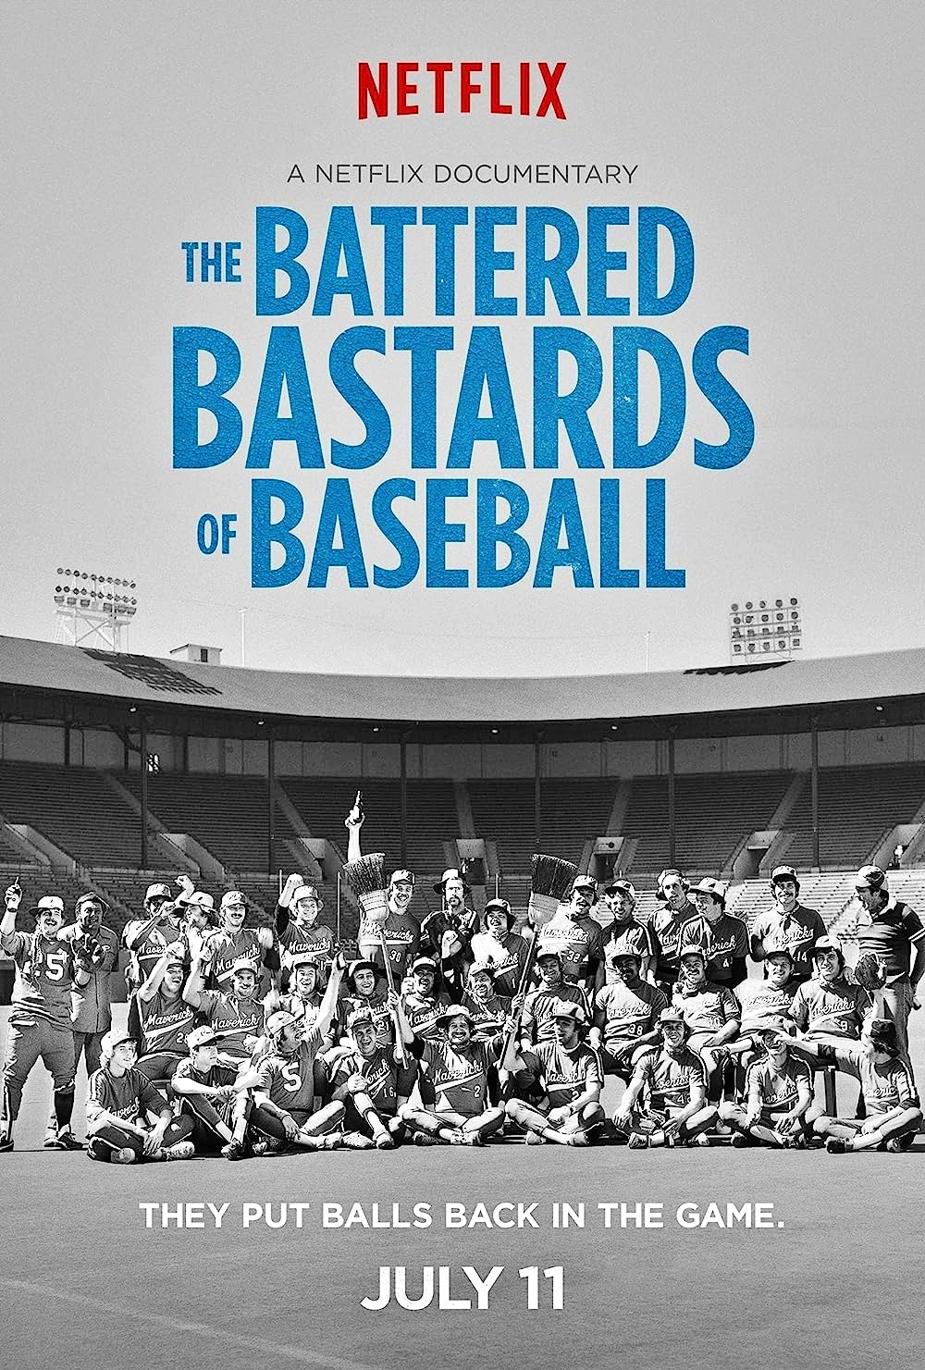
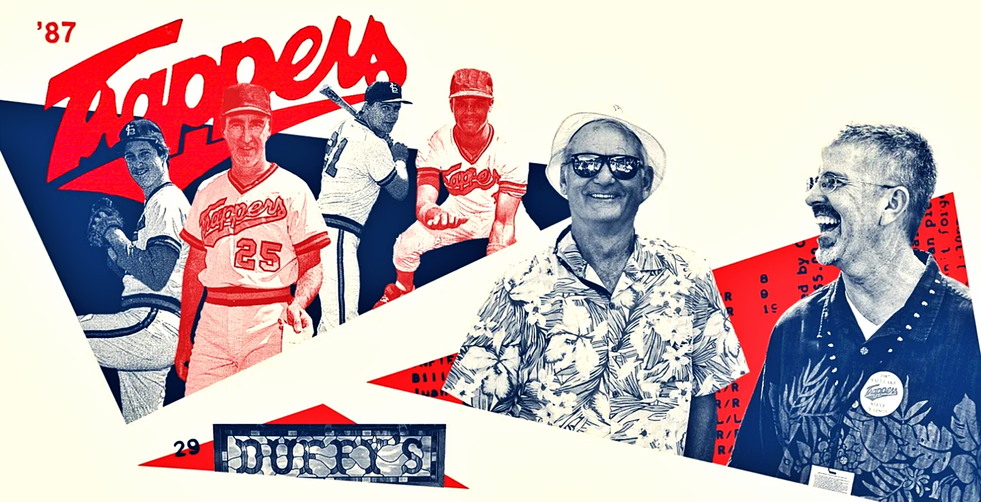
SALT LAKE CITY TRAPPERS, 1985-92
TRAPPERS SET PRO BASEBALL RECORD BY WINNING 29 CONSECUTIVE GAMES IN 1987
PORTLAND MAVERICKS, 1973-77

Slide 7
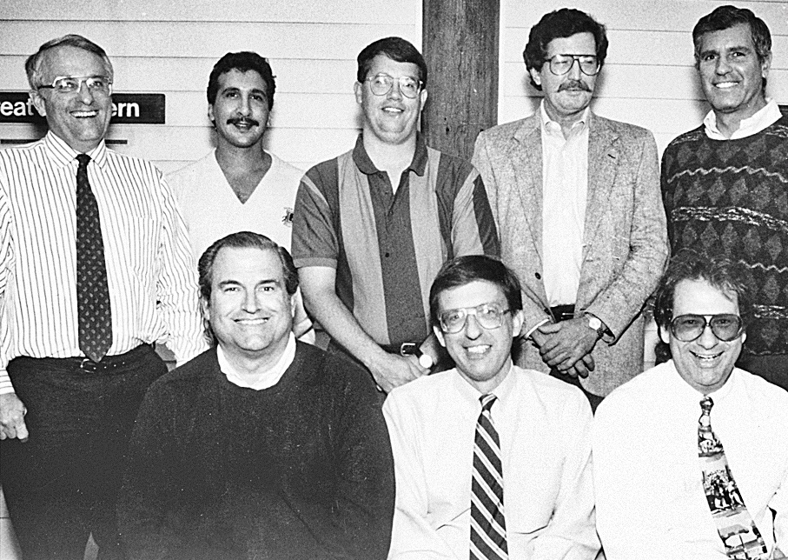
Miles and the Northern League
The 1980s see a revival of the minor leagues creating interest in mid-size cities without teams.
As publisher of Baseball America, Miles gets calls from Duluth, MN, Sioux Falls, SD, and Thunder Bay, Ont. asking how can they get Minor League franchises.
He visits those cities and recognizes their potential as franchises in an independent Northern League.
St. Paul, MN, is added to the list along with Sioux City, Iowa which promises to build a ballpark.
The final city in the upcoming six-team league is Rochester, MN.
Now that the cities are decided, Miles needs to find owners.

Slide 8
Miles and the Owners
St. Paul - Mike Veeck and Marvin Goldklang
Sioux City - Bill Pereira
Duluth - Bruce Engel
Sioux Falls - Harry Stavranos
Thunder Bay - Ricky May
Rochester - Charles Sanders
-----------------------------
New owners would not be charged a fee for the first three years. If league would succeed, they would each pay $50,000.

Slide 9
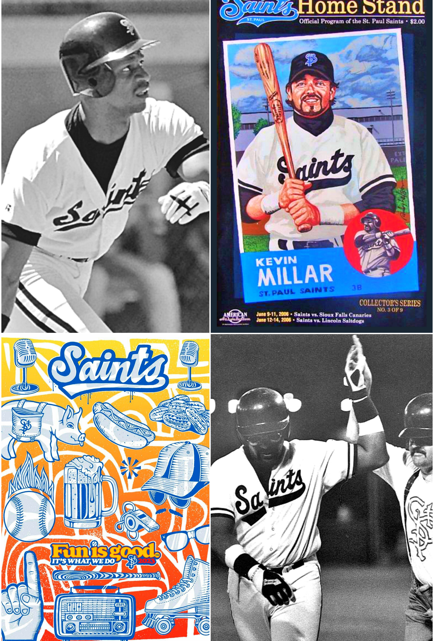
Who Is Going To Play in This League?
Given the MLB draft, minors must make space for draftees resulting in other minor leaguers being released.
College players who were not drafted.
Managers, coaches, and executives who no longer had positions in organized baseball.
Miles was somewhat surprised by the amount of people interested.
Leon “Bull” Durham, Daryll Strawberry, and Pedro Guerrero were among the many ex-big leaguers who played in Northern League.

Slide 10
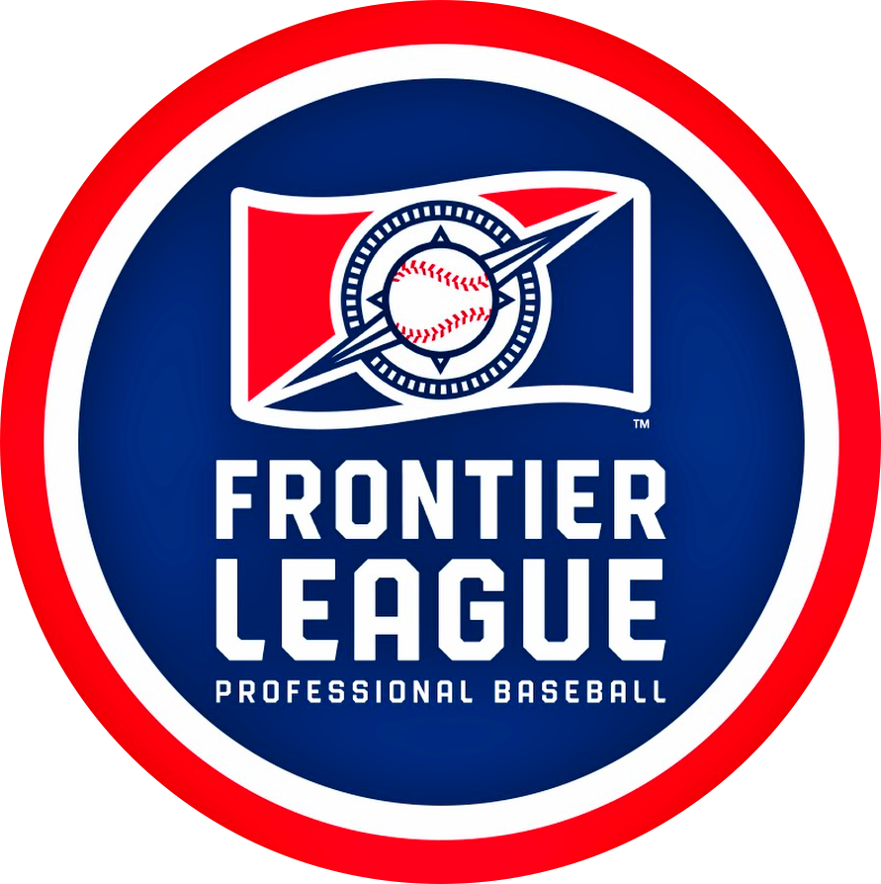
Show Them and Others Will Come
1993 – A second independent league, the Frontier League, begins play in towns in West Virginia, Kentucky, and Ohio
1994 - The Texas-Louisiana, North Central, and Great Central Leagues with the latter two Leagues folding after the 1994 season.
1995 - Eleven new leagues begin operating.

Slide 11
Northern League Continues to Grow
In 1994 Sam Katz purchases the Rochester franchise for $200,000 and moves them to Winnipeg.
1996 sees the addition of Fargo and Madison franchises.
By 2000 only the St. Paul ownership was still in place.
Duluth sold for $500,000, Thunder Bay for $750,000 and Sioux Falls for $1,000,000.

Slide 12
Miles Engages in New Ventures
Becomes commissioner of Northeast League in 1999.
Northern League Central and Northern League East operate as single entity for four seasons.
Buys Bangor, ME franchise and moves it to Quebec City as part of Northern League East
Quebec City begins play in 1999 with Miles taking on day-to-day operating duties
Sells Baseball America in 2000

Slide 13
Further Moves
In 2002 Northern League ends relationship with Northeast League.
Miles resigns as commissioner of Northern League.
Northeast League dissolves and remaining members form the Can-Am League with Miles as commissioner.
Becomes commissioner of Central League in 2002 (formerly TX-LA League).
In 2005 the Durham office is running those two leagues and the Burlington and Quebec City franchises.
Northern League eventually dissolves with several franchises joining Central League teams that already formed a new league, the American Association, with Miles as commissioner.

Slide 14
Miles and Ottawa
Sells Quebec City at the end of 2010 season.
Can-Am League needs new franchises, has only four or five teams.
Miles is encouraged to pursue Ottawa.
City of Ottawa selects Can-Am League for their franchise and play begins in 2015
Once again, Miles becomes hands-on owner.
Needs average attendance of 2,500 to break-even, actual is less than 2,000
After three years, City provides Miles with an incentive to continue in 2018
Attendance continues to disappoint

Slide 15
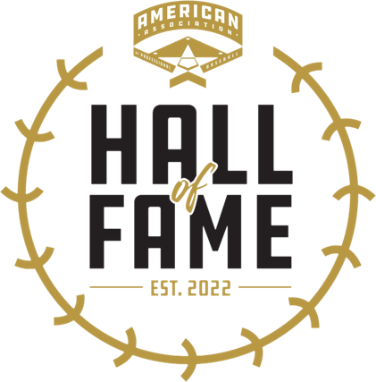
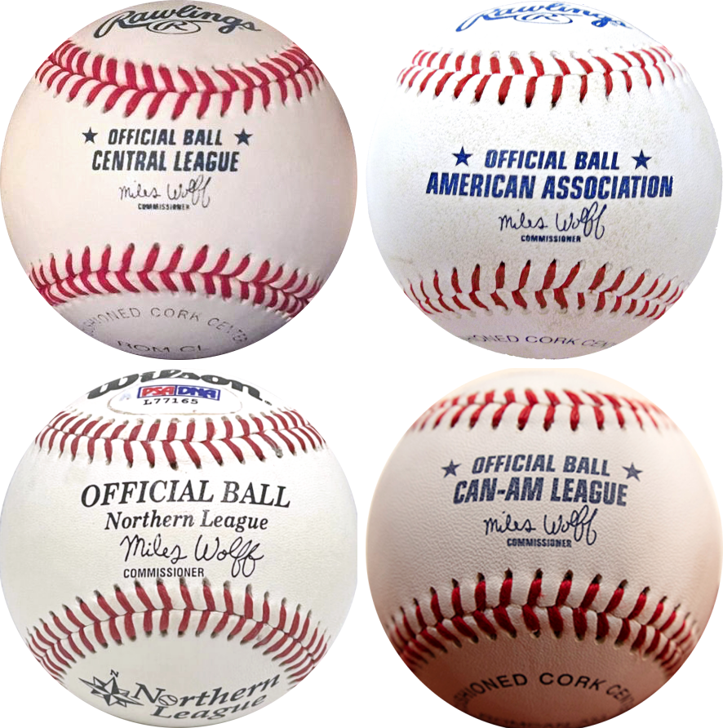
Final Moves
Steps down as Commissioner of both Can-Am and American Association following the 2018 season.
After losing $2,000,000 in Ottawa, Miles terminates his ownership following the 2019 season.
With the Appalachian League being threatened, Miles sells the Burlington franchise.
Writes There’s a Bulldozer on Home Plate: A 50-Year Journey in Minor League Baseball.

Slide 16
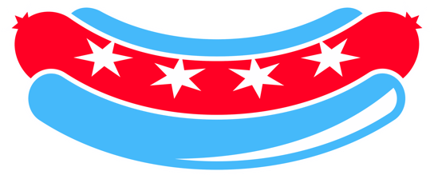
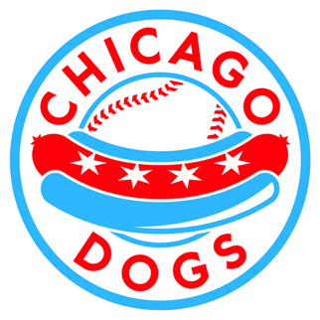
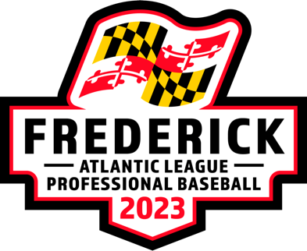
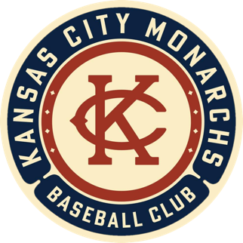
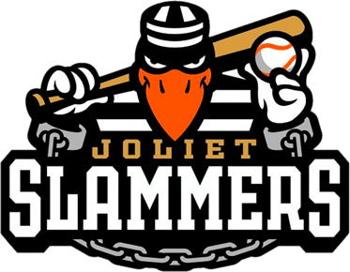
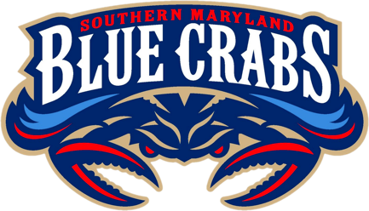
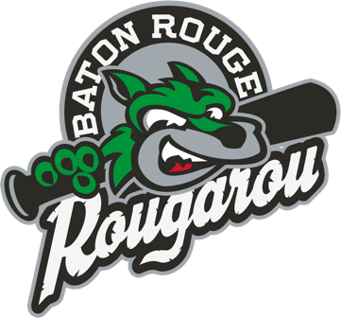
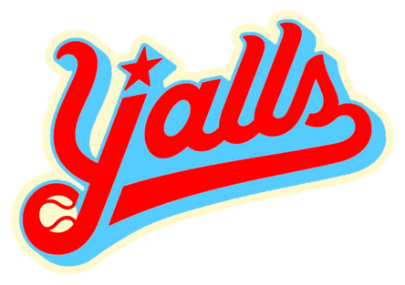
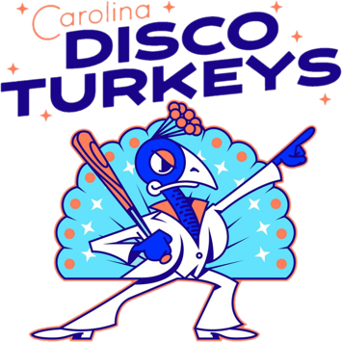
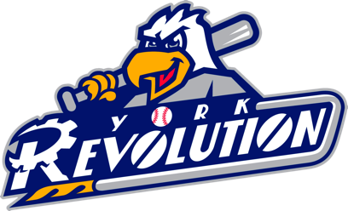
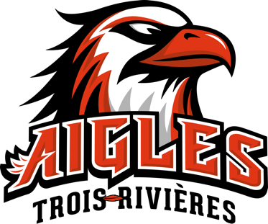
Current State of Independent Baseball
American Association OF PRO BASEBALL Including Chicago Dogs (12)*
Atlantic League Including York Revolution (10)*
Empire League (5)
Frontier League (16)*
Mavericks League (4)
Pecos League (16)
Pioneer League (10)*
United Shore League (4)
* MLB Partner Leagues

Slide 17
Legendary Independent Teams

Slide 18
Legendary Independent Teams

Slide 19
References
Miles Wolff Jr., There’s a Bulldozer on Home Plate: A Fifty-Year Journey in Minor League Baseball (Jefferson, NC: McFarland & Co., 2023)
Stefan Fatsis, Wild and Outside: How a Renegade Minor League Revived the Sport of Baseball in America’s Heartland (New York: Walker and Co., 1995)
https://sabr.org/bioproj/person/miles-wolff-jr/
The author wishes to thank Jim Considine from Baltimore for his contributions.

