Slide 1
A Fresh Scent of Scandal:
The Dolan-O’Connell Affair
Robert F. Garratt

Slide 2
The Play

Slide 3
John McGraw
and Jimmy O’Connell

Slide 4
National League Pennant Race
September 27, 1924
Team | W | L | gb
New York Giants | 92 | 59 | --
Brooklyn Robins | 91 | 61 | 1.5
Pittsburgh Pirates | 89 | 62 | 3

Slide 5
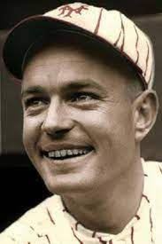
Cozy Dolan
Jimmy O’Connell

Slide 6
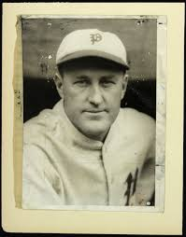
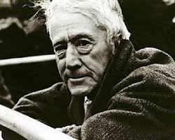
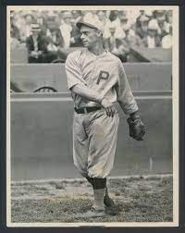
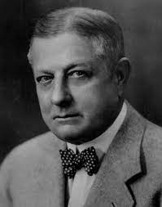
O’Connell
Art Fletcher
Commissioner Landis
Dolan
John Heydler
Heinie Sand

Slide 7
The Hearing

Slide 8
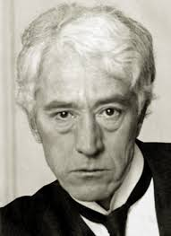

Slide 9
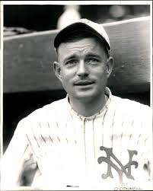

Slide 10
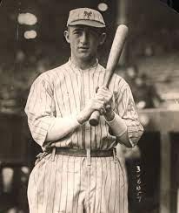
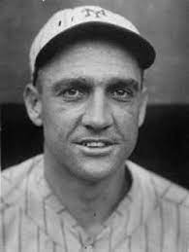
Frank Frisch
Ross Youngs
George Kelly

Slide 11
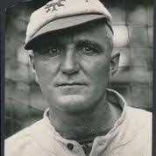

Slide 12
Landis: Did you tell O’Connell to offer Sand $500 not to bear down against the Giants?
Dolan: I don’t remember.
Landis: You don’t remember?
Dolan: No, sir
Landis: This is Monday. Do you mean to sit there and tell me that you don’t remember whether or not you told O’Connell to offer a bribe to Sand on Saturday--two days ago?
Dolan: Yes Sir.
Landis: ‘Yes Sir’ what?
Dolan: I don’t remember.
source: New York Times, Oct. 2, 1924; Frank Graham, The New York Giants: An Informal History, p. 154.

Slide 13
The Judgement

Slide 14
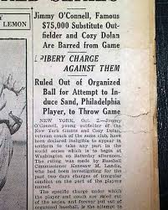
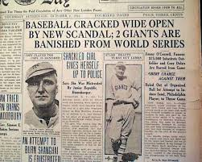

Slide 15
The Fallout

Slide 16
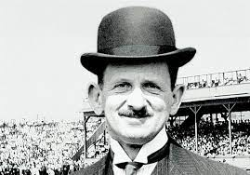
Ban Johnson
Barney Dreyfuss

Slide 17
Dolan and William J. Fallon

Slide 18
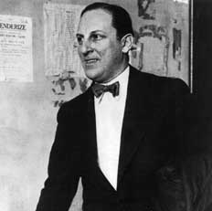
Arnold Rothstein
“AR”
The Big Brain
Close Associate and Business Partner of Charley Stoneham

Slide 19
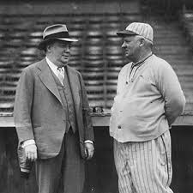

Slide 20
Stoneham

