Slide 1
The Perfect Platoon One Man’s Search
Mark Armour
SABR 48
Pittsburgh PA
June 23, 2018

Slide 2
Matty Alou and Manny Mota

Slide 3
1966 Pirates Centerfield
When facing RHP (122 games)
Alou 119 (97.5%)
Mota 2
Clemente 1
When facing LHP (40 games)
Mota 38 (95%)
Alou 2
Platoon Score: 157/162 = .969 OR … 97

Slide 4
Platoon Score
Platoon Score: How often manager employs two-person platoon “correctly”
Perfect Platoon: Platoon Score = 100
Fulltime Platoon
80% “compliance” from each half
Switch hitters allowed (only for one half of platoon)
Starting lineups only
What players does on “off days” of no matter.

Slide 5
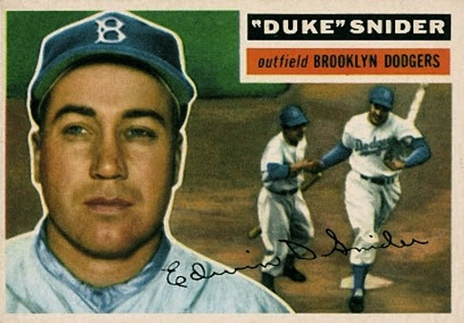
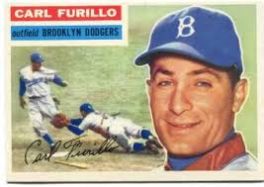
1956 Dodgers CF
Snider started 137 (of 140) against RHP
Furillo started 3 (of 14) against LHP
Platoon Score 91
DUKE SNIDER CLAUSE: 80% compliance from each half of the platoon

Slide 6
LH Starter %

Slide 7
Keys to Fulltime Platoons
Both players remain productive and healthy
Players at “compatible” positions need to stay productive and healthy
Manager needs the confidence/ego to stick with his plan
Roster must be large enough

Slide 8
Frequency?
Perfect Platoon: NEVER
Fulltime Platoon: 136 Times

Slide 9
By Position

Slide 10
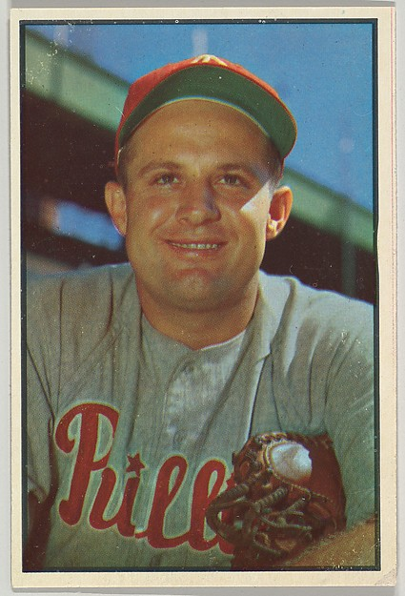
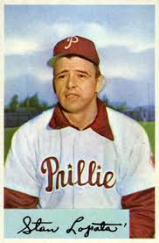
1952-54 Phillies Catcher
Smoky Burgess and Stan Lopata
Platoon Scores: 84, 84, 92

Slide 11
By 10-year intervals

Slide 12
First*
1909 Tigers catcher
Boss Schmidt and Oscar Stanage (85)
Last*
2016 Indians CF
Tyler Naquin and Rajai Davis (85)
2016 Mariners 1B
Adam Lind and Dae-ho Lee (86)

Slide 13
By Manager
Bobby Cox 13
Gene Mauch 7
Tris Speaker 5
Sparky Anderson 5
Davey Johnson 5
Ralph Houk 4
Jim Leyland 4
Jim Tracy 4
Jimy Williams 4

Slide 14
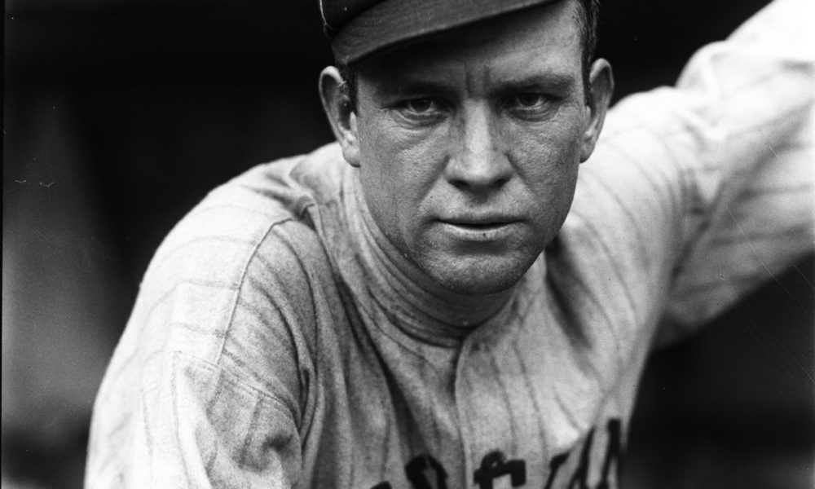
Tris Speaker
1919 RF (95) Elmer Smith, Joe Wood
1921 RF (96) Elmer Smith, Joe Wood
1921 1B (93) Doc Johnston, George Burns
1922 LF (90) Charlie Jamieson, Joe Evans
1925 C (82) Glenn Myatt, Luke Sewell

Slide 15
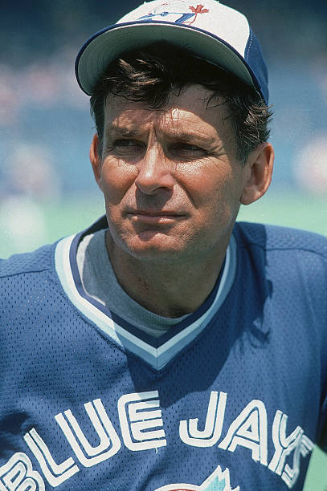
Bobby Cox
3B: Rance Mulliniks, Dane Iorg
1982-1985
C: Ernie Whitt and Buck Martinez
1982-1984, 1986
LF: Dave Collins, George Bell
1984

Slide 16
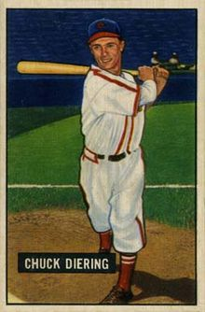
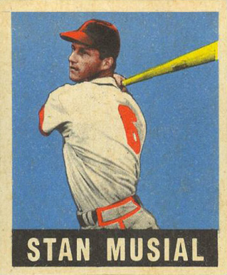
1949 Cardinals CF == 93
Musial 68/69 against RHP (the other at 1B)
Chuck Diering 78/88 against LHP

Slide 17
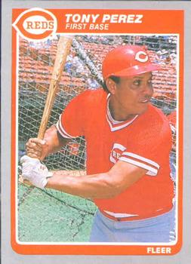
Hall of Famers
Tony Perez
1965 Reds 1B
Carl Yastrzemski & Tony Perez
1982 Red Sox DH
Pete Rose & Tony Perez
1985 Reds 1B
Ken Griffey Jr.
2009 Mariners DH

Slide 18
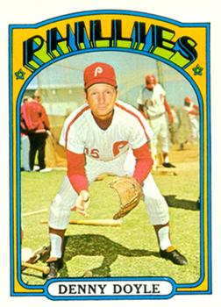
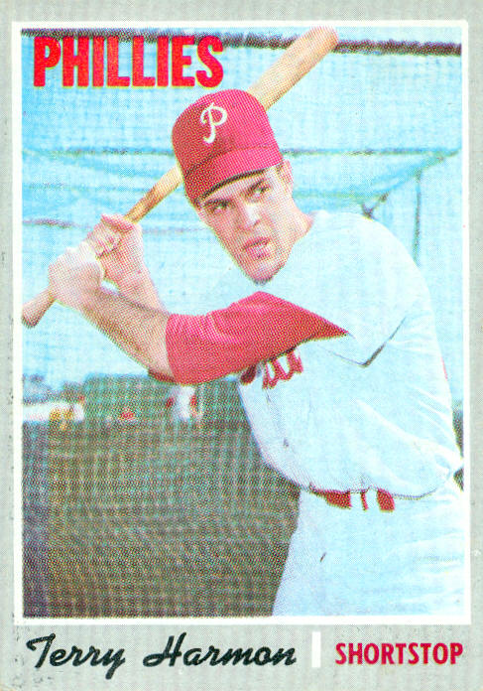
1972 Phillies 2B == 99
July 1, Harmon started against a RHP
September 30, neither started
154/156

Slide 19
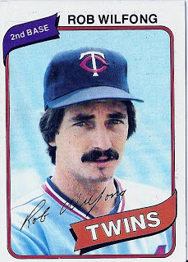
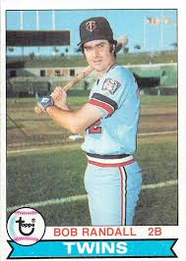
1979 Twins 2B == 99
August 8, Wilfong plays against LHP
September 28, Wilfong plays against LHP
160/162

Slide 20
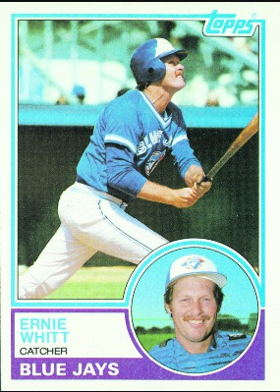
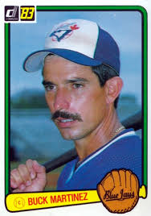
1983 Blue Jays C == 99
June 5, Martinez plays against RHP
June 30, Martinez plays against RHP
160/162

Slide 21
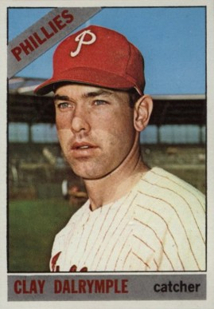
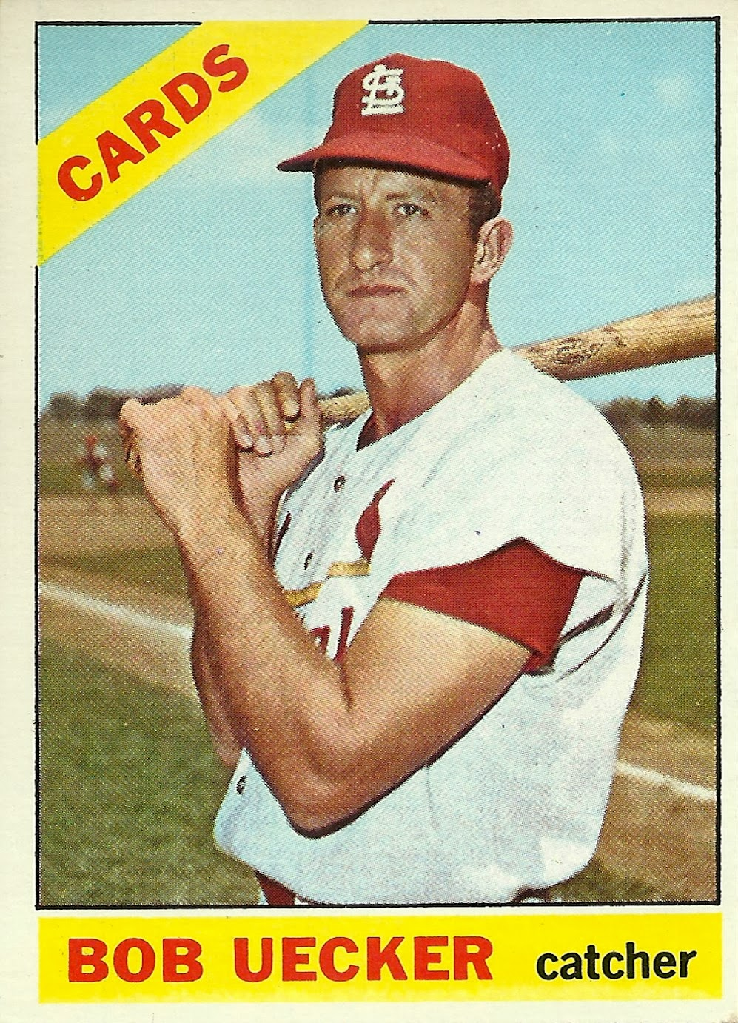
1966 Phillies C == 96
July 31, Uecker caught second game of DH against RHP
September: Jimmie Schaefer, ugh.

Slide 22
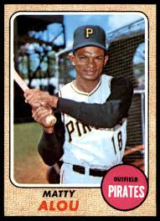
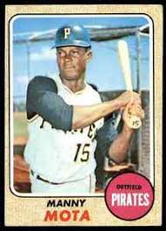
1965-68 Pirates CF
(1965 Virdon/Mota == 97)
1966 Alou/Mota == 97
1967 Alou/Mota == 96

Slide 23
Platoon HOF: Initial Class
Tris Speaker, Gene Mauch, Bobby Cox
Smoky Burgess, Stan Lopata
Ernie Whitt, Buck Martinez
Rance Mulliniks, Garth Iorg
Matty Alou, Manny Mota

