Slide 1
Jackie Robinson Comes to Baltimore
SABR50
August 19, 2022

Slide 2
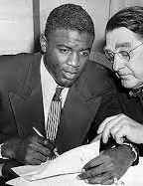
Jackie Breaks the Color Barrier
Robinson signed a contract with the Montreal Royals in October 1945
Montreal was the top farm team of the Brooklyn Dodgers
Montreal was in the International League along with Jersey City, Newark, Syracuse, Baltimore, Buffalo, Toronto and Rochester
Baltimore was only city below Mason-Dixon Line

Slide 3
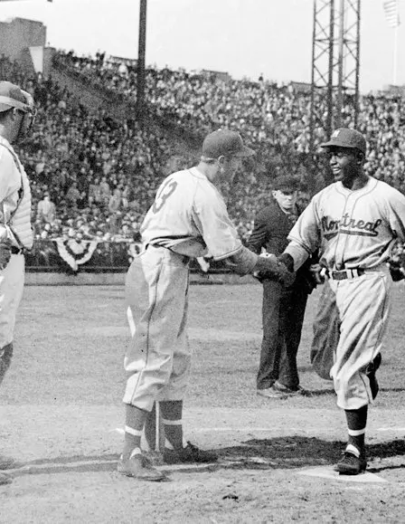
1946 Season Begins
After stressful Spring Training, season began with road trip that included Jersey City, Newark, Syracuse, and Baltimore
In his first game, Jackie went 4 for 5 with 3 run HR and two stolen bases as Royals won 14-1
Opening game was a rousing success but there were some storm clouds on the horizon

Slide 4
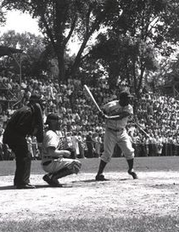
Syracuse
Syracuse provided rude awakening
Unmerciful heckling from some fans but mainly from Syracuse players
Player pushed black cat toward Jackie shouting “there’s your cousin clowning on the field.”
Jackie remembered visits as his worst experience but claimed it didn’t bother him

Slide 5
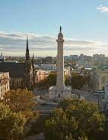
Baltimore in 1946
Practiced segregation in housing, education, dining, and other public venues
Slow movement in integrating such facilities although there were the “Hollander Awards”
Frank Shaughnessy, president of the International League, requested Jackie not play in Baltimore predicting riot and bloodshed
Rickey denied the request claiming predictions were exaggerated and Jackie needed to face such crowds

Slide 6
How the Newspapers Anticipated Jackie’s First Series
Baltimore Sun referred to “Negro star at second”
News-Post gave more play to Eddie Robinson but devoted a paragraph to “the highly publicized colored second baseman.”
Evening Sun described Jackie as “the Negro who is pioneering the cause of his race in organized baseball.”

Slide 7
Baltimore Afro-American
Montreal was in bold in IL standings
Headline on Sports page “Fans Await Jackie Robinson’s Initial Appearance”
Called upcoming games “a history making experience.”
Sam Lacy in his column called Jackie’s first game “a modern Emancipation Day.”

Slide 8
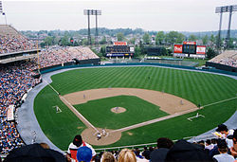
First Visit-April 27-29
Four game series began on a frigid Saturday night before 3,415
Jackie said it felt like playing in Alaska
Small but very abusive crowd as Rachel heard the “n” word amidst the heckling
Rachel cried that night wondering if it was worth all the abuse
Orioles won 12-7 as Jackie when 1 for 3 with a stolen base
John Wright also pitched

Slide 9
First Visit-April 27-29
Double-header on Sunday before 25,306 fans that included an estimated 10,000 Blacks
Heckling continued but Black fans cheered Jackie and Rachel was possibly relieved
Teams split DH while Jackie went 1 for 7 and committed costly error in nightcap that Afro-American attributed to stress
In the Monday night finale Jackie went 3 for 3 as Royals won 10-0

Slide 10
Second Visit-June 6-8
Jackie missed opener due to strained calf muscle
Played in second game which Royals won 5-4
Final play at home plate resulted in Jim Honochick and Herman Franks scuffling
Players and some fans joined fight
Wrath of fans quickly turned to Jackie as mob marched to clubhouse. “Come out here Robinson, you SOB” was heard.

Slide 11
Second Visit=June 6-8
Three teammates, Marv Rackley, Tommy Tatum, and Spider Jorgensen, stayed with Robinson until crowd dispersed
Jackie and teammates left clubhouse probably after 1:00 am
Robinson took a bus to go to his accommodations which were described as ‘staying with relatives.’
Jackie doesn’t play the following night given his calf issue as Royals win 10-6

Slide 12
Third Visit-July 26-28
Royals won opener 10-9 as Jackie went 3 for 5 with HR and steal of home
Game ended with another disputed play at home plate resulting in some fans storming the field
Afro-American stated Gus Winters, the white umpire, was target not Robinson
Orioles won second game in the series 6-5 as Jackie went 1 for 5
Royals and Orioles split Sunday doubleheader as Robinson went 1 for 6

Slide 13
Baltimore’s Hostile Environment
Sam Lacy reported abusive heckling was present in all the visits
Oriole manager Tommy Thompson tormented Jackie
Spider Jorgensen commented on the tension during the three visits
Robinson endured and performed well under such conditions

Slide 14
Remainder of 1946 Season
Royals dominated IL and won Little World Series
Robinson’s season stats were .349 BA, .468 OBP, 113 Rs, 3HRs, and 40 SBs
As season progressed, less emphasis on color and more on performance in the Montreal papers
Stress caught up with Jackie as he was told to take a rest in late August after Montreal clinched
Returned after missing a few games (maybe just one)
Announced he would not be going back to school after 1947 season

Slide 15
Conclusions
1946 was very stressful for Jackie and Rachel, conceivably more than 1947
Given the above, Robinson still dazzled and proved he should be in Brooklyn in 1947
Jackie’s presence had significant effect on IL attendance
Frank Shaughnessy was correct in worrying about the reaction in Baltimore as a near-riot occurred in Jackie’s second visit and possibly the third visit
The season proved successful as Jackie clearly validated Rickey’s decision selecting him to break the color barrier

Slide 16
Sources
The Baltimore Sun
The Baltimore Afro-American
Arnold Rampersad, Jackie Robinson
David Falkner, The Life Of Jackie Robinson
Jules Tygiel, Baseball’s Great Experiment
Kostya Kennedy, True
https://www.milb.com/milb/history/jackie-robinson-1946

