Slide 1
Baseball for the Blind
A Brief History
David Wanczyk

Slide 2
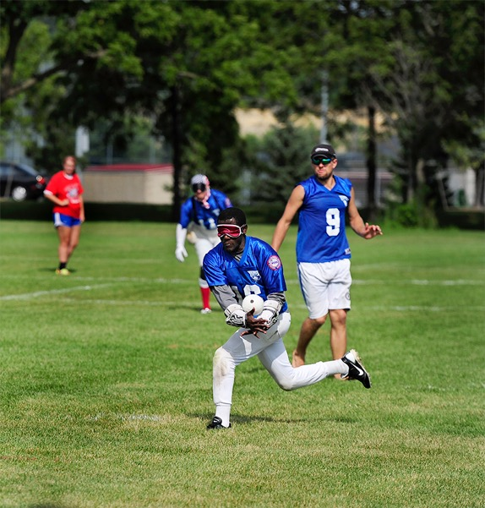

Slide 4
)
1938
Here’s the Pitch. (Kind of)

Slide 5
The Blind Bambino
1948
“I’d like to be in there every day. That’s how much I like to play. I think that tells you, Johnny.”

Slide 6
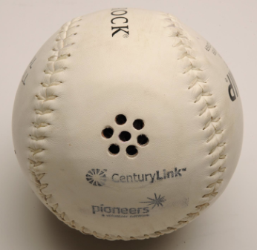
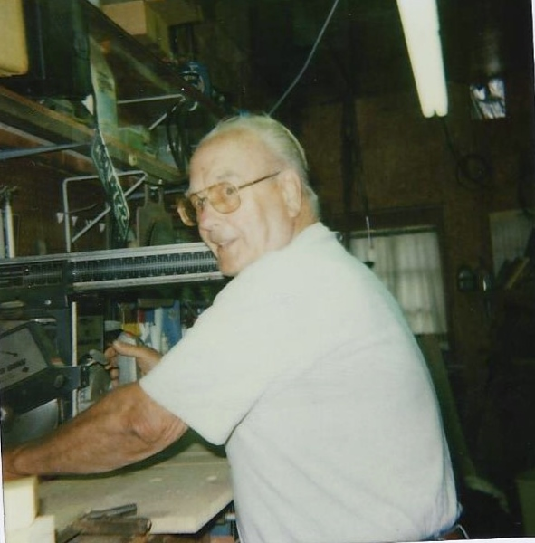
1964

Slide 7
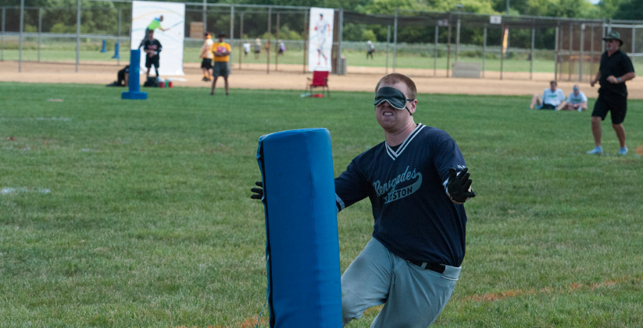
Beep 2.0

Slide 8
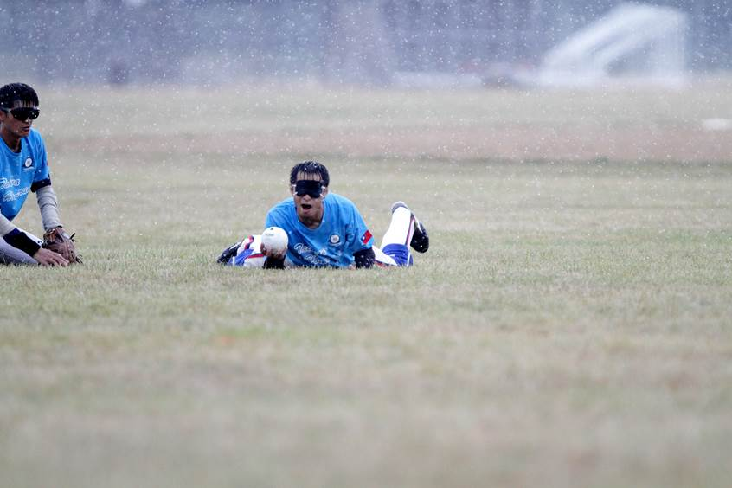
2012-2018: International Rivalry

