Slide 1
NO RETURN TO NORMALCY:
American Baseball Confronts the Postwar World
Steve Gietschier
(SABR member since 1987)

Slide 2
baseball on the radio

Slide 3
baseball during World War II

Slide 4
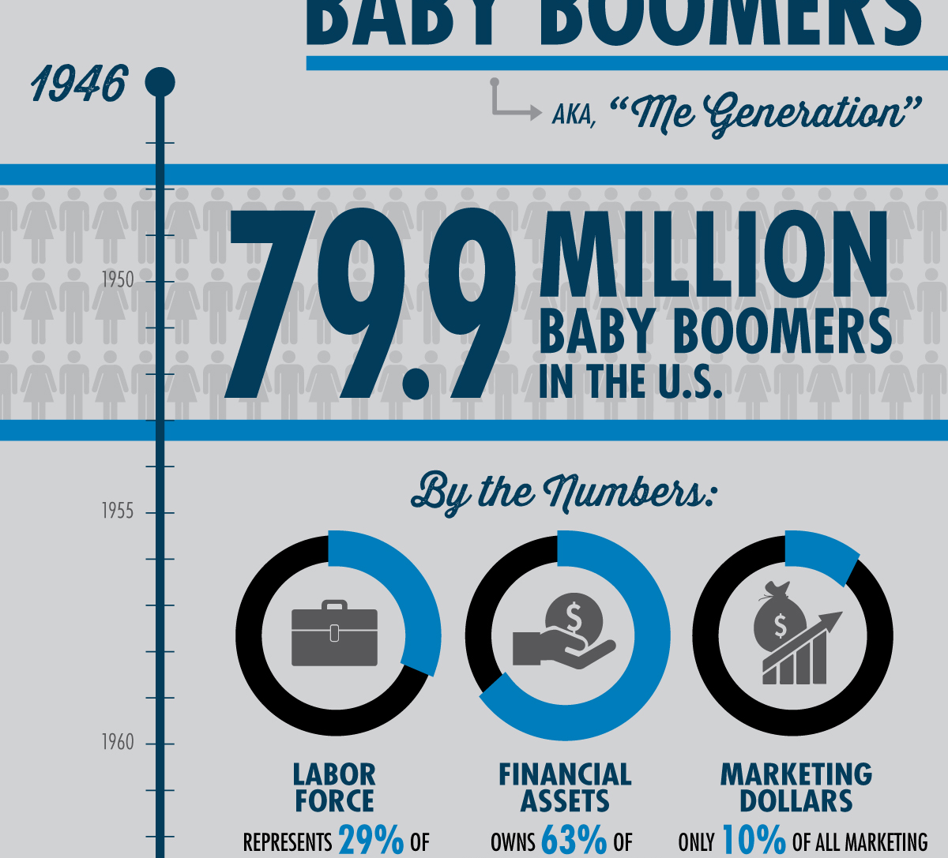
the baby boom generation

Slide 5
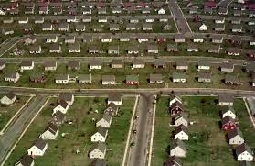
suburbia

Slide 6
household appliances

Slide 7
“not nostrums but normalcy”

Slide 8
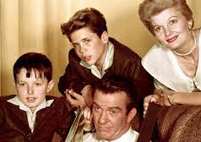
“Leave It to Beaver”

Slide 9
spring training, 1946

Slide 10
Robert Murphy and the American Baseball Guild

Slide 11
Jorge Pasquel (second from left) and the Mexican League

Slide 12
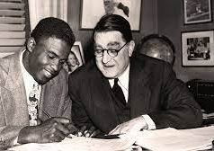
Jackie Robinson and Branch Rickey

Slide 13
major league cities, 1903-1952

Slide 14
Continental League owners

Slide 15
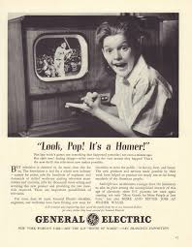
baseball on television

Slide 16
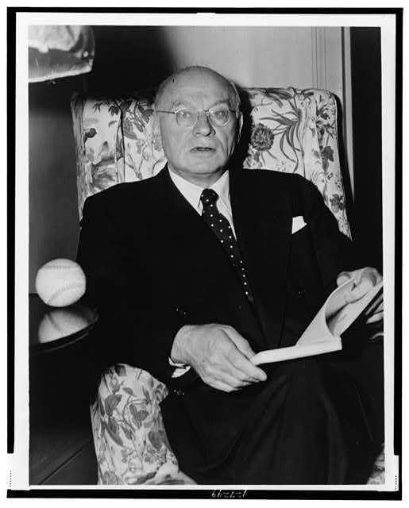
Congressman Emanuel Celler (D-NY)

Slide 17
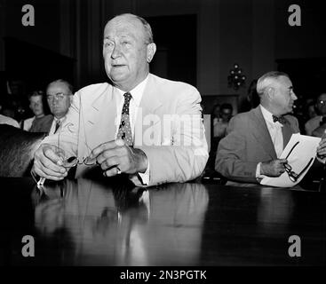
Ty Cobb testifying

Slide 18
Baseball: The Turbulent Midcentury Years

