Slide 1
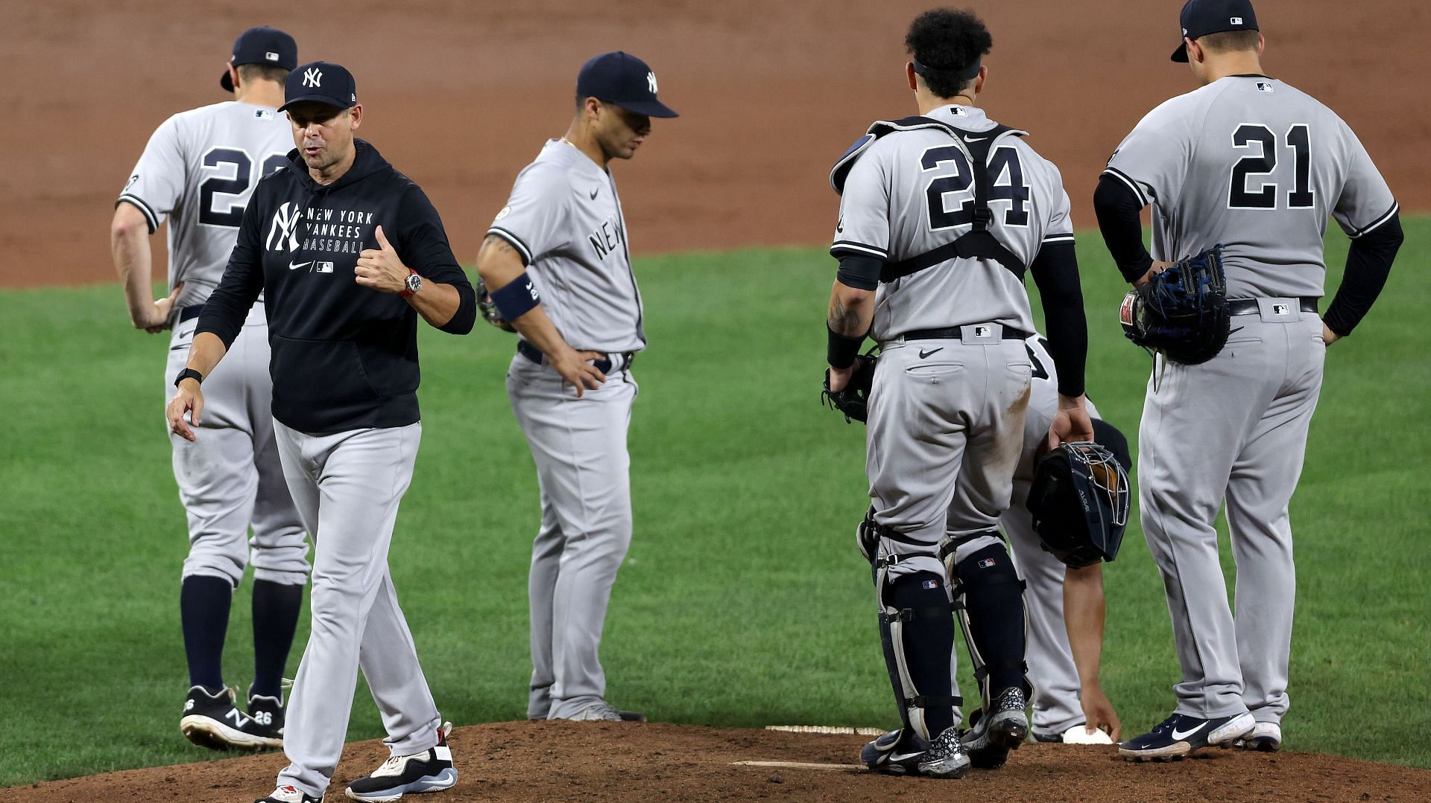
Weighted Bullpen Management Score Plus:
Quantifying MLB Pitching Change Decision Making Sean Sullivan

Slide 2
Introducing the Researcher
UIUC and DePaul Graduate
Data Scientist at Home Depot
www.uramanalytics.com
Sean Sullivan
@ URAM_Analytics
Notes:
School: <a href="https://www.flaticon.com/free-icons/university" title="university icons">University icons created by Smashicons - Flaticon</a>
Home Depot: <a href="https://www.flaticon.com/free-icons/the-home-depot" title="the home depot icons">The home depot icons created by Freepik - Flaticon</a>
Website: <a href="https://www.flaticon.com/free-icons/browser" title="browser icons">Browser icons created by Tanah Basah - Flaticon</a>
Twitter: <a href="https://www.flaticon.com/free-icons/twitter" title="twitter icons">Twitter icons created by Pixel perfect - Flaticon</a>

Slide 3
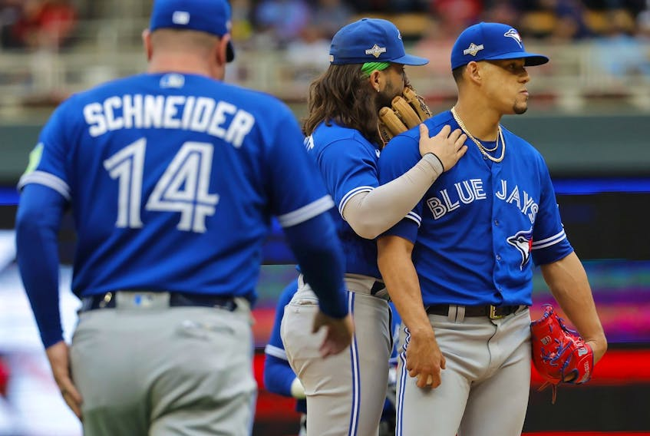
Poll Question #1
Raise your hand if you...
have ever disagreed with a pitching change decision
Notes:
School: <a href="https://www.flaticon.com/free-icons/university" title="university icons">University icons created by Smashicons - Flaticon</a>
Home Depot: <a href="https://www.flaticon.com/free-icons/the-home-depot" title="the home depot icons">The home depot icons created by Freepik - Flaticon</a>
Website: <a href="https://www.flaticon.com/free-icons/browser" title="browser icons">Browser icons created by Tanah Basah - Flaticon</a>
Twitter: <a href="https://www.flaticon.com/free-icons/twitter" title="twitter icons">Twitter icons created by Pixel perfect - Flaticon</a>

Slide 4
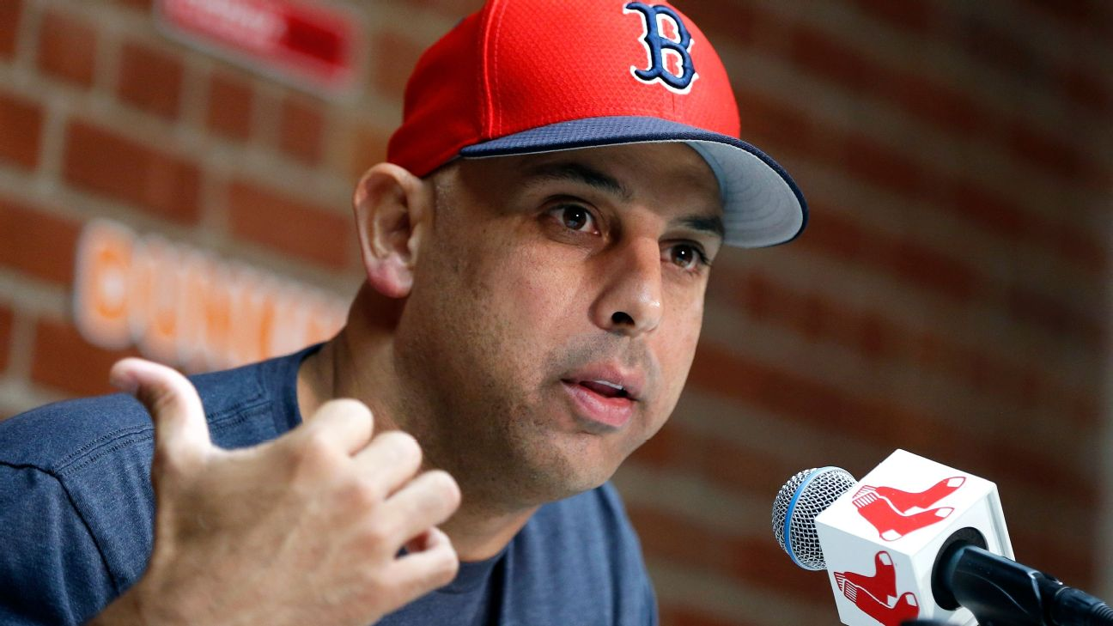
Poll Question #2
Raise your hand if you...
wish there was a public facing tool that aided in evaluating pitching change decision making
Notes:
School: <a href="https://www.flaticon.com/free-icons/university" title="university icons">University icons created by Smashicons - Flaticon</a>
Home Depot: <a href="https://www.flaticon.com/free-icons/the-home-depot" title="the home depot icons">The home depot icons created by Freepik - Flaticon</a>
Website: <a href="https://www.flaticon.com/free-icons/browser" title="browser icons">Browser icons created by Tanah Basah - Flaticon</a>
Twitter: <a href="https://www.flaticon.com/free-icons/twitter" title="twitter icons">Twitter icons created by Pixel perfect - Flaticon</a>

Slide 5
Project Inspiration
Watching baseball with friends led to an interesting discussion...

Slide 6
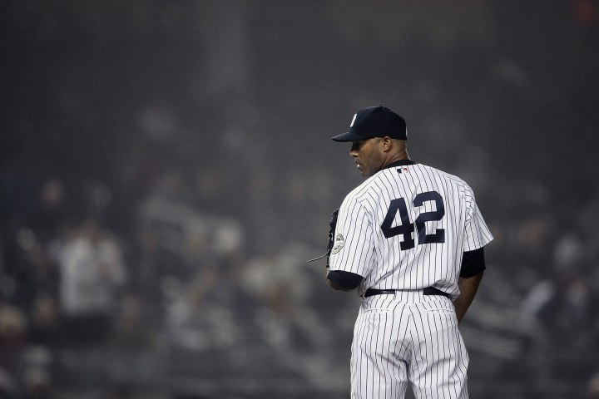
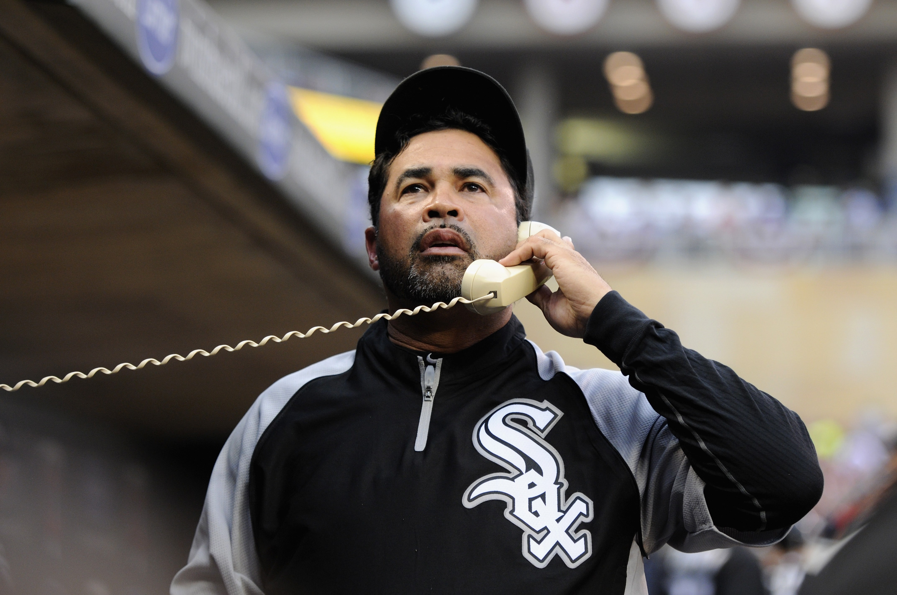
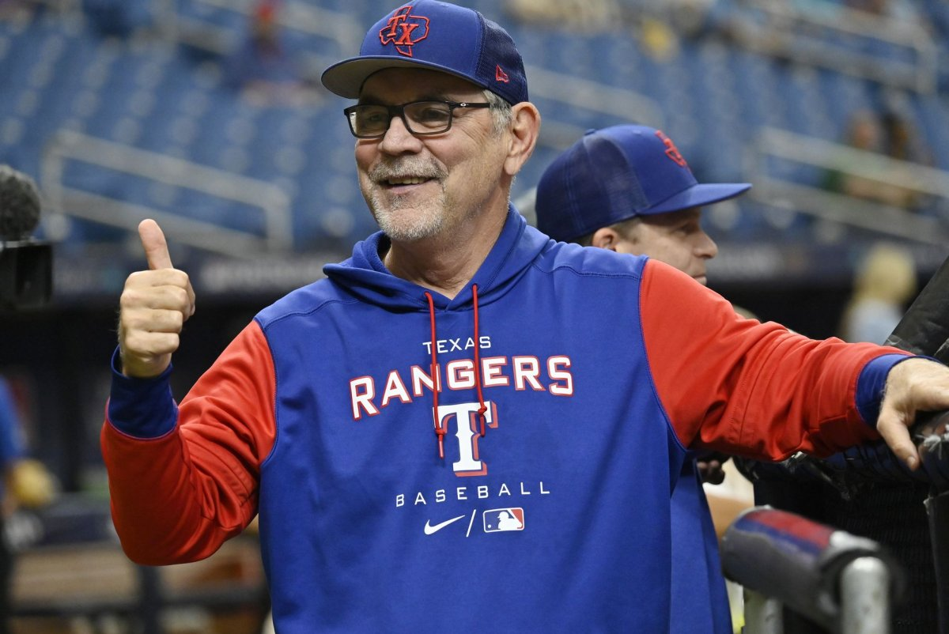
What Has Already Been Done?
Jeremy Greenhouse:
WPA / LI
Rob Arthur and Rian Watt:
Weighted Reliver Management +
Dani Treisman:
Manager Scorecard (xRuns Lost)
Notes:
Pitcher: <a href="https://www.flaticon.com/free-icons/pitcher" title="pitcher icons">Pitcher icons created by Leremy - Flaticon</a>
Batter: <a href="https://www.flaticon.com/free-icons/batter" title="batter icons">Batter icons created by Freepik - Flaticon</a>
List: <a href="https://www.flaticon.com/free-icons/priority" title="priority icons">Priority icons created by Freepik - Flaticon</a>
Machine: <a href="https://www.flaticon.com/free-icons/automation" title="automation icons">Automation icons created by Becris - Flaticon</a>
Arrow: <a href="https://www.flaticon.com/free-icons/arrow" title="arrow icons">Arrow icons created by Freepik - Flaticon</a>
Versus: <a href="https://www.flaticon.com/free-icons/vs" title="vs icons">Vs icons created by The Icon Tree - Flaticon</a>

Slide 7
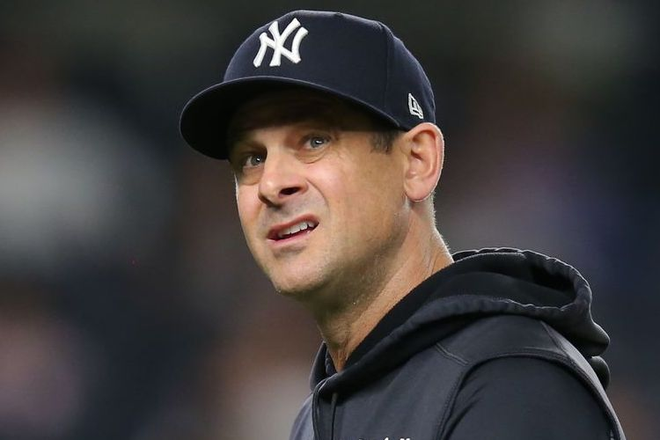
Project Introduction
Components of Decision
Data
Simulation
Results
Notes:
Pitcher: <a href="https://www.flaticon.com/free-icons/pitcher" title="pitcher icons">Pitcher icons created by Leremy - Flaticon</a>
Batter: <a href="https://www.flaticon.com/free-icons/batter" title="batter icons">Batter icons created by Freepik - Flaticon</a>
List: <a href="https://www.flaticon.com/free-icons/priority" title="priority icons">Priority icons created by Freepik - Flaticon</a>
Machine: <a href="https://www.flaticon.com/free-icons/automation" title="automation icons">Automation icons created by Becris - Flaticon</a>
Arrow: <a href="https://www.flaticon.com/free-icons/arrow" title="arrow icons">Arrow icons created by Freepik - Flaticon</a>
Versus: <a href="https://www.flaticon.com/free-icons/vs" title="vs icons">Vs icons created by The Icon Tree - Flaticon</a>
Data: <a href="https://www.flaticon.com/free-icons/data" title="data icons">Data icons created by Kiranshastry - Flaticon</a>

Slide 8
How Did I Define the Components?
Components of Decision
Data
Simulation
Results
Notes:
Pitcher: <a href="https://www.flaticon.com/free-icons/pitcher" title="pitcher icons">Pitcher icons created by Leremy - Flaticon</a>
Batter: <a href="https://www.flaticon.com/free-icons/batter" title="batter icons">Batter icons created by Freepik - Flaticon</a>
List: <a href="https://www.flaticon.com/free-icons/priority" title="priority icons">Priority icons created by Freepik - Flaticon</a>
Machine: <a href="https://www.flaticon.com/free-icons/automation" title="automation icons">Automation icons created by Becris - Flaticon</a>
Arrow: <a href="https://www.flaticon.com/free-icons/arrow" title="arrow icons">Arrow icons created by Freepik - Flaticon</a>
Versus: <a href="https://www.flaticon.com/free-icons/vs" title="vs icons">Vs icons created by The Icon Tree - Flaticon</a>
Data: <a href="https://www.flaticon.com/free-icons/data" title="data icons">Data icons created by Kiranshastry - Flaticon</a>

Slide 9
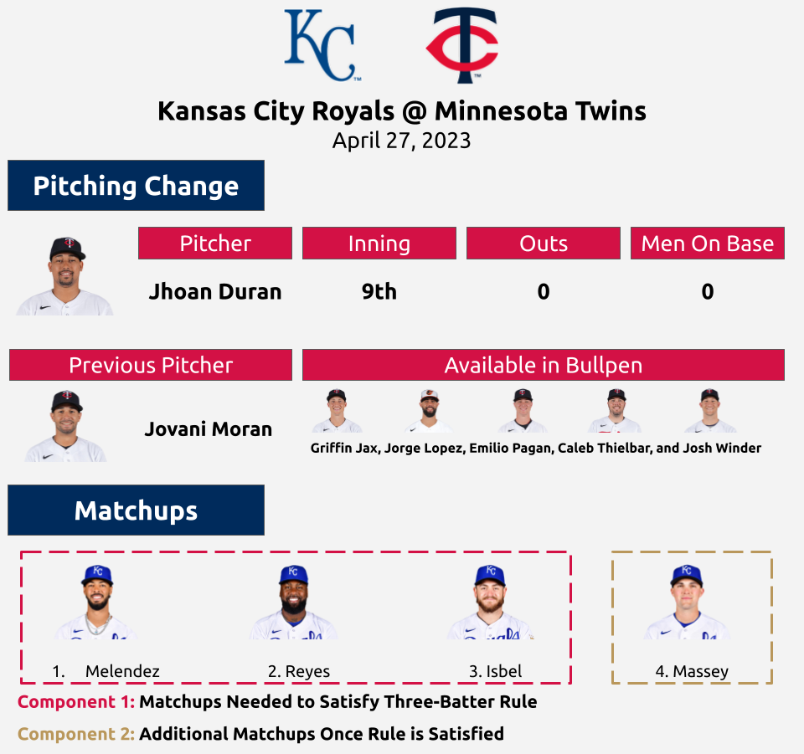
The Project's Framework
What Are Managers Considering?
Inserted pitcher will...
Limit runs
Limit more runs than removed pitcher
Perform just as well, or better, than other pitchers in the bullpen
Three Batter Minimum Rule
Game State / Situation (Leverage Index)
Notes:
Pitcher: <a href="https://www.flaticon.com/free-icons/pitcher" title="pitcher icons">Pitcher icons created by Leremy - Flaticon</a>
Batter: <a href="https://www.flaticon.com/free-icons/batter" title="batter icons">Batter icons created by Freepik - Flaticon</a>
List: <a href="https://www.flaticon.com/free-icons/priority" title="priority icons">Priority icons created by Freepik - Flaticon</a>
Machine: <a href="https://www.flaticon.com/free-icons/automation" title="automation icons">Automation icons created by Becris - Flaticon</a>
Arrow: <a href="https://www.flaticon.com/free-icons/arrow" title="arrow icons">Arrow icons created by Freepik - Flaticon</a>
Versus: <a href="https://www.flaticon.com/free-icons/vs" title="vs icons">Vs icons created by The Icon Tree - Flaticon</a>

Slide 10
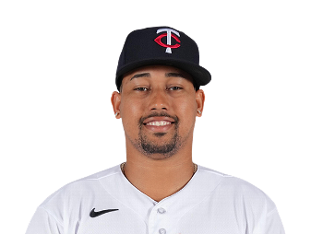
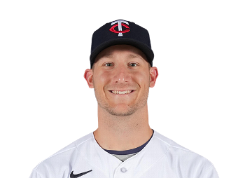
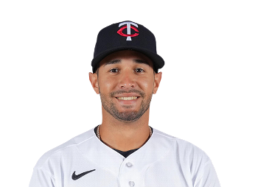
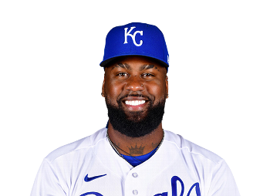
Hypothetical Matchups Are Needed To Make This Work
Component 1: Matchups Needed to Satisfy Three Batter Minimum Rule
Actual Pitcher
Previous Pitcher
Available In Bullpen
Batter 1: Duran vs Melendez
Batter 1: Moran vs Melendez
Batter 1: Bullpen vs Melendez
Batter 2: Duran vs Reyes
Batter 2: Moran vs Reyes
Batter 2: Bullpen vs Reyes
Batter 3: Duran vs Isbel
Batter 3: Moran vs Isbel
Batter 3: Bullpen vs Isbel
Notes:
Baseball Computer: <a href="https://www.flaticon.com/free-icons/sports-and-competition" title="sports and competition icons">Sports and competition icons created by Freepik - Flaticon</a>
<a href="https://www.flaticon.com/free-icons/card" title="card icons">Card icons created by Freepik - Flaticon</a>

Slide 11
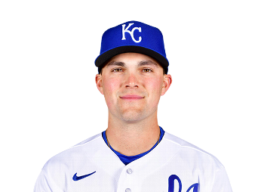
Hypothetical Matchups Are Needed To Make This Work
Component 2: Additional Matchups Once Rule is Satisfied
Actual Pitcher
Available In Bullpen
Batter 1: Duran vs Massey
Batter 1: Bullpen vs Massey
Notes:
Baseball Computer: <a href="https://www.flaticon.com/free-icons/sports-and-competition" title="sports and competition icons">Sports and competition icons created by Freepik - Flaticon</a>
<a href="https://www.flaticon.com/free-icons/card" title="card icons">Card icons created by Freepik - Flaticon</a>

Slide 12
What Data Did I Need?
Components of Decision
Data
Simulation
Results
Notes:
Pitcher: <a href="https://www.flaticon.com/free-icons/pitcher" title="pitcher icons">Pitcher icons created by Leremy - Flaticon</a>
Batter: <a href="https://www.flaticon.com/free-icons/batter" title="batter icons">Batter icons created by Freepik - Flaticon</a>
List: <a href="https://www.flaticon.com/free-icons/priority" title="priority icons">Priority icons created by Freepik - Flaticon</a>
Machine: <a href="https://www.flaticon.com/free-icons/automation" title="automation icons">Automation icons created by Becris - Flaticon</a>
Arrow: <a href="https://www.flaticon.com/free-icons/arrow" title="arrow icons">Arrow icons created by Freepik - Flaticon</a>
Versus: <a href="https://www.flaticon.com/free-icons/vs" title="vs icons">Vs icons created by The Icon Tree - Flaticon</a>
Data: <a href="https://www.flaticon.com/free-icons/data" title="data icons">Data icons created by Kiranshastry - Flaticon</a>

Slide 13
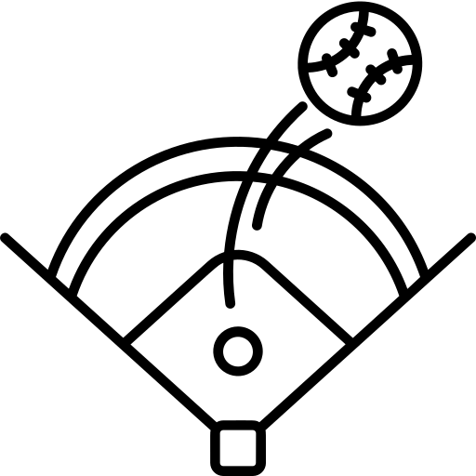
What Features Are Needed?
On Base Percentage
Singles Percentage
Flyball Percentage
Strikeout Percentage
Doubles Percentage
Groundball Percentage
Triples Percentage
Ball In Play Out Percentage
Line Drive Percentage
Home Run Percentage
Popup Percentage
Walks Percentage
Notes:
Base: <a href="https://www.flaticon.com/free-icons/base" title="base icons">Base icons created by Freepik - Flaticon</a>
Baseball: <a href="https://www.flaticon.com/free-icons/ball" title="ball icons">Ball icons created by Freepik - Flaticon</a>
Bat and Ball: <a href="https://www.flaticon.com/free-icons/ball" title="ball icons">Ball icons created by Freepik - Flaticon</a>
Baseball Diamond: <a href="https://www.flaticon.com/free-icons/arena" title="arena icons">Arena icons created by magnemizer - Flaticon</a>
Home Run: <a href="https://www.flaticon.com/free-icons/home-run" title="home run icons">Home run icons created by kerismaker - Flaticon</a>
Walking: <a href="https://www.flaticon.com/free-icons/people" title="people icons">People icons created by Bharat Icons - Flaticon</a>
Superhero: <a href="https://www.flaticon.com/free-icons/superhero" title="superhero icons">Superhero icons created by Freepik - Flaticon</a>
Shovel / Ground: <a href="https://www.flaticon.com/free-icons/ground" title="ground icons">Ground icons created by Freepik - Flaticon</a>
Lightning: <a href="https://www.flaticon.com/free-icons/flash" title="flash icons">Flash icons created by Smashicons - Flaticon</a>
Canned Food: <a href="https://www.flaticon.com/free-icons/tin-can" title="tin can icons">Tin can icons created by Ains - Flaticon</a>

Slide 14
Where The Data Came From
Pybaseball Python Package
ESPN MLB Team Rosters
Notes:
Baseball Computer: <a href="https://www.flaticon.com/free-icons/sports-and-competition" title="sports and competition icons">Sports and competition icons created by Freepik - Flaticon</a>
<a href="https://www.flaticon.com/free-icons/card" title="card icons">Card icons created by Freepik - Flaticon</a>

Slide 15
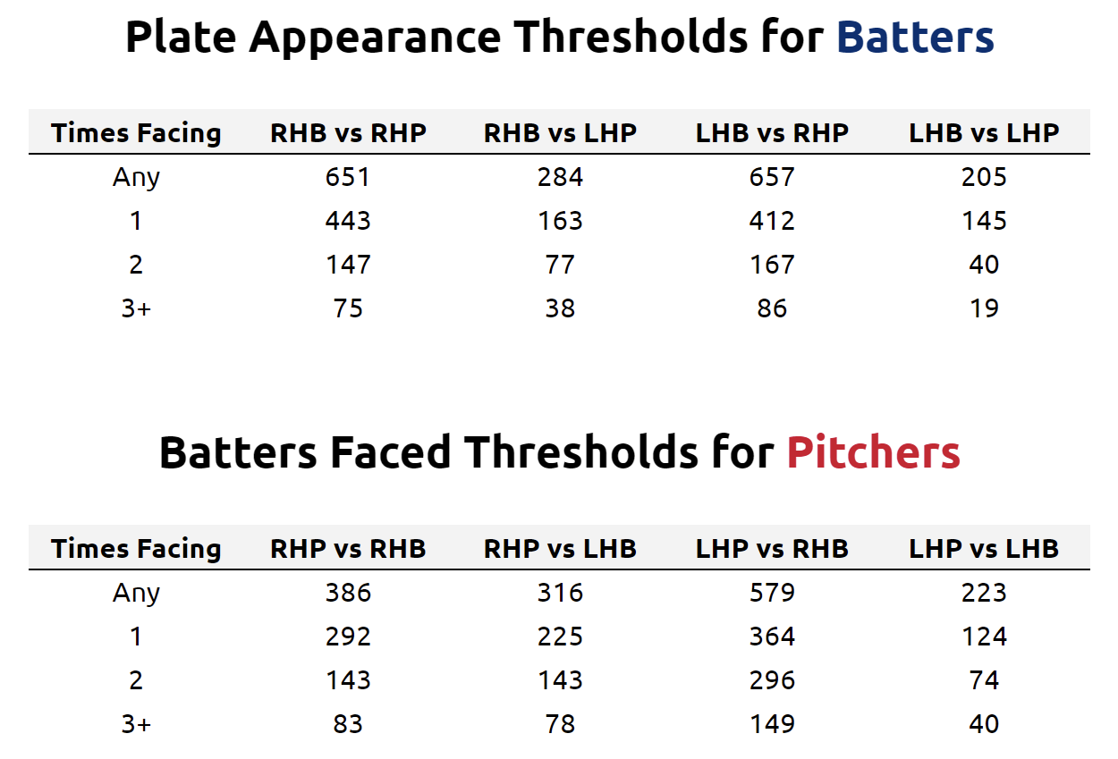
Plate Appearance and Batters Faced Thresholds
Wanted a large enough sample for "stable" results
Wanted to account for handedness splits as well as Times Facing
Inputs for next step were the weighted average of Element 1 and Element 2
If players didn't meet the threshold, a weighted average was used
Notes:
Baseball Computer: <a href="https://www.flaticon.com/free-icons/sports-and-competition" title="sports and competition icons">Sports and competition icons created by Freepik - Flaticon</a>
<a href="https://www.flaticon.com/free-icons/card" title="card icons">Card icons created by Freepik - Flaticon</a>

Slide 16
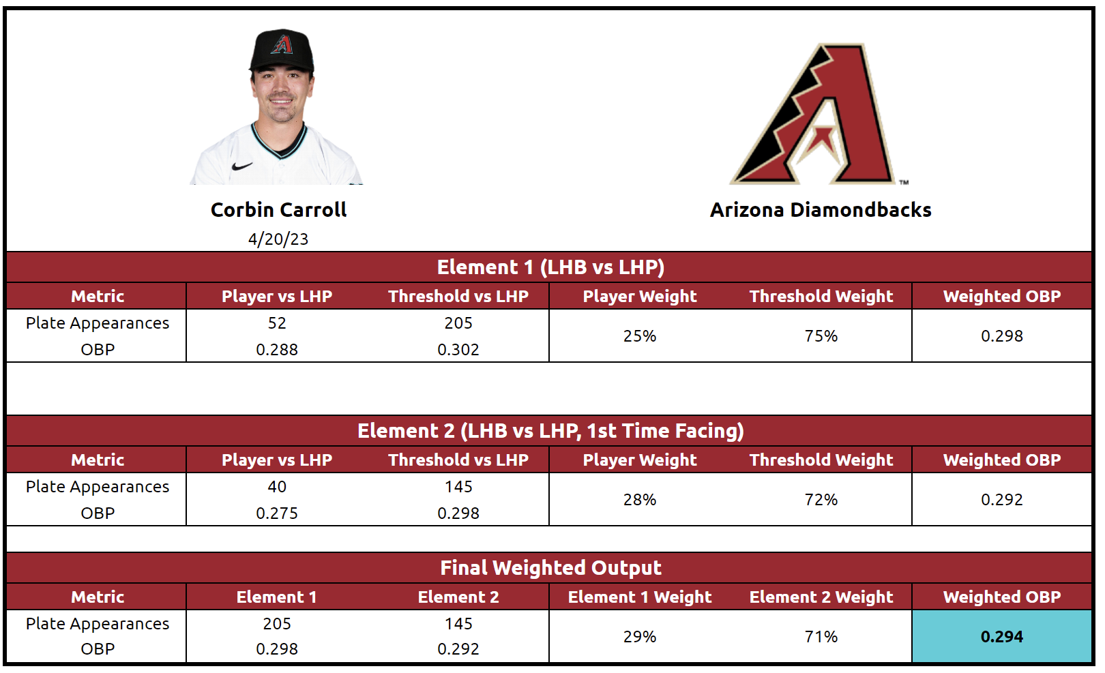
Input Generation Example
Notes:
Baseball Computer: <a href="https://www.flaticon.com/free-icons/sports-and-competition" title="sports and competition icons">Sports and competition icons created by Freepik - Flaticon</a>
<a href="https://www.flaticon.com/free-icons/card" title="card icons">Card icons created by Freepik - Flaticon</a>

Slide 17
Run Inputs Through Adjusted Log5 Method
Used Bill James' adapted log5 method
Run each feature through adapted log5 method
Imperfect – as pointed out by Haechral in 2014
Revisiting if a Machine Learning approach can substitute for this portion of the framework
Notes:
Baseball Computer: <a href="https://www.flaticon.com/free-icons/sports-and-competition" title="sports and competition icons">Sports and competition icons created by Freepik - Flaticon</a>
<a href="https://www.flaticon.com/free-icons/card" title="card icons">Card icons created by Freepik - Flaticon</a>

Slide 18
How Did I Simulate the Matchups?
Components of Decision
Data
Simulation
Results
Notes:
Pitcher: <a href="https://www.flaticon.com/free-icons/pitcher" title="pitcher icons">Pitcher icons created by Leremy - Flaticon</a>
Batter: <a href="https://www.flaticon.com/free-icons/batter" title="batter icons">Batter icons created by Freepik - Flaticon</a>
List: <a href="https://www.flaticon.com/free-icons/priority" title="priority icons">Priority icons created by Freepik - Flaticon</a>
Machine: <a href="https://www.flaticon.com/free-icons/automation" title="automation icons">Automation icons created by Becris - Flaticon</a>
Arrow: <a href="https://www.flaticon.com/free-icons/arrow" title="arrow icons">Arrow icons created by Freepik - Flaticon</a>
Versus: <a href="https://www.flaticon.com/free-icons/vs" title="vs icons">Vs icons created by The Icon Tree - Flaticon</a>
Data: <a href="https://www.flaticon.com/free-icons/data" title="data icons">Data icons created by Kiranshastry - Flaticon</a>

Slide 19
Plate Appearance Matchup Simulation
Reach Base, Ball In Play Out, or Strikeout is determined
Next step is dependent on initial outcome
Baserunning takes place after Reached Base type or BIPO type is determined
Outcome affects game state of the simulation iteration for the next plate appearance matchup
Notes:
Baseball Computer: <a href="https://www.flaticon.com/free-icons/sports-and-competition" title="sports and competition icons">Sports and competition icons created by Freepik - Flaticon</a>
<a href="https://www.flaticon.com/free-icons/card" title="card icons">Card icons created by Freepik - Flaticon</a>

Slide 20
Simulation Program Breakdown
Matchup sets simulated 10K times
Incorporates game state
Baserunning dynamics included, but not player specific
Output is the average runs scored
Notes:
Baseball Computer: <a href="https://www.flaticon.com/free-icons/sports-and-competition" title="sports and competition icons">Sports and competition icons created by Freepik - Flaticon</a>
<a href="https://www.flaticon.com/free-icons/card" title="card icons">Card icons created by Freepik - Flaticon</a>

Slide 21
So Many Simulations
Component 1
Component 2
Actual Pitcher Matchup Sets: 16,099
Actual Pitcher Matchup Sets: 37,557
Previous Pitcher Matchup Sets: 16,099
Bullpen Matchup Sets: 221,374
Bullpen Matchup Sets: 89,210
Notes:
Two pieces: <a href="https://www.flaticon.com/free-icons/two" title="two icons">Two icons created by Freepik - Flaticon</a>

Slide 22
How Did I Prepare the Results?
Components of Decision
Data
Simulation
Results
Notes:
Pitcher: <a href="https://www.flaticon.com/free-icons/pitcher" title="pitcher icons">Pitcher icons created by Leremy - Flaticon</a>
Batter: <a href="https://www.flaticon.com/free-icons/batter" title="batter icons">Batter icons created by Freepik - Flaticon</a>
List: <a href="https://www.flaticon.com/free-icons/priority" title="priority icons">Priority icons created by Freepik - Flaticon</a>
Machine: <a href="https://www.flaticon.com/free-icons/automation" title="automation icons">Automation icons created by Becris - Flaticon</a>
Arrow: <a href="https://www.flaticon.com/free-icons/arrow" title="arrow icons">Arrow icons created by Freepik - Flaticon</a>
Versus: <a href="https://www.flaticon.com/free-icons/vs" title="vs icons">Vs icons created by The Icon Tree - Flaticon</a>
Data: <a href="https://www.flaticon.com/free-icons/data" title="data icons">Data icons created by Kiranshastry - Flaticon</a>

Slide 23
Boiling Down the Results Into wBMS+
Results aggregated, normalized, and weighted
Component 1 and Component 2 combine to form a weighted composite score... wBMS+
Notes:
Two pieces: <a href="https://www.flaticon.com/free-icons/two" title="two icons">Two icons created by Freepik - Flaticon</a>

Slide 24
wBMS+ Rankings
Notes:
Two pieces: <a href="https://www.flaticon.com/free-icons/two" title="two icons">Two icons created by Freepik - Flaticon</a>

Slide 25
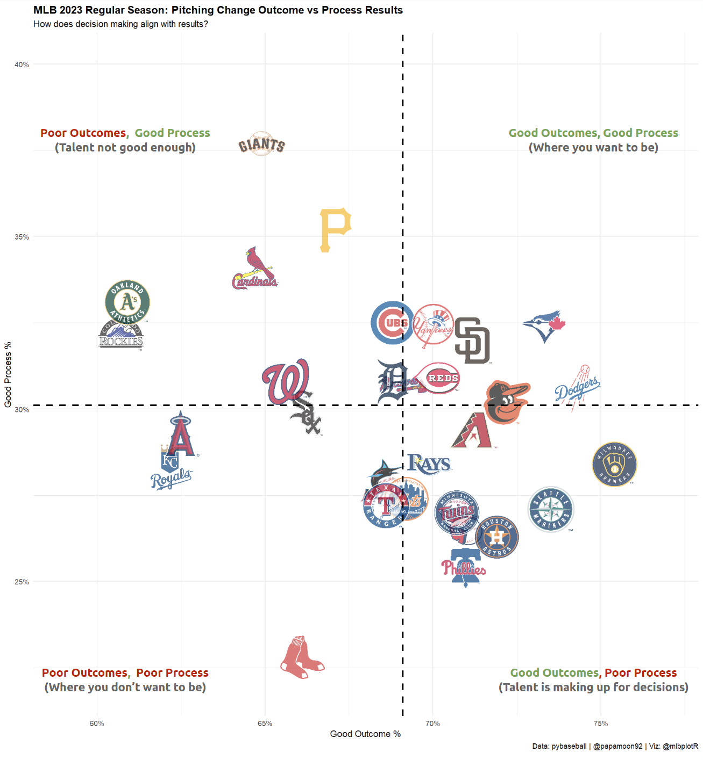
Process vs Outcome (Excluding Leverage)
Good Process = Actual Pitcher chosen is expected to outperform Previous Pitcher and Bullpen
Good Outcome = Actual Runs allowed < Expected Runs allowed (RE24 Matrix)
Compared to previous slide, you can see the impact of Leverage
Notes:
Two pieces: <a href="https://www.flaticon.com/free-icons/two" title="two icons">Two icons created by Freepik - Flaticon</a>

Slide 26
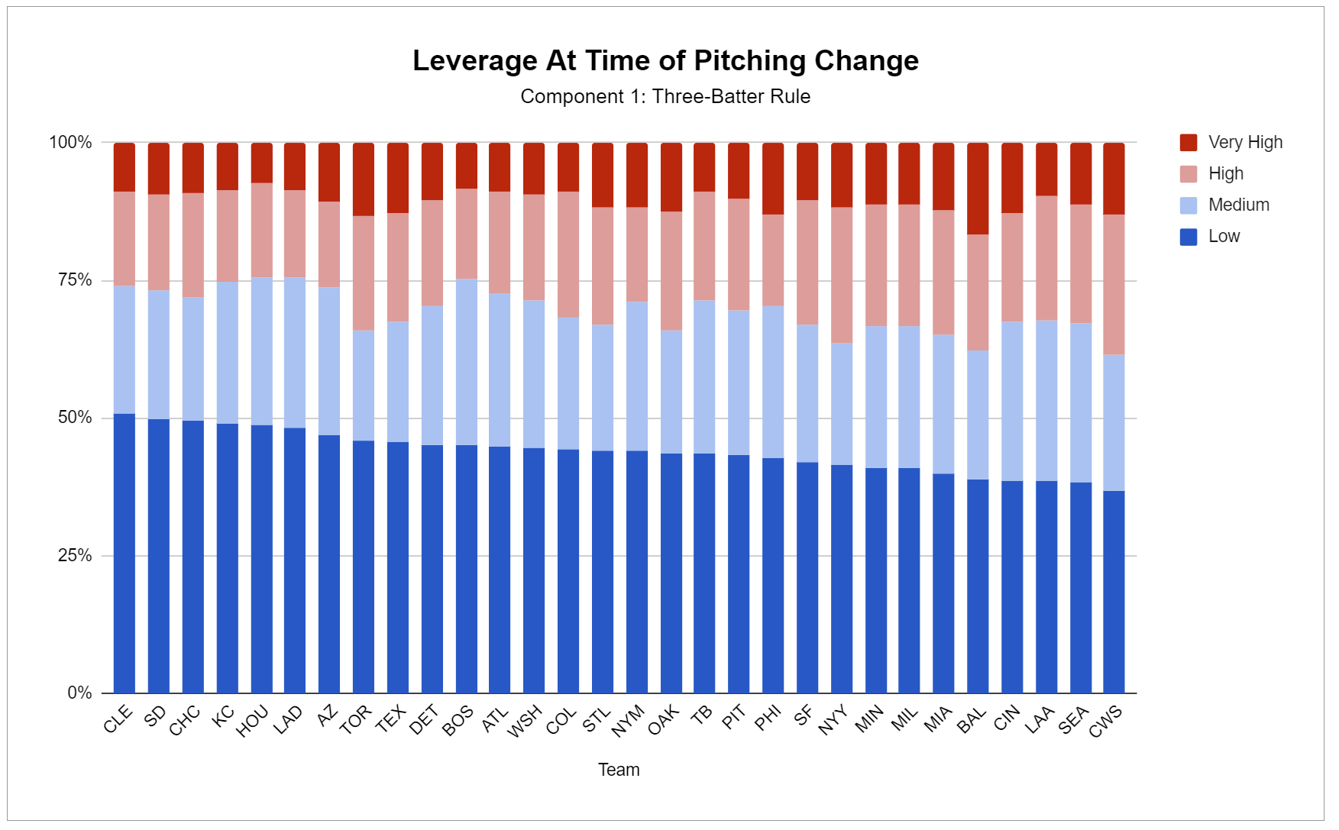
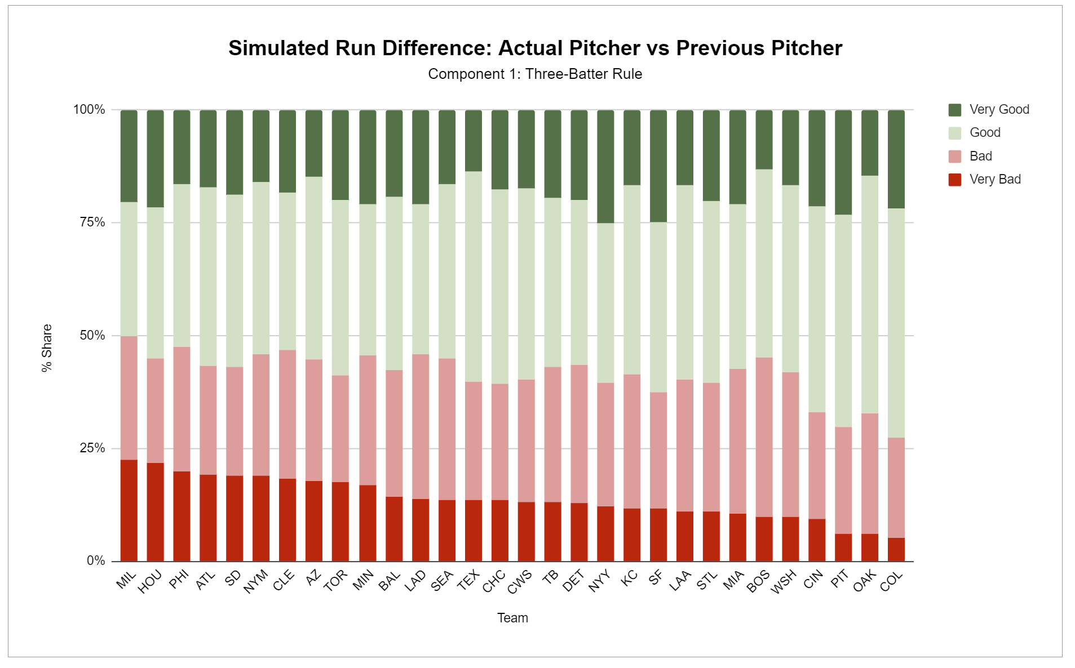
Contextualizing the Raw Results
Notes:
Two pieces: <a href="https://www.flaticon.com/free-icons/two" title="two icons">Two icons created by Freepik - Flaticon</a>

Slide 27
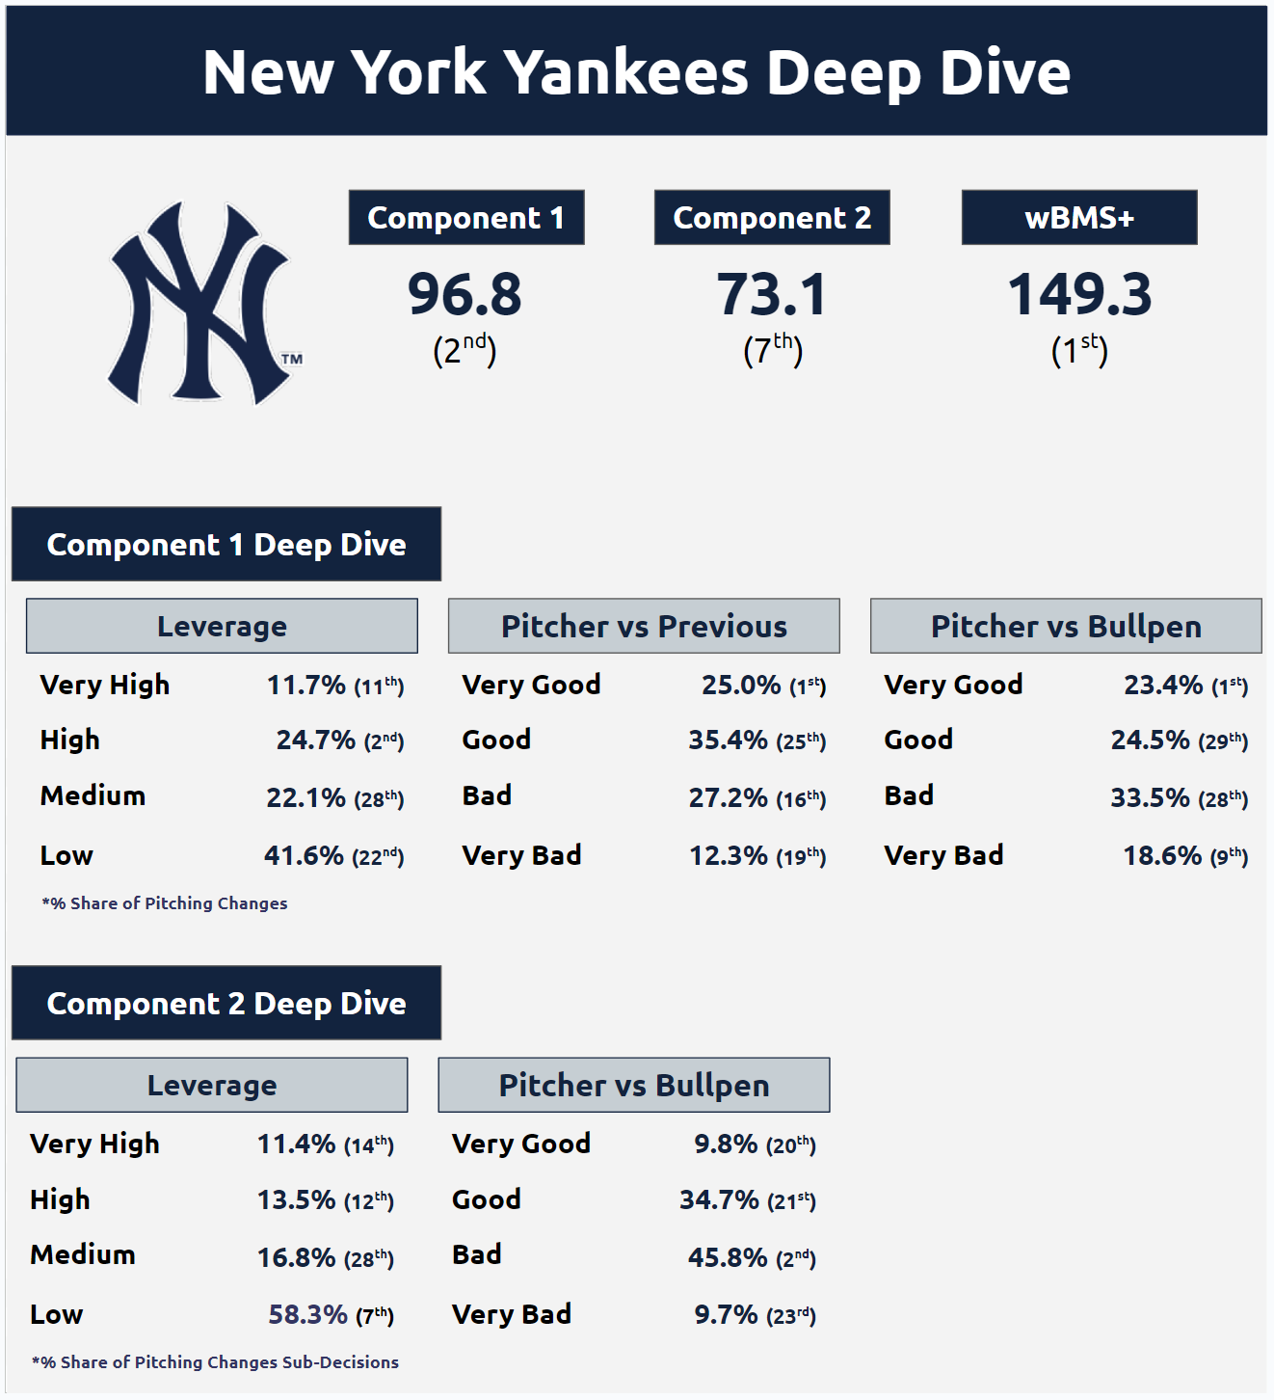
Team Review
Component 1:
Many decisions made in Very High and High
Leading the way with Very Good
Component 2:
Not as much Very High and High
Lots of Bad Decisions, but Low Leverage helps
Notes:
Two pieces: <a href="https://www.flaticon.com/free-icons/two" title="two icons">Two icons created by Freepik - Flaticon</a>

Slide 28
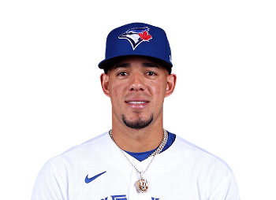
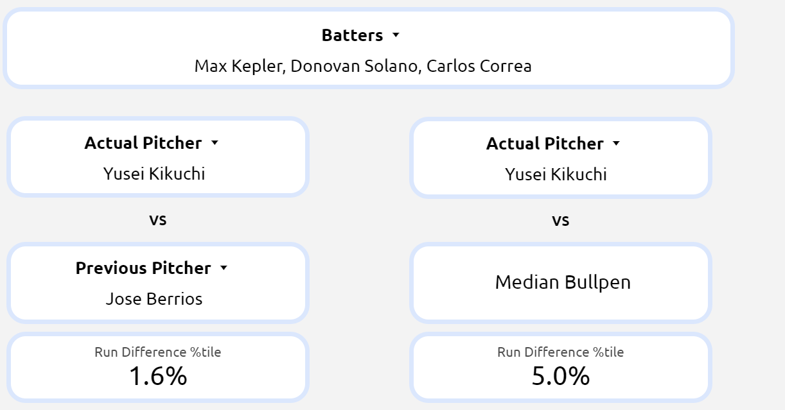
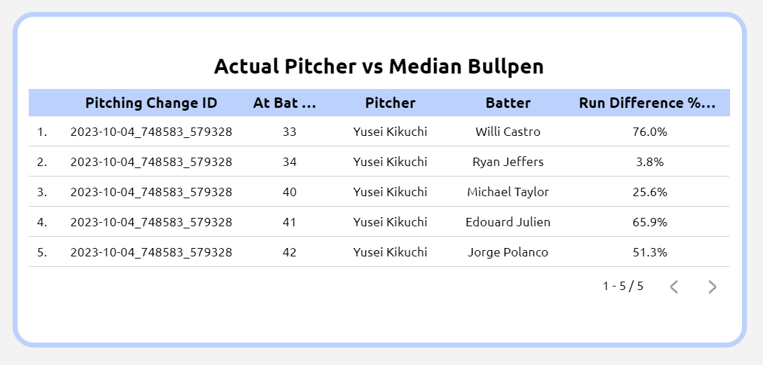
Specific Pitching Change Example
Toronto Blue Jays vs Minnesota Twins
ALWC Game 2 - 10.4.23
Jose Berrios on the mound...
Component 1
Component 2
Notes:
Two pieces: <a href="https://www.flaticon.com/free-icons/two" title="two icons">Two icons created by Freepik - Flaticon</a>

Slide 29
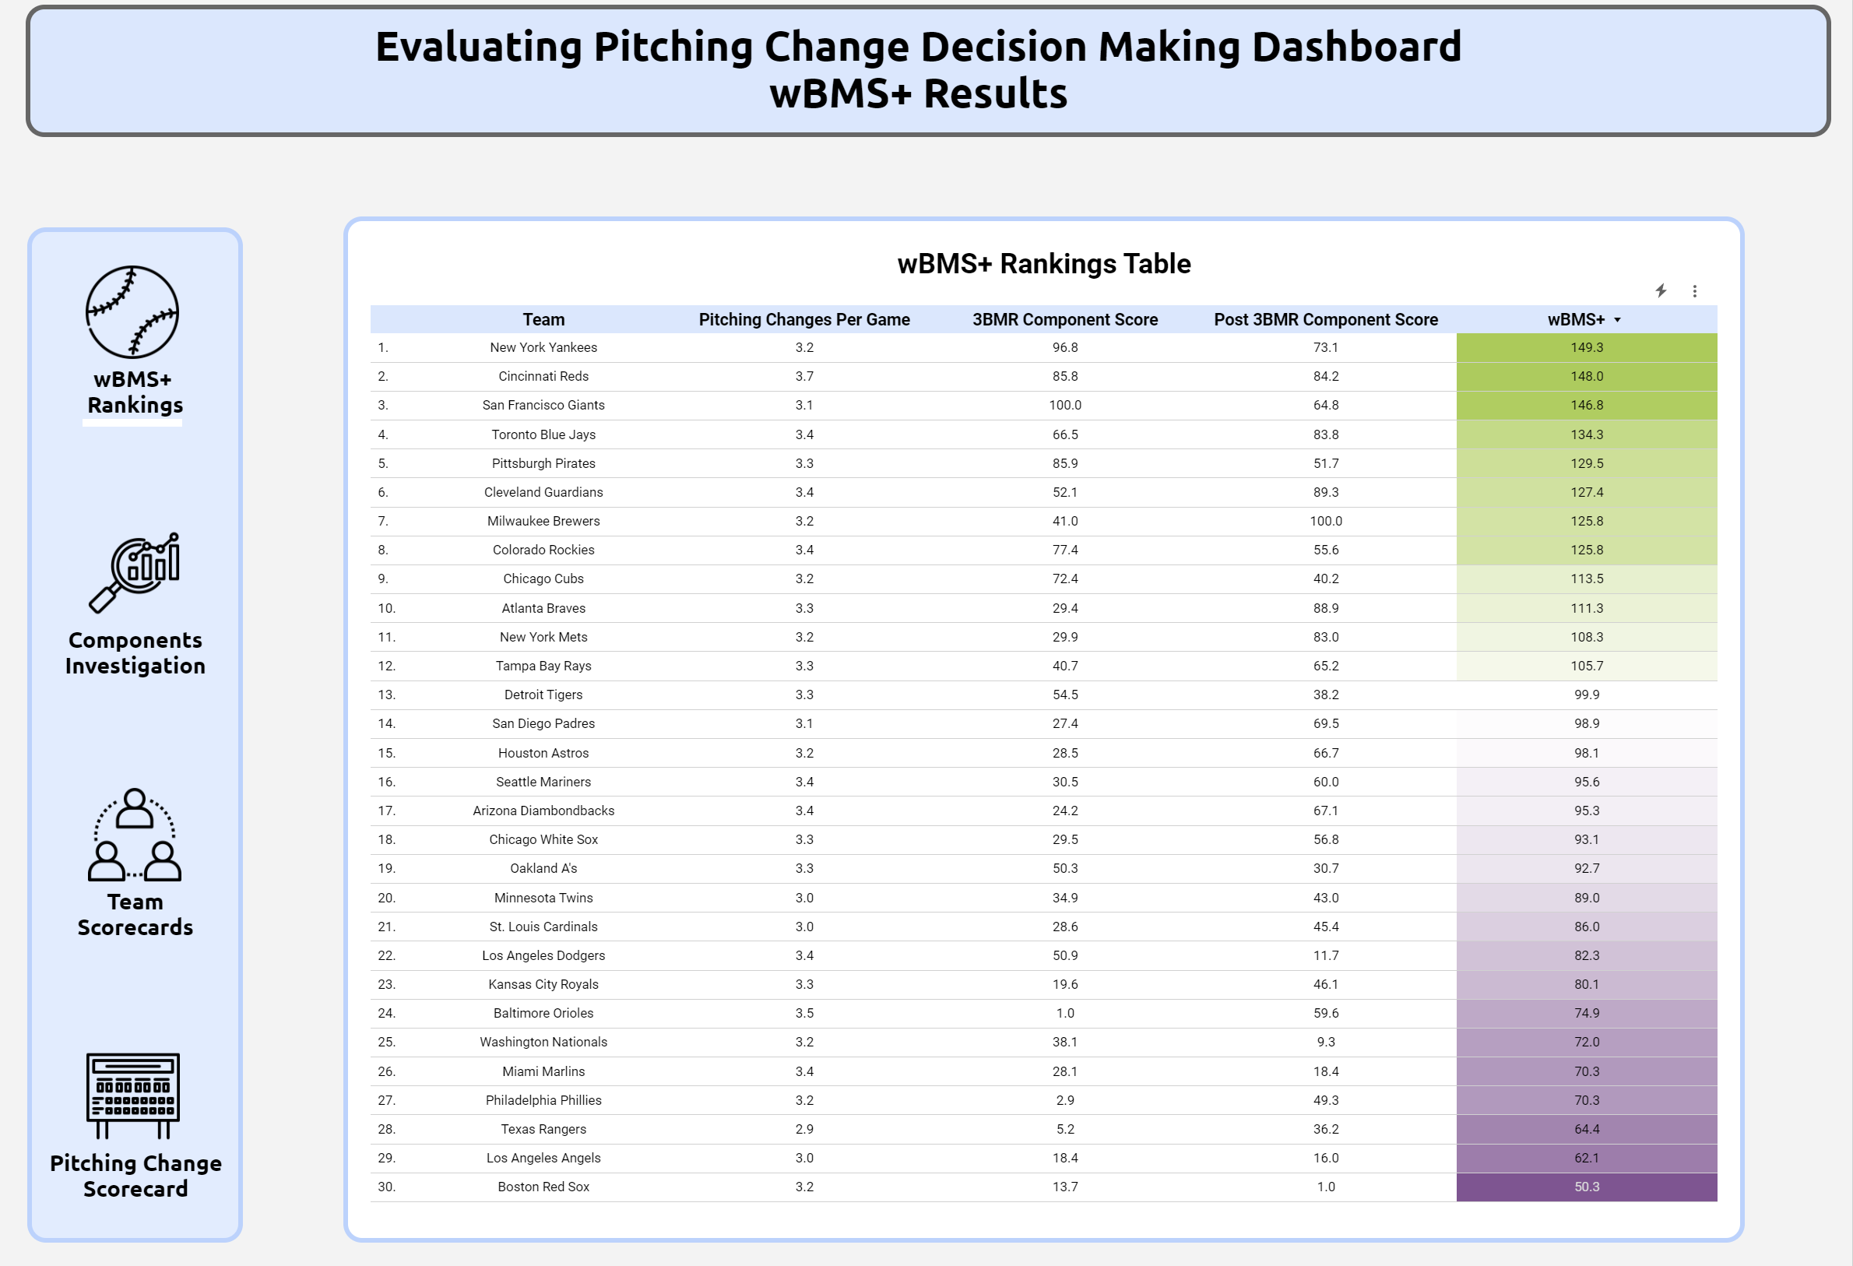
Remember the Tool I Alluded To?
Access to:
Overall Rankings
Components Breakdown
Team Specific Scorecards
Specific Pitching Change Decisions
Rankings only include regular season
Playoffs in Pitching Change Scorecard
Notes:
Two pieces: <a href="https://www.flaticon.com/free-icons/two" title="two icons">Two icons created by Freepik - Flaticon</a>

Slide 30
QR Link to Dashboard
Check It Out For Yourself!
Notes:
Two pieces: <a href="https://www.flaticon.com/free-icons/two" title="two icons">Two icons created by Freepik - Flaticon</a>

Slide 31
Caveats and Weaknesses
Relies On
Hypothetical Matchups
Decisions Evaluated
In a Vacuum
Roster Health and Availability
TTOP, Fatigue, Etc Not Fully Captured
Notes:
One: <a href="https://www.flaticon.com/free-icons/numbers" title="numbers icons">Numbers icons created by riajulislam - Flaticon</a>
Two: <a href="https://www.flaticon.com/free-icons/numbers" title="numbers icons">Numbers icons created by riajulislam - Flaticon</a>
Three: <a href="https://www.flaticon.com/free-icons/numbers" title="numbers icons">Numbers icons created by riajulislam - Flaticon</a>
Four: <a href="https://www.flaticon.com/free-icons/numbers" title="numbers icons">Numbers icons created by riajulislam - Flaticon</a>

Slide 32
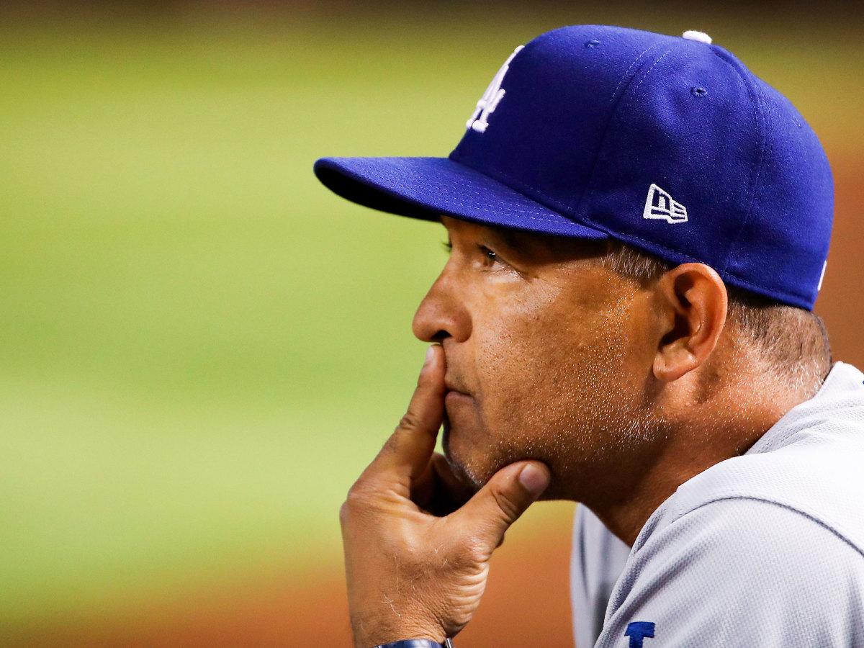
What's Next?
Revisiting input generation methodology
Dashboard edits
Automating full process
Blog posts + official reveal
Notes:
One: <a href="https://www.flaticon.com/free-icons/numbers" title="numbers icons">Numbers icons created by riajulislam - Flaticon</a>
Two: <a href="https://www.flaticon.com/free-icons/numbers" title="numbers icons">Numbers icons created by riajulislam - Flaticon</a>
Three: <a href="https://www.flaticon.com/free-icons/numbers" title="numbers icons">Numbers icons created by riajulislam - Flaticon</a>
Four: <a href="https://www.flaticon.com/free-icons/numbers" title="numbers icons">Numbers icons created by riajulislam - Flaticon</a>

Slide 33
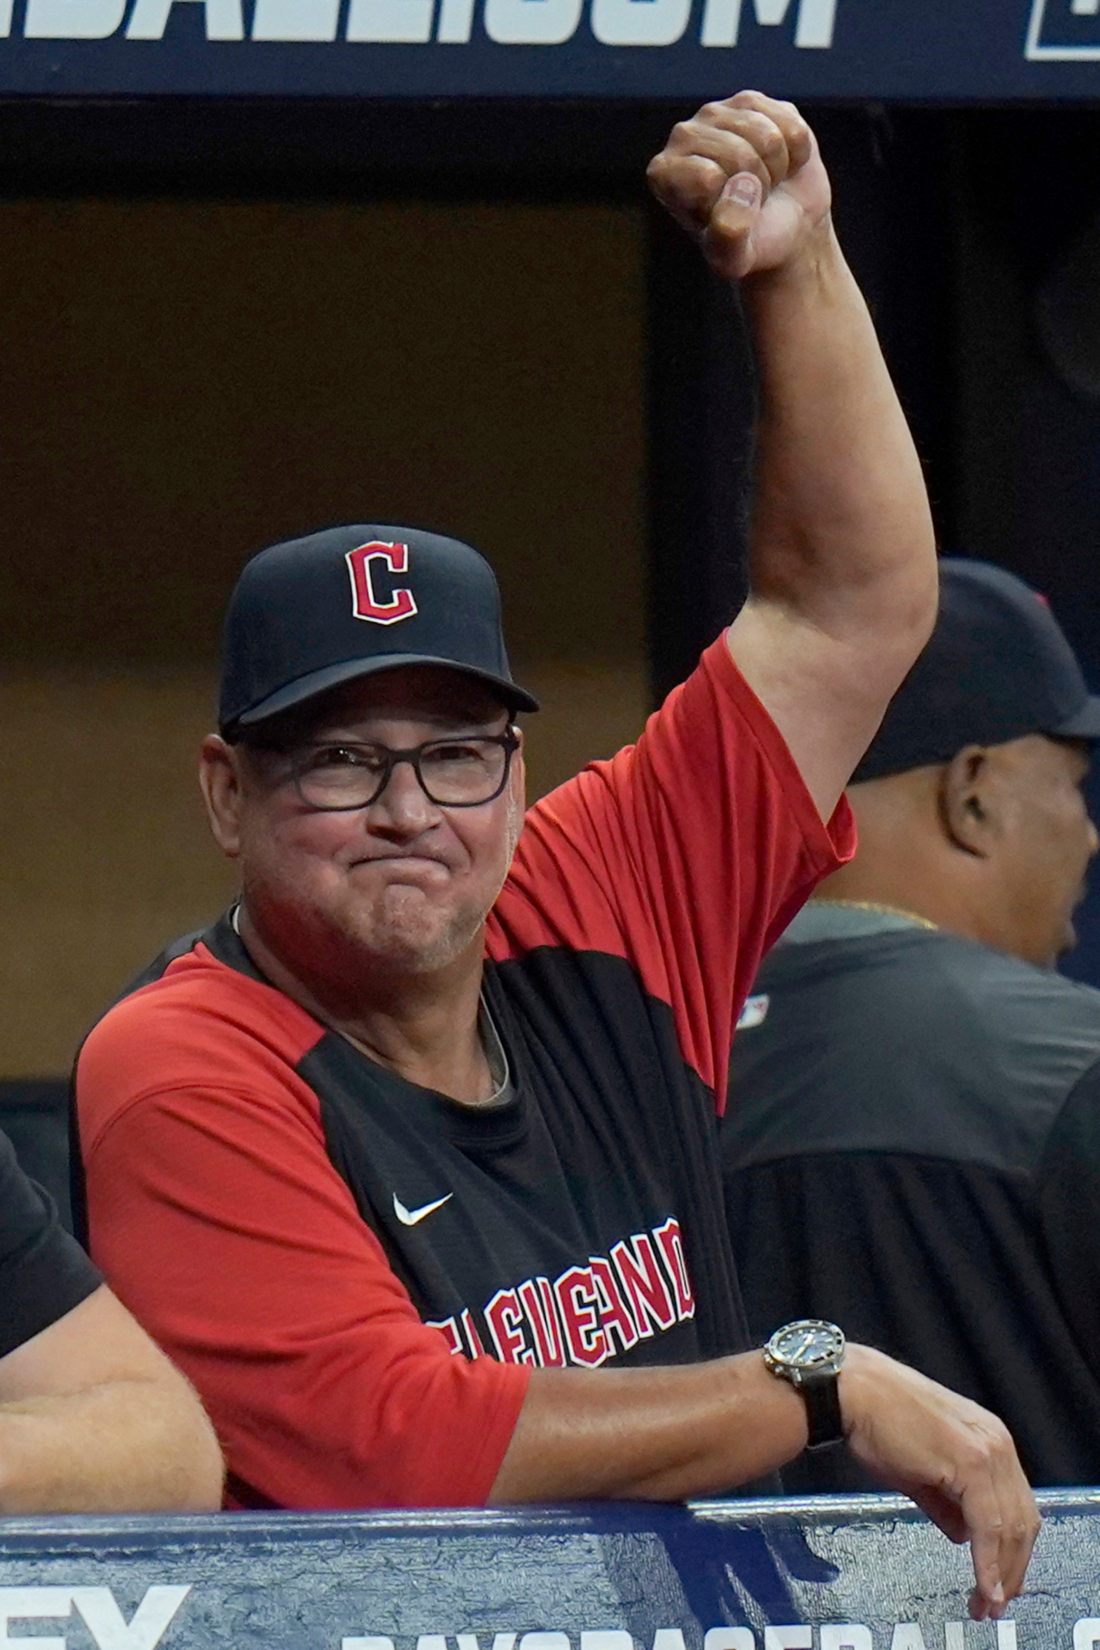
Thank You!
My Wife!
SABR and the Selection Committee
MLB, pybaseball, mlbplotR
You!
Notes:
One: <a href="https://www.flaticon.com/free-icons/numbers" title="numbers icons">Numbers icons created by riajulislam - Flaticon</a>
Two: <a href="https://www.flaticon.com/free-icons/numbers" title="numbers icons">Numbers icons created by riajulislam - Flaticon</a>
Three: <a href="https://www.flaticon.com/free-icons/numbers" title="numbers icons">Numbers icons created by riajulislam - Flaticon</a>
Four: <a href="https://www.flaticon.com/free-icons/numbers" title="numbers icons">Numbers icons created by riajulislam - Flaticon</a>

Slide 34
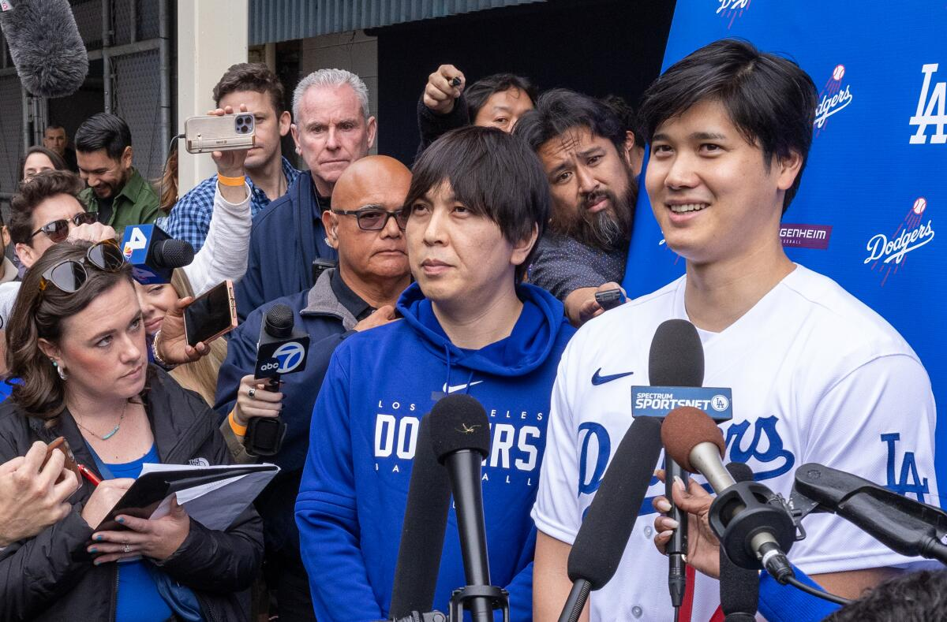
Questions?
If You'd Like To Connect...
www.uramanalytics.com
@URAM_Analytics (Twitter)
I'm also on LinkedIn
Notes:
One: <a href="https://www.flaticon.com/free-icons/numbers" title="numbers icons">Numbers icons created by riajulislam - Flaticon</a>
Two: <a href="https://www.flaticon.com/free-icons/numbers" title="numbers icons">Numbers icons created by riajulislam - Flaticon</a>
Three: <a href="https://www.flaticon.com/free-icons/numbers" title="numbers icons">Numbers icons created by riajulislam - Flaticon</a>
Four: <a href="https://www.flaticon.com/free-icons/numbers" title="numbers icons">Numbers icons created by riajulislam - Flaticon</a>

