Slide 1
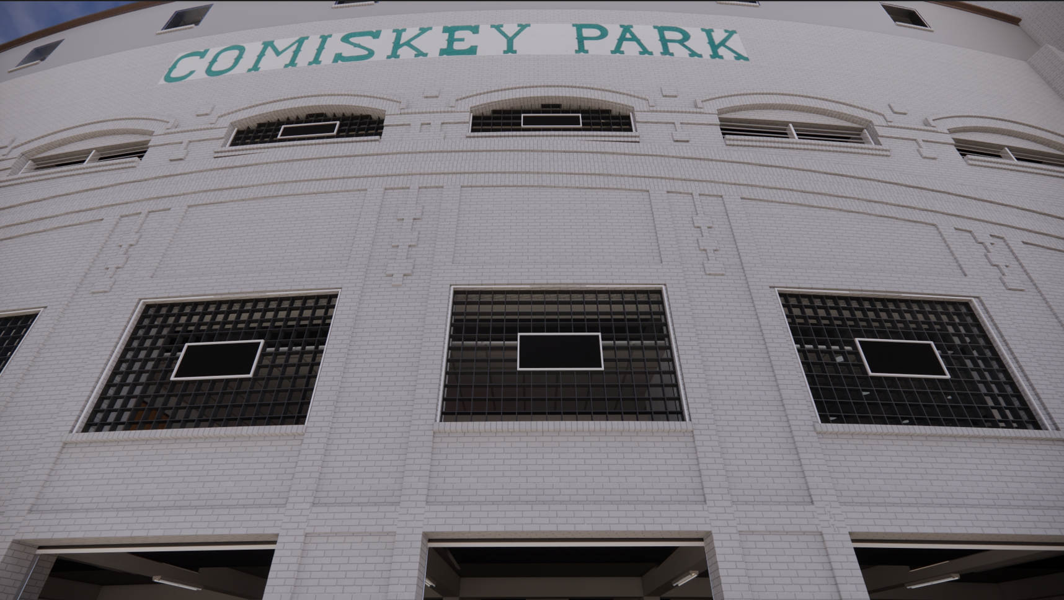
harnessing the power of building information TECHNOLOGY TO PRESERVE CHICAGO’S “BASEBALL PALACE OF THE WORLD”
Notes:
I want to thank Society of American Baseball Research for allowing me to present this year at SABR 51 in Chicago.
The title of my presentation is:
HARNESSING THE POWER OF BUILDING INFORMATION TECHNOLOGY TO PRESERVE CHICAGO’S “BASEBALL PALACE OF THE WORLD”

Slide 2
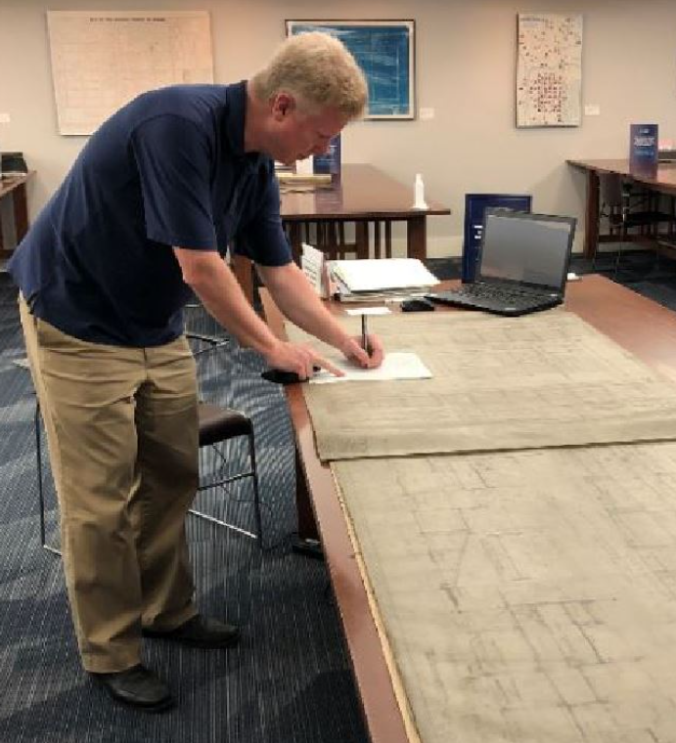
introduction
Brian v. powers, aia, leed ap
Brian Powers is a Chicago architect with dedicated experience in the preservation of historic sporting facilities of amateur and professional teams across the country. Brian’s work has been featured in many publications in addition to exhibits in the Baseball Heritage Museum in Cleveland and the National Baseball Hall of Fame in Cooperstown.
In 2019, Brian founded Bandbox Ballparks as a platform to share his specialized research in digital preservation of historic ballparks. Brian is a member of SABR and the American Institute of Architects, and a Life Member of the National Baseball Hall of Fame and Museum.
Notes:
My name is Brian Powers, and I’m a practicing architect here in Chicago who has devoted much of my professional (and personal) career to sports facilities including the design and preservation of our historical baseball venues across the country. I’ve been a SABR member over 30 years and I’ve found it as a wonderful forum to share my work.

Slide 3
Digitally preserving Chicago’s “baseball palace of the world”
Presentation objectives
Objective 1: Define Building Information Modeling and how it can be applied to baseball park research.
Objective 2: Understand how the project workflow was established, how research documentation was acquired, and how information was organized and implemented into a 3D digital working model.
Objective 3: Demonstrate how data is identified and embedded into predefined modeling elements. Attendees will learn how this data can be used for valuation of old stadium seating through "artifact tracing".
Notes:
Objective 1: Define Building Information Modeling and how it can be applied to baseball park research.
Objective 2: Understand how the project workflow was established, how research documentation was acquired, and how information was organized and implemented into a 3D digital working model.
Objective 3: Demonstrate how data is identified and embedded into predefined modeling elements. Attendees will learn how this data can be used for valuation of old stadium seating through "artifact tracing".

Slide 4
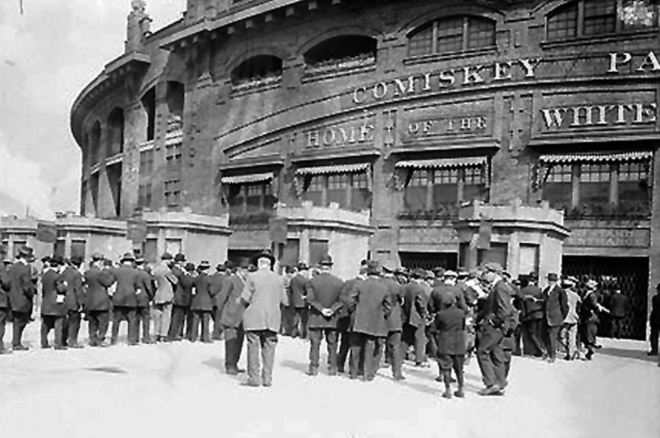
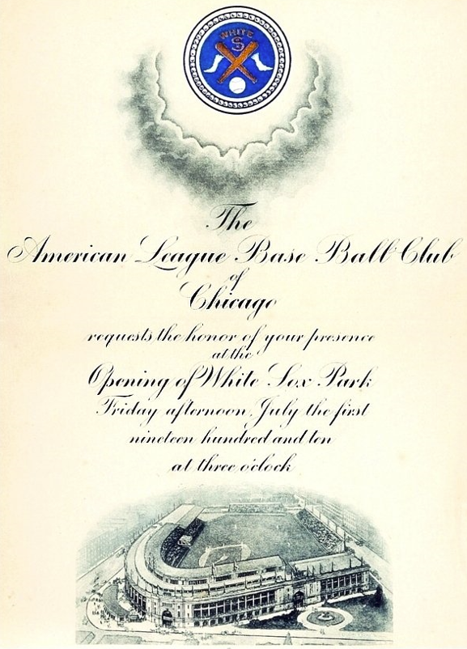
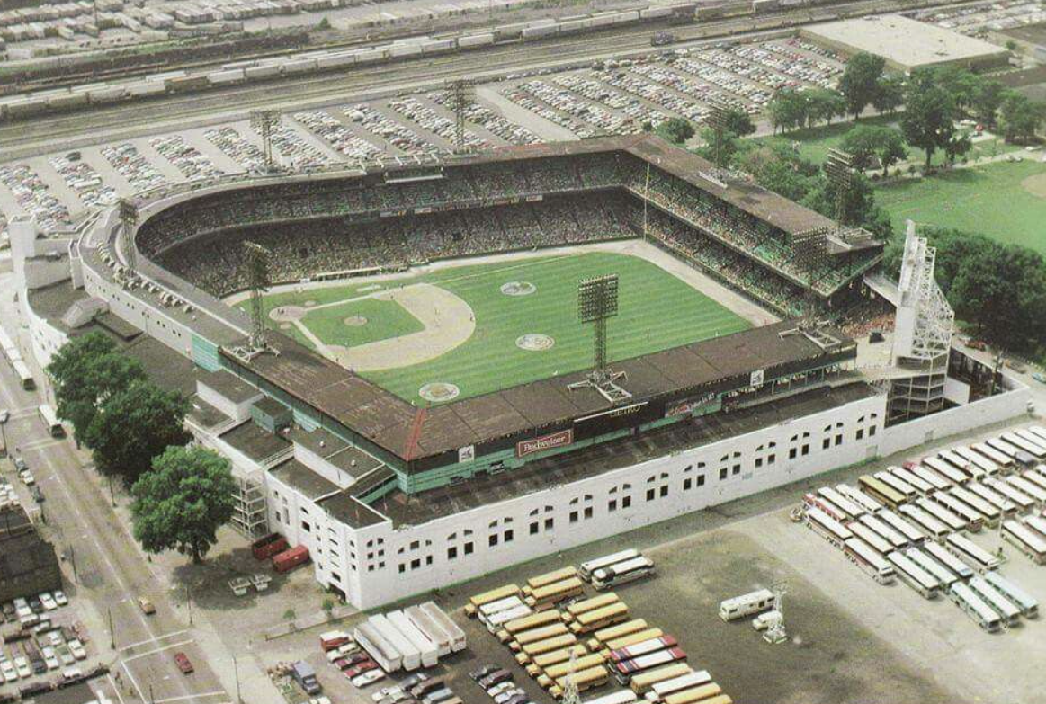
Comiskey park - Background
General history
Home of the Chicago White Sox 1910-1990, Chicago American Giants (Negro AL) and Chicago Cardinals (NFL)
Designed by Zachary Taylor Davis (Comiskey, Wrigley Field, Wrigley LA)
Opened July 1, 1910 ($750,000)
Oldest baseball park in Major League Baseball 1970-1990
Hosted 4 World Series (1917, 1918*, 1919, 1959)
Site of 3 All-Star Games (1933, 1953, 1983)
Notes:
Brief History:
Home of the Chicago White Sox 1910-1990, Chicago American Giants (Negro AL) and Chicago Cardinals (NFL)
Comiskey replaced wooden South Side Park
Opened July 1, 1910 (start of the early 20th century ballpark building boom) at a cost of $750,000.
Oldest baseball park in Major League Baseball 1970-1990
Hosted 4 World Series (1917, 1918*, 1919, 1959) –Cubs vs Red Sox in 1918.
Site of 3 All-Star Games (1933, 1953, 1983)

Slide 5
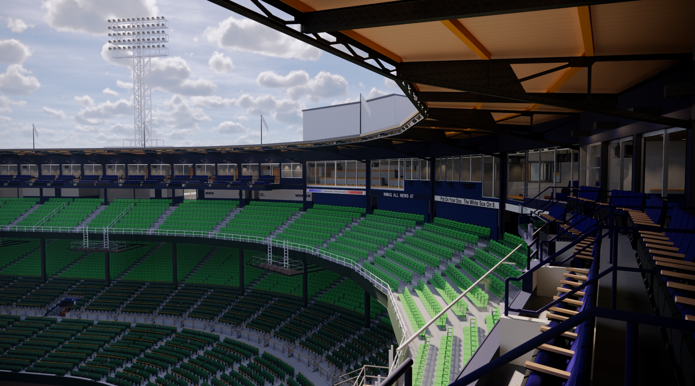
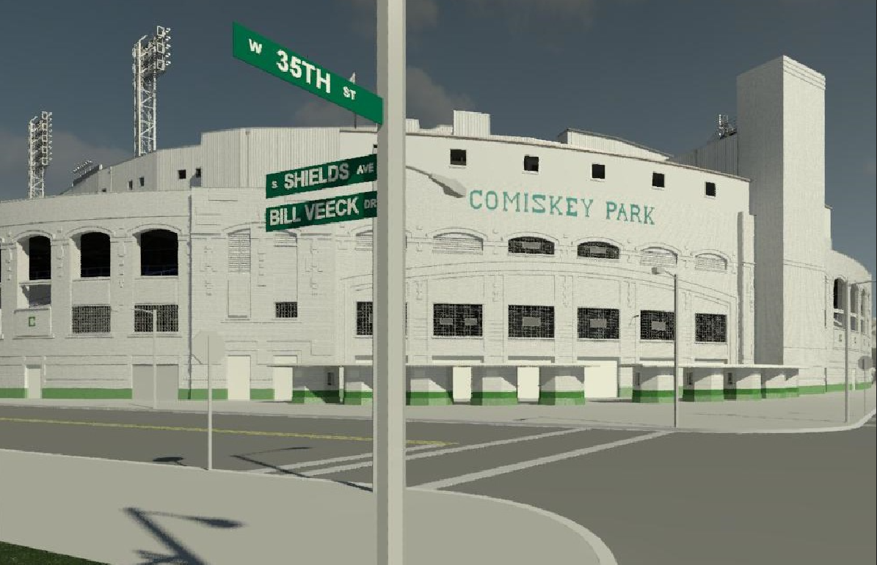
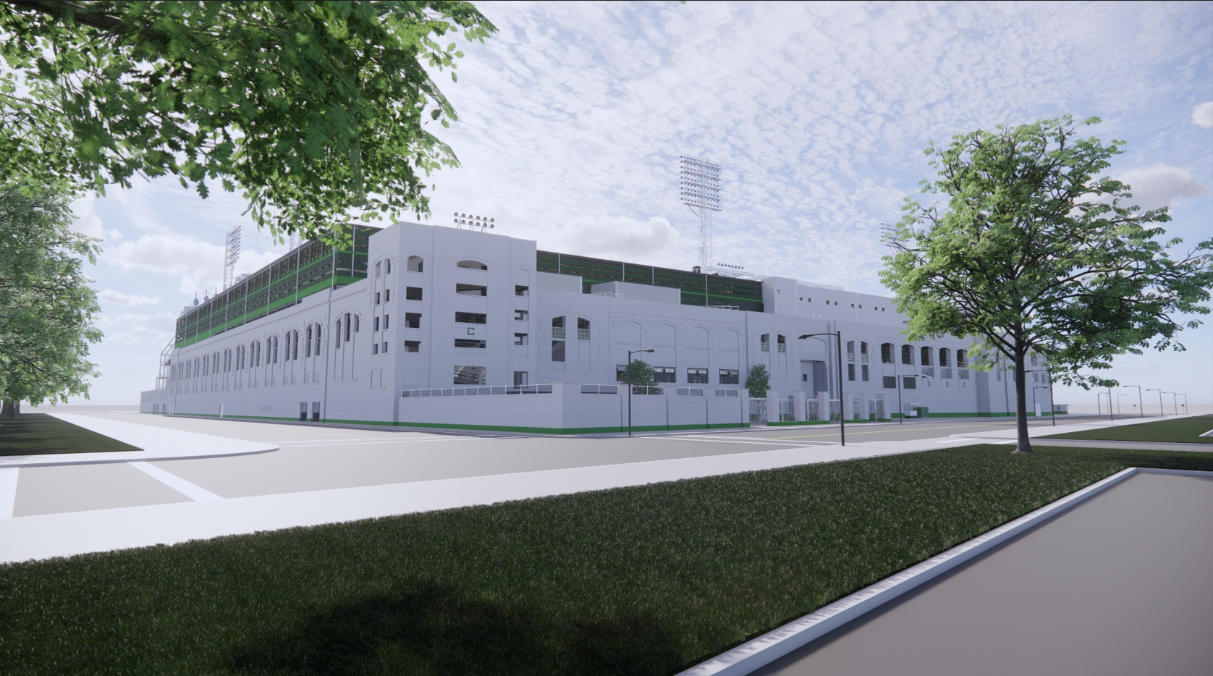
The Comiskey project
1990-2020
Notes:
What I dubbed as “The Comiskey Project” was a 30-year endeavor that culminated into an interactive digital model completed in 2020.
Product of the pandemic.

Slide 6
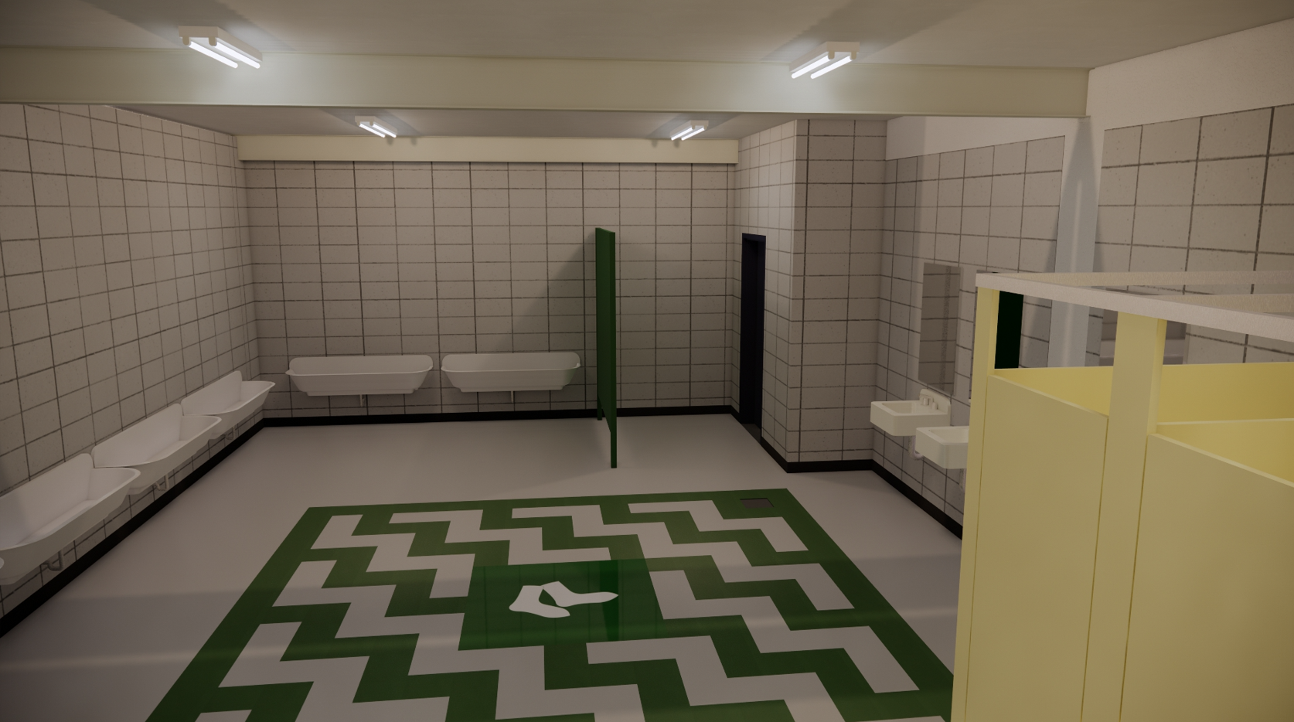
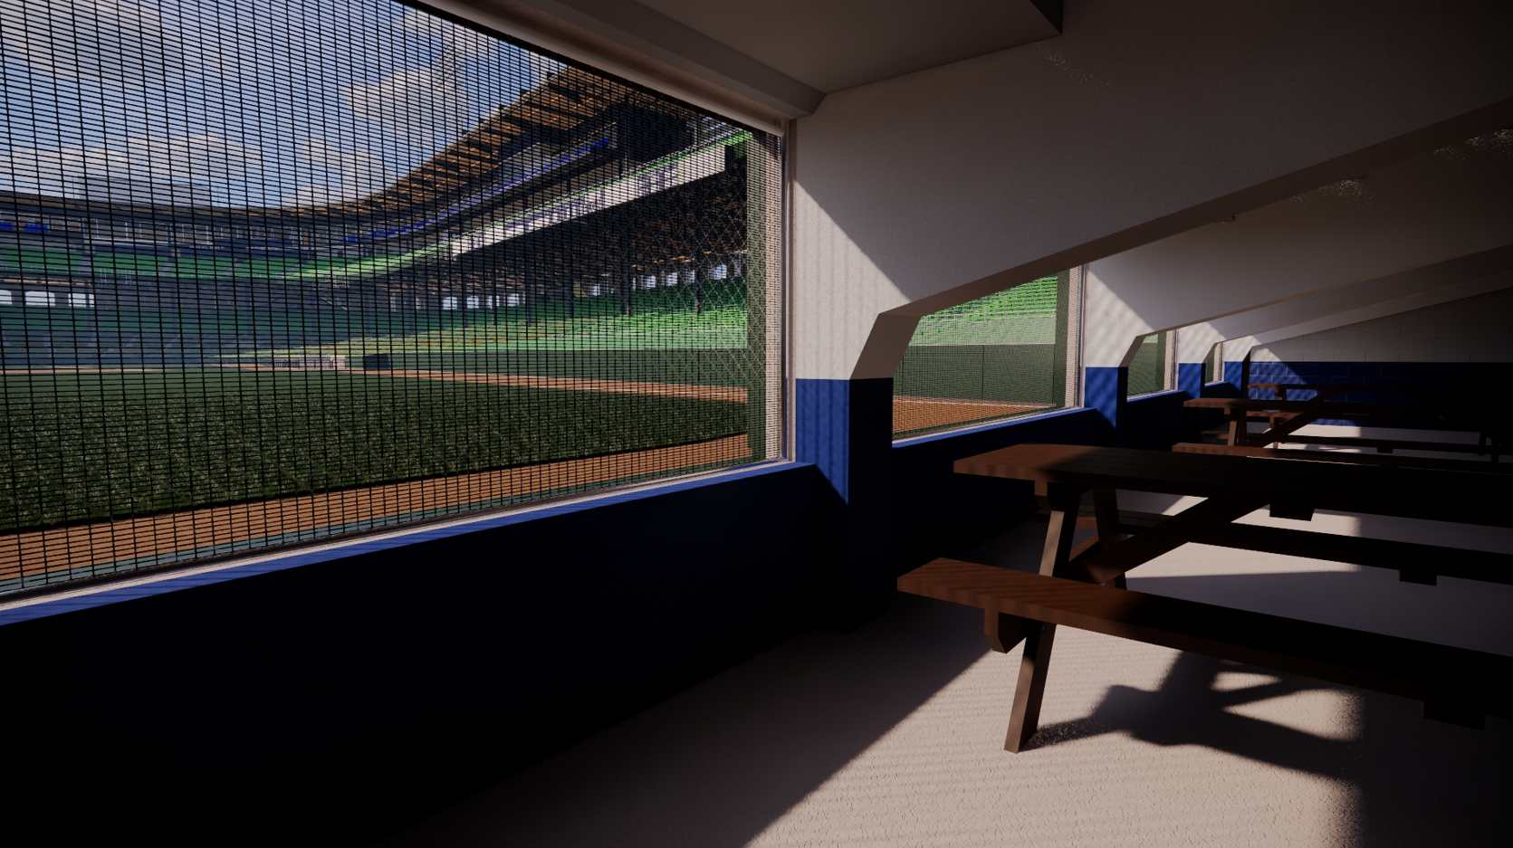
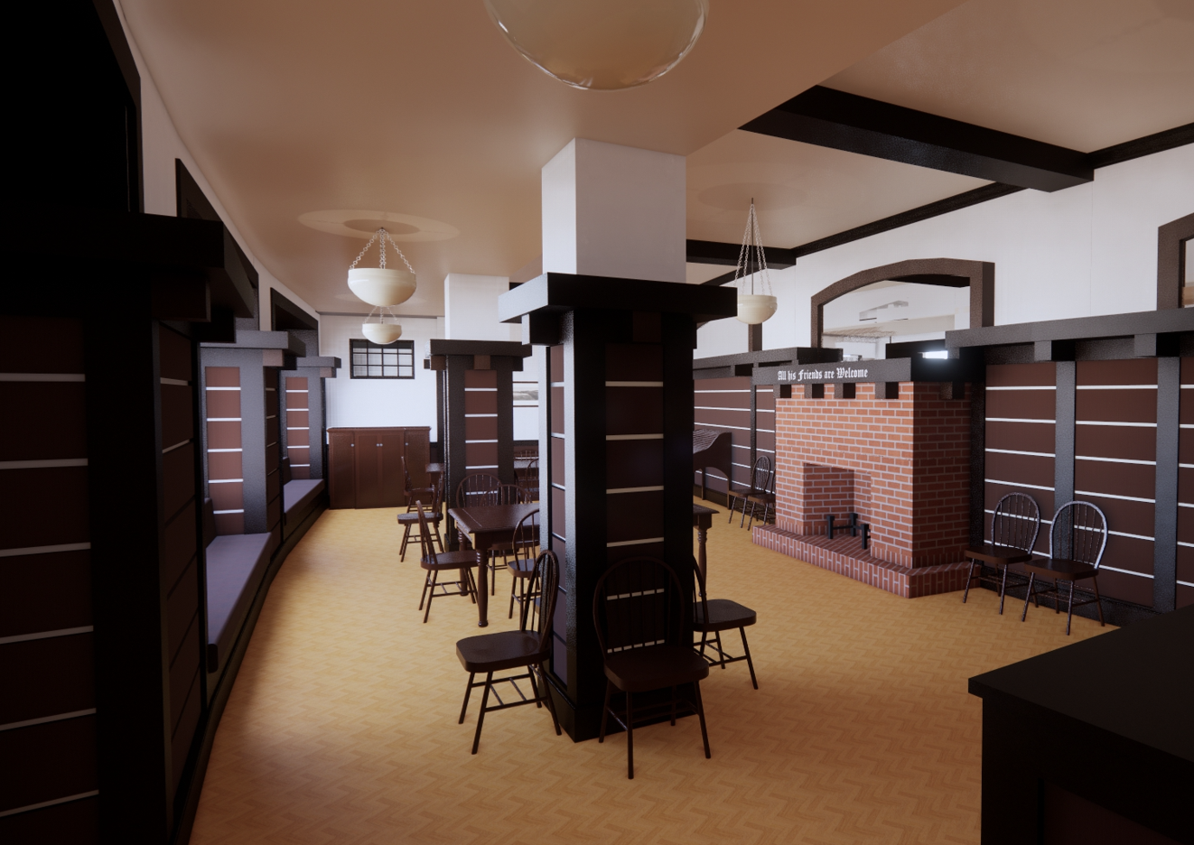
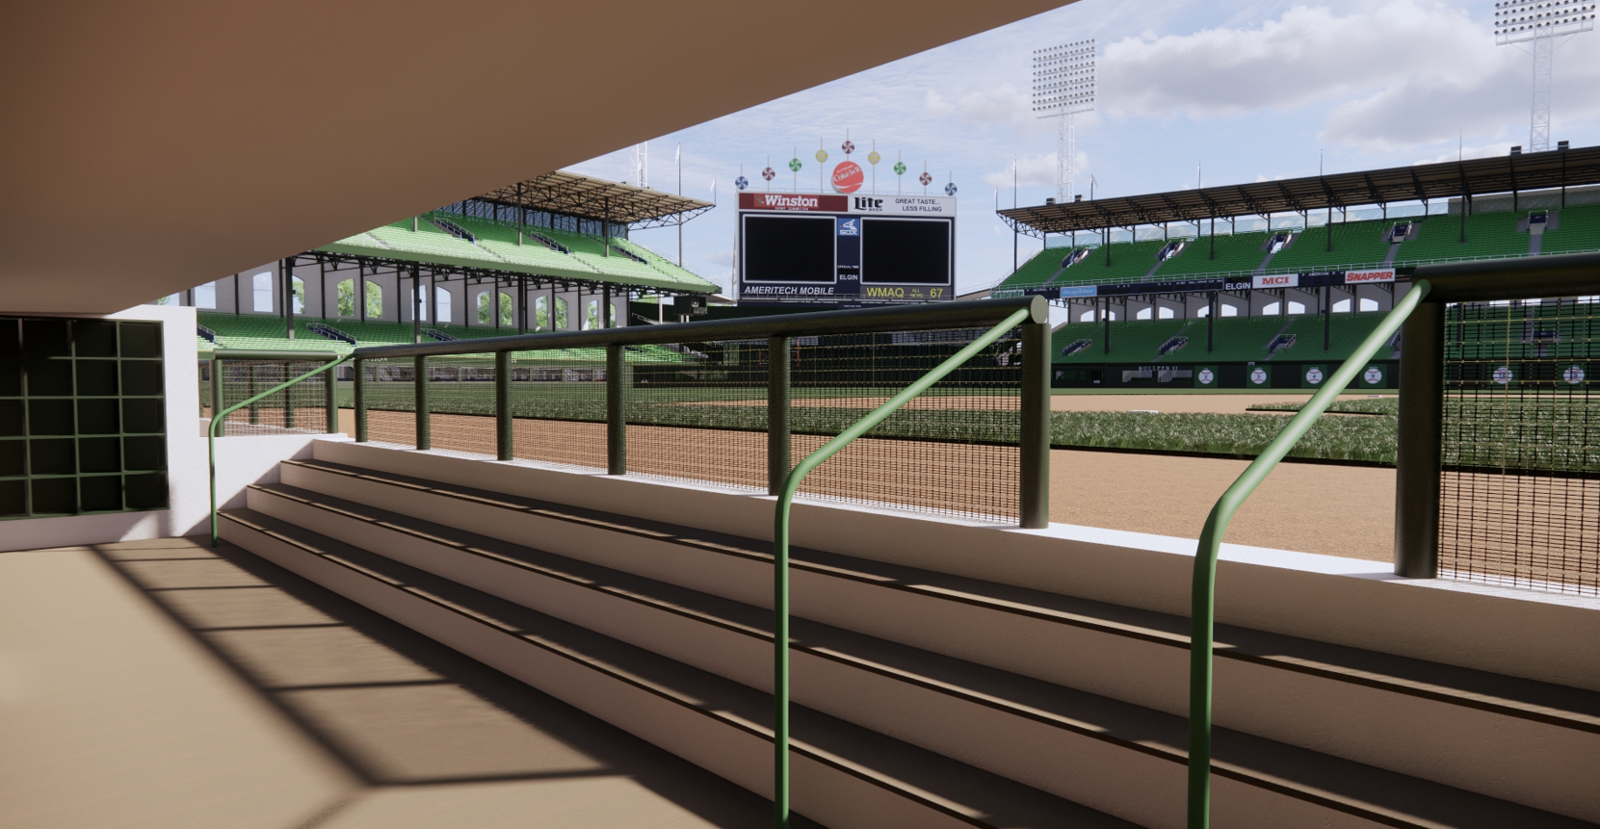
The Comiskey project
1990-2020
Notes:
Recreated all areas of the ballpark, including concourses, clubhouses and even the Bards Room.
I will share the power of this model that goes beyond the images and how it will benefit research of these cathedrals of baseball.

Slide 7
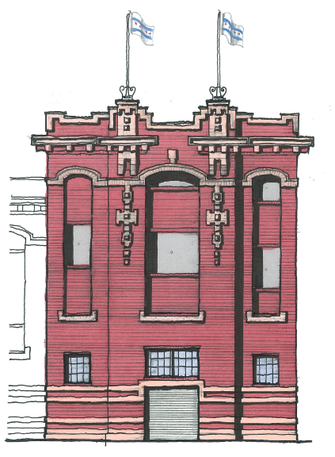
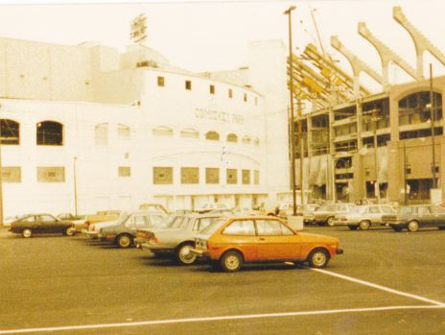
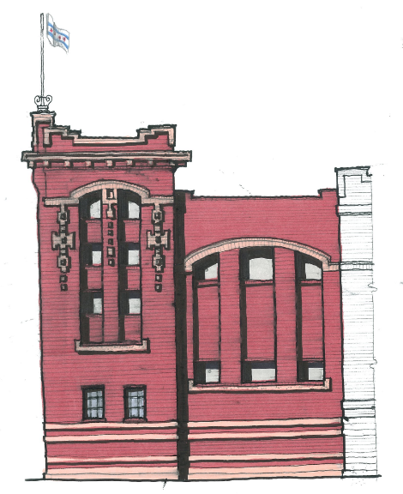
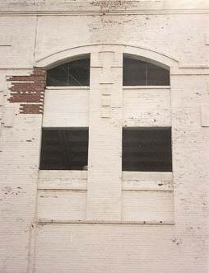
Comiskey Park - The odyssey begins
peeling away the paint
Comiskey Park “reconstruction” sketch study 1990
Intrigued with details
Wanted to learn more: 30-year preservation odyssey begins
Notes:
My involvement started as a college student in 1990.
Comiskey Park historical sketch study 1990 –”Reconstruction exercise”
Intrigued with details
Wanted to learn more: 30-year preservation odyssey begins.

Slide 8
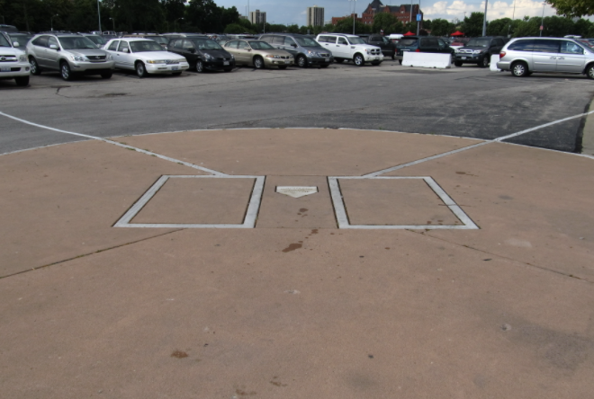
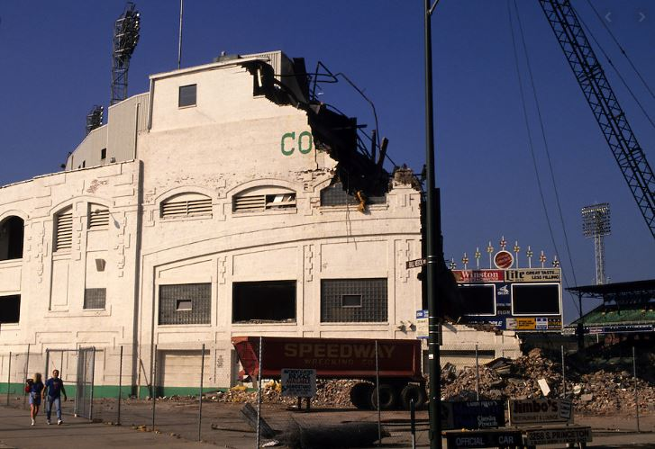
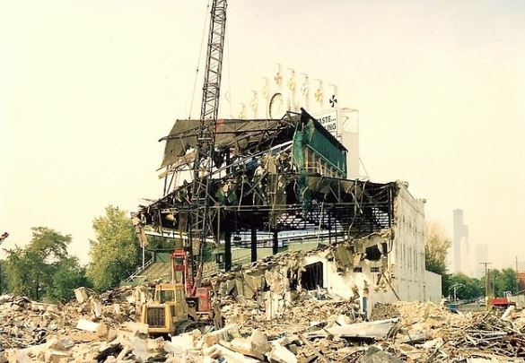
Comiskey park - The odyssey begins
The walls come down
Comiskey Park demolished in 1991
Understood loss of built environment
Disappointed by lack of preservation
Set precedent as other ballparks were replaced in next 15 years
Notes:
Comiskey Park demolished in 1991
Understood loss of built environment
Disappointed by lack of preservation –No remnants.
Set precedent as other ballparks were replaced in next 15 years.

Slide 9
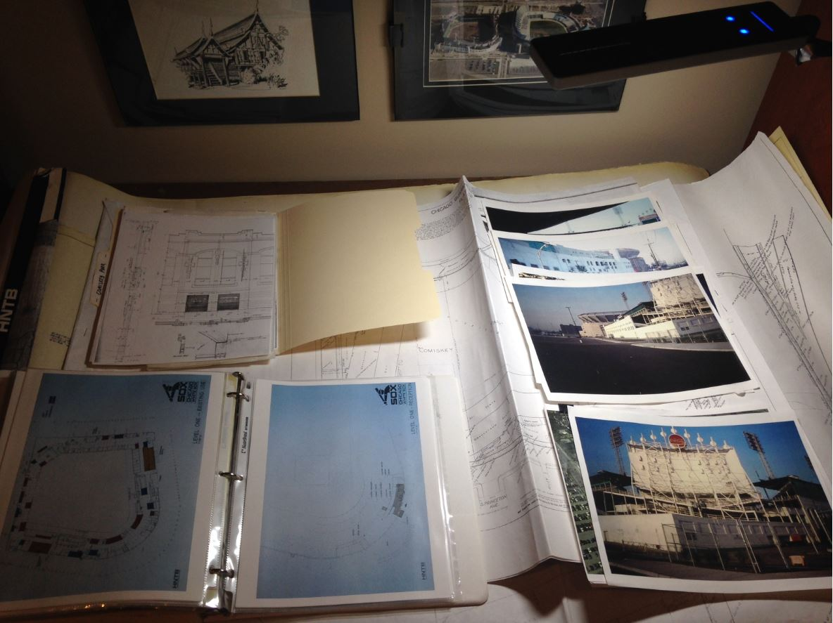
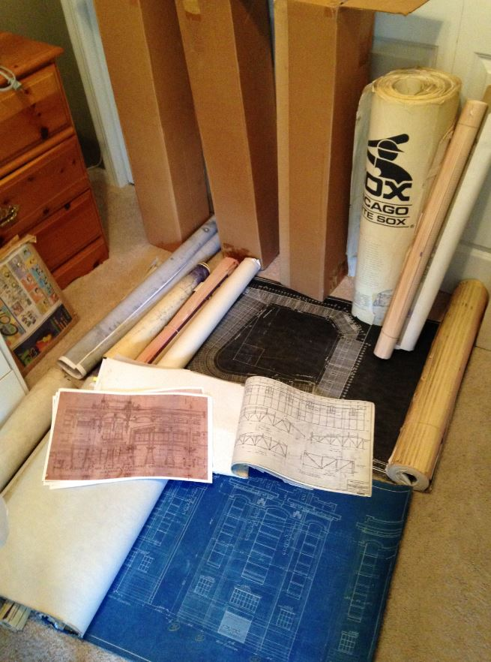
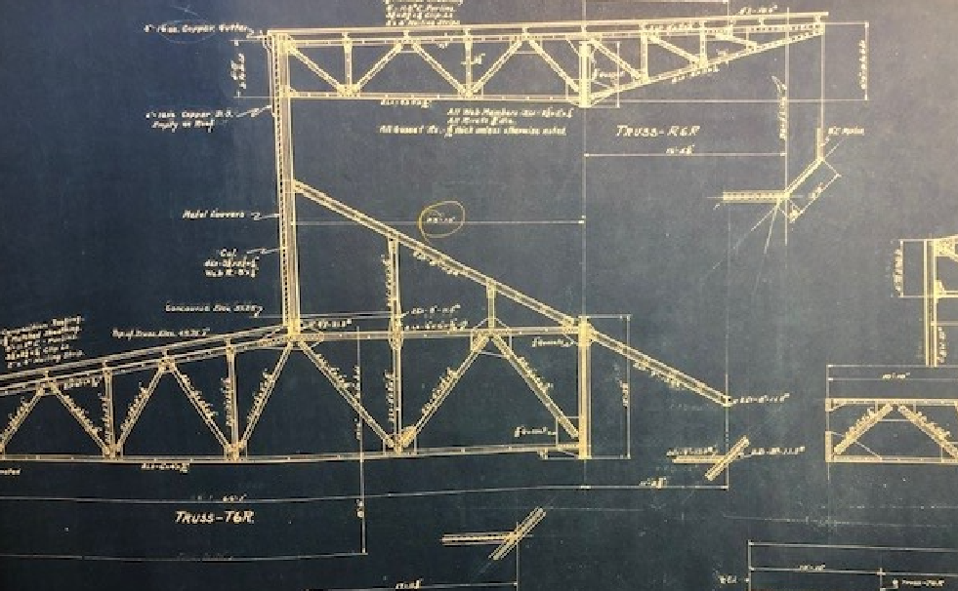
Comiskey park – gathering the information
30-year process
The search was on for drawings, photos and historical records
5 key sources:
Users/owners
Archives
City Records
Museums/Repositories
A/E Firms
The Journey:
Chicago, IL
Cleveland, OH
Kansas City, MO
Cooperstown, NY
Notes:
Had kind of an “epiphany”
The search was on for drawings, photos and historical records
My professional involvement allowed me contact with 5 key sources:
Users/owners
Archives
City Records
Museums/Repositories
A/E Firms
The Journey:
Chicago, IL
Cleveland, OH
Kansas City, MO
Cooperstown, NY

Slide 10
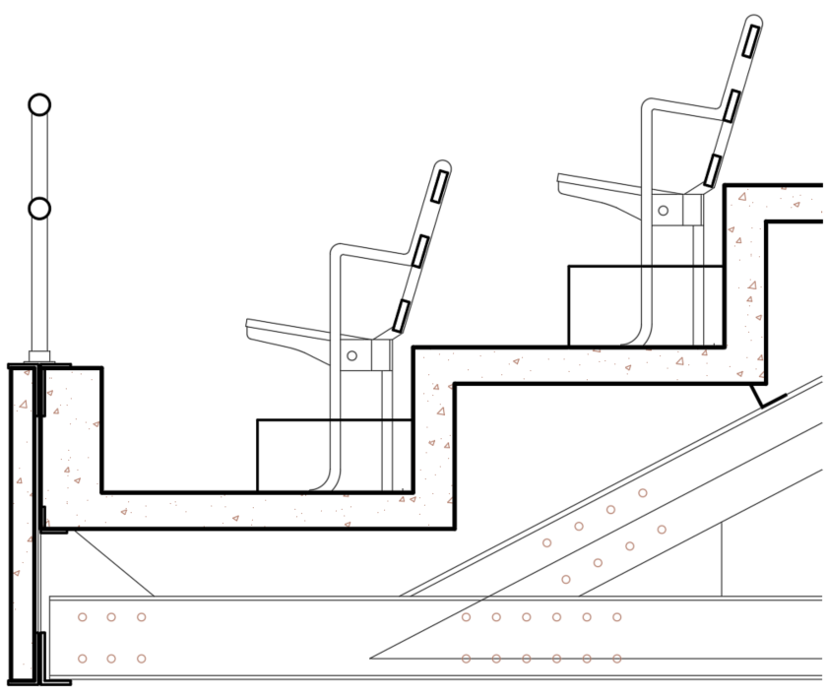
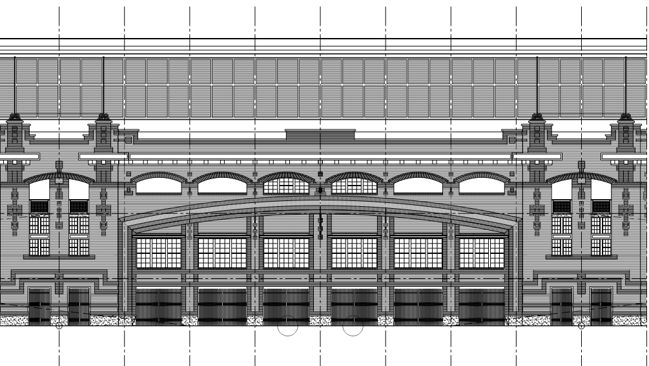
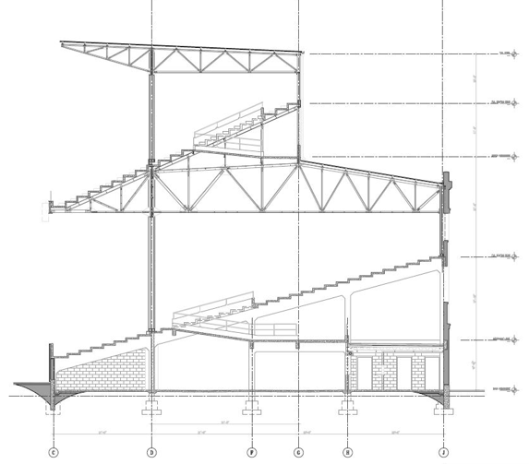
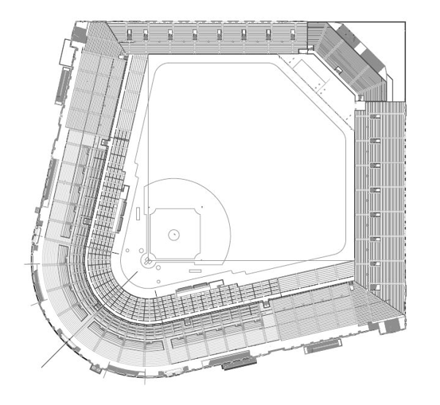
Comiskey park – assembling the information
Creating the as-builts
Developed comprehensive as-built drawing set in CAD
Met Historic American Building Survey (HABS) standards
Intend to submit to Library of Congress
Challenged to advance use of immersive digital technology (AR, VR)
Notes:
As I acquired these materials, what do I do with this information?
Developed comprehensive as-built drawing set in CAD
Met Historic American Building Survey (HABS) standards
Intend to submit to Library of Congress
Challenged to advance use of immersive digital technology (AR, VR)

Slide 11
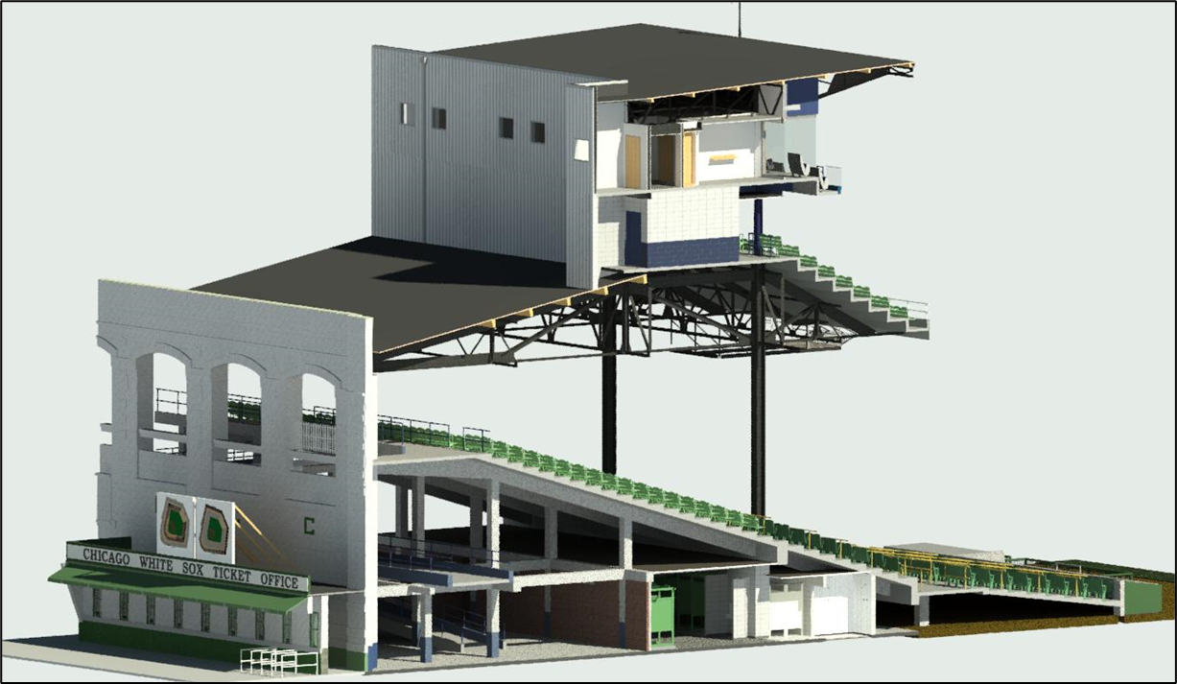
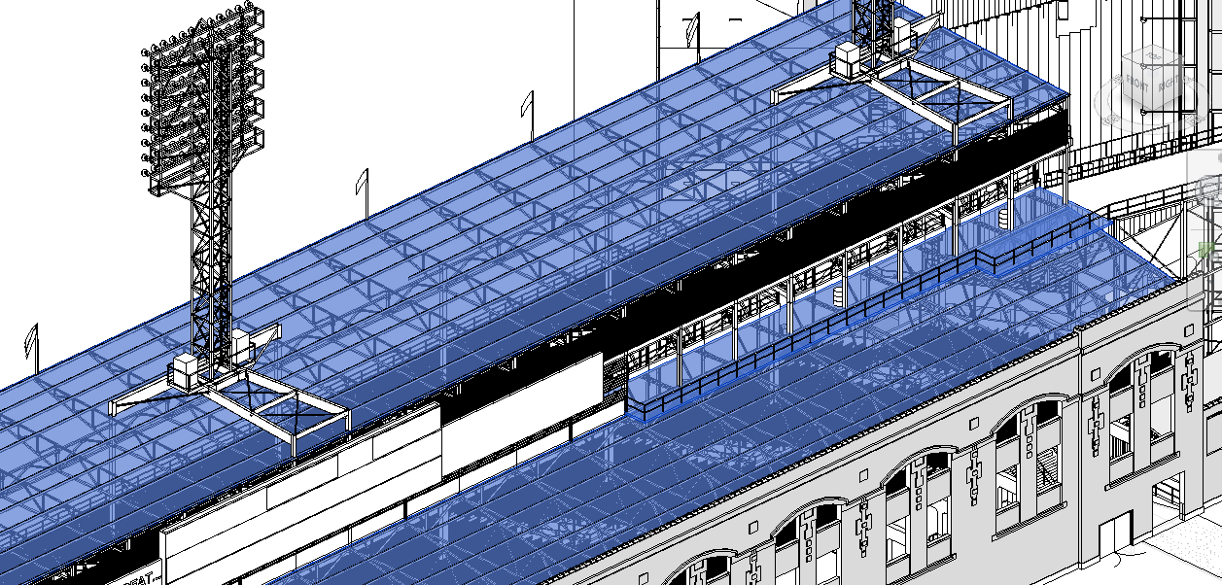
Building information modeling (bim)
Definition
Emerging tech in AE industry for 15-20 years
Definition:
Building Information Modeling (BIM) is the holistic process of creating and managing information for a built asset. Based on an intelligent model and enabled by a cloud platform, BIM integrates structured, multi-disciplinary data to produce a digital representation of an asset across its lifecycle, from planning and design to construction and operations. -Autodesk
Notes:
A new method emerged in last 15-20 years that changed the way architecture and engineering industry developed their work called “Building Information Modeling” or BIM.
By Definition:
Building Information Modeling (BIM) is the holistic process of creating and managing information for a built asset. Based on an intelligent model and enabled by a cloud platform, BIM integrates structured, multi-disciplinary data to produce a digital representation of an asset across its lifecycle, from planning and design to construction and operations. -Autodesk

Slide 12
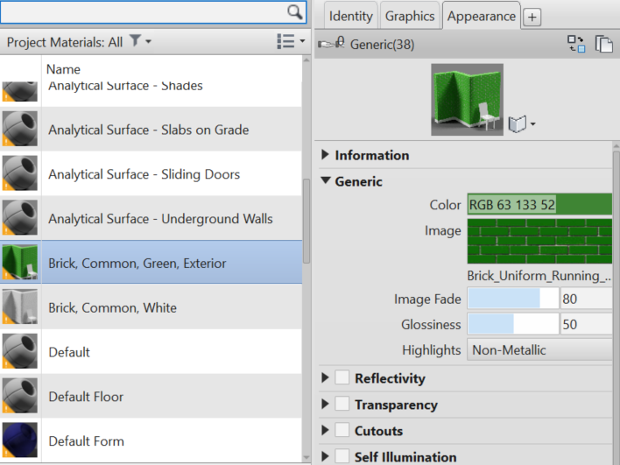
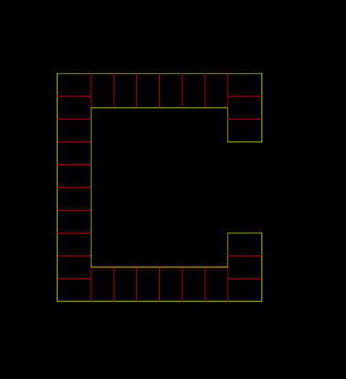
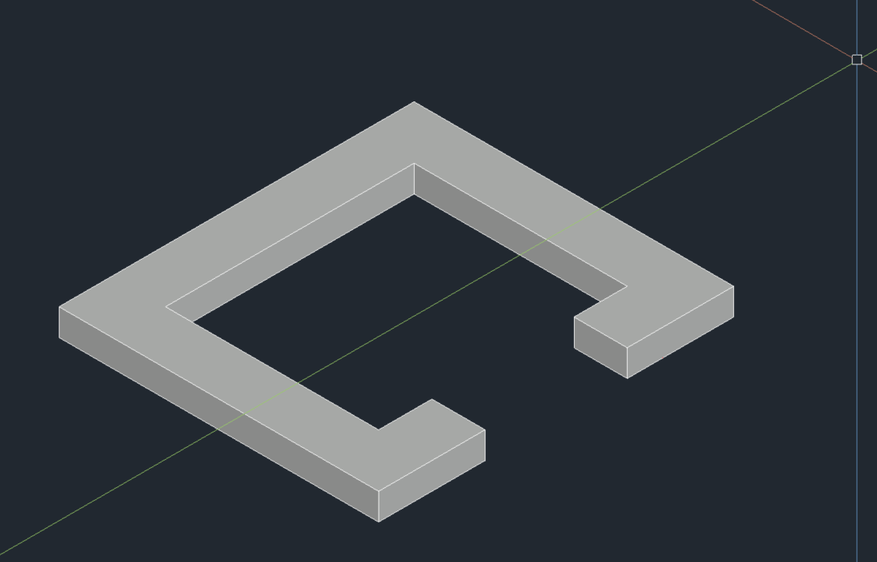
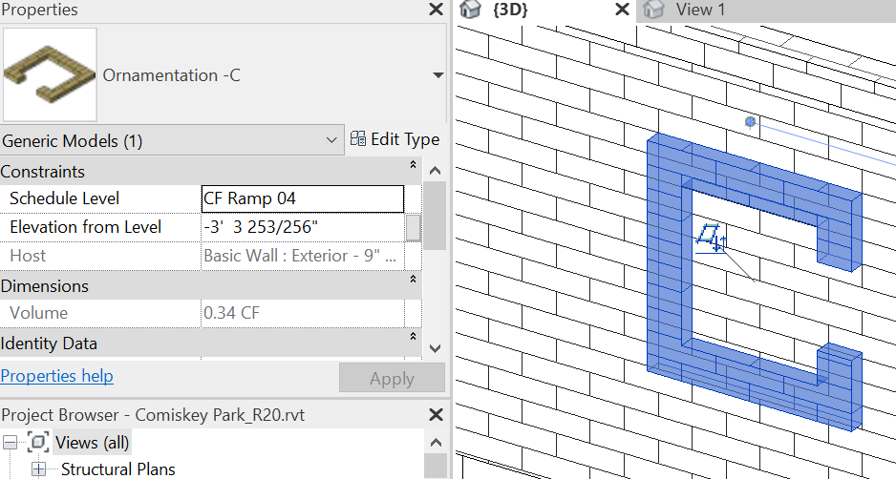
3D cad and bim
Digital evolution and Differences
Both provide geometric expressions of buildings and architecture
BIM goes beyond to capture relationships, metadata and behaviors essential to real world components
Data drives project outcomes in a way 3D modeling cannot.
CAD (2-D vector)
CAD (Mass Modeling)
Informational Modeling
Notes:
Digital evolution:
Basic CAD and line Drawing -2D Vectors
CAD Mass modeling
Informational modeling
Differences:
Both provide geometric expressions of buildings and architecture
BIM goes beyond to capture relationships, metadata and behaviors essential to real world components
Data drives project outcomes in a way 3D modeling cannot.

Slide 13
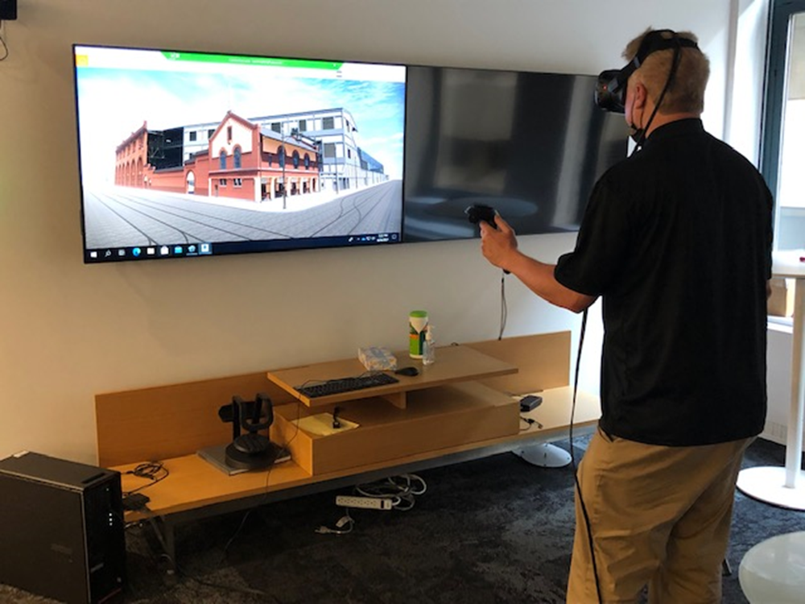
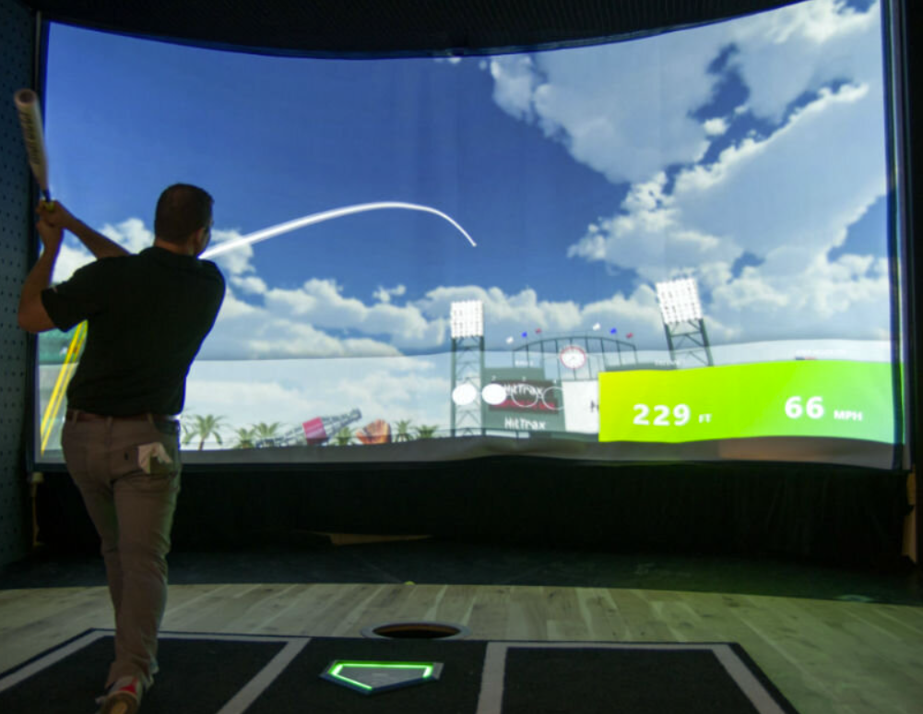
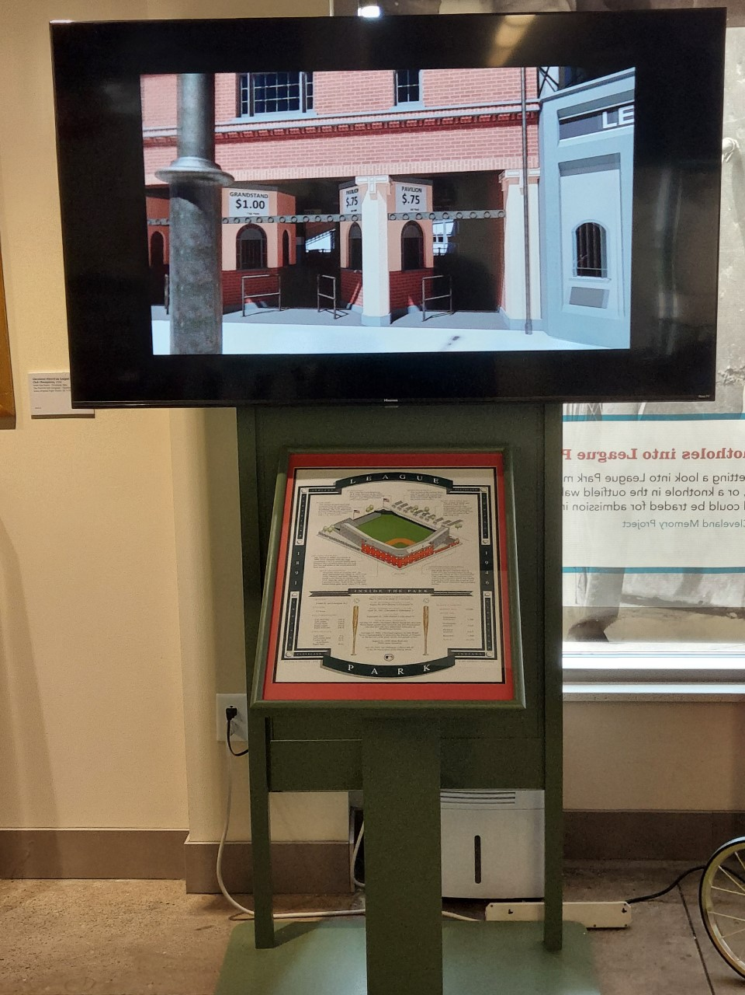
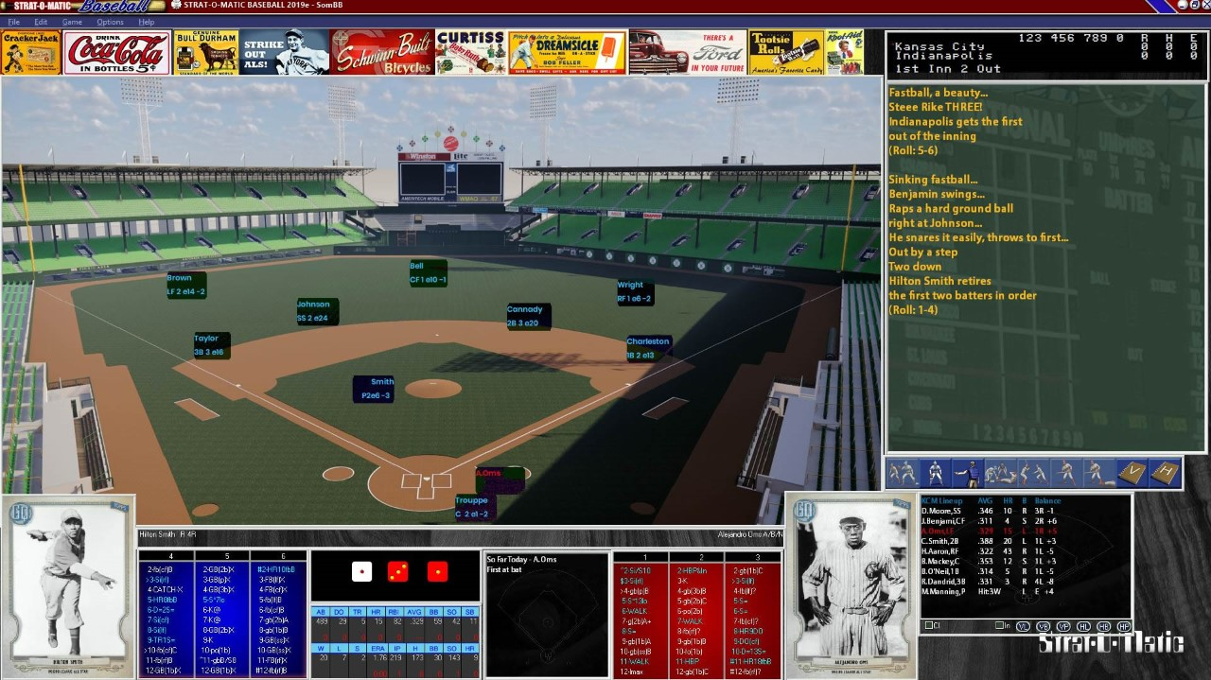
Bim applications to architectural research
ballparks
Drawing and Preservation (HABS)
Augmented and Virtual Reality
Database Cataloguing
Simulations
Education, Story Telling, Museum Immersion
Gaming
Notes:
BIM applications to architectural research:
Drawing and Preservation (HABS)
Augmented and Virtual Reality
Database Cataloguing
Simulations
Education, Story Telling, Museum Immersion
Gaming

Slide 14
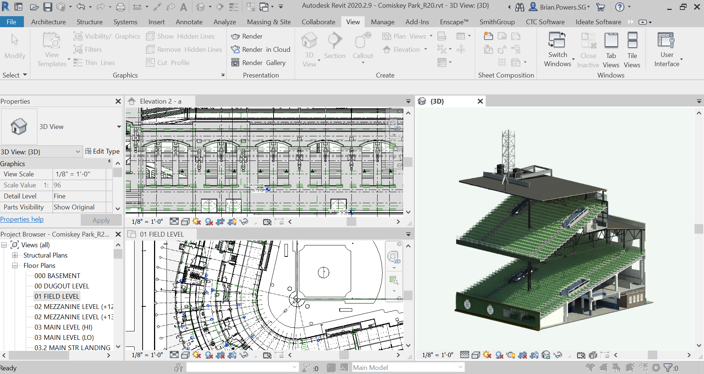
Identifying bim software
Revit 2020
Data hosting and extraction ability
Parametric (adaptable)
Accommodation of supplemental software platforms (Enscape, etc)
Ability to continually add information and data (short and long term)
Incorporation into VR/AR platforms.
Ability to catalogue building elements
Notes:
Often asked about software and how chose it:
Revit 2020
Data hosting and extraction ability
Parametric (adaptable)
Accommodation of supplemental software platforms (Enscape, etc)
Ability to continually add information and data (short and long term)
Incorporation into VR/AR platforms.
Ability to catalogue building elements

Slide 15
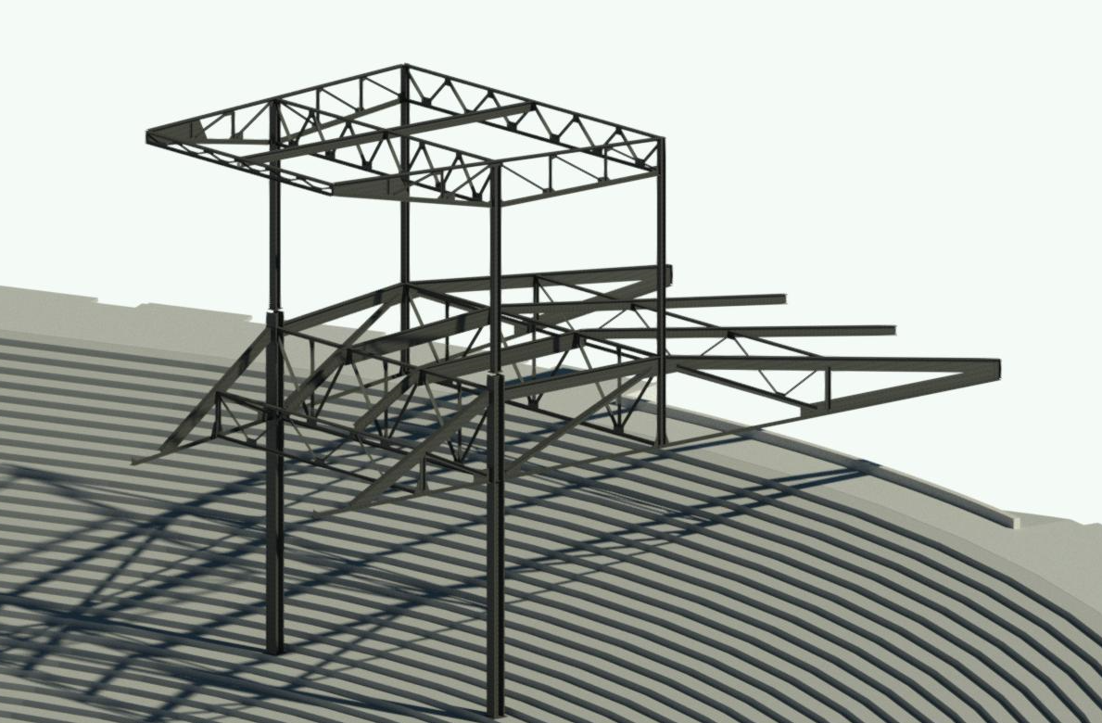
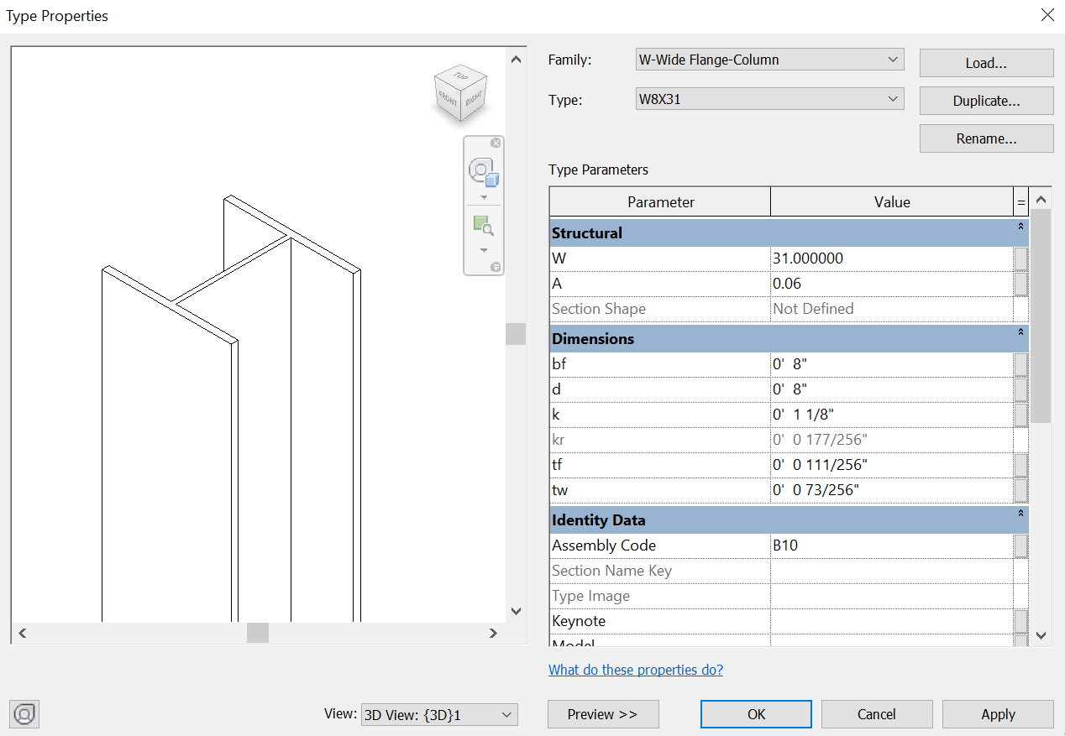
Data input in model
Community of families
Building “Information”
Quality In/Quality Out
Information housed in BIM “Families”
Kit of Parts
Notes:
Building “Information”
Use of “Families:
Quality In/Quality Out
Information housed in BIM “Families”
Kit of Parts

Slide 16
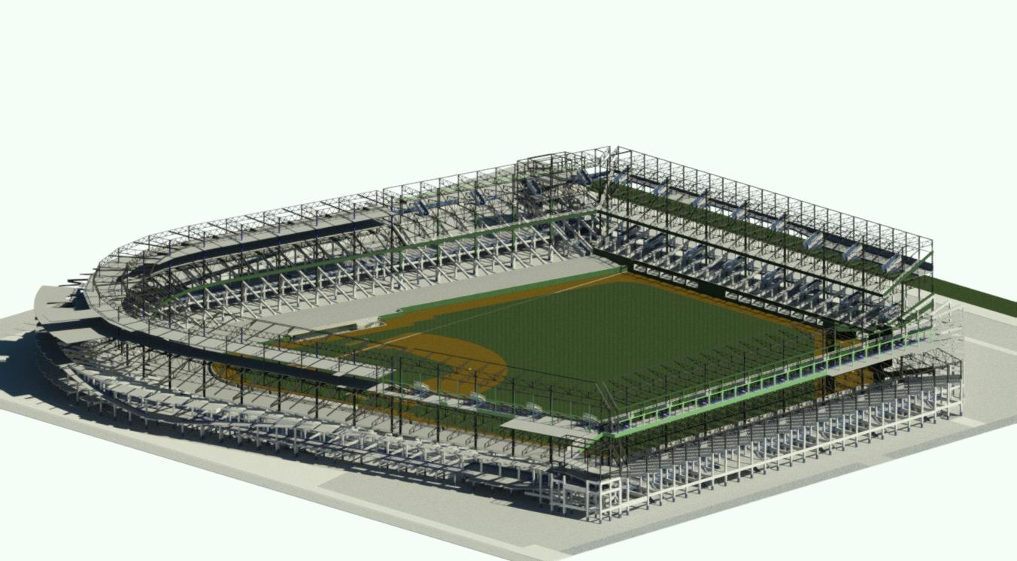
Brining the model to life
The fun begins
Ground up construction
Notes:
Once these digital families are developed, I construct the model.
Much like a real construction project: Ground up
Allows study of the ballpark in the basic elements.

Slide 17
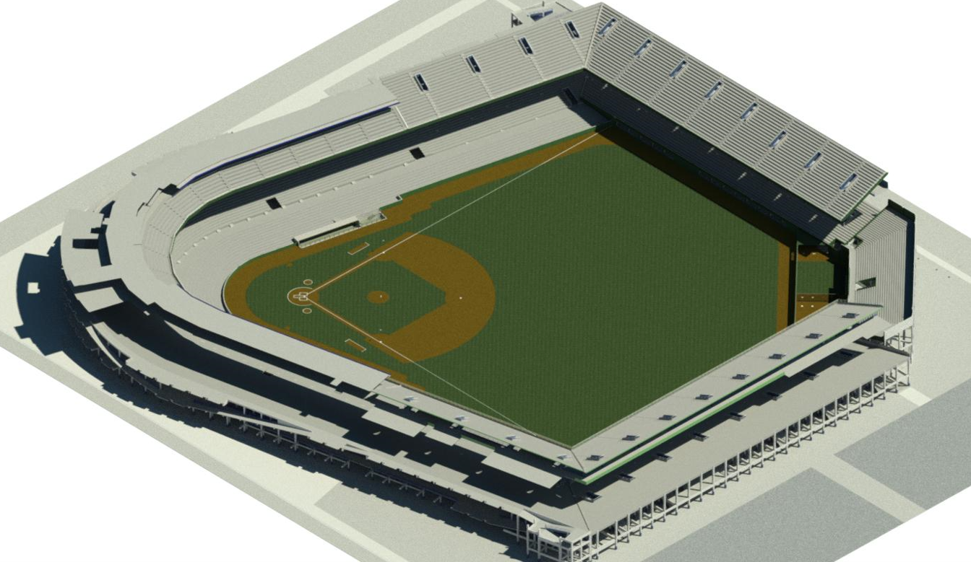
Brining the model to life
The fun begins
Ground up construction
Notes:
Isolate elements like seating bowl, concourses, and structure.
Understanding of forms and design.

Slide 18
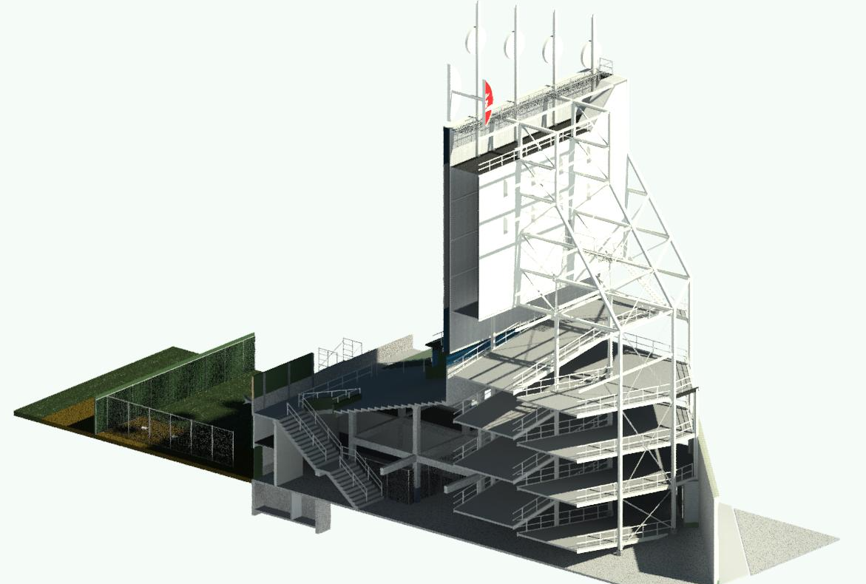
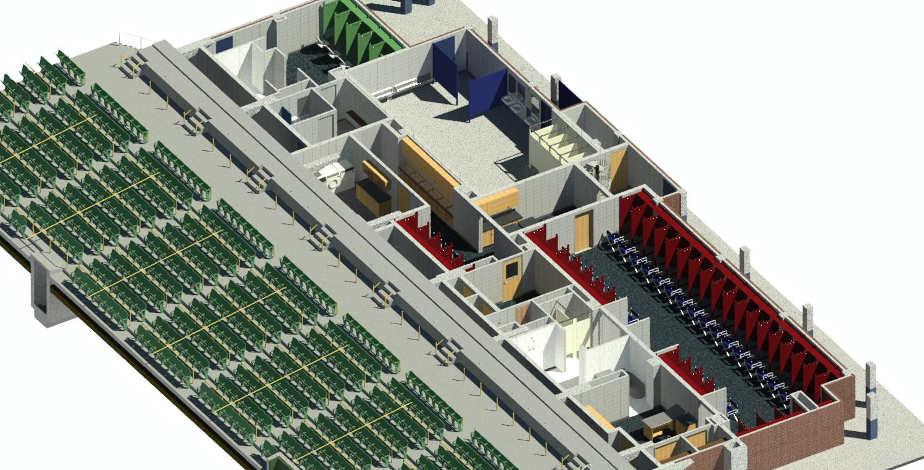
Brining the model to life
The fun begins
Ground up construction
Notes:
Sectional information can tell a lot about a ballpark not seen through other ways.

Slide 19
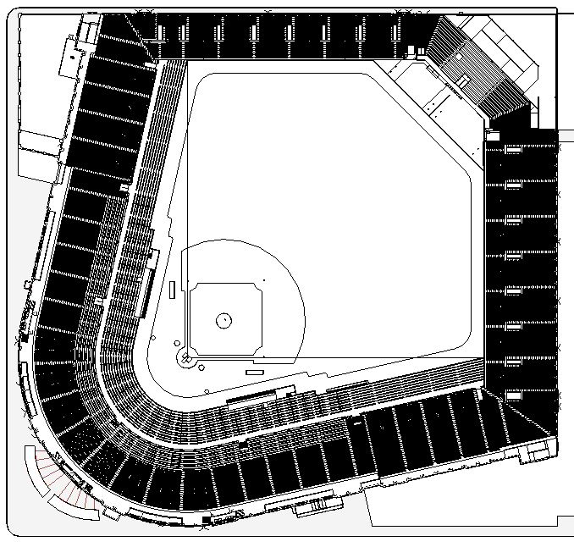
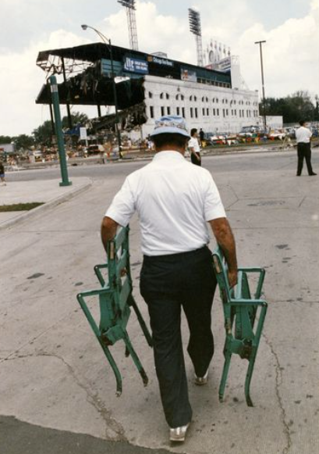
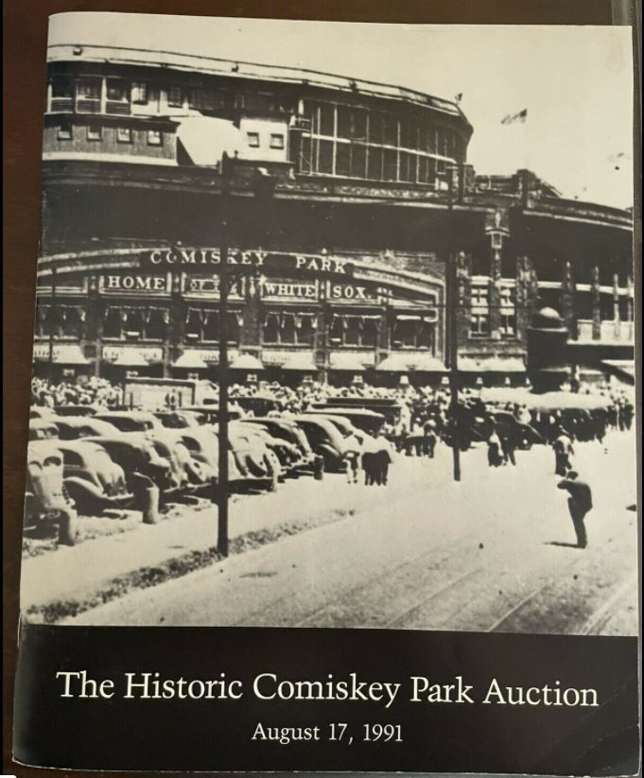
Comiskey park – artifact tracing
definition: identifying and incorporating data within the model to trace locations & identify properties
Of Architectural elements
Identify objects within buildings (such as catalogued seat types)
Understand history and specifications of individual building elements
Assists in the assessment and valuation of objects
Notes:
Demonstrate the power of data and families through “Artifact Tracing”
“By definition: Identifying and incorporating data within the model to trace locations & identify properties of architectural elements. Artifact tracing helps us:
Identify objects within buildings (such as catalogued seat types)
Understand history and specifications of individual building elements
Assist in the assessment and valuation of objects

Slide 20
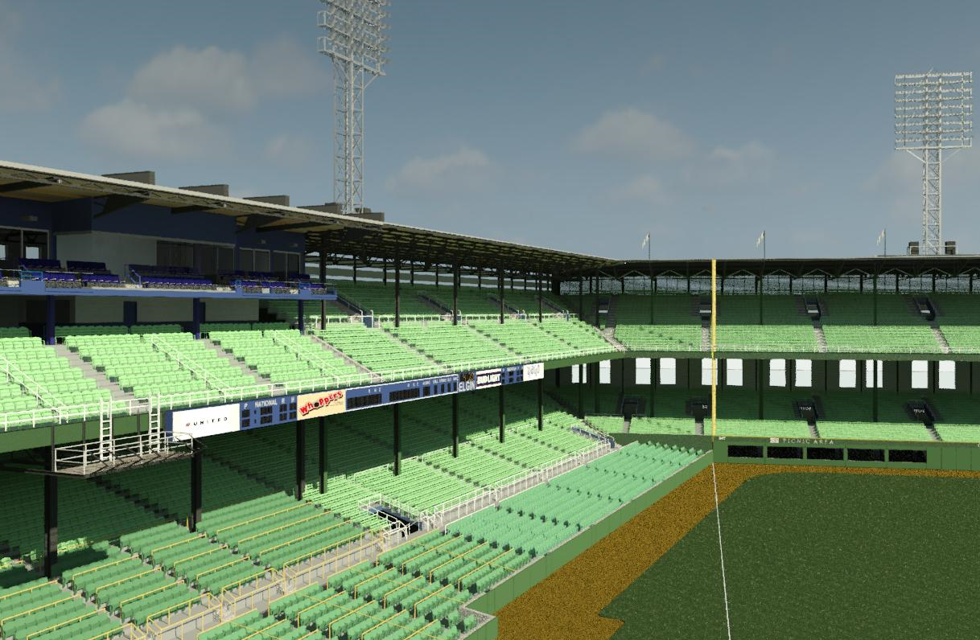
Comiskey park – artifact tracing
5 Steps of implementation (example study: seat detection)
Identify, model and categorize Revit family typologies
Identify parameters and filters for each family type
Incorporate families and parameters into model
4. Test parameters in model
5. Locate the element
Notes:
5 Steps of implementation (Example: Seat detection)
Identify, model, and categorize Revit family typologies
Identify parameters and filters for each family type.
Incorporate families and parameters into model.
Test parameters in model
5. Locate the element

Slide 21
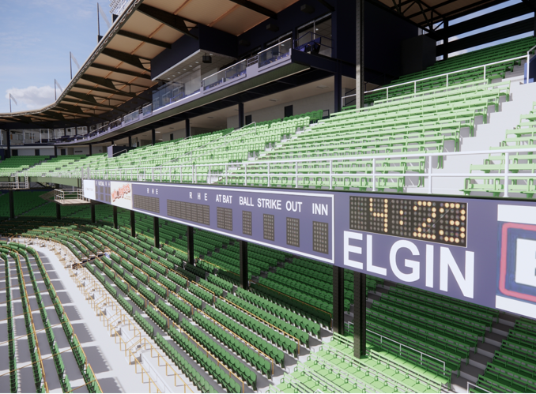
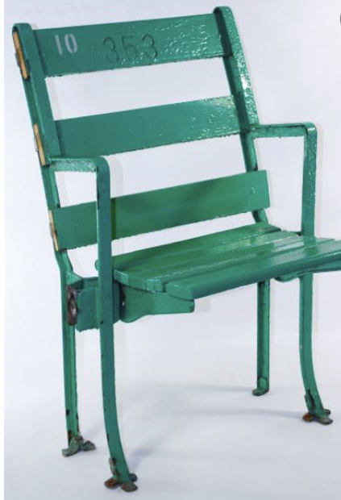
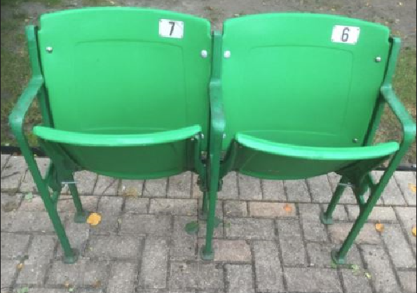
Comiskey park – artifact tracing
step 1
Identify, model and categorize Revit family typologies
Classic
Box
Suite
Contoured
Notes:
Identify, model and categorize Revit family typologies
-4 types of chairs in old Comiskey.
-Each has sub-categories and types.

Slide 22
Comiskey park – artifact tracing
step 1
Identify, model and categorize Revit family typologies
Original Numbering
(Alias 1)
Revised Numbering
(Alias 2)
Final Numbering
Notes:
I wanted to embed historical seat numbers from earlier eras.
-Comiskey used 3 primary seat/section numbering systems over the years.
-Assigned “Aliases” for earlier designations (to permit easier sorting)

Slide 23
Comiskey park – artifact tracing
step 2
Identify parameters (sorting characteristics) and filters for each family type.
CENTER SEAT
AISLE SEAT
Notes:
2. Identify parameters and filters.
Identify commonalities and differentiators that can be catalogued or used in searching.
Identify clues. Each element has a story.
Since the seats were renumbered and painted over the years, it’s helpful to create “alias” or sub-categories to help filter items.

Slide 24
Comiskey park – artifact tracing
step 2
Identify parameters (sorting characteristics) and filters for each family type.
Add into Family Types
Notes:
Incorporate these parameters within each seat type (4 seat types)

Slide 25
Comiskey park – artifact tracing
step 3
Incorporate families and parameters into central model
Notes:
Incorporate families and parameters into central model. (Identify how you want to identify parameters)
Layout seats based on seating manifests.

Slide 26
Comiskey park – artifact tracing
step 4
Test parameters in model
3 types of Parameters:
Project Parameters –Scheduling, sorting and filtering
Shared Parameters –Scheduling and tagging
Global Parameters –Specific to single project file
Notes:
Test the parameters for sorting.
Confirm available parameters and decide how to sort them.

Slide 27
Comiskey park – artifact tracing
step 5
Locate the Element
Seat Example
Notes:
Locate the Element: (Using previous seat example)
Once parameters are embedded in the model or families, the scheduling command allows us to filter and identify elements in the project or within schedules.
Use the filtering tab to enter and filter the data. (See seat example from earlier slide)
3D model is open in the background

Slide 28
Comiskey park – artifact tracing
step 5
Locate the Element
Notes:
Locate the element
The filter yielded 6 results and located the seat we were looking for.
Highlight in model.

Slide 29
Comiskey park – artifact tracing
step 5
Locate the element
Notes:
Locate the element
When highlighted, the properties tab panel also displays specification/history info for that element.

Slide 30
Comiskey park – artifact tracing
valuation
Appraisals
COA
Notes:
Valuation:
Knowing more about the artifact or element, helps appraisal and identify collectors value.
Fun to know the story.
Can track price history.
Also assists with specs for rehabilitation

Slide 31
Comiskey park – artifact tracing
example 2: ticket detection
Use filtering process to identify seat and view located on ticket
Notes:
Artifact Tracing: Example 2 (Ticket Detection)
Similar to seats
Use filter process to identify seat and view on ticket

Slide 32
Comiskey park – artifact tracing
example 2: ticket detection
Use filtering process to identify seat and view located on ticket
Notes:
Similar to seats
Use filter process to identify seat and view on ticket

Slide 33
Comiskey park – artifact tracing
example 2: ticket detection
Use filtering process to identify seat and view located on ticket

Slide 34
Comiskey park – artifact tracing
example 2: Ticket detection
VIEW FROM SELECTED SEAT
Notes:
You can embed pictures (or links) to experience the element virtually.
View is from the highlighted seat.

Slide 35
Crosley field
Cincinnati, oh

Slide 36
League park
Cleveland, oh

Slide 37
Hamtramck stadium
Hamtramck, mi
Notes:
Put BIM into practice at Hamtramck Stadium.
MI SHPO Award 2023

Slide 38
Conclusion–building information modeling
Ballpark research
Building Information Modeling: Holistic process of creating and managing information for a built asset.
Data can be hosted within “Families”
Information can be extracted from BIM models to assist in research and valuation
Artifact Tracing can be used to identify, trace and catalogue elements within a BIM model.
Notes:
Conclusion:
Building Information Modeling: Holistic process of creating and managing information for a built asset.
Data can be hosted within “Families”
Information can be extracted from BIM models to assist in research and valuation
Artifact Tracing can be used to identify, trace and catalogue elements within a BIM model.

Slide 39
Communications plan
Questions?
Less physical connectivity requires more communication
Other Helpful hints
Microsoft Teams is a powerful platform
Let’s use SG-Chicago to share information that would be useful for the entire office
Working on a formal communication that we can share with our clients
BandboxBallparks.com

Slide 40
Comiskey park – Bringing the park to life
Virtual reality –step up to the plate
Interactive Panorama
Notes:
Engagement exercise
Scan QR code to the right with your phone.
Should see an interactive digital image that will allow you to pan from the same perspective from home plate.

