Slide 1
Pitch Sequence Optimization in Major League Baseball
Kevin Antonevich
William & Mary ‘19

Slide 2
Pitch Sequencing
What determines the outcome on a specific pitch?
Decision
Execution
Defining pitch sequencing
Challenges posed in studying
2
1

Slide 3
Previous Research
Jon Roegele, “The Effects of Pitch Sequencing”, November 2014
Russell Carleton, “Baseball Therapy: The Power of Changing Speeds”, February 2015
Peter Bonney, “Defining the Pitch Sequencing Question”, March 2015

Slide 4
Motivations and Research Goals
Prior research has explored components of sequencing and their individual impact on outcomes
Aggregating effects into one model
Research goal: Create a program that produces a sequence of five pitch type and location pairings that maximizes expected swinging strike rate for a specific matchup
Subsequently use program for larger analyses

Slide 5
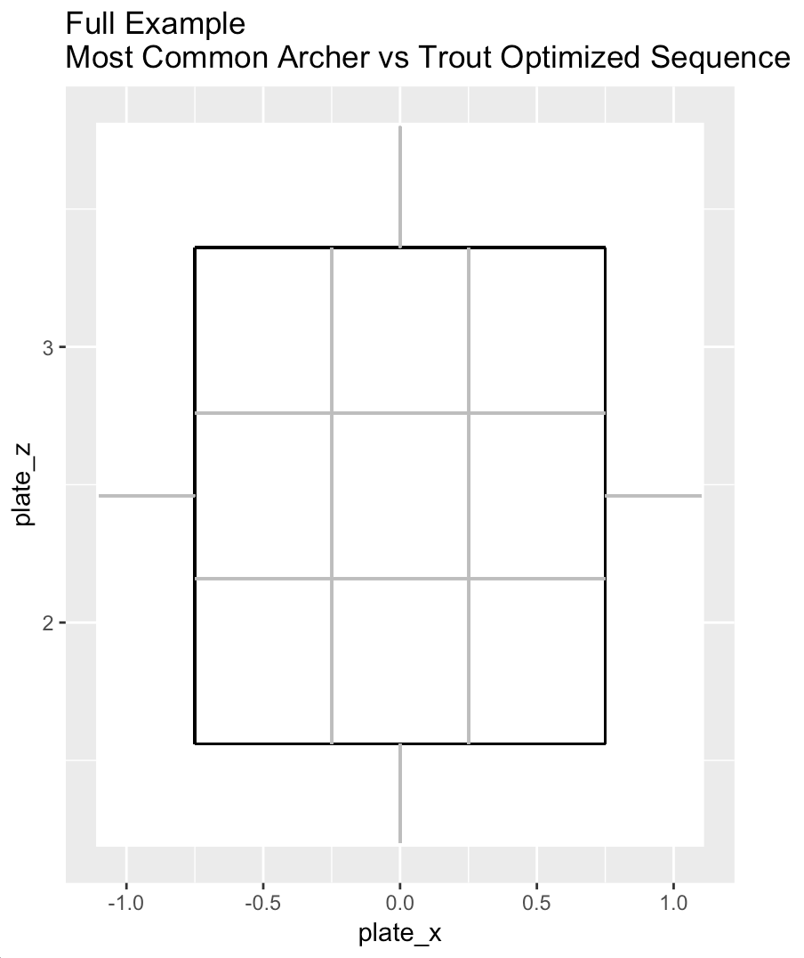
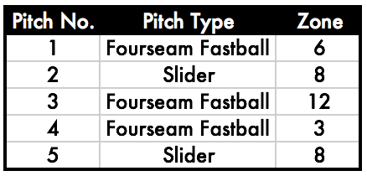
Example Program Output
3
4
1
2
5

Slide 6
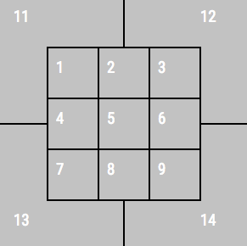
Methods: Modeling Swinging Strikes
Model swinging strike probability based on physical characteristics and location of a pitch as well as the pitch preceding it using 2018 Statcast data
Variables included in model
Pitch Movement
Horizontal movement, vertical movement
Pitch Velocity
Pitch Location
MLB Gameday zones
Tunneling metrics
Pre-Tunnel Maximum Distance
How far apart two consecutive pitches are at the decision point
MLBAM Gameday Zones

Slide 7
Methods: Modeling Swinging Strikes
Tested both support vector machines (SVMs) and random forests (RFs) and evaluated out of sample performance
Made out-of-sample predictions for many matchups and viewed performance on aggregate
Judged performance based on ROC Curves

Slide 8
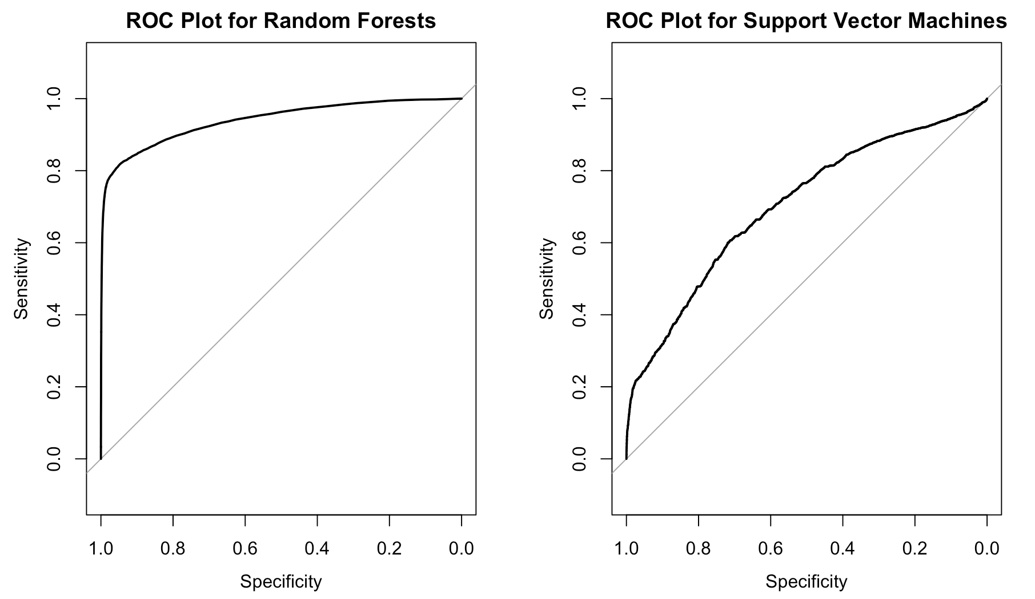
Model Performance
Out-of-sample performance suggests RF is stronger model
Mechanics behind model-fitting process support this idea

Slide 9
Methods: Program Overview
Take pitcher_id and batter_id as inputs
Find similar batters and similar pitchers
Subset data set to include only similar pitchers and similar hitters
Filter subset of data to include only first pitches of a plate appearance
Fit random forest based on components of each pitch
Fit random forest based on components of each pitch and pitch preceding it
“First Pitch Model”
“Next Pitch Model”

Slide 10
Methods: Program Overview
Determine avg. movement/velocity for all pitch types for the pitcher in question
1
For all pitch-type and location pairings, calculate xSwStr% using First Pitch Model
Select the pitch type/location that maximizes xSwStr%
Pitch 1
2
Given Pitch 1, calculate xSwStr% for all pitch type/location pairings using Next Pitch Model
Select the pitch type and location that maximizes the likelihood of a swinging strike
3
Pitch 2
Given Pitch 2, calculate xSwStr% for all pitch type/location pairings using Next Pitch Model
Select the pitch type and location that maximizes the likelihood of a swinging strike
Pitch 3
...

Slide 11
Methods: Program Overview - Notes
Bagging inherent to random forest results in variation between runs
Running multiple times for one matchup gives a range of potential sequences
Potential for one pitch type to dominate model output
Could be controlled for using pitch-location selection logic if desired
Model output is based on real sequences and subsequent events
Leads to realistic, strong results, but unlikely to propose dramatic results
Embracing complexity using black box algorithms and then working backwards to understand why the model makes certain decisions

Slide 12
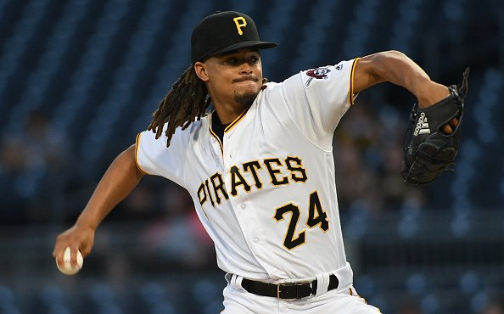
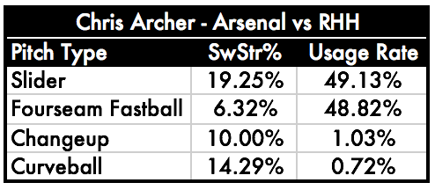
Matchup-Specific Analyses
Suppose we are exploring how a pitcher should best operate in one specific matchup, such as Chris Archer pitching to Mike Trout
Generate optimized sequences 50 times and analyze aggregated results
Justin Berl/Getty Images

Slide 13
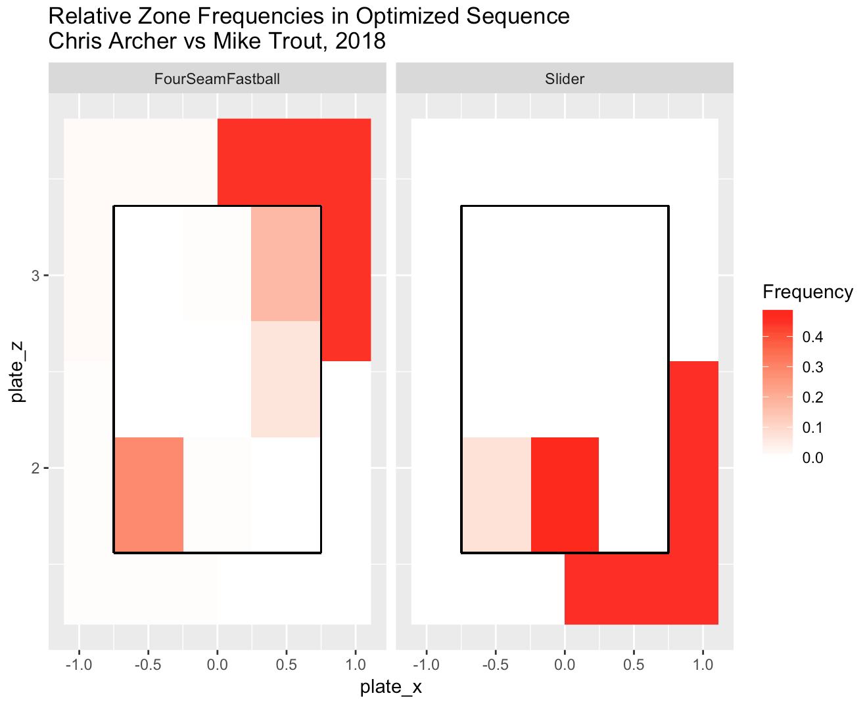
Matchup-Specific Analyses

Slide 14
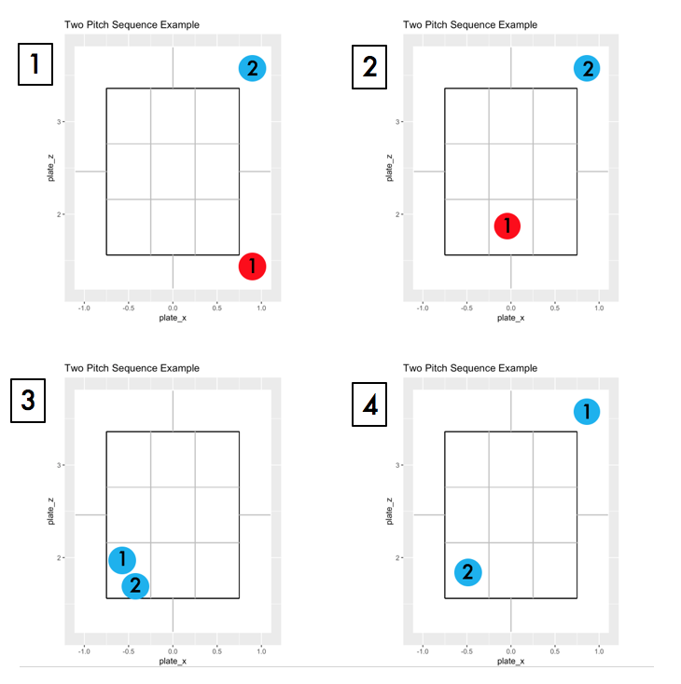
Matchup-Specific Analyses

Slide 15
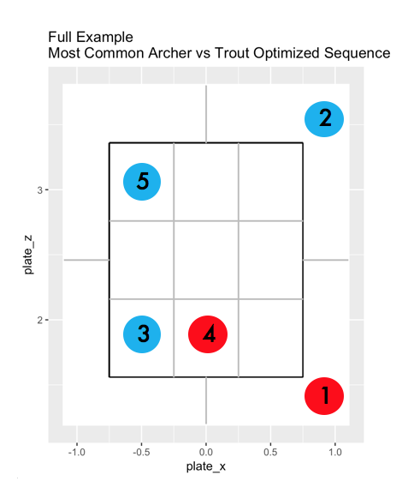
Matchup-Specific Analyses
Slider | 14
2
Fastball | 12
5
Fastball | 3
3
4
Slider | 8
1
Fastball | 1

Slide 16
Matchup-Specific Analyses: Main Takeaways
Generating a large number of sequences for a specific matchup can provide insight into optimal sequencing decisions
For Archer vs Trout:
Throwing a low slider and then a high fastball has a high likelihood of success
Consider throwing a first pitch slider
Changing locations seems to have a greater sequencing impact than changing speeds for this matchup
Avoid throwing a changeup, at least in Trout’s first plate appearance

Slide 17
Large-Scale Analyses
Generate n optimized sequences for all pitchers against one specific batter
Jose Altuve vs. all right-handed MLB Pitchers (50+ IP)
Provides more general understanding of how to pitch to a specific hitter

Slide 18
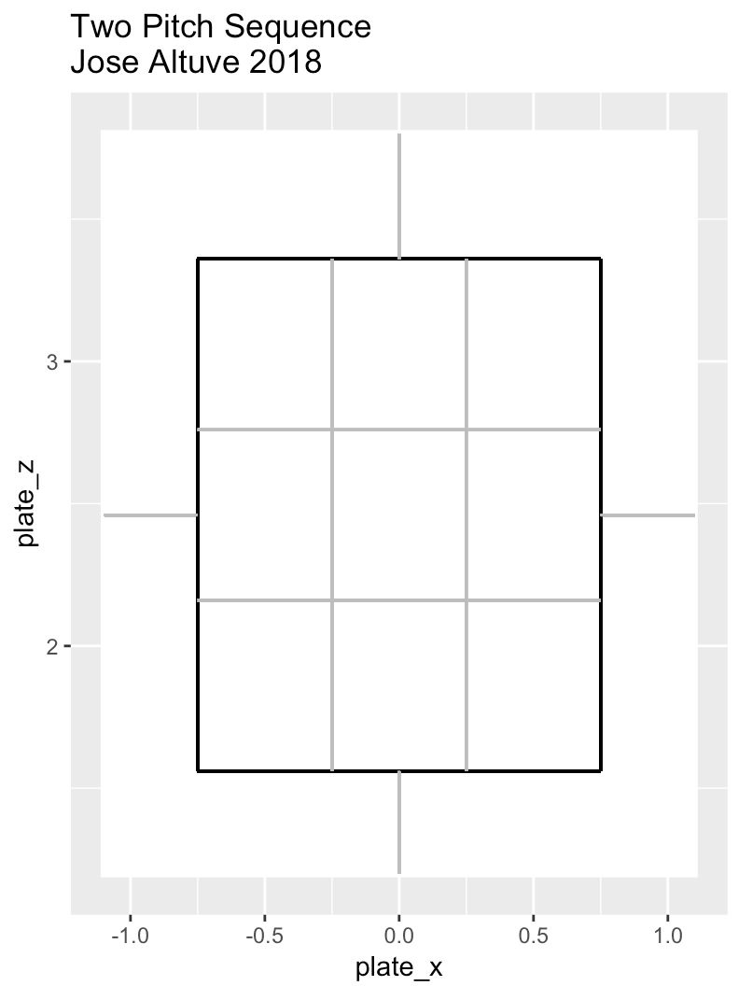
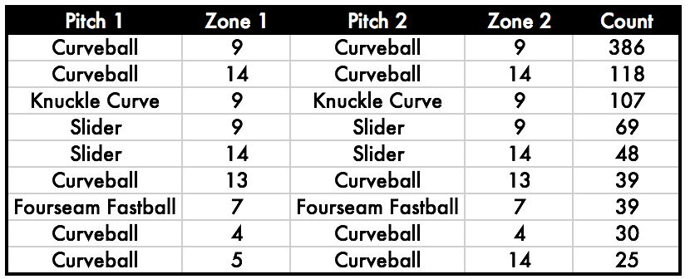
Most Frequent Pitch-Location Pairs

Slide 19
Most Frequent Pitch-Location Pairs

Slide 20
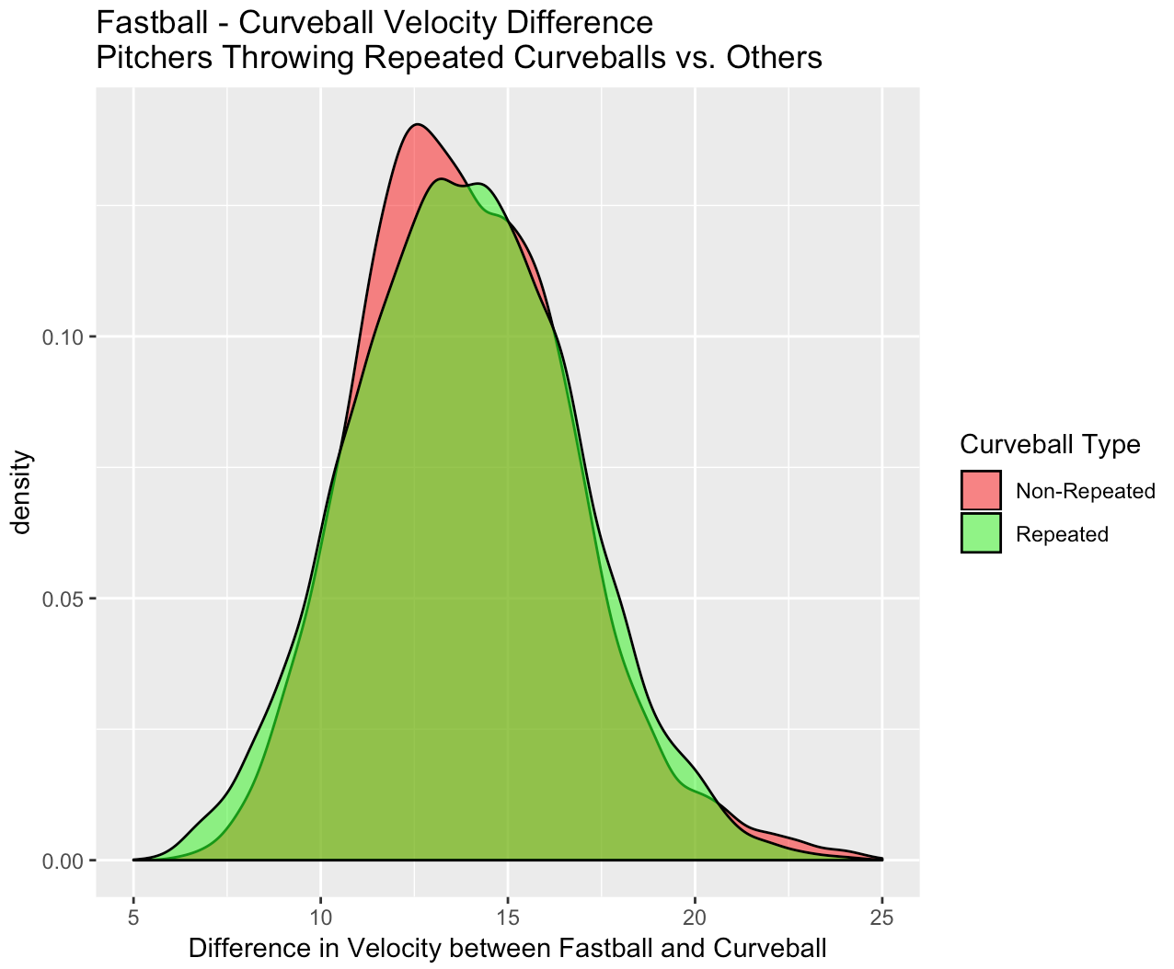
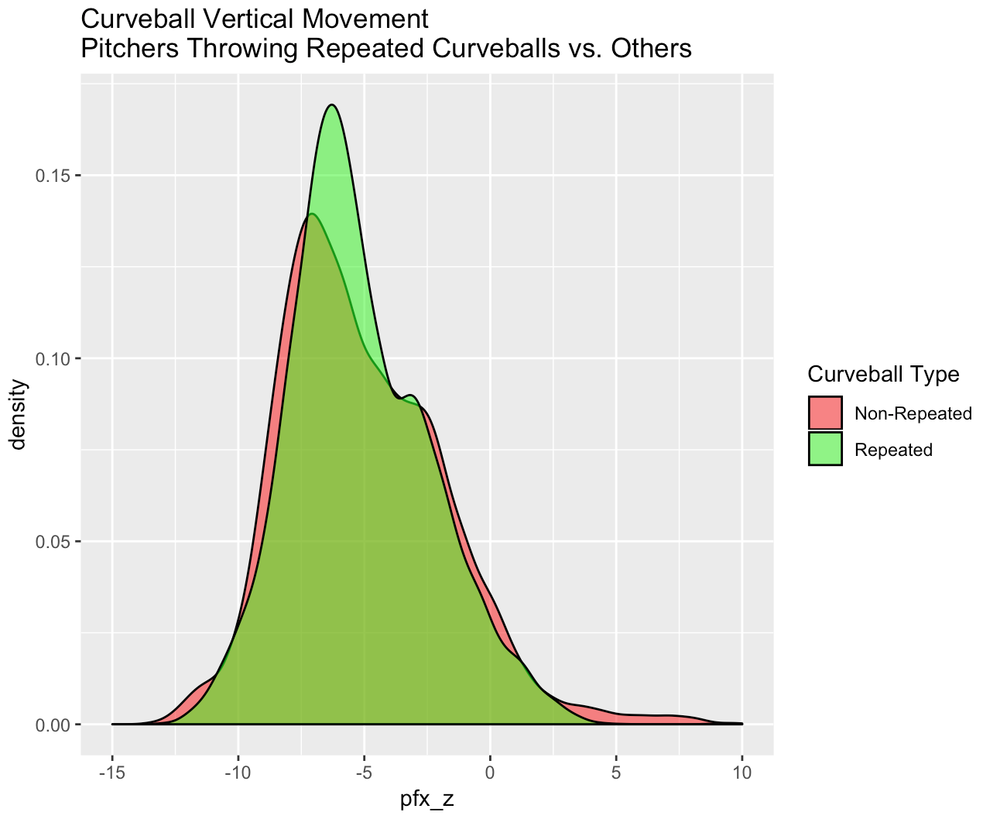
Pitch Quality Differences: Curveballs
Are the curveballs that the model selects to be thrown consecutively different than those it does not?

Slide 21
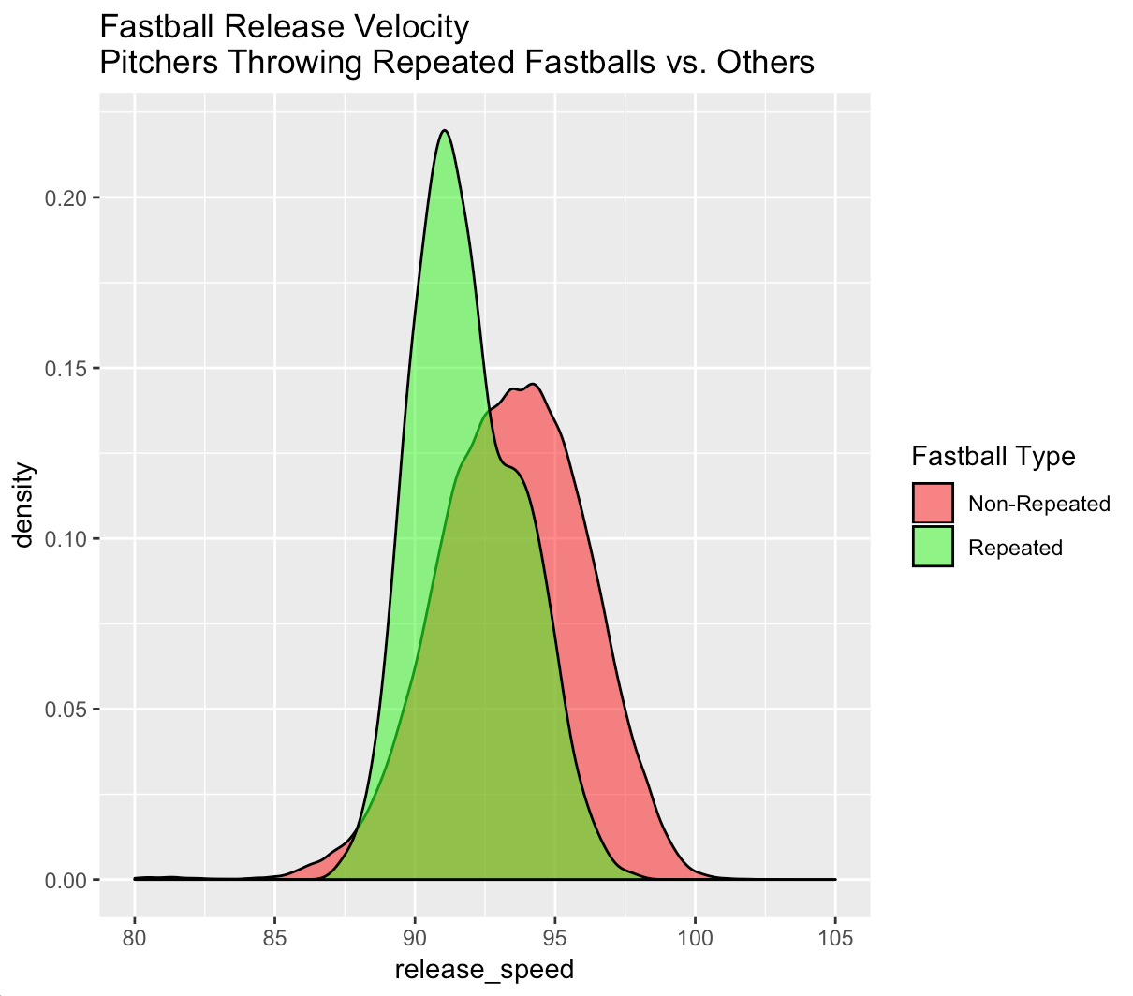
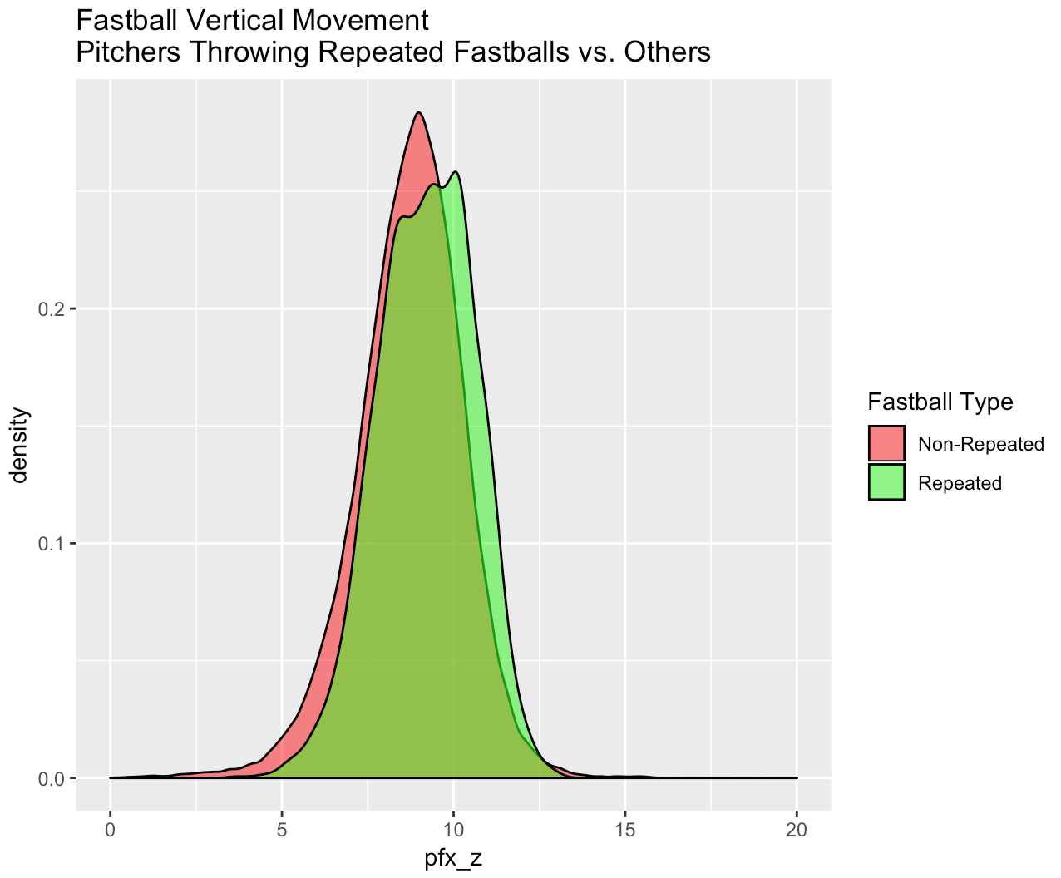
Pitch Quality Differences: Fastballs

Slide 22
Future Research and Project Extensions
Compare optimized sequences to a variety of batters and explore underlying trends
Is there a specific type of hitter, for example, that struggles against certain sequences?
Optimize to different targets
Soft contact, groundballs, or a combination of targets
Control for pitches dominating output

Slide 23
Conclusions
We can effectively model the expected swinging strike rate based on characteristics and locations of a specific pitch as well as the prior pitch for individual matchups
This modeling approach can be utilized in a program to produce an optimized pitch sequence for a specific matchup
The resulting program can be used to identify particular sequencing strengths and weaknesses of specified hitters or pitchers

Slide 24
References
Blewett, Dan. "Pitch Tunneling: Is It Real? And How Do Pitchers Actually Pitch?." The Hardball Times. Fangraphs, 16 Jun 2017. Web. 1 Mar 2019. <https://tht.fangraphs.com/pitch-tunneling-is-it-real-and-how-do-pitchers-actually-pitch/>.
Bonney, Peter. “Defining the Pitch Sequencing Question.” The Hardball Times, FanGraphs Baseball, 6 Mar. 2015, www.fangraphs.com/tht/defining-the-pitch-sequencing-question/.
---. "Defining the Pitch Sequencing Question, Part Two | The Hardball Times." The Hardball Times. Fangraphs Baseball, 4 May 2015. Web. 27 Nov 2018. http://www.fangraphs.com/tht/defining-the-pitch-sequencing-question-part-two/>
Carleton, Russell. "Baseball Therapy: The Power of Changing Speeds." Baseball Prospectus. Baseball Prospectus, 3 Feb 2015. Web. 27 Nov 2018. <https://www.baseballprospectus.com/news/article/25494/baseball-therapy-the-power-of-changing-speeds/>.
Cortes, Corinna and Vladimir Vapnik. "Support-vector networks." Machine Learning. 20.3 (1995): 273–297. Web.<https://link.springer.com/article/10.1007%2FBF00994018>.
"Custom Statistic Report: Pitch Tunnels by Pitcher - v2." Baseball Prospectus. Baseball Prospectus, 20 Nov 2018. Web. 27 Nov 2018. <https://legacy.baseballprospectus.com/sortable/index.php?cid=2741965>.
Gareth, James, Daniela Witten, Trevor Hastie and Robert Tibshirani. An Introduction to Statistical Learning. New York: Springer, 2013. Print.
Gower, J.C.. "A General Coefficient of Similarity and Some of Its Properties." Biometrics. 27.4 (1971): 857-887. Web. <https://www.jstor.org/stable/2528823?seq=1#metadata_info_tab_contents>
"Linear Weights ." FanGraphs Baseball. FanGraphs Baseball, Web. 27 Nov 2018. <http://www.fangraphs.com/library/principles/linear-weights/>.
Kuhn, Max. "The caret Package." GitHub. GitHub, 26 May 2018. Web. 27 Nov 2018. <http://topepo.github.io/caret/index.html>.
"MLB Gameday." MLB.com. Major League Baseball Advanced Media, Web. <http://mlb.mlb.com/mlb/gameday/y2010/>.
Pavlidis, Harry, Jonathan Judge and Jeff Long. "Prospectus Feature: Introducing Pitch Tunnels." Baseball Prospectus. Baseball Prospectus, 24 Jan 2017. Web. 27 Nov 2018. <https://www.baseballprospectus.com/news/article/31030/prospectus-feature-introducing-pitch-tunnels/>.
Petti, Bill. "What Starting Pitcher Metrics Correlate Year-to-Year?." Beyond the Box Score. SB Nation, 9 Jan 2012. Web. 27 Nov 2018. <https://www.beyondtheboxscore.com/2012/1/9/2690405/what-starting-pitcher-metrics-correlate-year-to-year>.
---. "Baseballr." GitHub. GitHub, Web. <http://billpetti.github.io/baseballr/>.
"ROC curve analysis." Medcalc. MedCalc Software, Web. <https://www.medcalc.org/manual/roc-curves.php>.
Roegele, Jon. "The Effects of Pitch Sequencing." The Hardball Times. Fangraphs Baseball, 24 Nov 2014. Web. 27 Nov 2018. <https://www.fangraphs.com/tht/the-effects-of-pitch-sequencing/>.
Wilman, Daren. "Baseballsavant." Baseballsavant. MLB Advanced Media, Web. <https://baseballsavant.mlb.com/statcast_leaderboard>.

