Slide 1
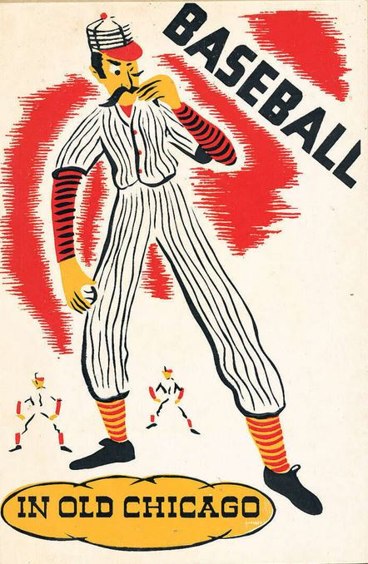
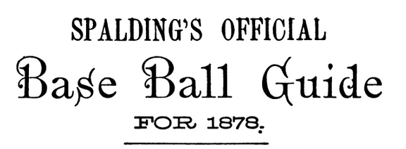
The Mysterious Lewis Meacham
The Untold Story of William Hulbert’s Right-Hand Man
Jack Bales, jbales@umw.edu
Fredericksburg, Virginia
Baseball in Old Chicago (1939)

Slide 2
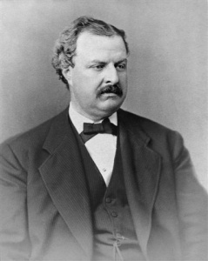
“In the winter of 1875-’76, Mr. Hulbert, together with Lewis Meacham, then the baseball reporter of THE TRIBUNE, now deceased, matured the plan of the National League.” (Obituary of William Hulbert, Chicago Daily Tribune, April 11, 1882.)
Left: William Hulbert (1832-1882)

Slide 3
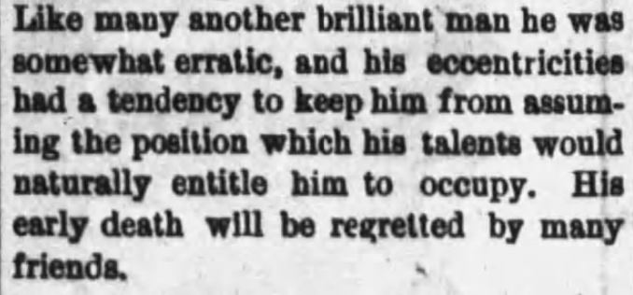
“Death of Lewis Meacham”
Rutland (Vermont) Daily Herald and Globe
October 4, 1878

Slide 4
Lewis Henry Meacham
More than two birth dates
Two birthplaces
Two burial locations
Two entries in “Find a Grave” website
Two names besides “Lewis Henry Meacham”
One name with assorted middle initials
One name used in the Civil War
Two Civil War ranks
Two terms of service in the Civil War

Slide 5
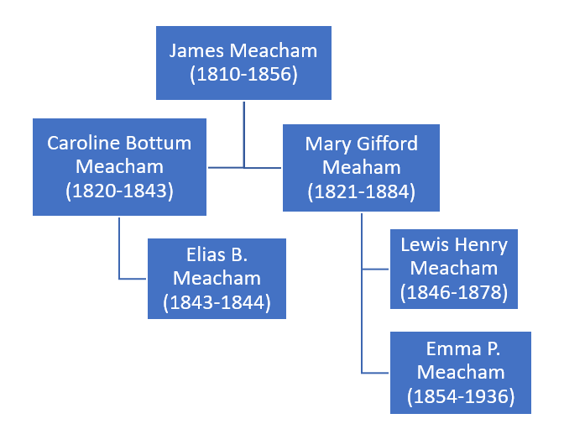
James married Caroline Bottum in 1842. Their child died at age one.
James married Mary Gifford in early 1845 and they had two children.
(Her brother was named Henry; hence Lewis’s middle name.)

Slide 6
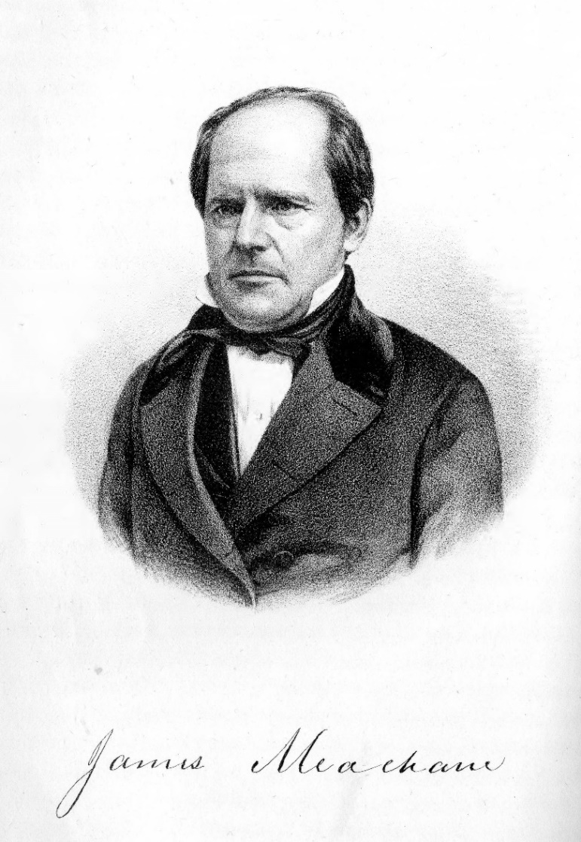
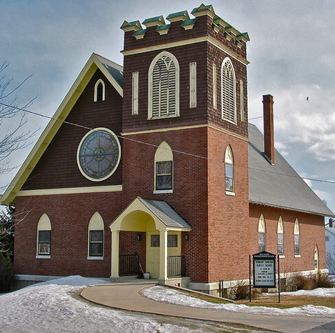
Below: (Bellow Falls) Vermont Chronicle, July 4, 1838

Slide 7
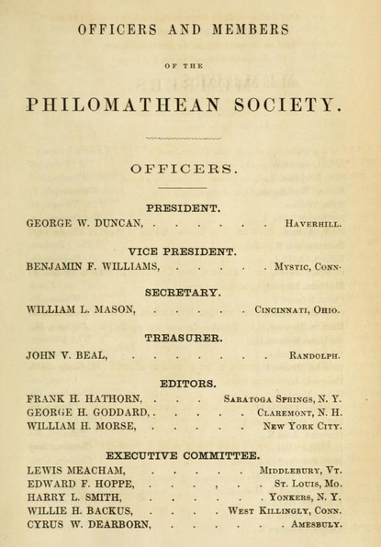
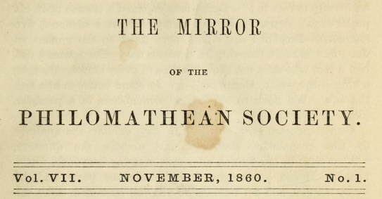
Phillips Academy’s Philomathean Society was a debate club, which published The Mirror literary magazine.

Slide 8
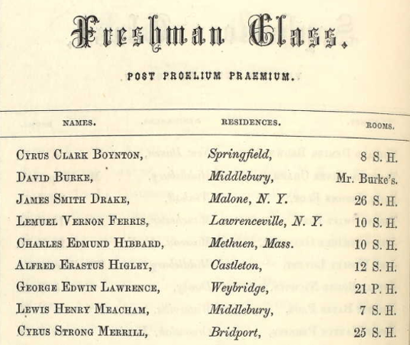
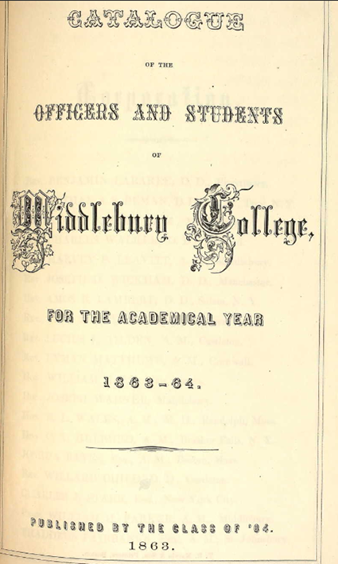
Catalogue of the Officers and Students of Middlebury College,
for the Academical Year 1863-1864 (1863)

Slide 9
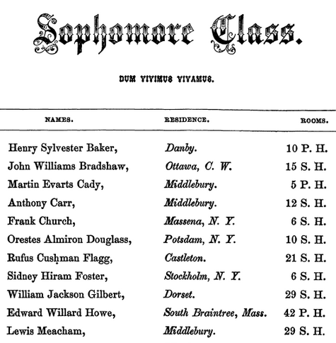
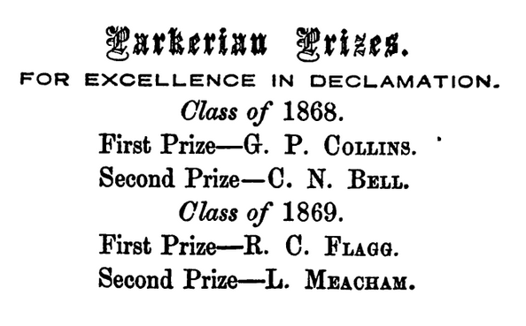
Catalogue of the Officers and Students of Middlebury College,
for the Academical Year 1866-7 (1866)

Slide 10
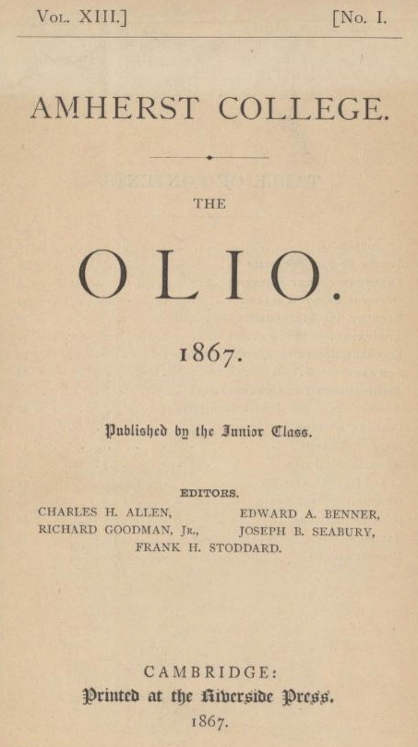
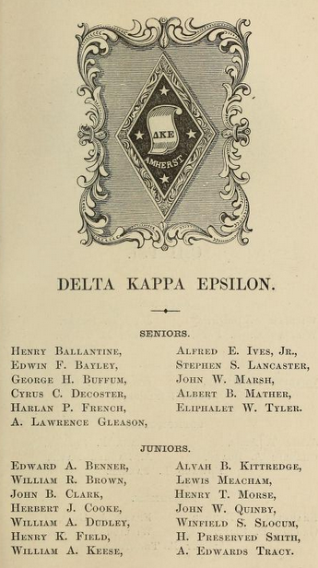

Slide 11
Top: Chicago Tribune, December 6, 1871
Bottom: Chicago Evening Post, April 11, 1872

Slide 12
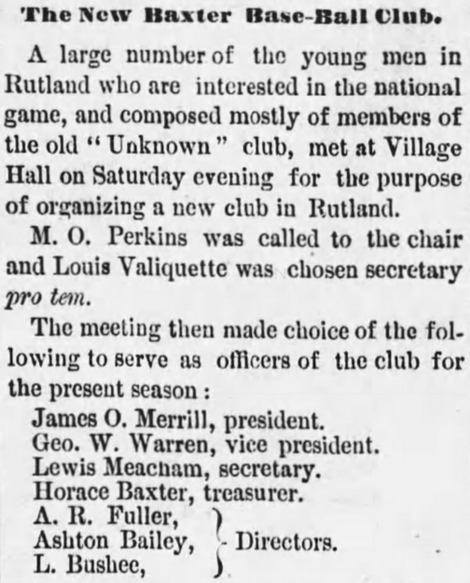
Top: St. Albans (Vermont) Daily
Messenger, December 19, 1873
Right: Rutland (Vermont) Daily
Globe, August 10, 1874

Slide 13
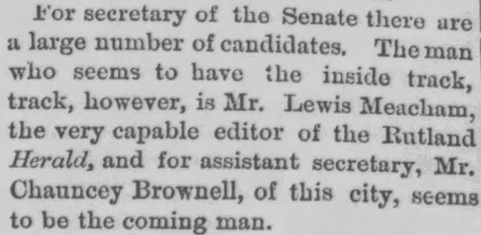
Burlington (Vermont) Daily Sentinel, October 7, 1874

Slide 14
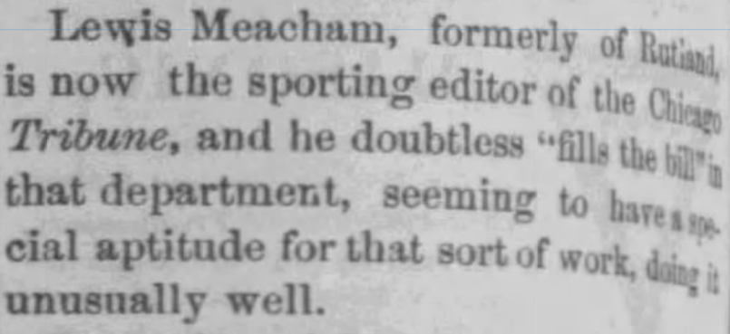
Montpelier, Vermont Argus and Patriot, October 21, 1875

Slide 15
“Mr. Meacham of the Chicago Tribune was recommended as [umpire] in every way qualified and accepted. He proved to be the worst we have ever seen. . . . The audience numbered about 300, and were fully as much disgusted with Mr. Meacham’s laughable errors as the players of both sides were.”
St. Louis Republican, October 2, 1875

Slide 16
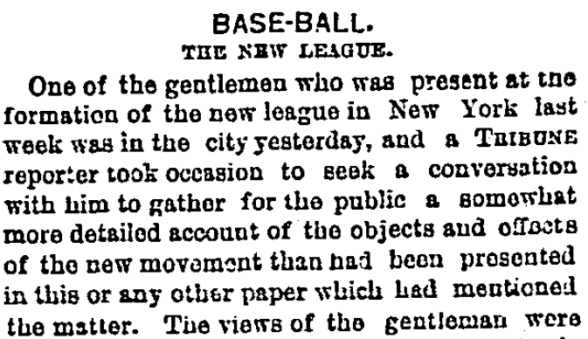
Chicago Daily Tribune, February 13, 1876

Slide 17
“Mr. President Hulbert, while affable, is unsatisfactory, and any attempt to get an answer to a question from him about the future policy of the organization, of which he is the only visible head, is as fruitless as it would be to attempt to perceive a prominent bone in his well-fed body.”
Chicago Daily Tribune, September 17, 1876

Slide 18
April 9, 1877
[Letter from William Hulbert to Charles Fowle, Secretary of the
St. Louis Brown Stockings]
“Enclosed find note from Meacham to me referring to the Htfd. Club.” [Hartfords of Brooklyn]
(Image courtesy Chicago History Museum, Chicago Cubs Records)

Slide 19
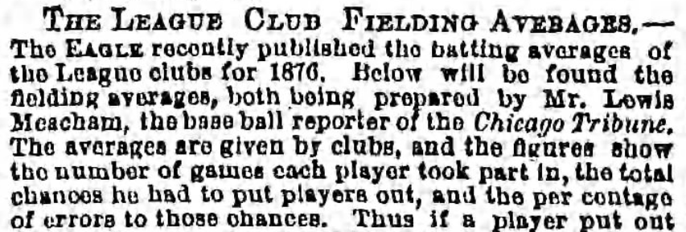
Brooklyn Daily Eagle, November 10, 1876

Slide 20
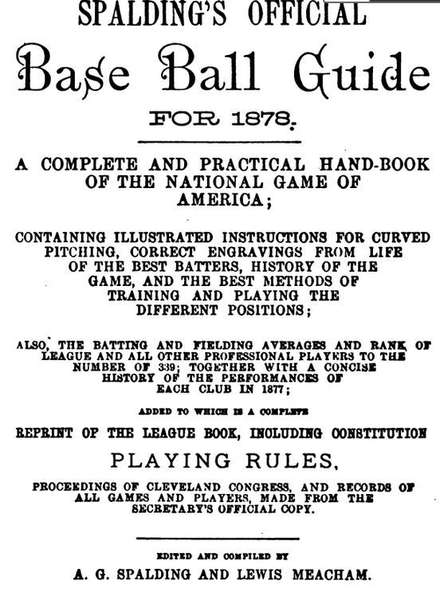

Slide 21
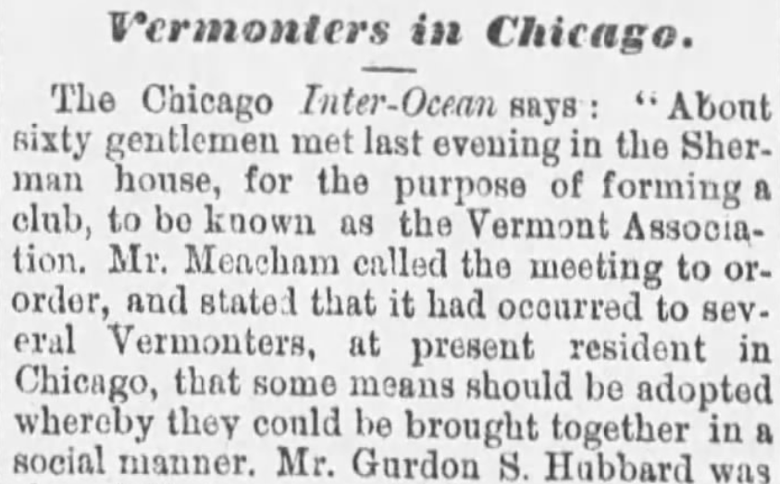
(Windsor) Vermont Journal, January 20, 1877

Slide 22
Boston Globe, August 15, 1878

Slide 23
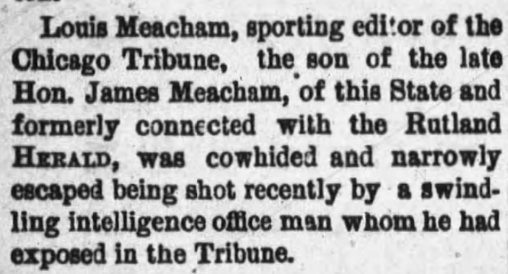
Rutland (Vermont) Daily Herald and Globe, January 16, 1878

Slide 24
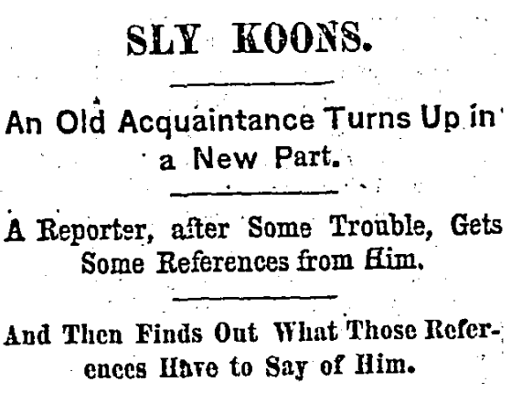
Chicago Daily Tribune, December 23, 1877

Slide 25
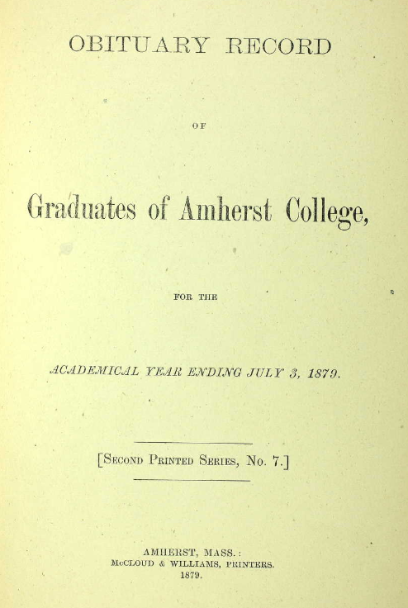
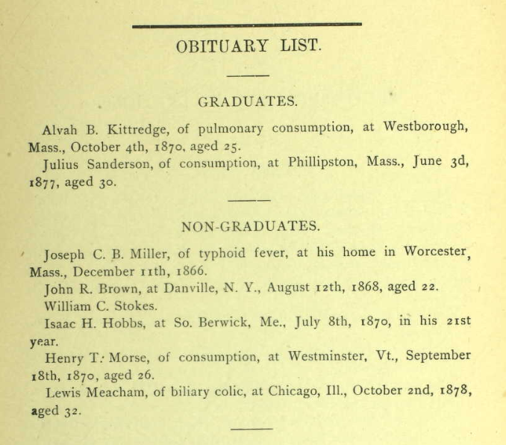

Slide 26
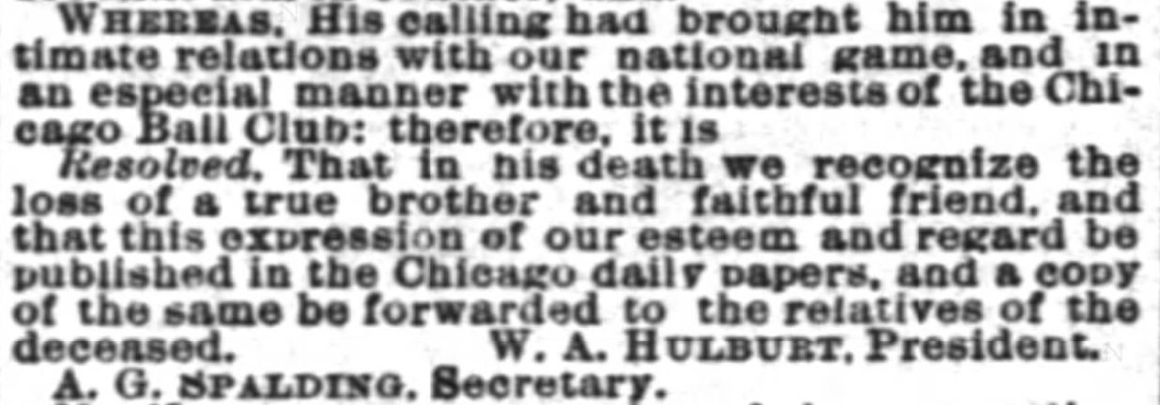
“Another Chicago Journalist Gone,” (Chicago) Daily Inter Ocean, October 3, 1878. (Reprinted in Spalding’s Base Ball Guide, 1879)

Slide 27
Examples of Chicago Obituaries with
Meacham Middle Initials of E, B, and S
Top: Chicago Daily Tribune, October 3, 1878
Middle: Chicago Inter Ocean, October 4, 1878
Bottom: Chicago Times, October 5, 1878

Slide 28
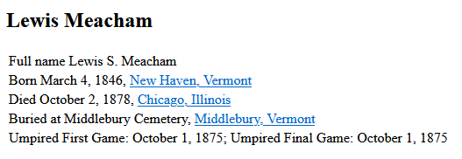
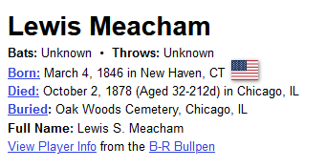
Right: Middle initial in “full name” and birth date are incorrect. Note umpired game. Burial at Middlebury.
Left: Birthdate and the “S” in his “full name” are incorrect. (He was born on March 8, 1846.) Burial at Oak Woods.

Slide 29
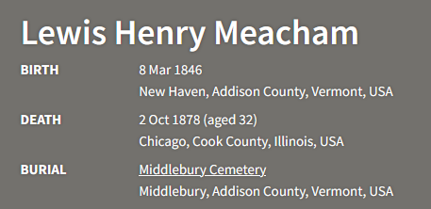
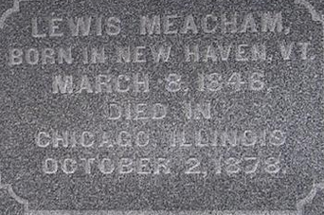
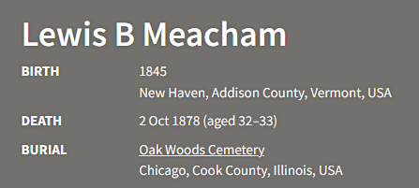
Top left:
Correct name and birth date
Burial at Middlebury
Bottom left:
Incorrect middle initial
Incorrect birth date
Burial at Oak Woods
Two entries on the “Find a Grave” website. Grave marker (top right) in Middlebury, Vermont, includes correct information.

Slide 30
“Physician’s Certificate of Death,” Lewis Meacham, Chicago Illinois
Line 1, Name: Incorrect [middle name was Henry]
Line 2, Age: Incorrect [he was 32 when he died]
Line 4, Place of birth: Incorrect [born in New Haven, VT]

Slide 31
Birthdates and Ages Given for Lewis Meacham
March 8, 1846: His actual birthdate (he died at age 32)
“Aged 33 years”: Plate on burial casket
1845: Chicago Inter Ocean
1843: Chicago Times
“About 1846”: Chicago Daily Tribune
“About 35 years old”: Chicago Daily Telegraph
35 years old: Out-of-state obituaries (though most did not list an age or birth year)

Slide 32
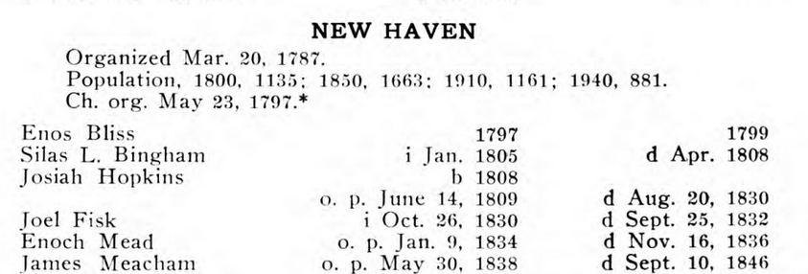
John Comstock, The Congregational Churches of Vermont and Their Ministry, 1762-1942 (1942)
James Meacham left New Haven Church on Sept. 10, 1846
“O. P.” = Ordained as pastor
“D” = Dismissed from pastorate (that is, left the pastorate)

Slide 33
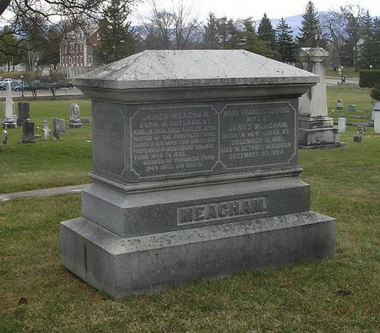
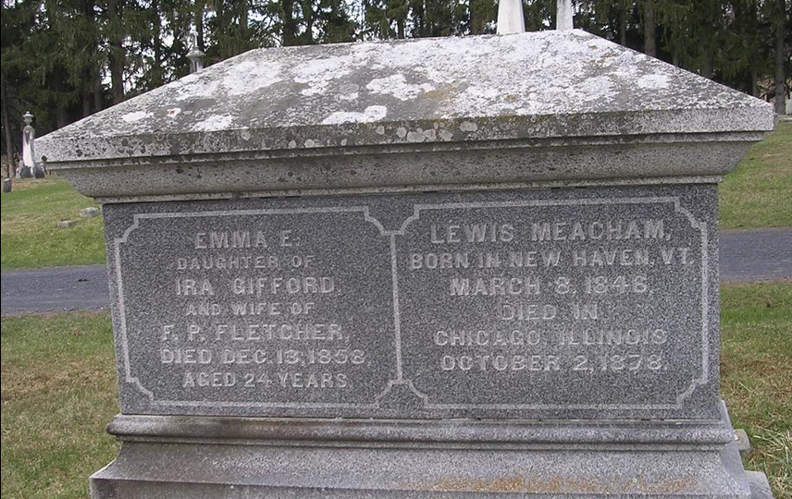
Meacham family marker in the West Cemetery in Middlebury, Vermont. At the left are the names of Lewis’s parents, James and Mary, and below are Lewis and his mother’s sister, Emma.
Lewis is included in the cemetery index, but that is no guarantee he was actually buried in the cemetery. In addition, Emma’s name is not even included in the index. (Images from FindaGrave, www.findagrave.com)

Slide 34
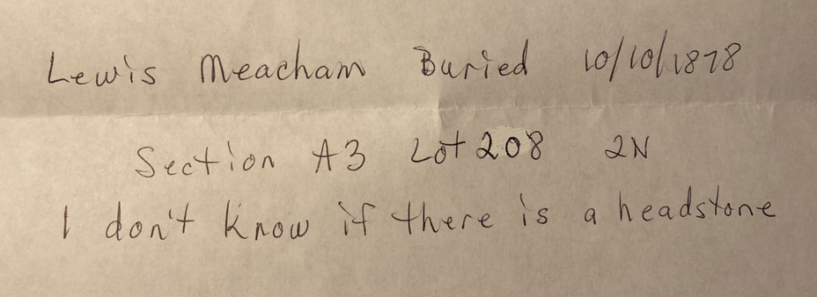
A note from an administrator of the Oak Woods Cemetery in Chicago, Illinois.

Slide 35
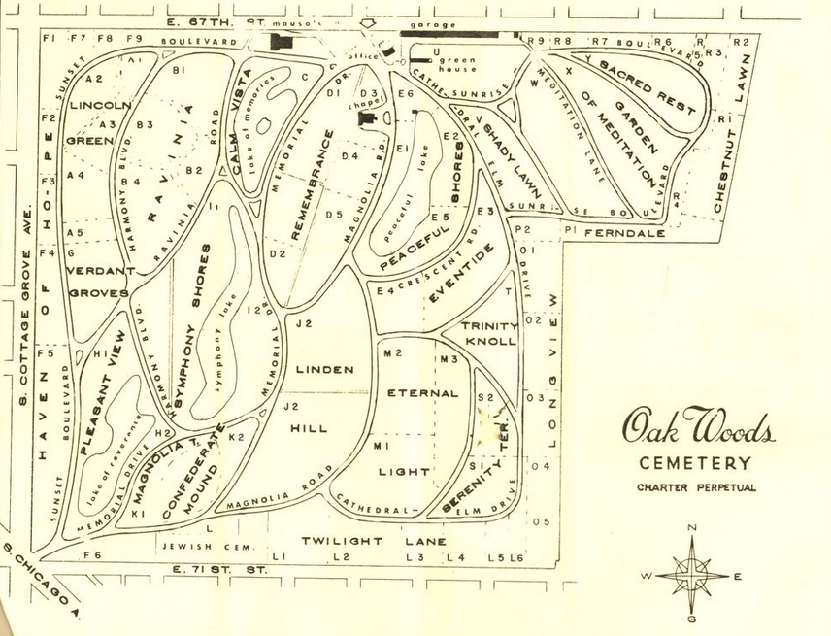
Lewis Meacham is buried in the Lincoln Green area of Oak Woods Cemetery (upper left, in A3 section, lot 208).

Slide 36
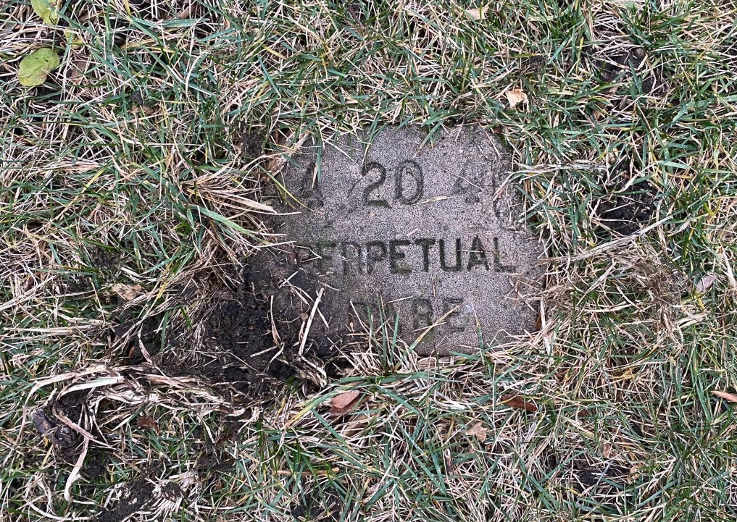
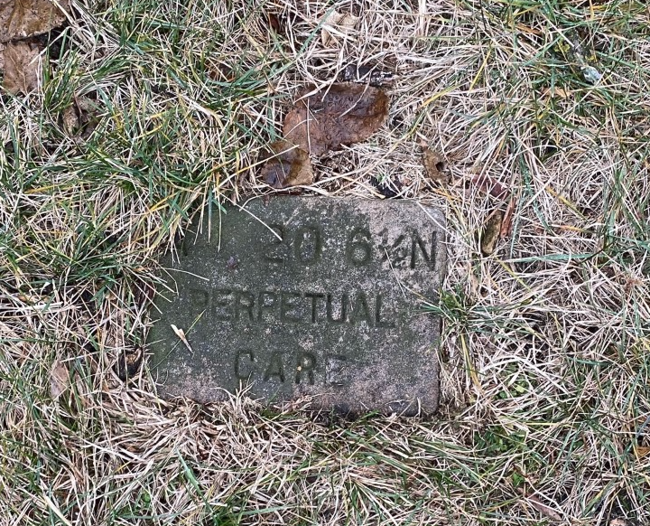
“It doesn’t appear that there is a gravestone for Lewis Meacham. This is a sad part of the cemetery because many of the graves were covered up over the years and are now under the soil as though they are part of the landscape. I was able to find markers close to where the grave should be, but not much is still in that section sadly.” (Images and quotation courtesy of Mallory Price, Hyde Park Historical Society, Chicago)

Slide 37
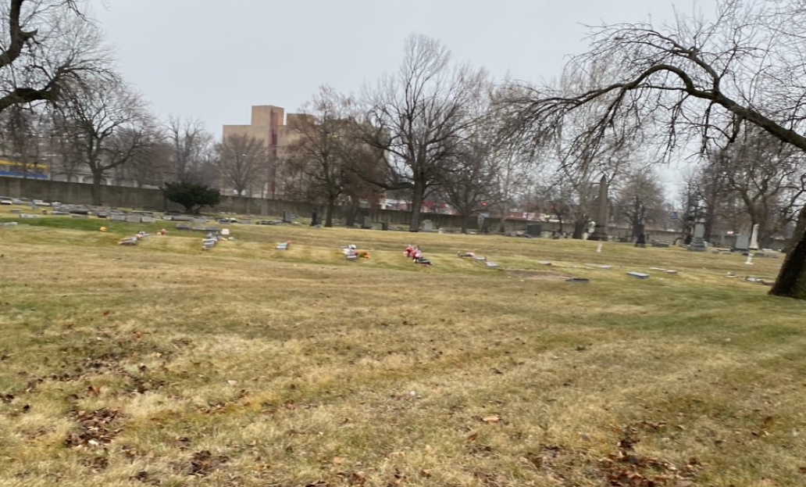
Oak Woods Cemetery, showing the general area where Lewis Meacham is buried. (Image courtesy of Mallory Price, Hyde Park Historical Society, Chicago)

Slide 38
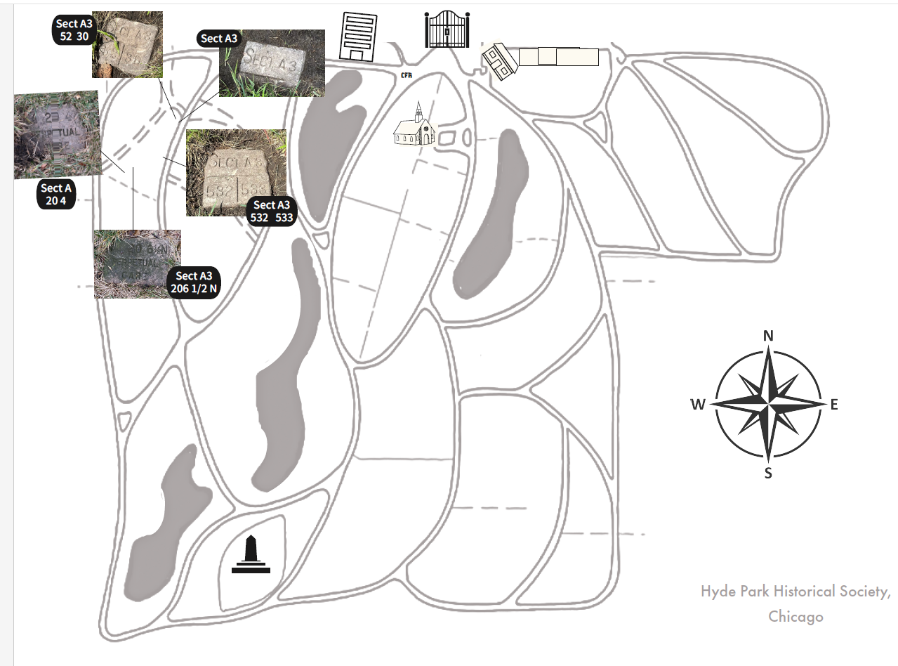
A map of Oak Woods Cemetery showing the only visible markers in the section where Lewis Meacham is buried. (Image courtesy of Mallory Price, Hyde Park Historical Society, Chicago)

Slide 39
Lewis Henry Meacham
More than two birth dates [March 8, 1846]
Two birthplaces [New Haven, Vermont]
Two burial locations [Chicago]
Two entries in “Find a Grave” website [both have errors]
Two names besides “Lewis Henry Meacham”
One name with assorted middle initials
One name used in the Civil War
Two Civil War ranks
Two terms of service in the Civil War

Slide 40
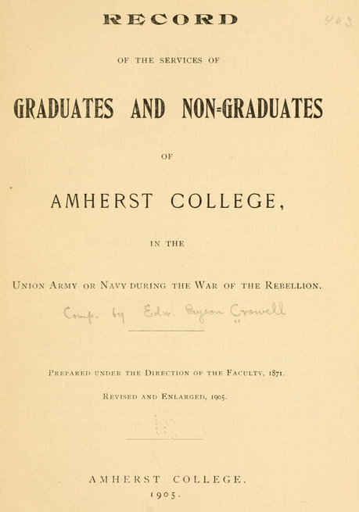
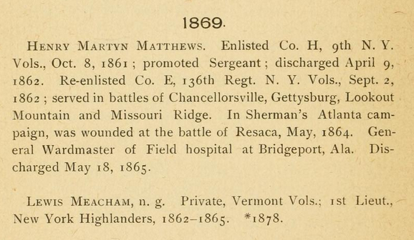

Slide 41
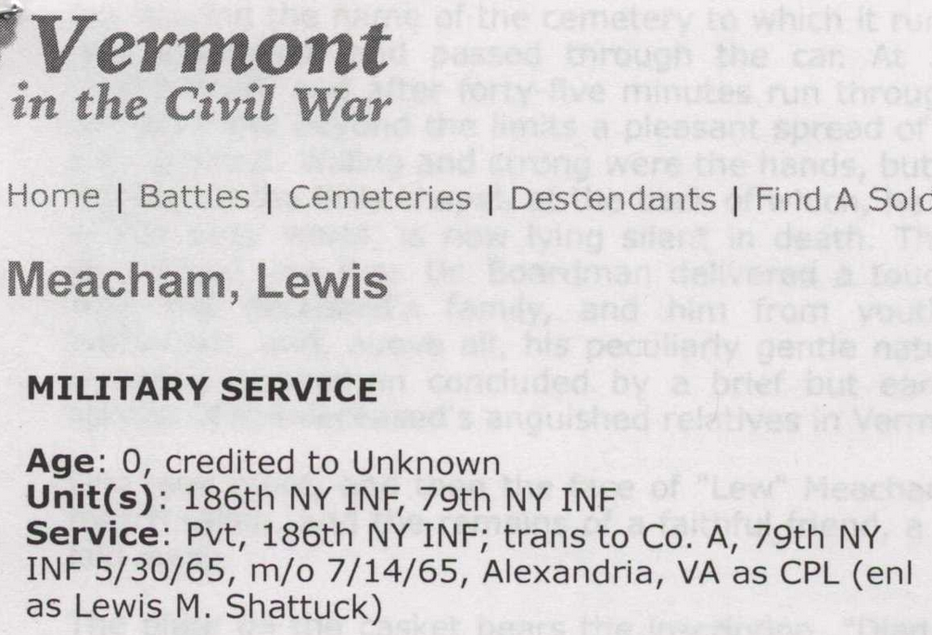
https://www.vermontcivilwar.org
Pvt = Private; m/o = mustered out; CPL = corporal; enl = enlisted

Slide 42
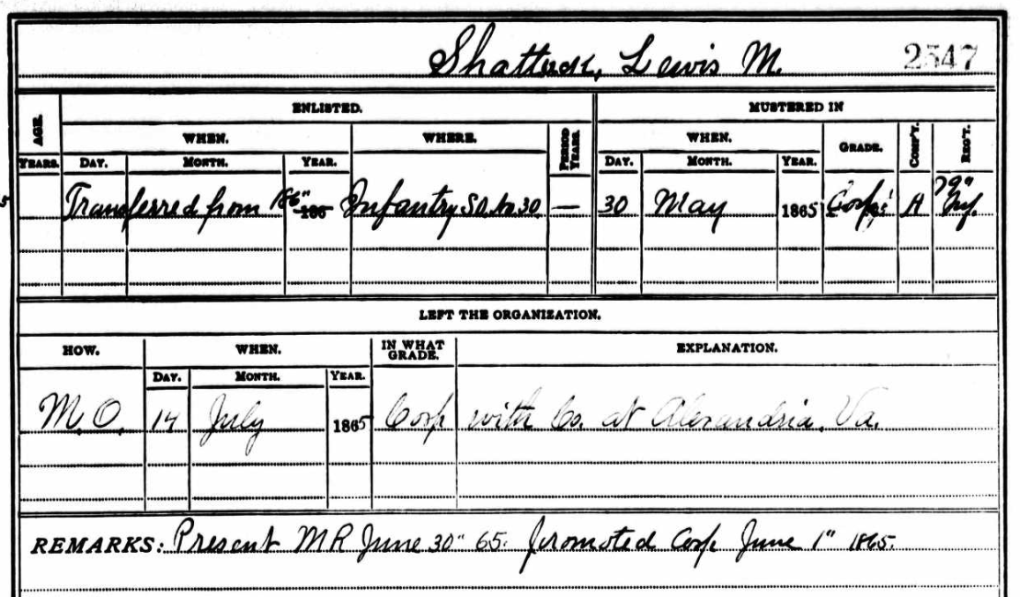
On May 30, 1865, Lewis M. Shattuck was transferred from the 186th Infantry to the 79th Infantry. He was promoted to corporal on June 1, 1865. He and his company were mustered out on July 14, 1865.
(New York, U.S., Civil War Muster Roll Abstracts, 1861-1900)

Slide 43
Corporal Lewis M. Shattuck, of Company A, 79th Regiment of the New York Infantry Volunteers, enlisted on August 2, 1864, to serve three years, and was discharged on July 14, 1865, in Alexandria, Virginia (after having served less than one year).
(Image courtesy of Eva Garcelon-Hart, Stewart-Swift Research Center, Henry Sheldon Museum, Middlebury, Vermont)

Slide 44
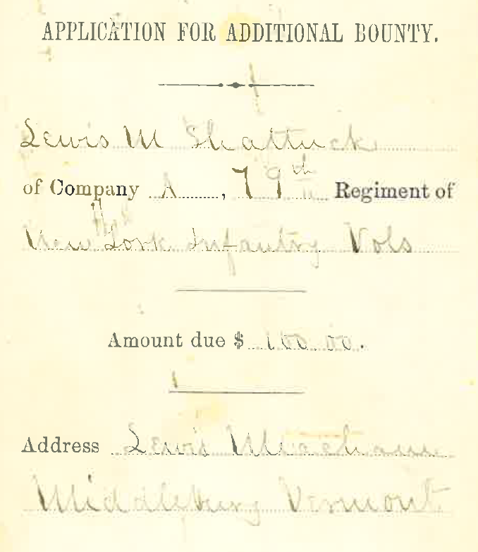
Lewis M. Shattuck
Lewis Meacham
Civil War veteran “Lewis M. Shattuck” requests a stipend of $100. His return address is “Lewis Meacham” of Middlebury, Vermont.
(Image courtesy of Eva Garcelon-Hart, Stewart-Swift Research Center,
Henry Sheldon Museum, Middlebury, Vermont)

Slide 45
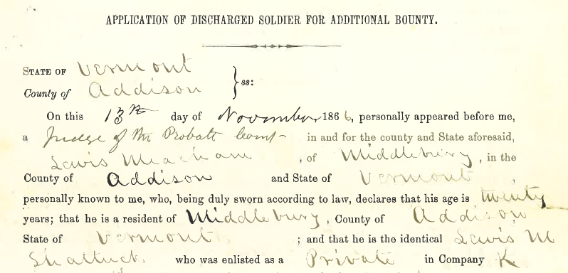
On November 13, 1866, Meacham admits he is “the identical Lewis M. Shattuck who was enlisted as a private.” Note rank of corporal and age of 20.
(Image courtesy of Eva Garcelon-Hart, Stewart-Swift Research Center,
Henry Sheldon Museum, Middlebury, Vermont)

Slide 46
Where did the name “Shattuck” come from?
?

Slide 47
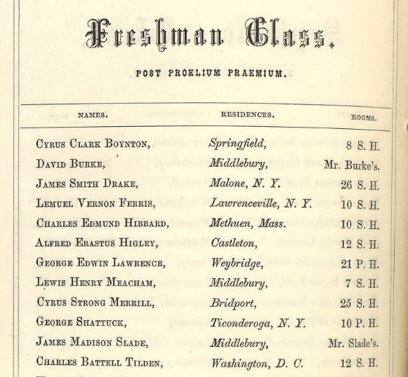
Catalogue of the Officers and Students of Middlebury College,
for the Academical Year 1863-1864 (1863)

Slide 48
Middlebury College
Lewis Meacham: 1863-1864; 1865-1867
George Shattuck: 1863-1865
Amherst College
Lewis Meacham: 1867-1868
George Shattuck: 1865-1867

Slide 49
(Meacham was at Middlebury College from 1863-1864 and 1865-1867)
Biographical Record of the Alumni of Amherst College
During Its First Half Century, 1821-1871 (1883)

Slide 50
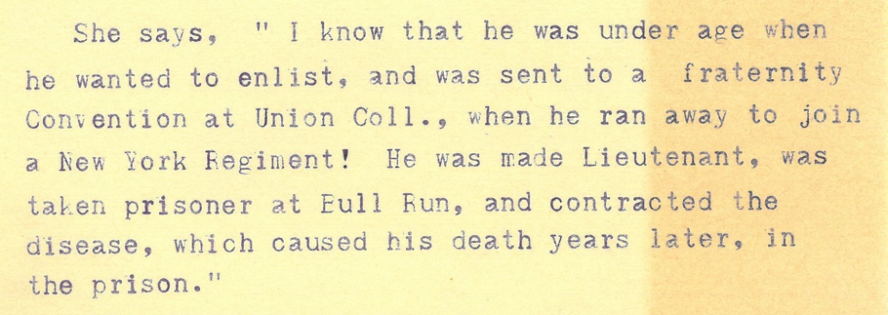
Comments made by Lewis Meacham’s sister, Emma Meacham Davis, in 1910. (Courtesy of Kaitlin Buerge, Middlebury College Special Collections, Middlebury, Vermont)
Lewis Meacham
March 8, 1846 (date of birth)
March 8, 1864 (date of 18th birthday)
August 2, 1864 (date of enlistment)

Slide 51
Lewis Meacham’s Enlistment in the Civil War
His politically connected family may have tried to prevent him from enlisting; hence, he ran away.
Perhaps he wanted to make a name for himself, far away from politics and his well-known family name.
He might have felt inferior to prominent family members (which later led him to exaggerate his military service).

Slide 52
“Death of Lewis Meacham”
Rutland (Vermont) Daily Herald and Globe
October 4, 1878

Slide 53
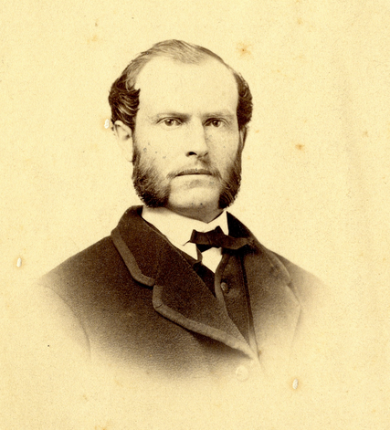
George Shattuck
(Courtesy of Middlebury College
Special Collections, Middlebury, Vermont)

Slide 54
Lewis Henry Meacham
More than two birth dates [March 8, 1846]
Two birthplaces [New Haven, Vermont]
Two burial locations [Chicago]
Two entries in “Find a Grave” website [both have errors]
Two names besides “Lewis Henry Meacham”
One name with assorted middle initials [wrong]
One name used in the Civil War [alias]
Two Civil War ranks [corporal]
Two terms of service in the Civil War [one year]

Slide 55
“I see no great objection to giving papers friendly to us an inside view. I am sure we can trust Meacham and the Tribune.”
--William Hulbert to C. Orrick Bishop
(Image courtesy Chicago History Museum, Chicago Cubs Records)

