Slide 1
From Comiskey Park to Comiskey Park
John Bauer, SABR 51, 7 July 2023

Slide 2
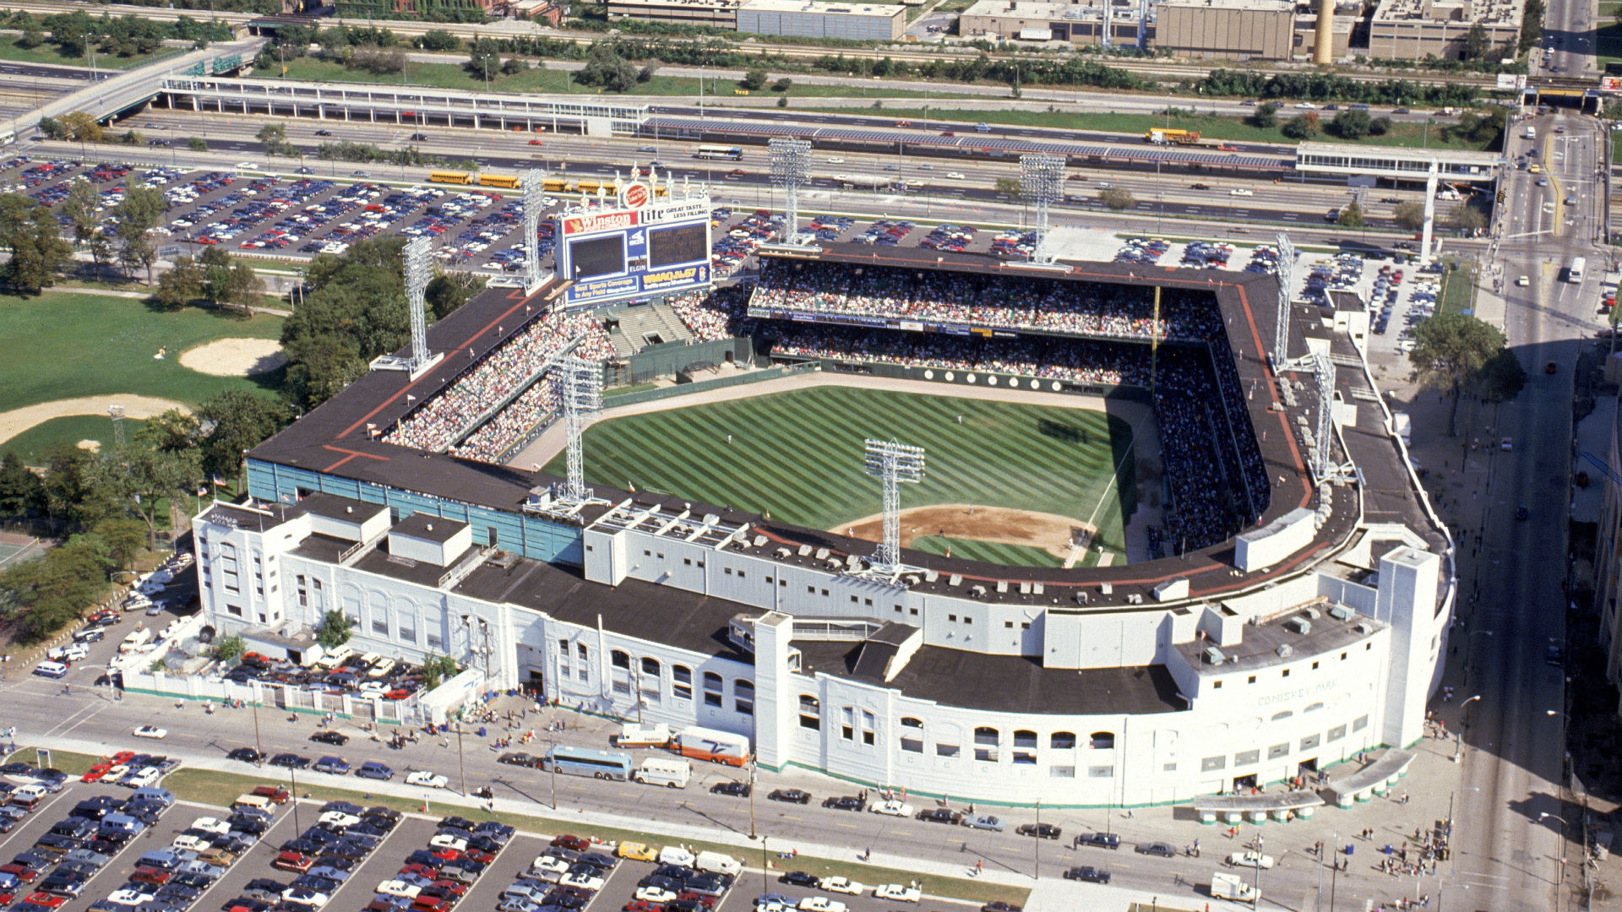

Slide 3
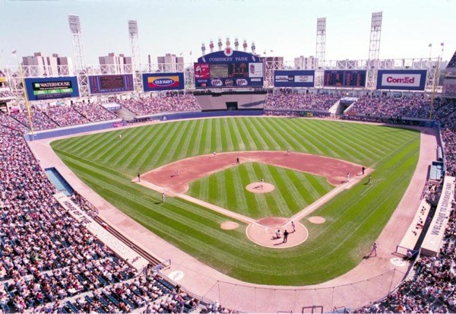

Slide 4
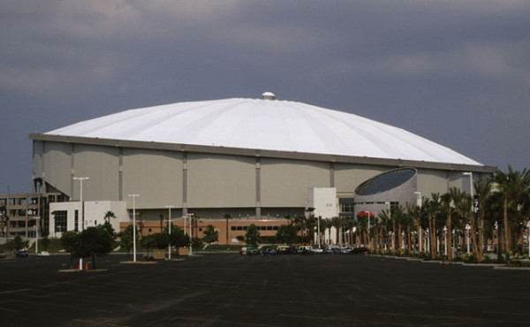

Slide 5
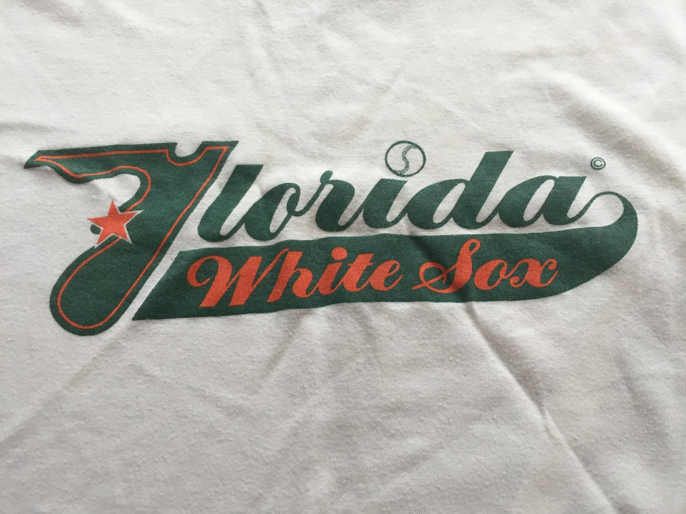

Slide 6
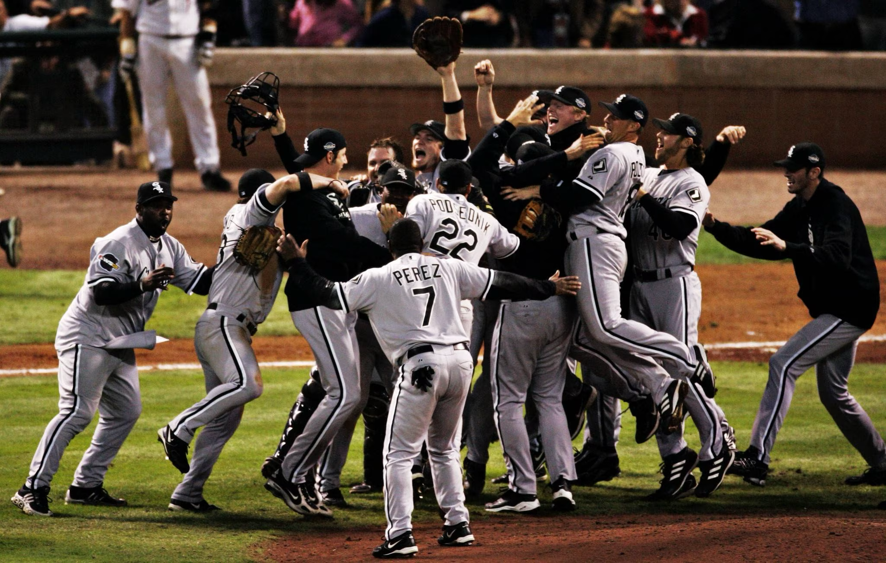

Slide 7
White Sox for sale
Bill Veeck bought the club for a second time in 1975
Saved White Sox from possible move to Seattle
By 1980, preparing to sell Sox for a second time

Slide 8
AL rejects sale to DeBartolo
Veeck agrees to sell Sox to Edward DeBartolo, Sr. for $20M
AL twice rejected sale
Out-of-town ownership
Possible move to New Orleans
Horse racetrack ownership

Slide 9
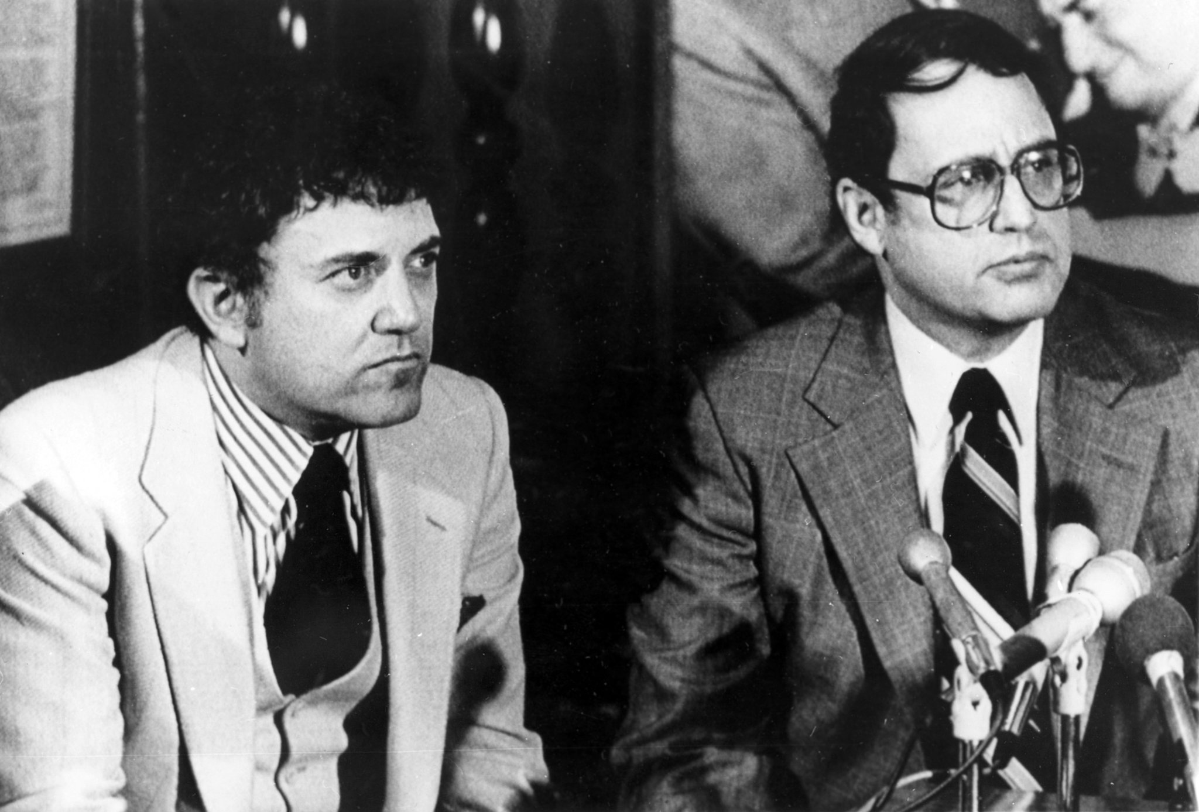
Reinsdorf and Einhorn buy the team
Sale approved by American League, January 1981
Set out to improve atmosphere at Comiskey Park
Renovations over 1981-1982 and 1982-1983 offseasons

Slide 11
Thompson’s view
Thompson to Reinsdorf and Einhorn:
“You’ll never get [a new ballpark] unless there’s a crisis — unless people think you’re going to leave town if you don’t get one.”

Slide 12
1985: New stadium proposals
Chicago
Roosevelt Road/South Loop
Dome on Soldier Field?
What about the Bears?
Suburbs
Dome in Itasca
Addison: Reinsdorf-controlled Balcor has a large tract of land
Rush to secure tax-exempt financing

Slide 13
“Move or else” letter
January 1986: AL President Bobby Brown directs White Sox to get a new stadium
Reinsdorf: recognition that Comiskey Park is a “financial disaster” and “a sinkhole of repairs”
Similar letters not sent to other clubs in older ballparks

Slide 14
Harold Washington
Chicago mayor formed task force on stadium issues
Asked two developers — Daniel Shannon and Robert Wislow — to work with White Sox on South Loop solution
Baseball-only stadium or multi-use football/baseball stadium

Slide 15
Enter the governor
Illinois governor gets engaged
With Illinois legislature working past its June 30 deadline, Washington and Thompson reach an agreement in early July 1986
Key points:
$54M for infrastructure
$126M for stadium
2% increase in Chicago hotel/motel tax

Slide 16
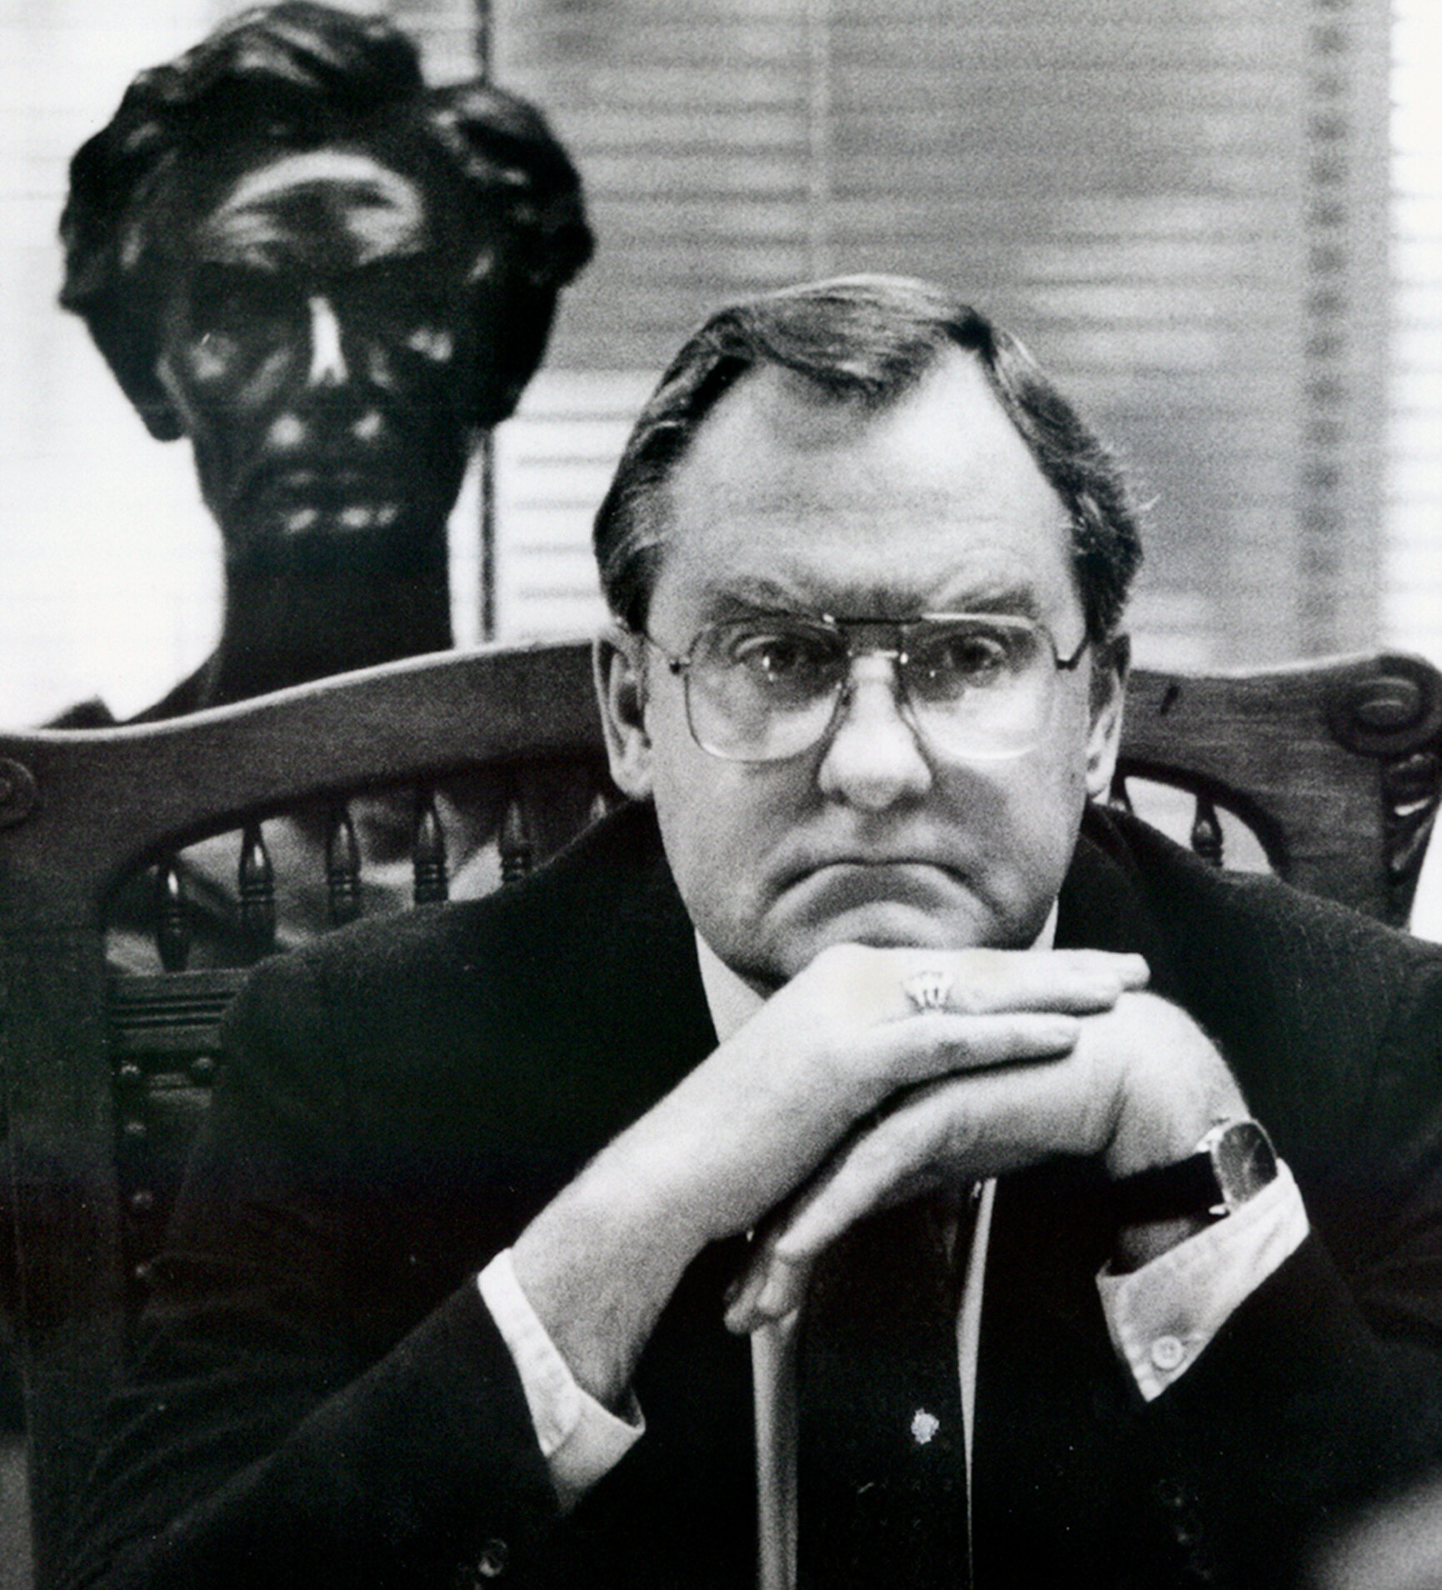
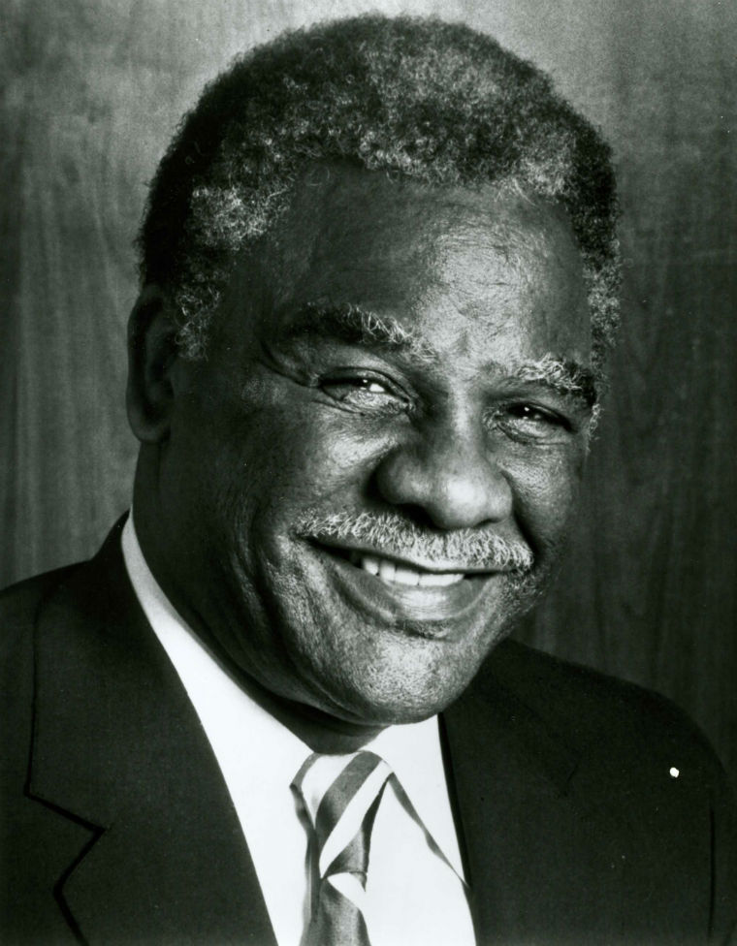
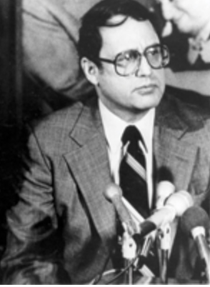
Back to Addison
Thompson: “It would be my desire to do everything possible to keep the White Sox in Illinois.
Washington: “If you go beyond the border, you can’t take [Chicago] with you.”
Reinsdorf: “Addison isn’t Iowa. Addison is Chicago as far as I am concerned.”

Slide 17
Addison falls through
White Sox need zoning permit
Addison homeowners get referendum on November 1986 ballot
Bloomingdale Township rejects two referenda to create open space district
Addison rejects advising Board of Trustees to grant the permit, by 43 votes!

Slide 18
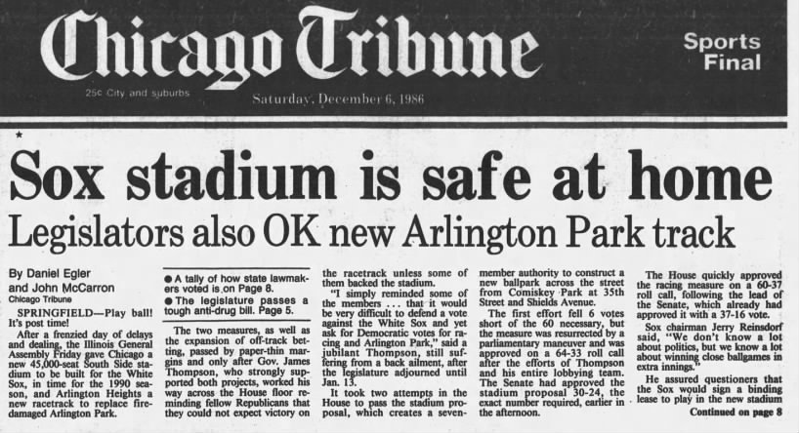
Meanwhile, back in Springfield

Slide 19
1986 bill
Key components
Created Illinois Sports Facilities Authority
ISFA authorized to sell $120M in bonds funded from 2% Chicago hotel/motel tax increase
Sox agreed to pay $4M in rent and maintenance costs (~$2M)
City and state will cover operating deficits

Slide 20
1987: Project stalled
Federal solution needed to ensure tax-exempt status of bonds
ISFA unable to get organized
Effective date of July 1, 1989
Thompson gets three appointees
Washington gets three appointees
Thompson can name chair but Washington has veto
No agreement until October

Slide 21
Enter St. Petersburg
Florida Suncoast Dome under construction
Officials go to Florida legislature to seek $30M to have dome ready for Opening Day 1989
White Sox offered more favorable terms and expect greater TV revenues

Slide 22
Guess who wants to renegotiate?
White Sox, Thompson, new Chicago Mayor Eugene Sawyer, ISFA return to negotiating table
While refusing the break off talks with St. Petersburg, new deal reached
White Sox say they will stay in Chicago if legislature approves the deal

Slide 23
And what is that new deal?
White Sox pay no rent for first 10 years of lease unless attendance exceeds 1.2M
In years 11 through 20, ISFA has to buy up to 300K tickets if attendance falls below 1.5M
Maintenance will now be split between White Sox and ISFA
White Sox will share 35% of local radio and TV revenues about $5.8M
If stadium isn’t ready by Opening Day 1991, ISFA will pay a $5M penalty that increases by $2.5M each year after that
Bond authority increased from $120M to $150M

Slide 24
Back in Florida
Sunshine Boys back to Sunshine State
Florida governor Bob Martinez: “When I see something in writing that they want to be Florida’s first team instead of the second team in Chicago, we’ll have some serious business.”
June 7: Florida legislature approves $30M for dome
Reinsdorf and Einhorn statement: “Their commitment is impressive.”

Slide 25
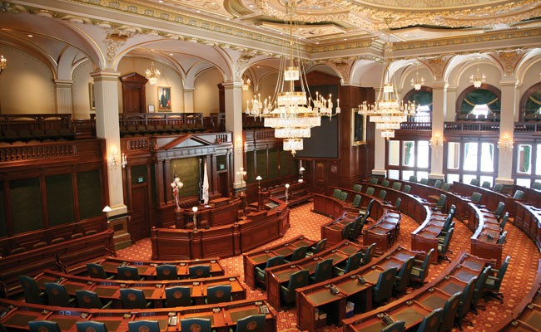
Back in Springfield
Passage uncertain
Thompson working the Rs; House Speaker Mike Madigan working the Ds
Proposal for state to buy the Sox passed the Senate
Sox signature on lease required to go forward with the bill
Lease signed June 29
Legislation passed June 30

Slide 26
Thompson signs bill
Comiskey Park, July 6, 1988
Thompson: “I want to send the message that Chicago is the most American of all cities and Illinois is the most American of all states.”

Slide 27
Project advances
ISFA has October 15, 1988 deadline to acquire 80% of the land
Also in October, federal legislation to allow tax-exempt status for bonds is passed
Bonds sold in the spring of 1989
But bids come in much higher than expected

Slide 28
Groundbreaking
Contractor, ISFA, White Sox huddle and find savings
Shovels in dirt, May 7, 1989
Einhorn: “The bottom line is we are here today and we are here to stay.”

Slide 29
The end for the original
Speedway Wrecking wins demolition contract
Wrecking ball hits corner where first-base upper deck meets right-field upper deck at 10:08 AM on April 3, 1991
Asked if he is feeling nostalgic, Reinsdorf: “All I see passing away is an antiquated, obsolete ballpark.”

Slide 30
Opening Day
First game at new Comiskey Park on April 18, 1991
Tigers 16, White Sox 0

Slide 31
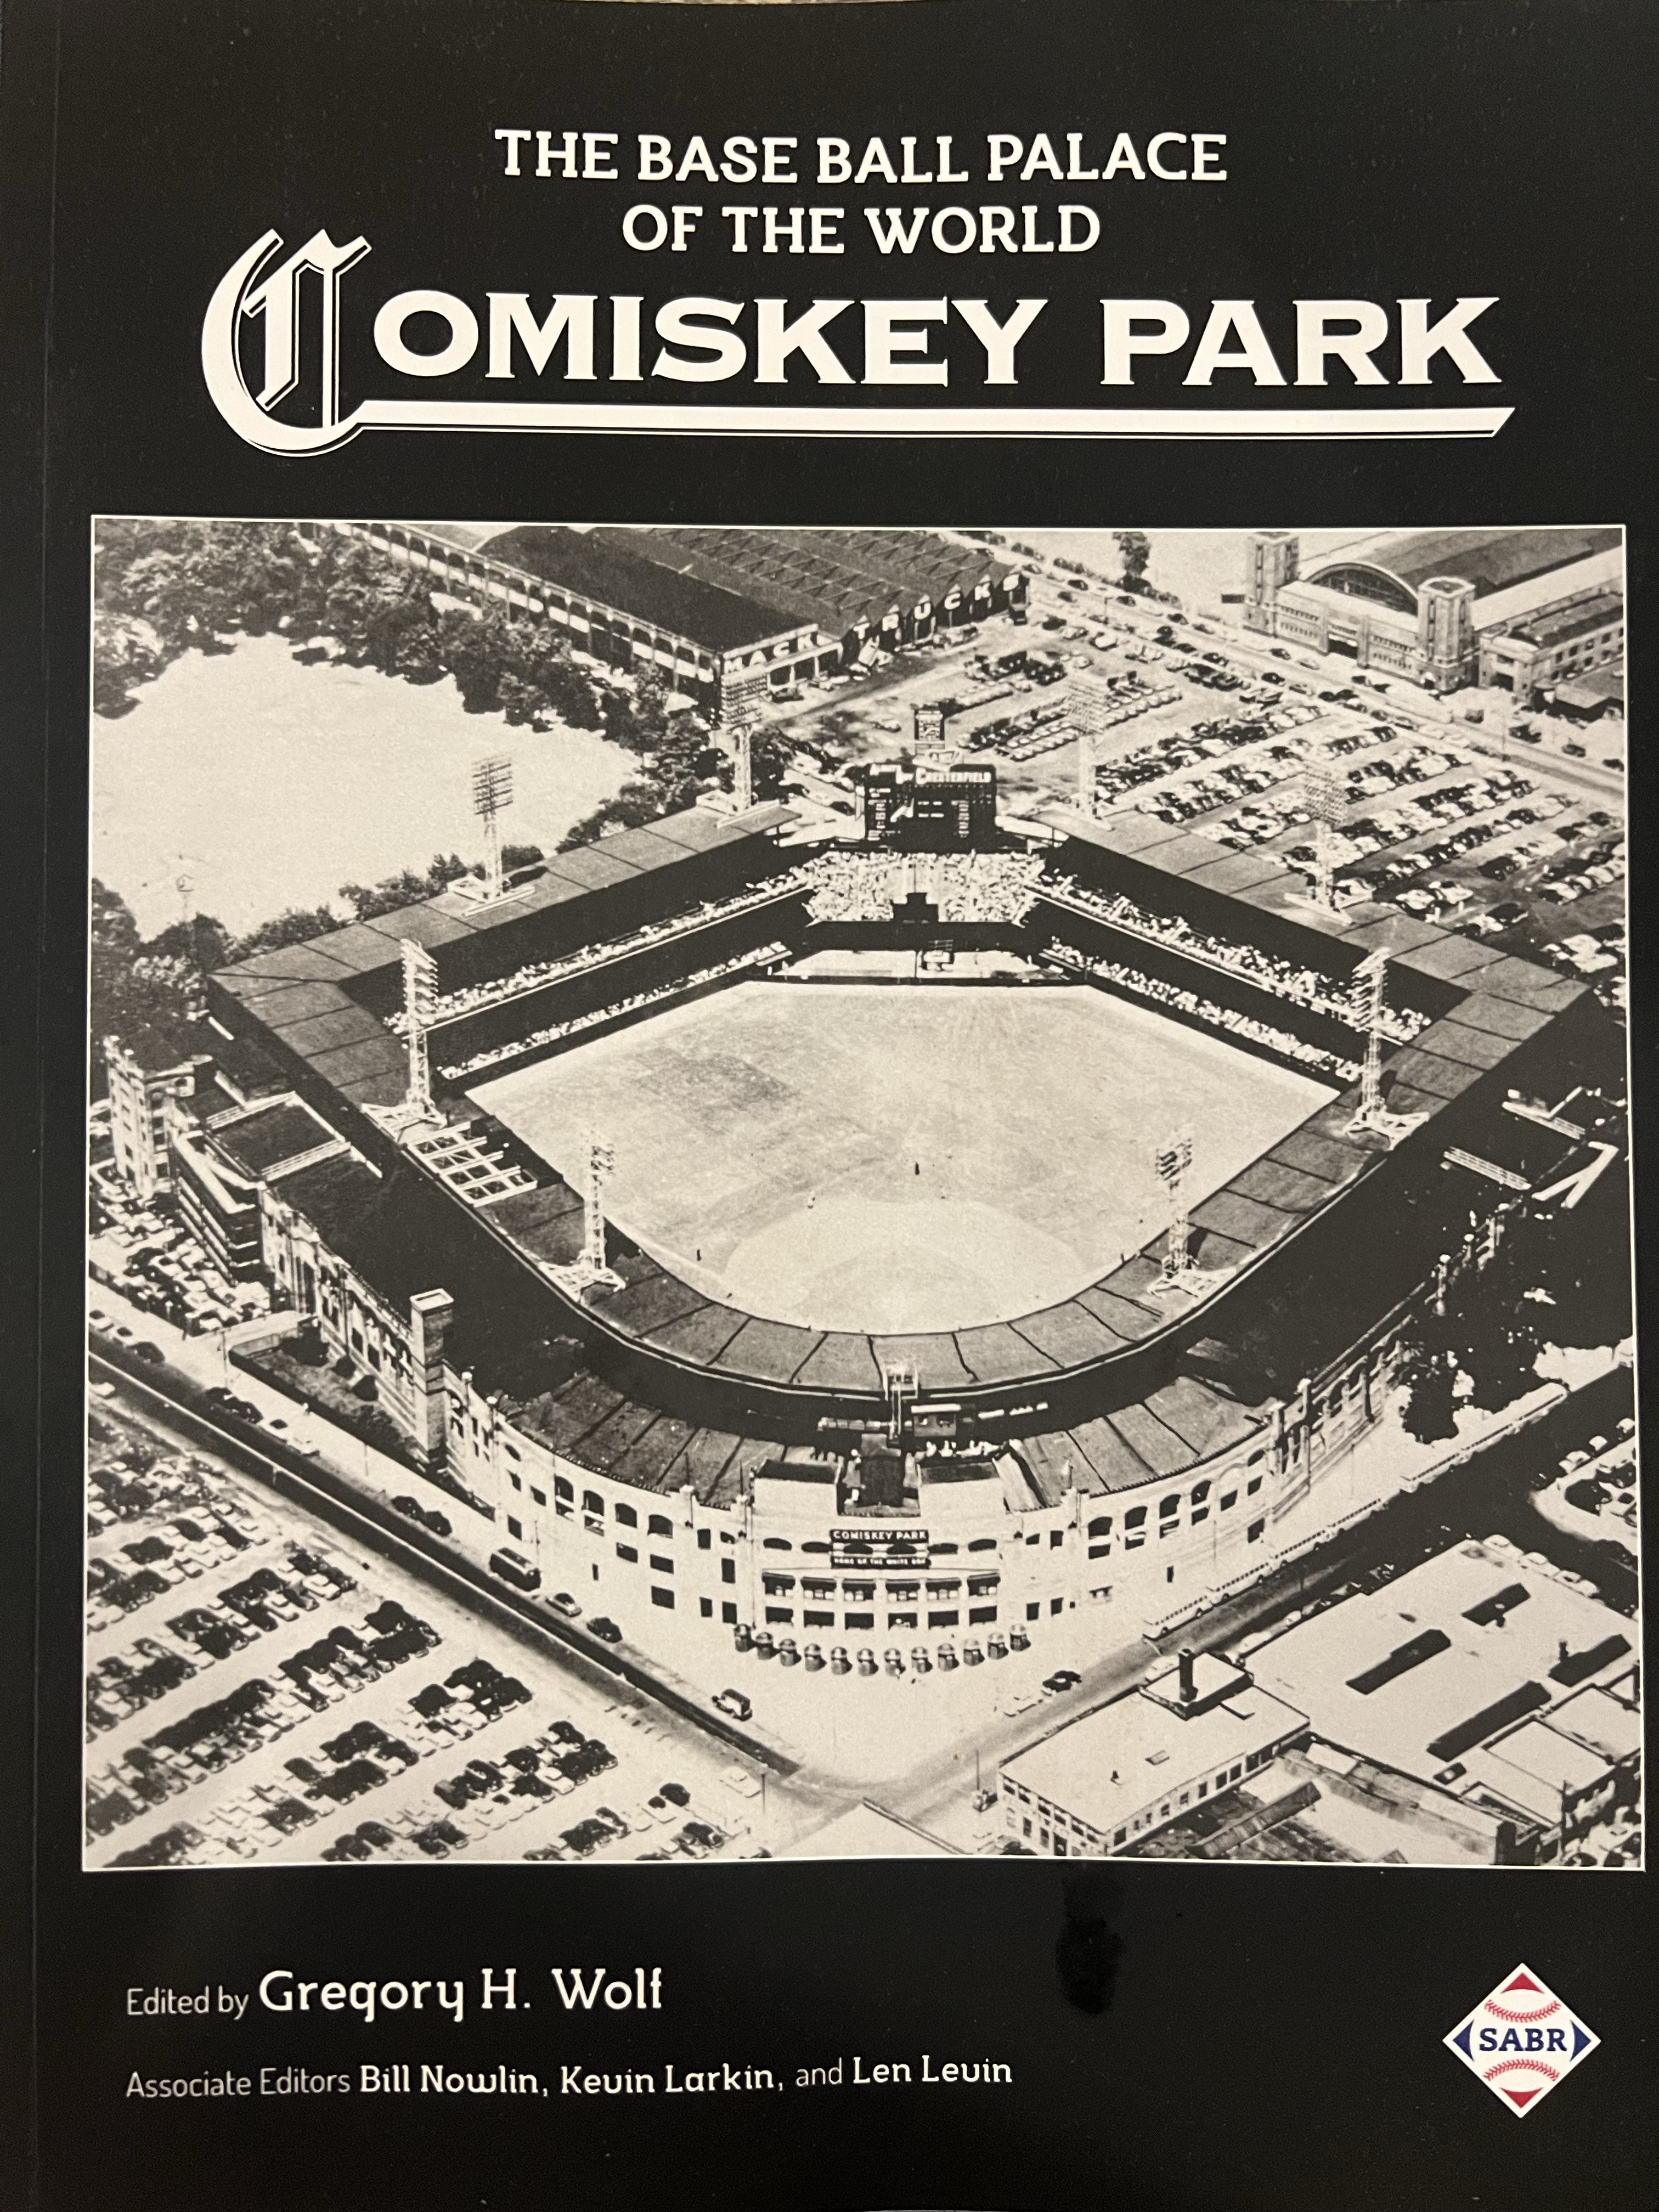
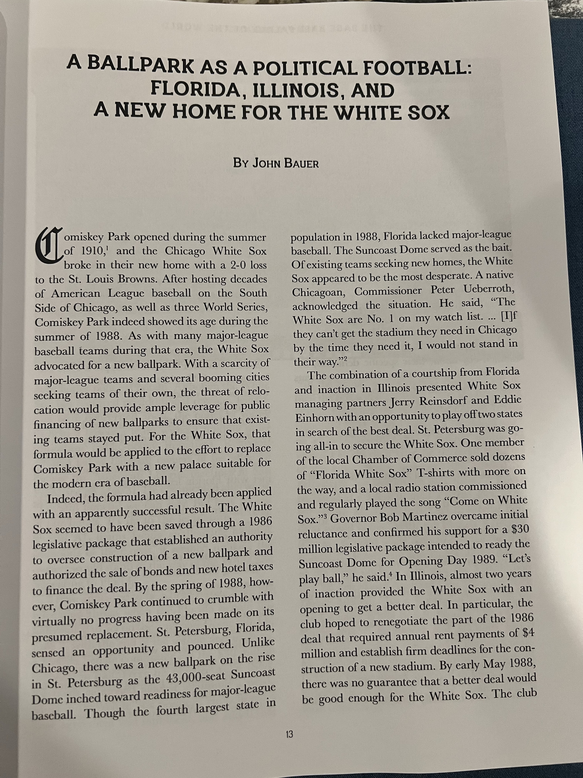

Slide 32
Sources
Andy McCue, Stumbling Around The Bases: The American League’s Mismanagement in the Expansion Eras, University of Nebraska Press, 2022
AP photos
ballparksofbaseball.com
baseball-reference.com
Bill Veeck (with Ed Linn), Veeck as in Wreck, University of Chicago Press, 1962 (2001 edition)
cbssports.com
Chicago Tribune
Dallas Morning News
Getty Images
Gregory Wolf (editor), Comiskey Park: The Baseball Palace of the World, SABR Publishing, 2019
illinois times.com
John Helyar, Lords of the Realm, Ballantine Books, 1994
Lawrence S. Ritter, Lost Ballparks, Studio Publishing 1994
Neil deMause & Joanna Cagan, Field of Schemes: How the Great Stadium Swindle Turns Private Money into Profit, Bison Books, 2008
New York Times
newspapers.com
The Sporting News
sportsbusinessjournal.com
stadiumpage.com
State Journal Register (Springfield, Illinois)
wikipedia.com

Slide 33
Questions?
John Bauer
jwbauer72@gmail.com

