Slide 1
Modeling Batter Characteristics Using Hit-Tracking Data
Glenn Healey and Shiyuan Zhao
Electrical Engineering and Computer Science
University of California, Irvine
Data provided by Baseball Savant, Brooks Baseball
SABR Analytics Conference 2018

Slide 2
Goal: Compare players using distributions defined
over parameters measured by ball-tracking systems
Motivation: Physical parameters of pitches and batted balls are intrinsic to player skill
Applications:
Optimize performance and health projections
Larger samples for modeling batter/pitcher matchups
Compare players across time and competition level
Monitor individual players over time
Relate distributions and performance

Slide 3
Previous Work
Bill James (1986) similarity scores
Nate Silver (2003) PECOTA
Josh Kalk (2008) Pitcher Similarity Scores
Stephen Loftus (2013) Pitcher Similarity Scores 2.0
Vince Gennaro (2013) Clustering pitchers by similarity

Slide 4
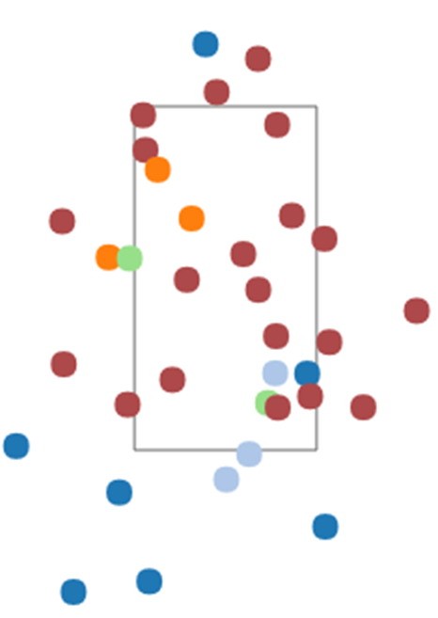
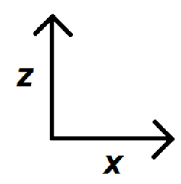
Pitch Data
For every pitch
Speed s
Horizontal movement x
Vertical movement z

Slide 5
Pitch Value Depends on s: 0-0, RHP vs. RHB, l_{z} = 2.5 feet, b_{x} = -3 inches, b_{z} = 6 inches

Slide 6
Pitch Value depends on z: 0-0, RHP vs. RHB, s = 90 mph, l_{z} = 2.5 feet, x = -3 inches

Slide 7
Comparing Pitch Distributions
Lester pitches, 2016
Sale pitches, 2016

Slide 8
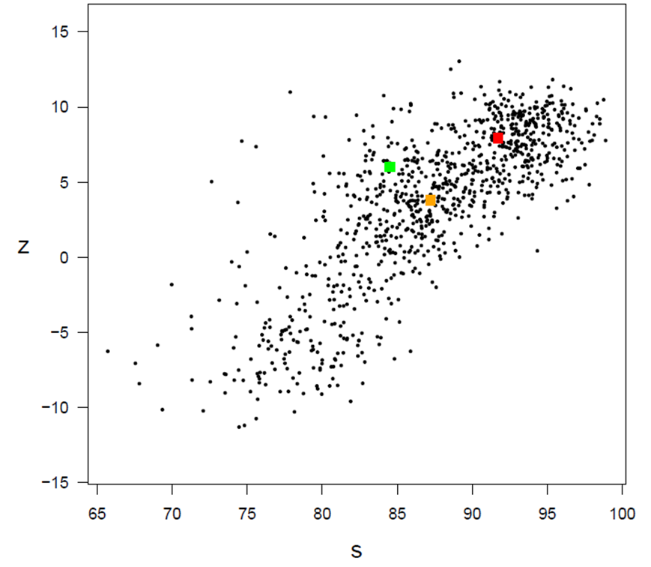
Ground Distance
Color | Pitcher | Type
Green | Ian Kennedy | Change
Orange | Mat Latos | Cutter
Red | Jhoulys Chacin | 4-seam
Whitening transform
Speed and Vertical Movement
RHP vs. RHB, 2016

Slide 9
Pitcher Similarity Measure
For right-handers A and B
Most similar RHP in 2016: Matt Harvey, Shelby Miller
For left-handers Y and Z
Most similar LHP in 2016: Jon Niese, Chris Rusin

Slide 10
NMDS for Unique Right-handers, 2016

Slide 11
NMDS for Unique Left-handers, 2016

Slide 12
Regression for Forecasting
Previous Work:
B. Efron and C. Morris, “Stein’s paradox in statistics,”
Sci. Amer., vol. 236, no. 5, pp. 119–127, 1977.
T. Tango, M. Lichtman, and A. Dolphin, The Book:
Playing the Percentages in Baseball. Dulles, VA,
USA: Potomac Books, 2007.
G. Healey, “Learning, visualizing, and assessing a
model for the intrinsic value of a batted ball,” IEEE
Access, vol. 5, pp. 13811–13822, 2017.

Slide 13
Forecasting for RHP vs. RHB

Slide 14
Chris Archer Group vs. RHB, 2015

Slide 15
Yovani Gallardo Group vs. RHB, 2015

Slide 16
Felix Hernandez Group vs. RHB, 2015

Slide 17
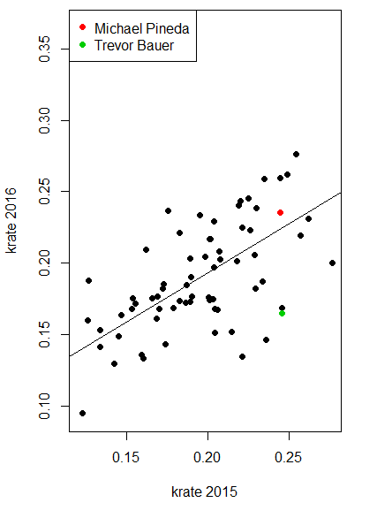
Forecasting Example, RHP vs. RHB
Pitcher | 2015 krate | 2016 krate
Pineda | 24.5% | 26.0%
Bauer | 24.6% | 16.9%
Pitcher | 2016 Full Regression | 2016 Error
Pineda | 22.4% | 3.6%
Bauer | 22.5% | 5.6%
Pitcher | 2016 Group Regression | 2016 Error
Pineda | 23.5% | 2.5%
Bauer | 16.5% | 0.4%

Slide 18
Batted Ball Data
vertical launch angle v
horizontal spray angle h
Batted ball exit speed s
Batted ball spin rate ω

Slide 19
Batted Ball Value Depends on s, v, and h

Slide 20
Comparing Batted Ball Distributions Speed and Launch Angle, RHP vs. RHB, 2017

Slide 21
Exit speed and vertical launch angle, RHP vs. RHB, 2017
Ground Distance
Whitening Transform

Slide 22
Batter Similarity Measure
RHB:
Most Similar: Andrew McCutchen and Nolan Arenado
LHB:
Most similar: Mitch Moreland and Shin-Soo Choo
Switch:
Most similar: Jose Ramirez, Francisco Lindor

Slide 23
Unique Right-Handed Batters, 2017
RHB | Distance to Nearest RHB
Aaron Judge | 0.3286
Giancarlo Stanton | 0.3282
Jose Iglesias | 0.3038
Willson Contreras | 0.3013
Hunter Renfroe | 0.2987
Ronald Torreyes | 0.2964
Paul DeJong | 0.2915
Guillermo Heredia | 0.2904
Jose Peraza | 0.2904
Jorge Bonifacio | 0.2871

Slide 24
NMDS for Unique RHB, 2017

Slide 25
Unique Left-Handed Batters, 2017
LHB | Distance to Nearest LHB
Jarrod Dyson | 0.3352
Didi Gregorius | 0.3207
Norichika Aoki | 0.3134
Lucas Duda | 0.3057
Kyle Schwarber | 0.3035
Ben Revere | 0.3034
Dee Gordon | 0.3034
Bryce Harper | 0.3022
Ender Inciarte | 0.2993
Carlos Gonzalez | 0.2956

Slide 26
NMDS for Unique LHB, 2017

Slide 27
Unique Switch-Hitters, 2017
Switch-Hitter | Distance to Nearest
Kendrys Morales | 0.3271
Billy Hamilton | 0.3186
Erick Aybar | 0.3186
Carlos Santana | 0.3184
Cesar Hernandez | 0.3055
Jose Reyes | 0.2993
Yangervis Solarte | 0.2964
Tucker Barnhart | 0.2931
Melky Cabrera | 0.2904
Matt Wieters | 0.2835

Slide 28
NMDS for Unique Switch-Hitters, 2017

Slide 29
RHB with Most Change, 2016-2017
RHB | Distance | Age on 6/30/17 | 2016 wOBA | 2017 wOBA
Matt Holliday | 0.4165 | 37 | .335 | .320
Giancarlo Stanton | 0.4120 | 27 | .344 | .410
Hernan Perez | 0.3926 | 26 | .312 | .298
Jonathan Lucroy | 0.3903 | 31 | .362 | .311
Evan Longoria | 0.3809 | 31 | .350 | .312
Mark Trumbo | 0.3566 | 31 | .358 | .295
Mike Trout | 0.3543 | 25 | .418 | .437
Jose Bautista | 0.3533 | 36 | .355 | .295
Marcell Ozuna | 0.3493 | 26 | .330 | .388
Hanley Ramirez | 0.3444 | 33 | .367 | .318

Slide 30
LHB with Most Change, 2016-2017
LHB | Distance | Age on 6/30/17 | 2016 wOBA | 2017 wOBA
Yonder Alonso | 0.4027 | 30 | .299 | .366
Logan Morrison | 0.3751 | 29 | .318 | .363
Jackie Bradley Jr. | 0.3596 | 27 | .354 | .313
Scooter Gennett | 0.3569 | 27 | .315 | .367
Jake Lamb | 0.3535 | 26 | .352 | .353
Jason Kipnis | 0.3528 | 30 | .347 | .300
Dee Gordon | 0.3504 | 29 | .280 | .312
Gerardo Parra | 0.3456 | 30 | .284 | .337
Matt Carpenter | 0.3442 | 31 | .375 | .361
Bryce Harper | 0.3434 | 24 | .343 | .416

Slide 31
Switch-Hitters with Most Change, 2016-2017
Switch-Hitter | Distance | Age on 6/30/17 | 2016 wOBA | 2017 wOBA
Erick Aybar | 0.3853 | 33 | .271 | .282
Yasmani Grandal | 0.3809 | 28 | .350 | .325
Jed Lowrie | 0.3782 | 33 | .282 | .347
Yangervis Solarte | 0.3704 | 29 | .346 | .311
Eduardo Escobar | 0.3532 | 28 | .269 | .320
Carlos Beltran | 0.3421 | 40 | .358 | .283
Francisco Lindor | 0.3405 | 23 | .340 | .353
Kendrys Morales | 0.3291 | 34 | .339 | .332
Matt Wieters | 0.3253 | 31 | .307 | .273
Neil Walker | 0.3238 | 31 | .351 | .346

Slide 32
Batters with Least Change, 2016-2017
Distance
wOBA16
wOBA17
RHB:
Nolan Arenado
0.2268
.386
.395
LHB:
Jay Bruce
0.2343
.340
.350
Switch:
Freddy Galvis
0.2414
.284
.298

Slide 33
Forecasting wOBAcon, RHB

Slide 34
Elvis Andrus Group, 2016

Slide 35
Forecasting wOBAcon, RHB
Batter | 2017 Full Regression | 2017 Error
Andrus | .369 | .012
Abreu | .395 | .043
Altuve | .403 | .032
Castro | .377 | .023
Batter | 2017 Group Regression | 2017 Error
Andrus | .382 | .001
Abreu | .422 | .016
Altuve | .434 | .001
Castro | .394 | .006

Slide 36
Summary
Similarity Measure
Distributions over physical measurements
Whitened EMD metric
Applications
Compare players across time and level
Optimize performance and health projections
Matchup modeling
Performance modeling
Entertainment

