Slide 1
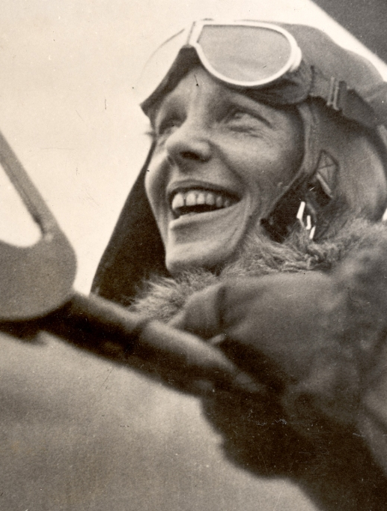
Some of us have great runways already built for us. If you have one, take off! But if you don’t have one, realize it is your responsibility to grab a shovel and build one for yourself and for those who will follow after you.
Amelia Earhart

Slide 2
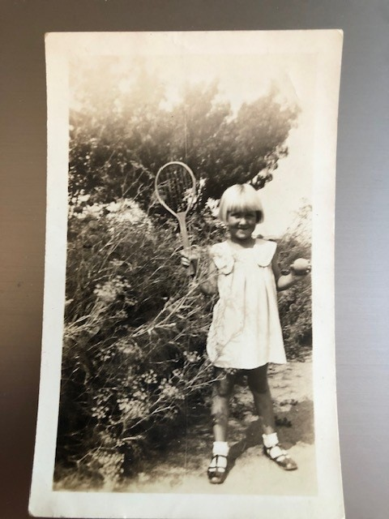
Young Maybelle Blair
No matter how hard her mother tried, nothing replaced baseball

Slide 3
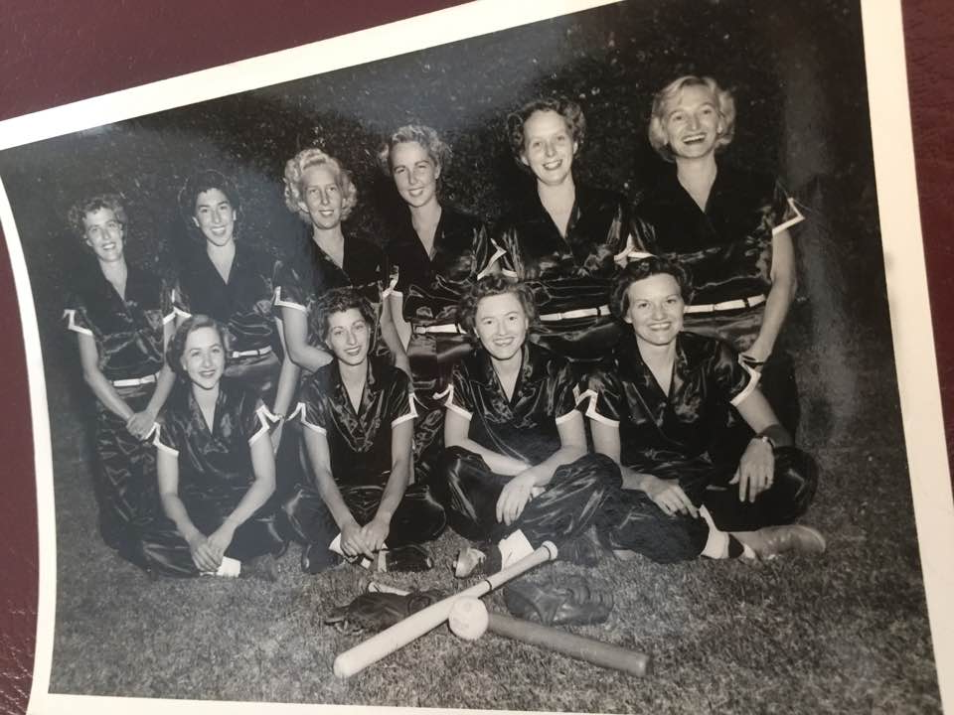

Slide 4
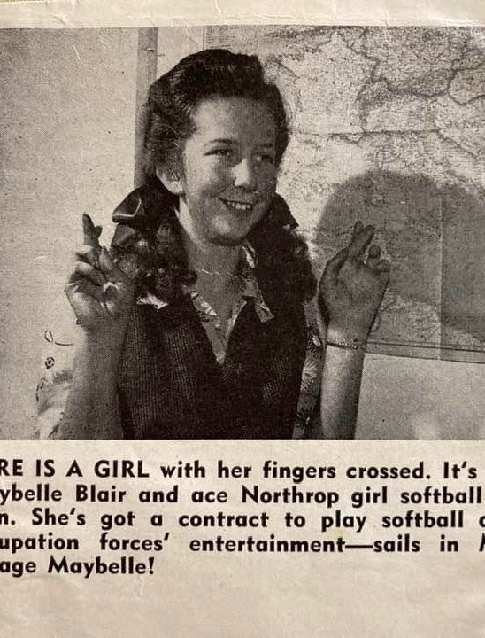
Doing her part for the War effort

Slide 5
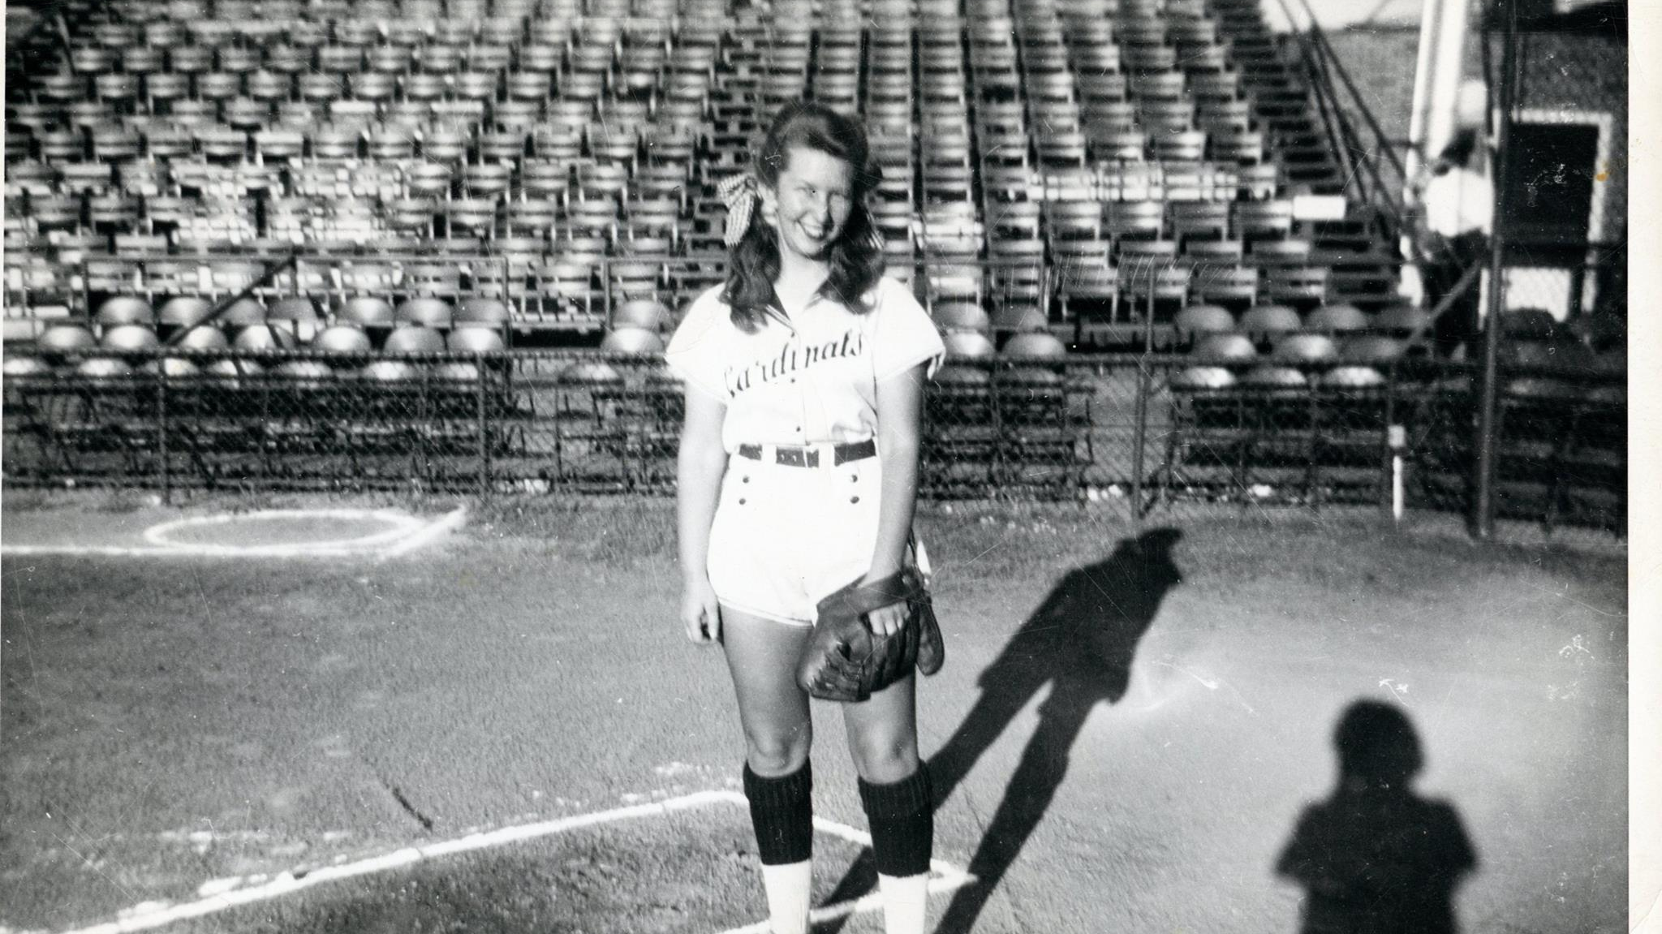

Slide 6
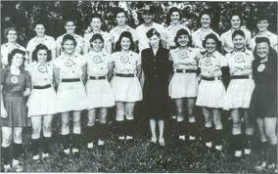
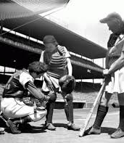
All American Girls Professional Baseball League

Slide 7
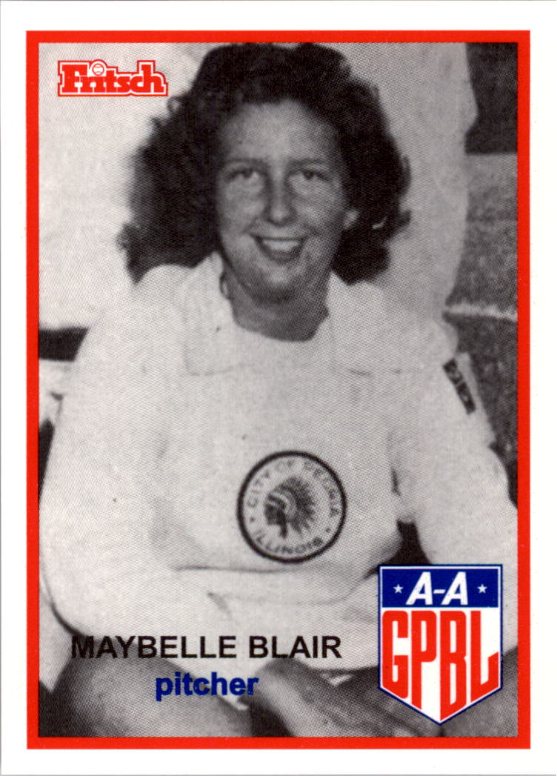
The Peoria Redwings
Maybelle Blair

Slide 8
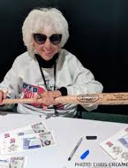
Signing autographs at an AAGPBL reunion

Slide 9
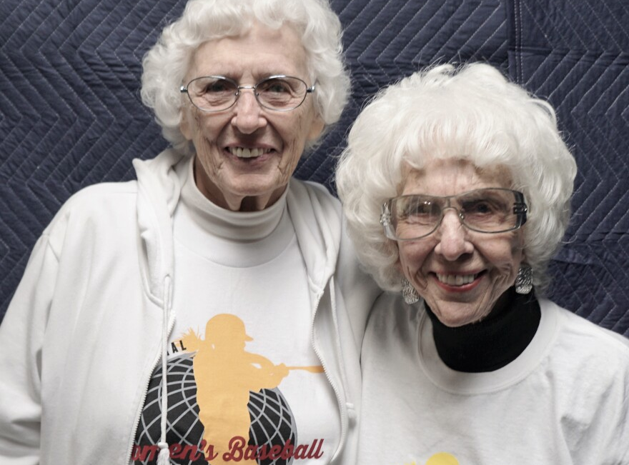
Blair and Shirley. Founders of the International Women’s Baseball Center

Slide 10
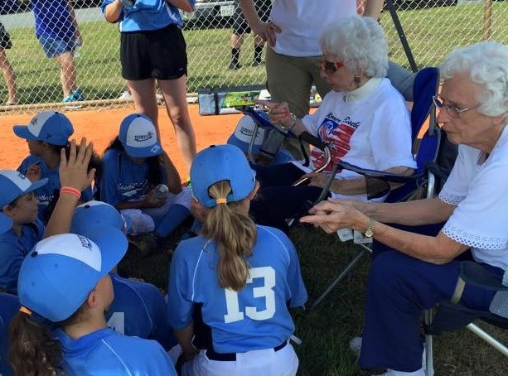
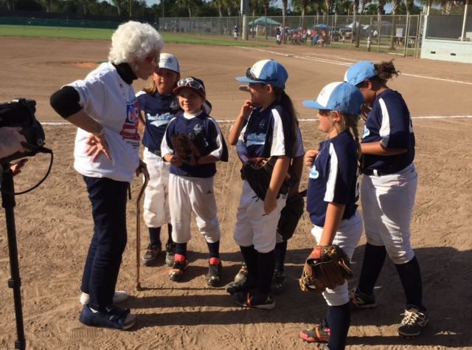
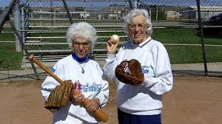
Holding Court: Maybelle and Shirley

Slide 11
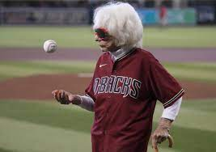
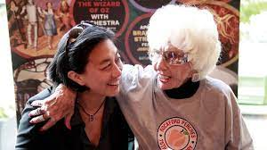
From throwing out a first pitch to hanging out with MLB’s first female GM, Maybelle stays in the game.

Slide 12
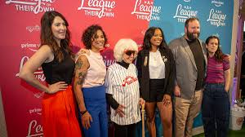
Blair and the creators and cast of Amazon Prime’s A League of Their Own

Slide 13
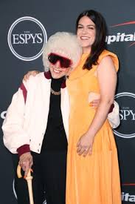
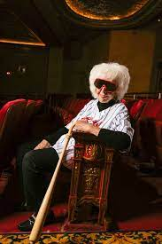
At the Espys with Abby Jacobson and in the New York Times

