Slide 1
THE 1959 WORLD SERIES:
A CLASH OF STYLES
BETWEEN THE CHICAGO WHITE SOX
AND THE LOS ANGELES DODGERS
STEVE KREVISKY & BARRY MEDNICK
JULY 2023 SABR CONVENTION
CHICAGO, ILLINOIS

Slide 2
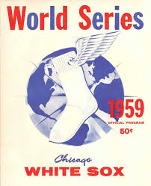
1959 AL
W L PYTH HOME ROAD 1-RUN
Chi 94 60 86-68 47-30 47-30 35-15
Clev 89 65 87-67 43-34 46-31 30-24
NY 79 75 81-73 40-37 39-38 23-24
Det 76 78 75-79 41-36 35-42 17-27

Slide 3
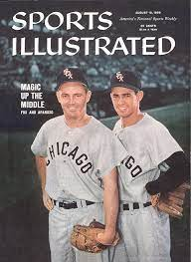
1959 AL
SCORED ALLOWED RS-RA
Chi 669 588 +81
Clev 745 646 +99
NY 687 647 +40
Det 713 732 -19

Slide 4
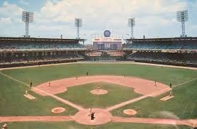
AL ERA rankings
TEAM ERA RANK
WHITE SOX 3.29 1
YANKEES 3.60 3
INDIANS 3.75 4
TIGERS 4.20 7

Slide 5
Runs scored
TEAM RUNS RANK
INDIANS 745 1
RED SOX 726 2
TIGERS 713 3
YANKEES 687 4
CHISOX 669 5

Slide 6
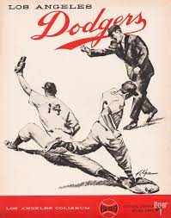
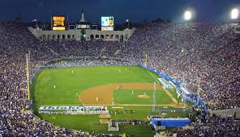
DoDGERS
RS RA RS – RA PYTH ONE RUN
705 670 +35 82-74 33-22

Slide 7
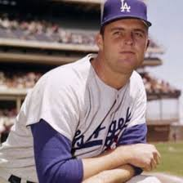
DoDGERS VS BRAVES
RS RA RS – RA PYTH ONE RUN
LA 705 670 +35 82-74 33-22
MIL 724 623 + 101 89-67 21-26

Slide 8
DoDGERS VS GIANTS
RS RA RS – RA PYTH ONE RUN
LA 705 670 +35 82-74 33-22
SF 705 613 +92 87-67 20-22

Slide 9
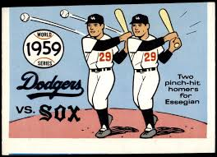
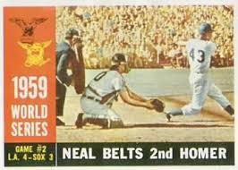
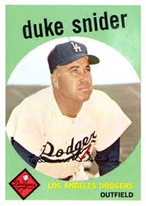
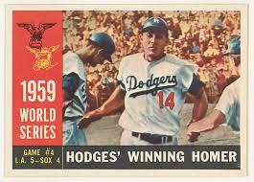
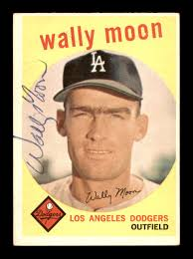
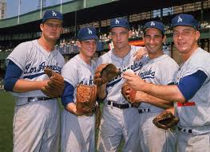
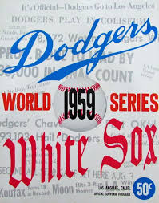
1959

Slide 10
1963 White sox
Won-Lost Pyth Home Road
94-68 98-64 49-33 45-35
1Run RS RA
22-25 683 544

Slide 11
1963 dodgers
Won-Lost PYTH Home Road
99-63 92-70 50-31 49-32
1Run RS RA
33-18 640 550

Slide 12
White sox vs previous pennant winners
White Sox Previous winners with lower
Runs 669 1945 Tigers 633
BA .250 1918 Red Sox .249
Slugging .364 1945 Tigers .361
HR 97 1948 Braves 95
SB 113 (more) 1949 Dodgers 117

Slide 13
White sox vs subsequent pennant winners
White Sox Next winners with lower
Runs 669 1963 Dodgers 640
BA .250 1965 Dodgers .245
Slugging .364 1963 Dodgers .357
HR 97 1965 Dodgers 78
SB 113 (more) 1963 Dodgers 124

Slide 14
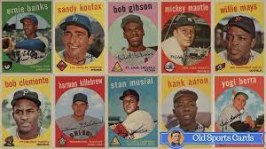
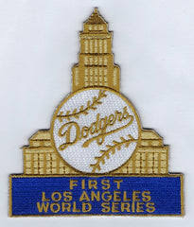
references
Comisky’s Last World Series, BY Charles Billington
BASEBALL-REFERENCE.COM
Go-Go to Glory, editor Don Zminda
The Sports Encyclopedia Baseball, Neft & Cohen

