Slide 1
Noisier Judgments:
In-game applications of probability surface-based analysis of umpiring variability
Emily-Anne Patt
SABR Analytics Conference
10 March 2024

Slide 2
Emily-Anne
Patt
Introduction
Manager,
Quantitative Intelligence & Methodologies
Alphabet, Inc.
Coach at Washington Nationals Youth Baseball Academy

Slide 3
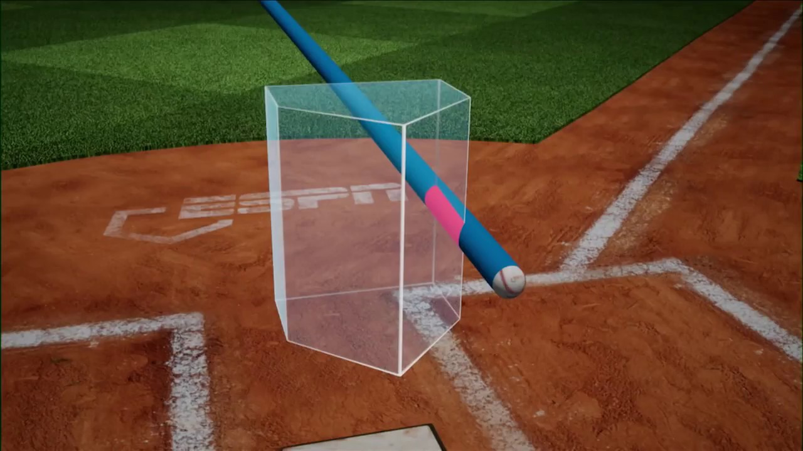
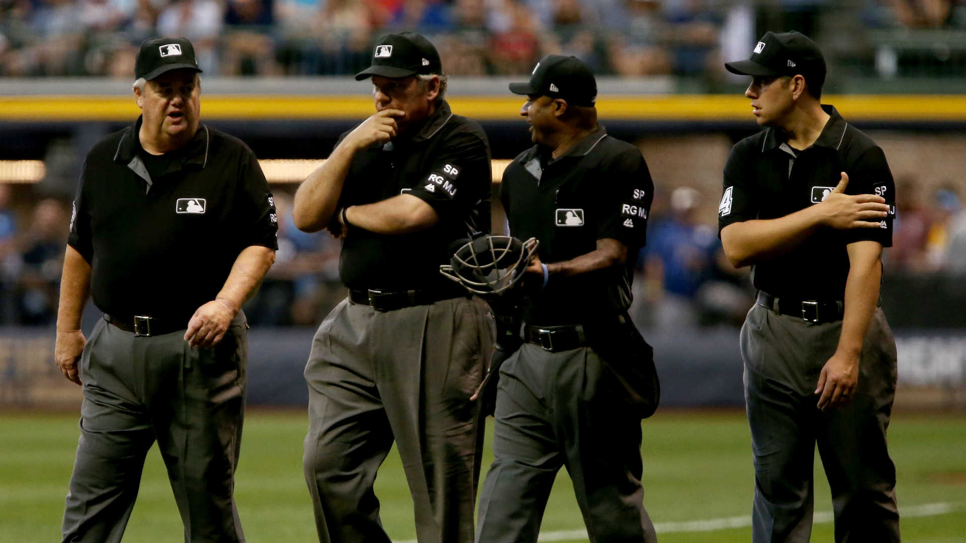
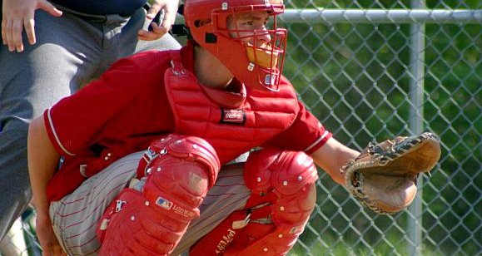
Introduction
Analytical Outline
Review the strike zone probability model.
Explore model sensitivity and situational analysis.
Deep-dive into player performance evaluation.

Slide 4
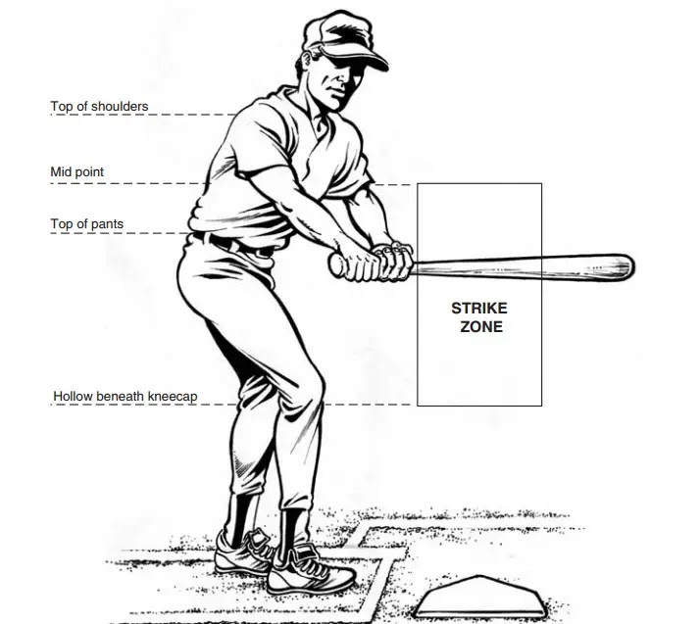
Introduction
Motivation
The strike zone is the fundamental measurement of baseball.
A measurement is only as good as its ruler.
The umpire is the ruler, not the MLB rule book.
So…how good is that ruler?

Slide 5
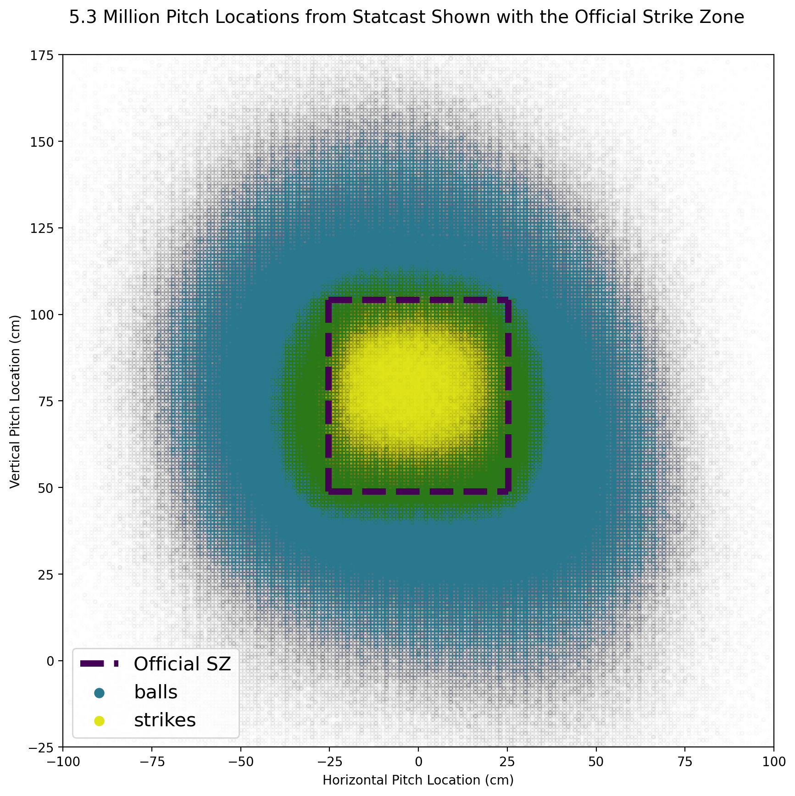
Pitch location for 5.3 million called pitches
(z)
(x)
Modeling
Notes:
Noisy judgements in Green

Slide 6
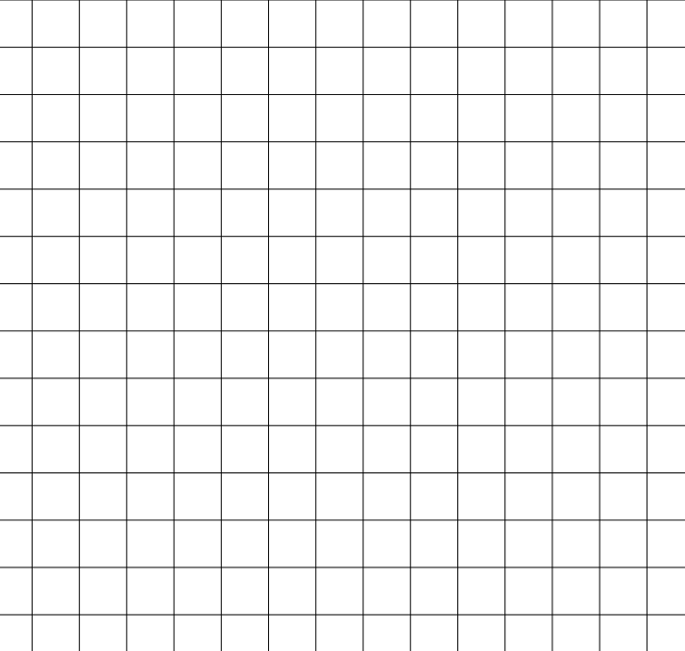
Building a Strike Zone Probability Surface: Step 1
(z)
(x)
1 cm
Modeling
71% | 63% | 54% | 47%
72% | 65% | 55% | 43%
78% | 65% | 57% | 47%
76% | 64% | 55% | 41%
Note: Reported pitch location accuracy and precision changes over time with evolution of pitch tracking technology.

Slide 7
Building a Strike Zone Probability Surface: Step 4
The Anatomy of a Strike Zone Sigmoid
Pitch Data
P
z
Modeling

Slide 8
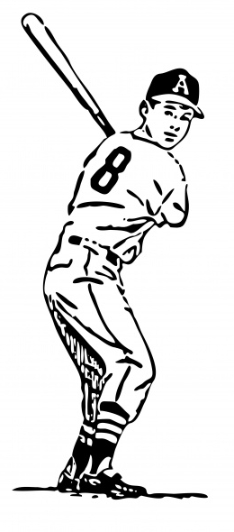
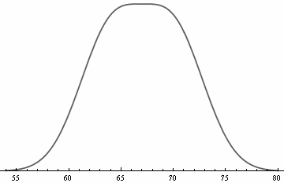
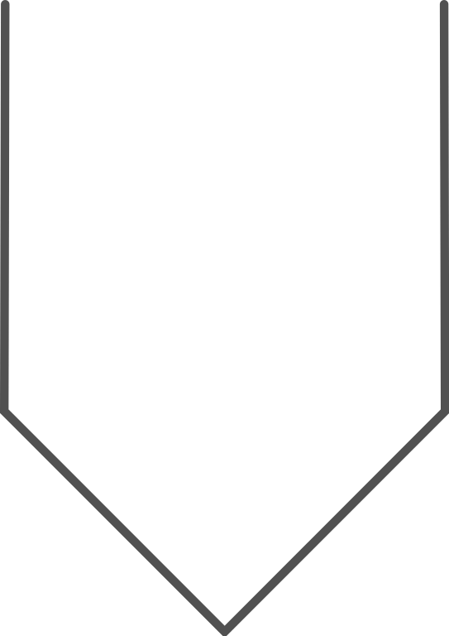
Building a Strike Zone Probability Surface: Step 3
The Anatomy of a Strike Zone Sigmoid
100%
Probability of the umpire calling the pitch a strike.
(z)
0%
(x)
0%
100%
Probability of the umpire calling the pitch a strike.
Modeling
Takeaway: Each probability distribution is made up of two sigmoids, curving from the middle of the strike zone where the pitch will nearly always be called a strike to the edge of the strike zone where the strike calls are rare.

Slide 9
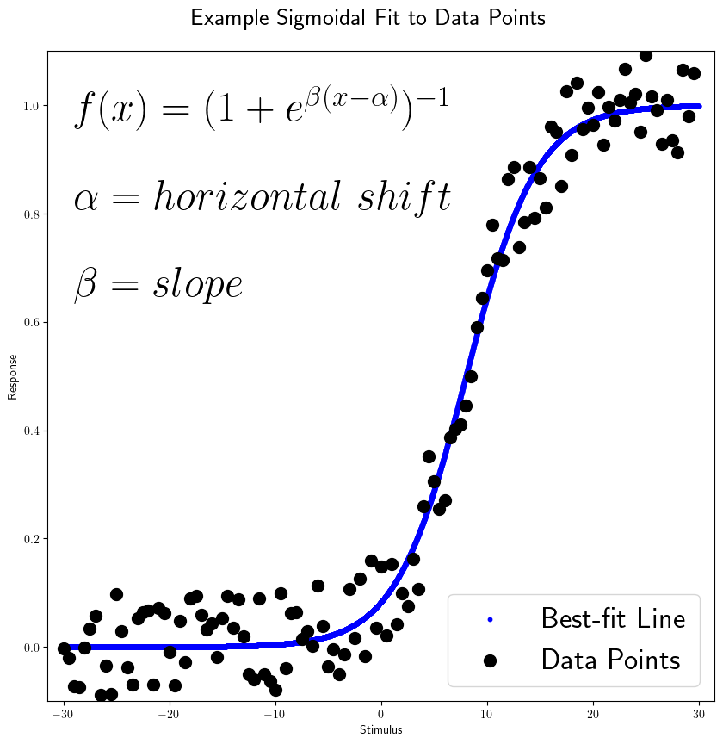
Building a Strike Zone Probability Surface: Step 4
The Anatomy of a Strike Zone Sigmoid
P
z
Modeling

Slide 10
Building a Strike Zone Probability Surface: Step 4
The Anatomy of a Strike Zone Sigmoid
Pitch Data
Best Fit Surface
P
P
z
z
Modeling

Slide 11
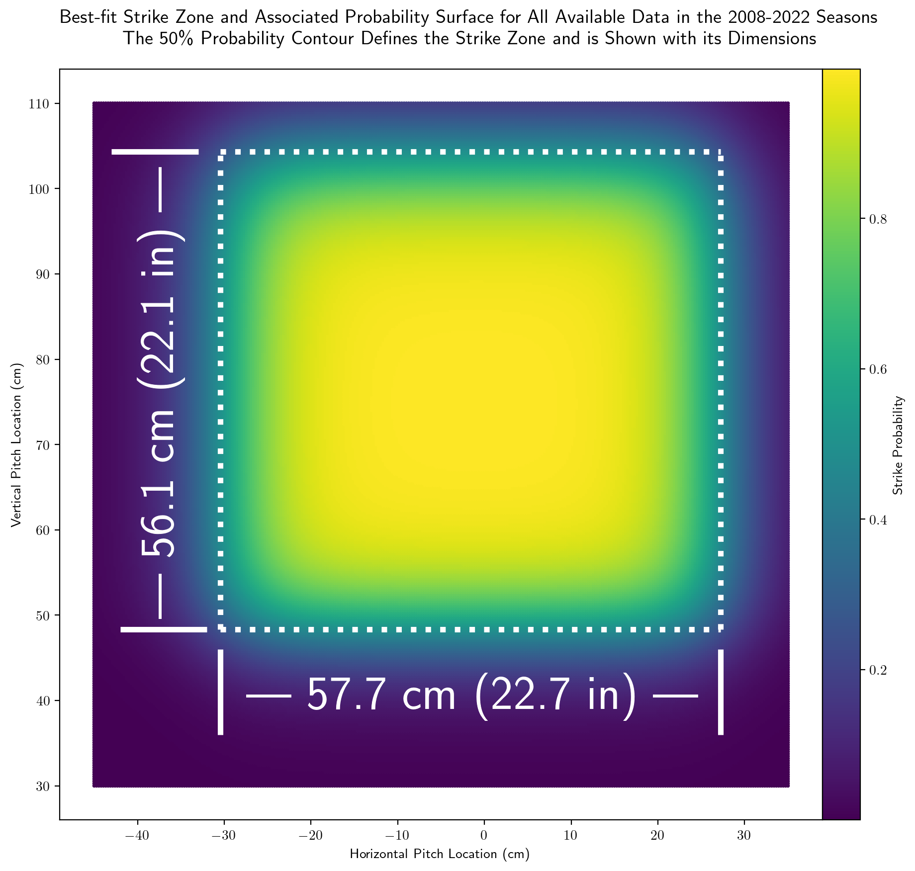
The Umpires’ Strike Zone
(z)
(z)
(P)
(x)
Results
The best-fit strike zone for all umpires across all seasons in the data set is 57.7 cm along the horizontal axis and 56.1 cm tall.
The best-fit strike zone is shifted 1.6 cm to the left of the center of the plate.

Slide 12
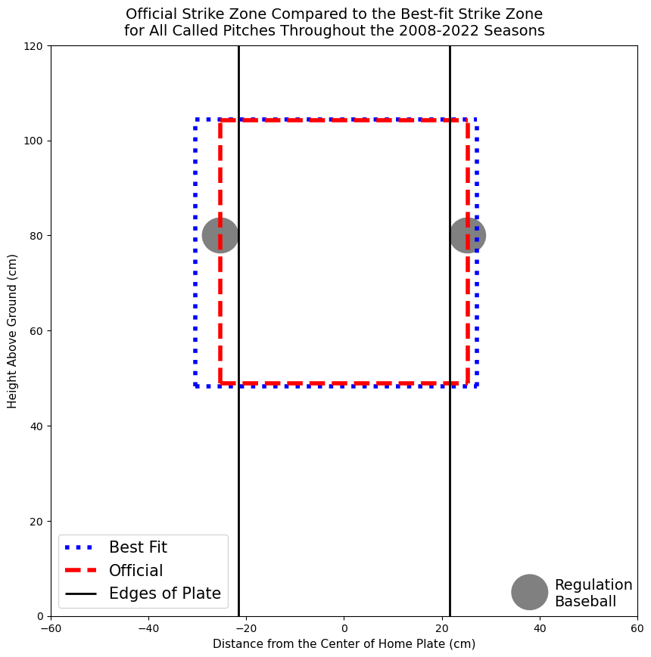
How does the actual strike zone compare to the official MLB strike zone?
Validating the Ruler
The Umpires’ Best-Fit Strike Zone Compared to the Official Zone
Results
The best-fit strike zone (blue dotted box) is 7.1 cm wider than the official strike zone (red dashed box).
Red dashed box passes through the center of a baseball that is tangent to home plate.
The best-fit strike zone is shifted 1.6 cm to the left of the center of the plate.

Slide 13
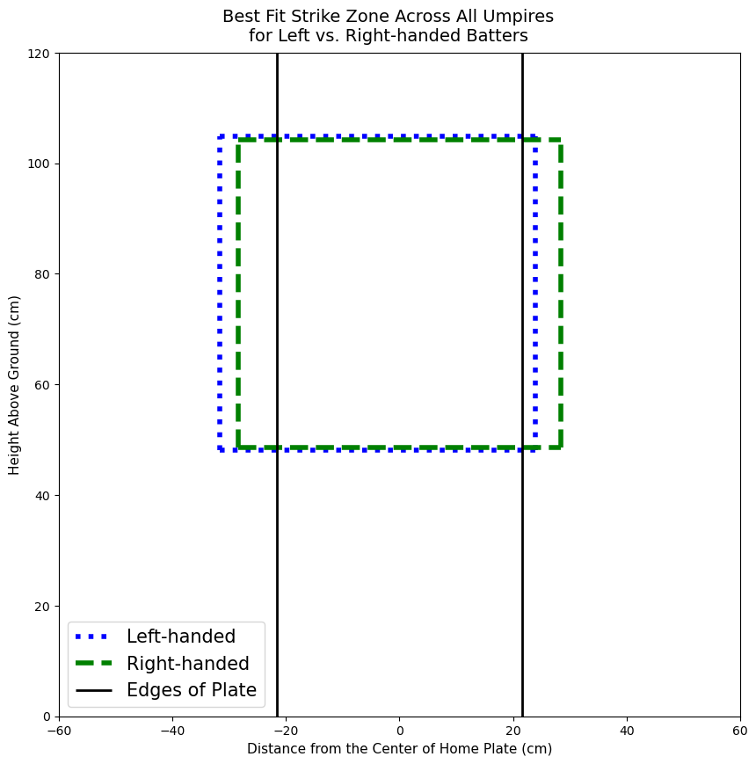
Validating the Ruler
Left vs. Right-handed Batters
The Umpires’ Best-Fit Strike Zone Compared to the Official Zone
Results
The best-fit strike zone for right-handed batters (green dashed box) and left-handed batters (blue dotted box) have nearly identical areas.
The right-handed strike zone is centered roughly over the plate, while the left-handed strike zone is shifted 3.9 cm to the outside of the plate.

Slide 14
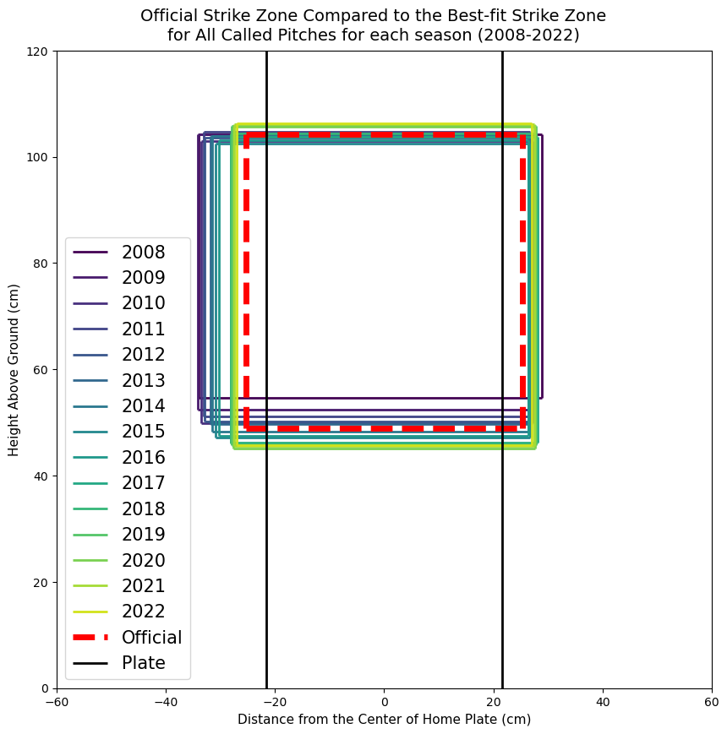
Seasonal Shifts
Results
The strike zone narrowed nearly 14%, from 63 to 54 cm between the 2008 and 2022 seasons.
The left side of the strike zone moved towards the plate about 7 cm.
The upper limit of the strike zone has remained relatively consistent across the umpire corps since 2008, rising by 2 cm (2%) during that period.
The bottom of the strike zone, however, dropped by nearly 9 cm—more than 16%—between 2008 and 2022.

Slide 15
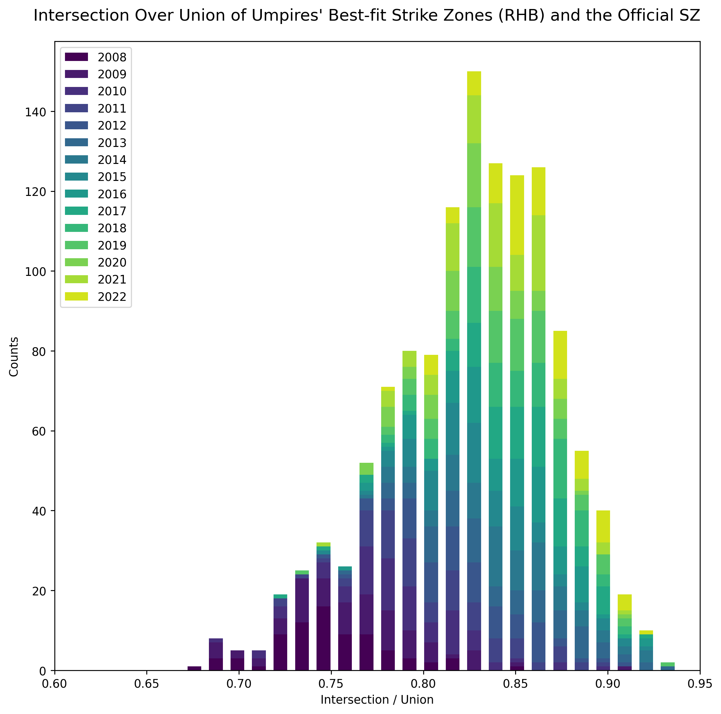
Around the League: Umpire Accuracy
Results
IoU =
Area of Intersection
Area of Union
The IoU ratio for the umpire corps for right-handed batters ranges from 0.68 to 0.93, with the majority of umpires clustering around the 0.83 mark.

Slide 16
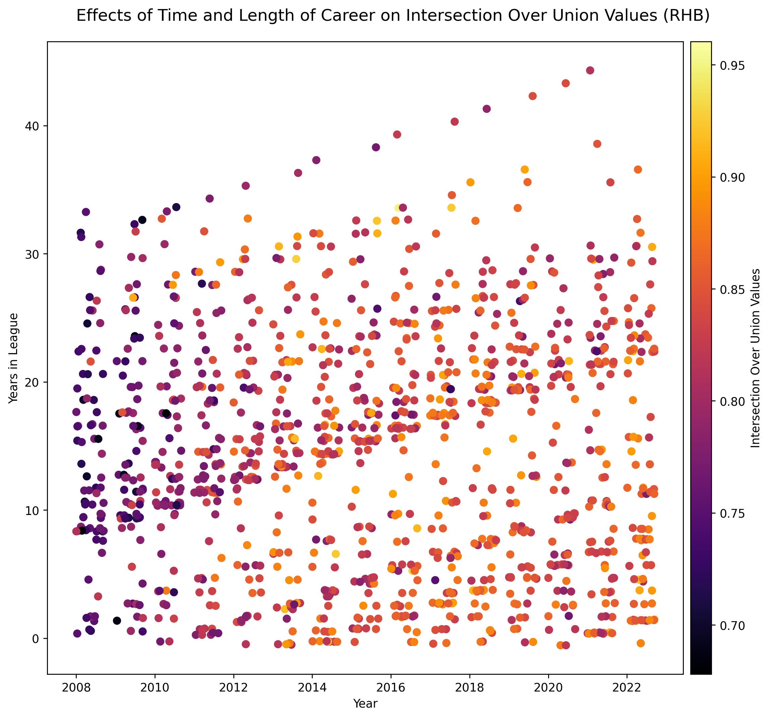
Around the League: Umpire Accuracy
Results
Umpires who started at the same time move together as cohorts towards higher IoUs—more accuracy.
New additions to the umpire corps are generally adapting to the existing zone rather than driving changes.

Slide 17
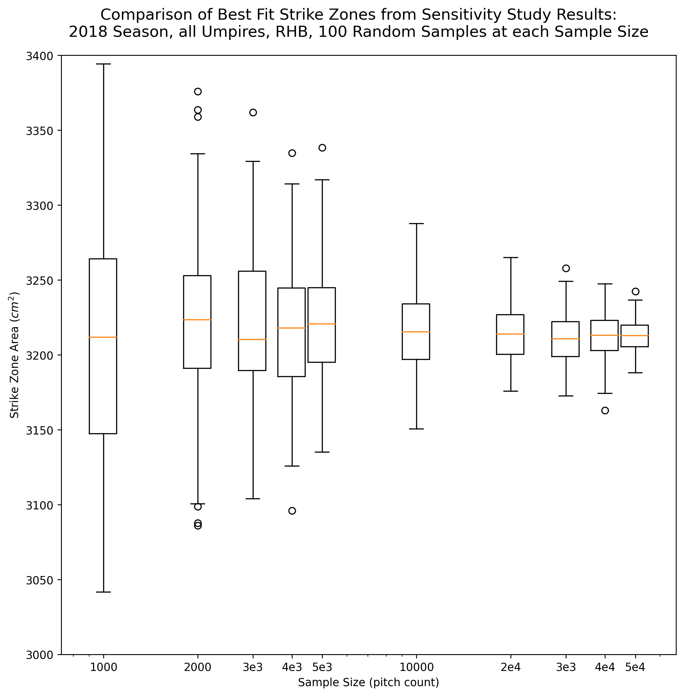
Model Sensitivity: How Low Can We Go?
Discussion
We reconstructed the best-fit surface with successively lower pitch counts to determine how finely we could split the data and still have reliable results.
Predictably smooth decrease in variability in best-fit strike zone areas shows the surface is mathematically well-behaved.
We can slice the data to about 10,000 pitches and still have robust results.

Slide 18
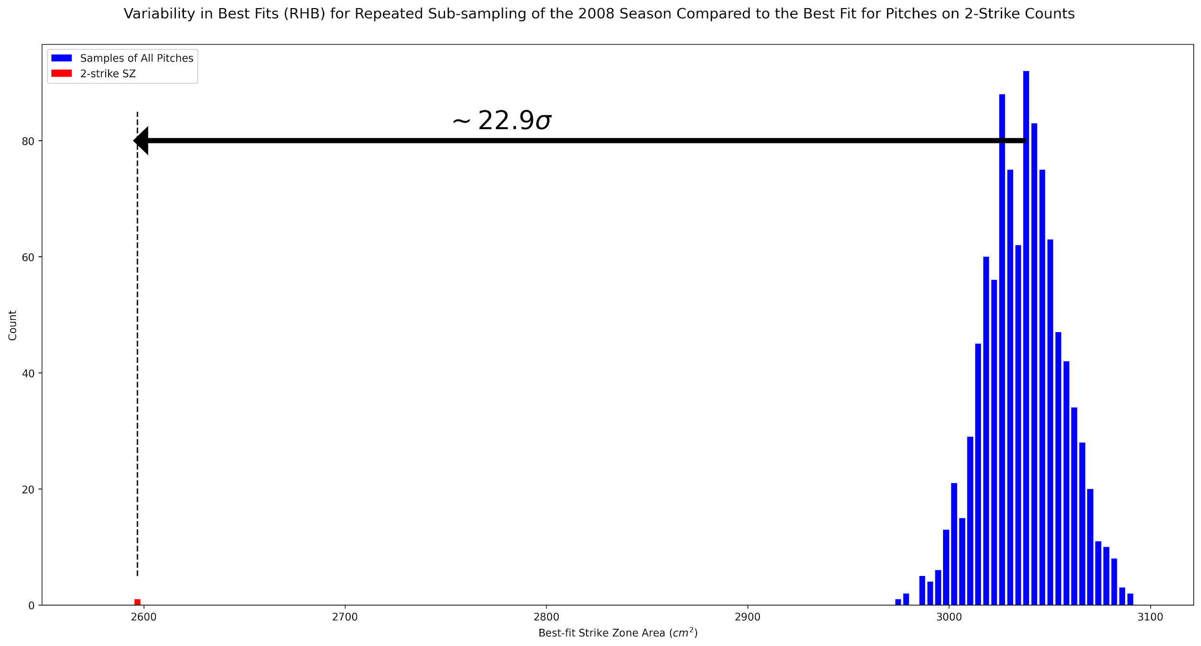
Situational Analysis: Umpires’ 2-Strike Bias
Discussion
23 standard divisions apart
Best-fit strike zone area of random samples of 30-40,000 pitches.
Best-fit strike zone area of random samples of 30-40,000 pitches when there are 2-strikes.

Slide 19
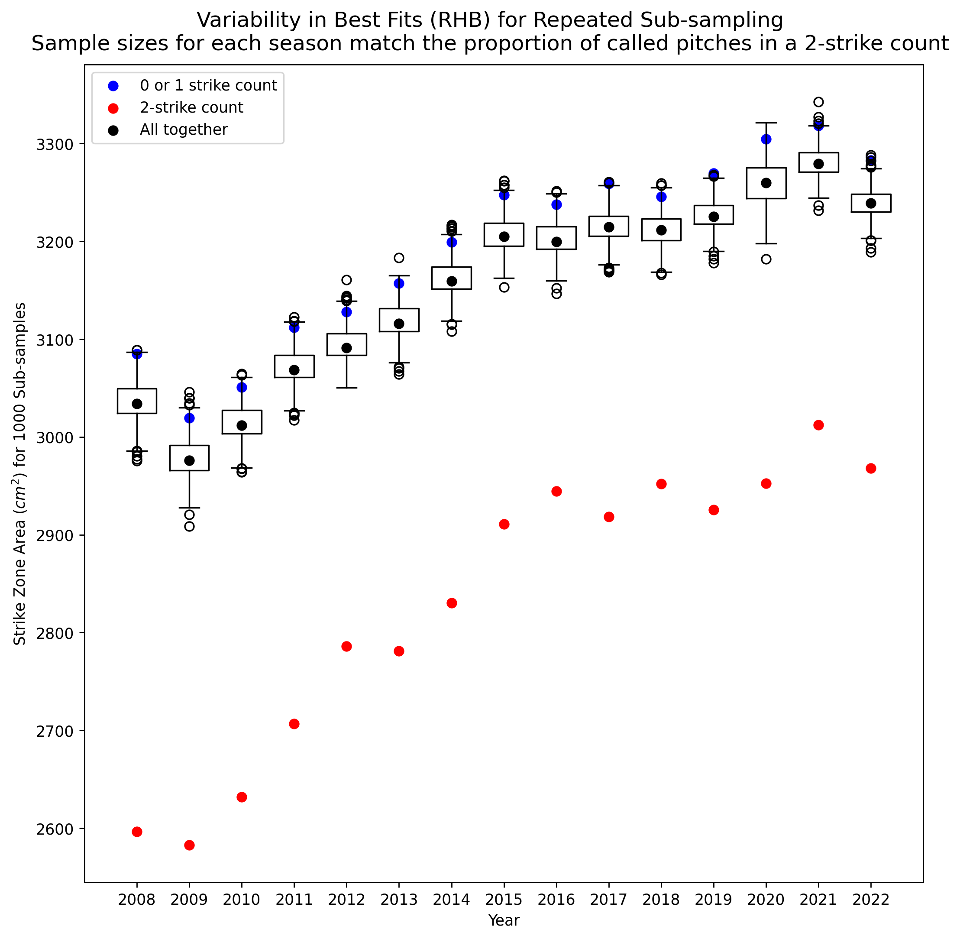
Situational Analysis: Umpires’ 2-Strike Bias
Discussion
The average area of the best-fit strike zone in 2008 to RHB is 3,030 cm² (black dot). If we just look at best-fit with 2 strikes (red dot), that area shrinks to less than 2,600 cm².
That’s the equivalent of a pitcher losing 2 cm on each side of the strike zone rectangle when there are 2 strikes.
The shrinking 2-strike strike zone is apparent for all seasons in the data set.

Slide 20
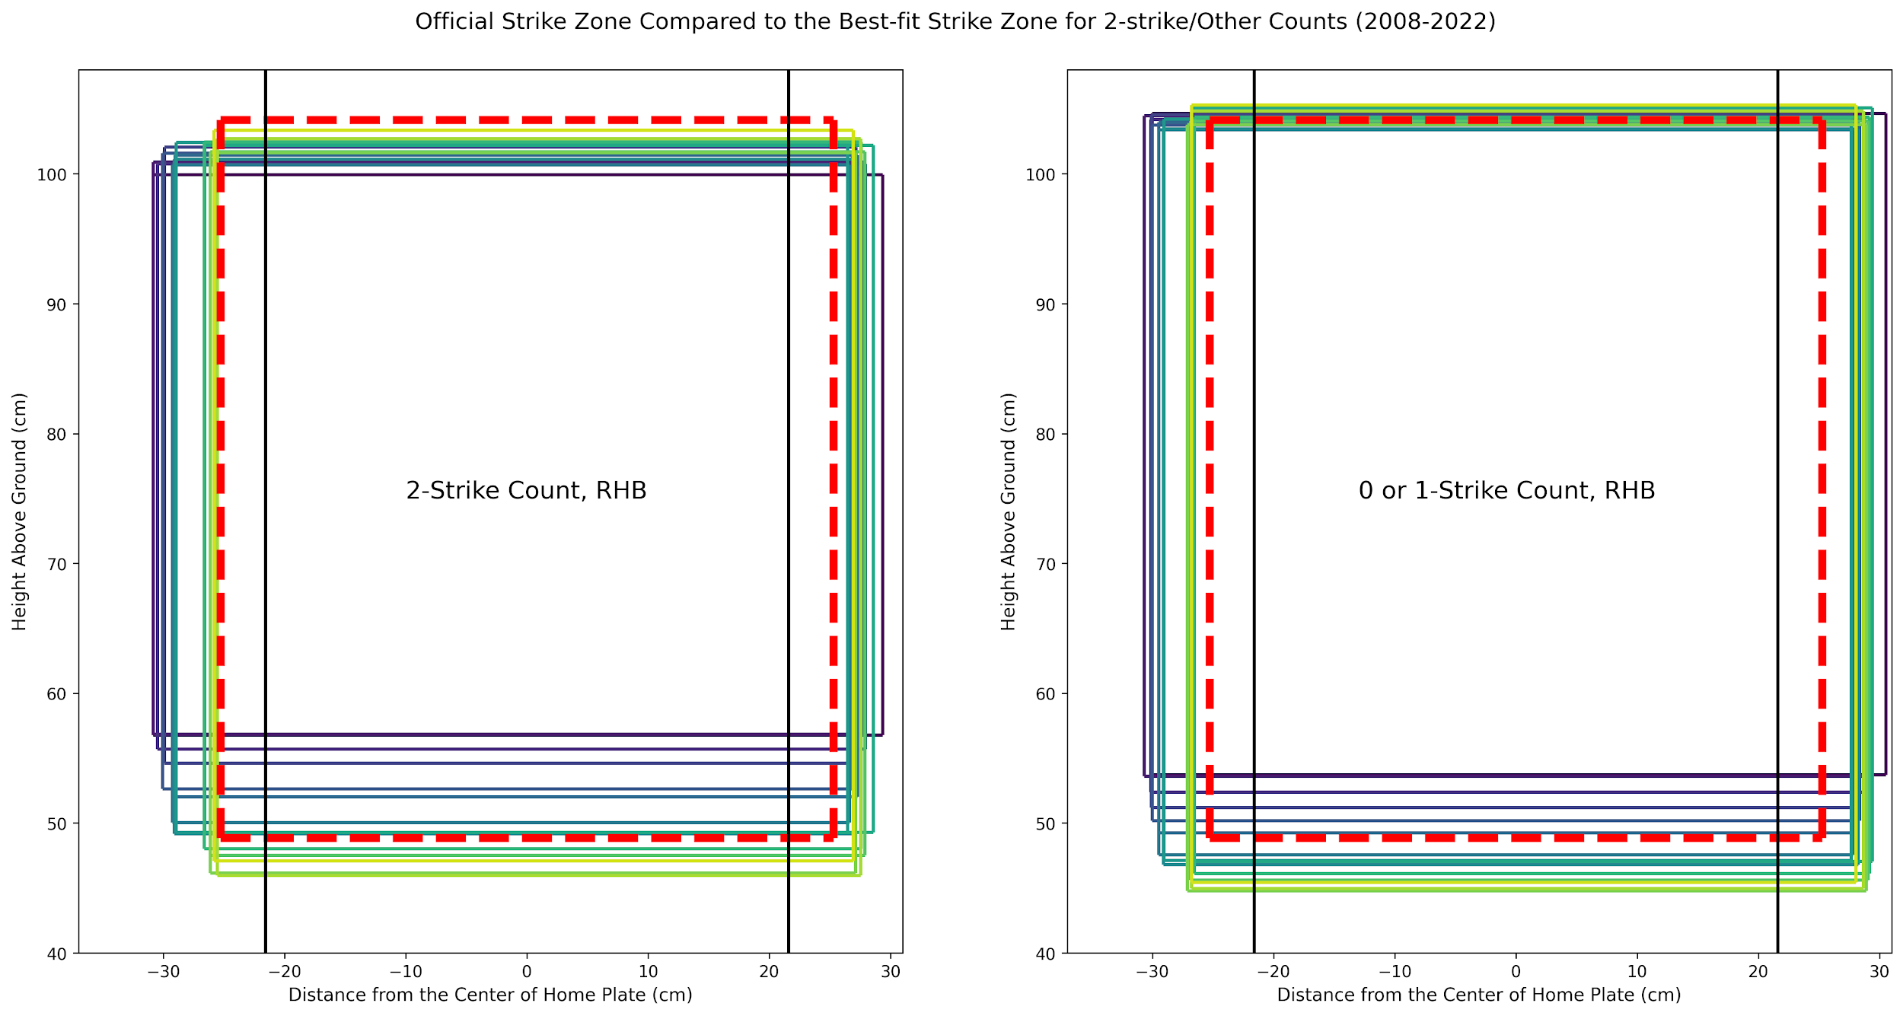
Situational Analysis: Umpires’ 2-Strike Bias
Discussion
While there is tightening all around the strike zone, the 2-strike bias (left) is primarily a bias against high and low strikes.

Slide 21
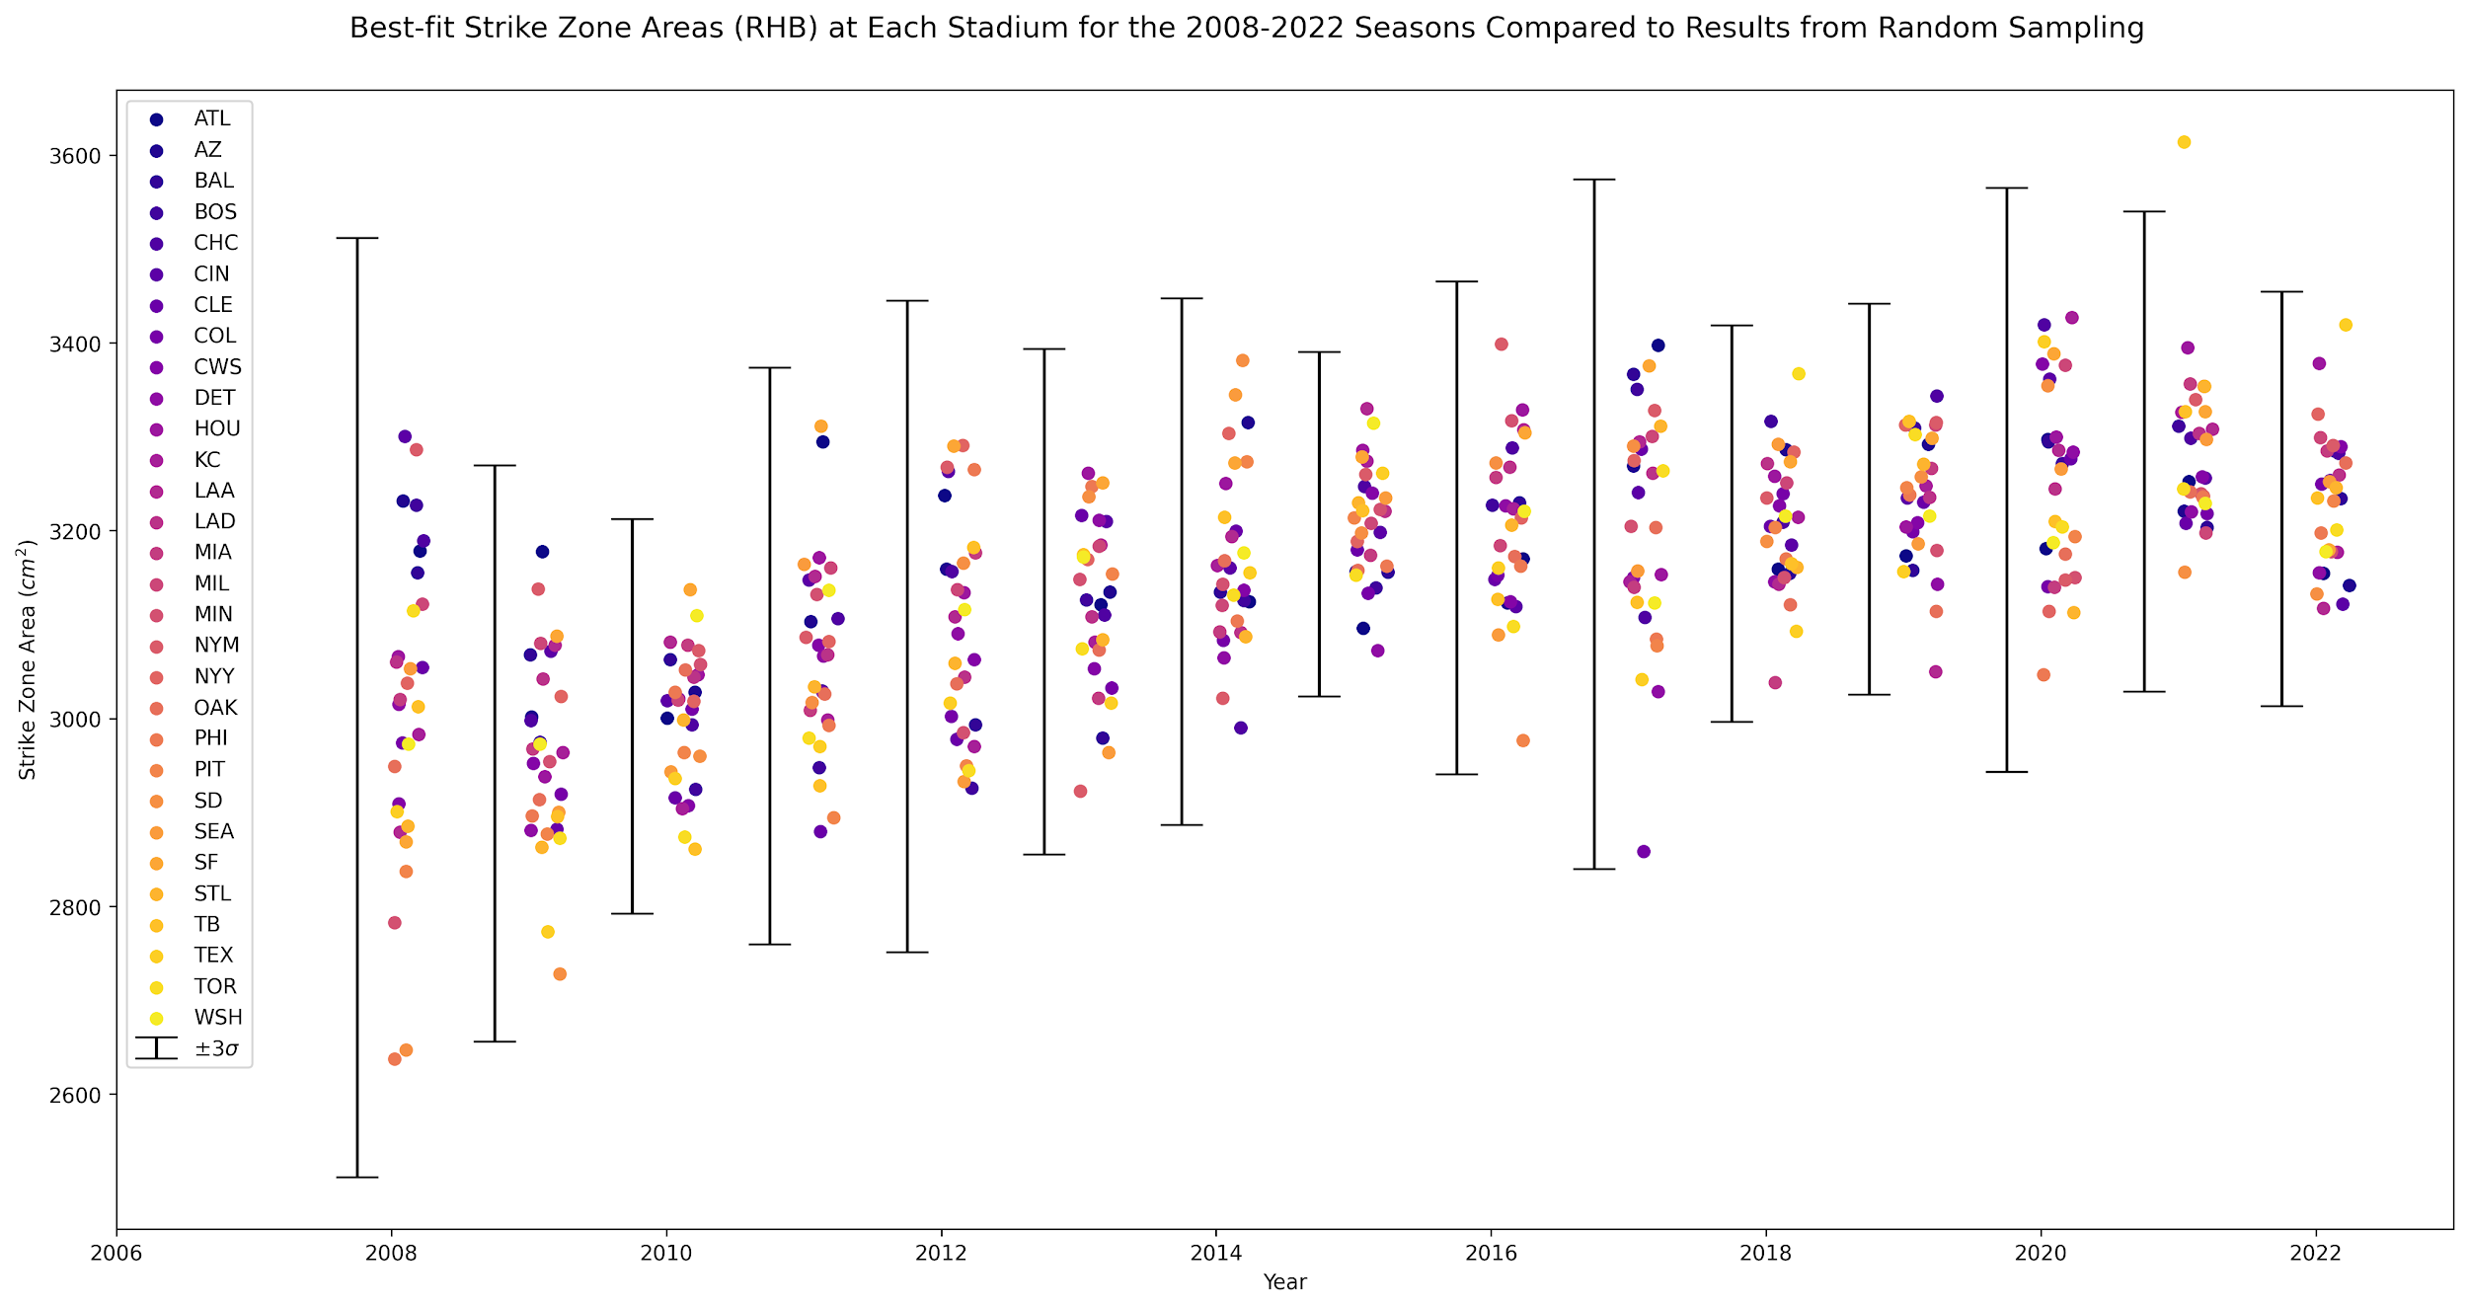
Situational Analysis: Ballpark Effects
Discussion
Nothing to see here.

Slide 22
Player Evaluation: Catcher Framing and the FISZ
Application
Traditional Catcher Framing Metrics
The Framing-Induced Strike Zone (FISZ)
Official Strike Zone
The FISZ
Shadow Zone
Takeaway: Traditional catcher framing metrics give credit to catchers for strike calls that are already inside an umpire’s own strike zone. The FISZ takes the umpire’s own strike zone into account and credits the catcher’s framing only with strikes that would have otherwise been called a ball.

Slide 23
Player Evaluation: Catcher Framing and the FISZ
Application
We measure the FISZ as the difference in the area of a strike zone when a specific catcher is behind the plate vs. the average umpires’ strike zone.
The FISZ accounts for the season and batter handedness.
The majority of MLB catchers have minimal impact on extra strikes.
The Framing Induced Strike Zone
- FISZ
+ FISZ
Better pitch
framers

Slide 24
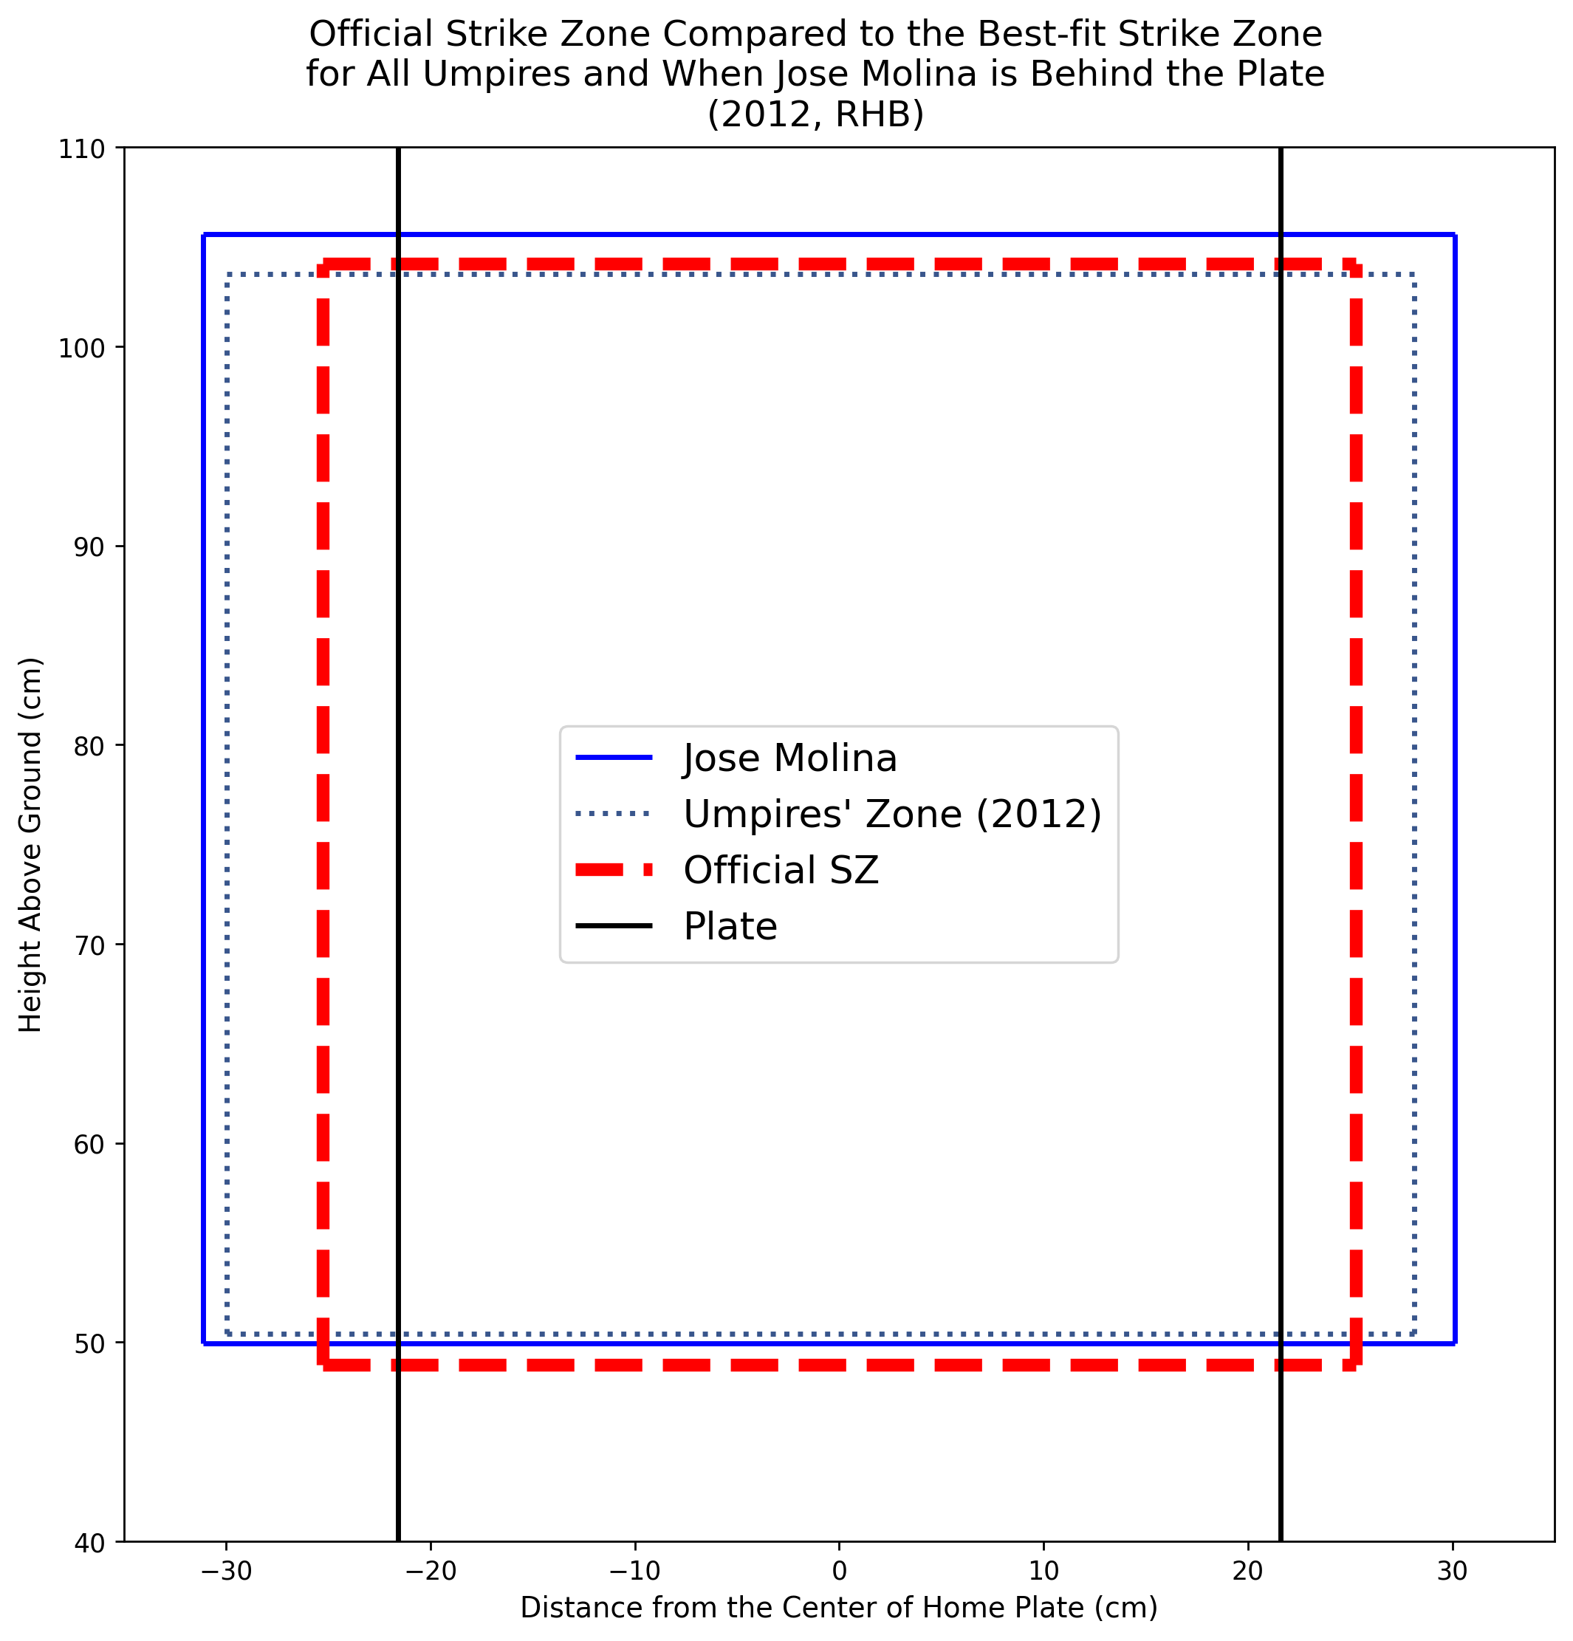
Player Evaluation: Catcher Framing and the FISZ
Application
Jose Molina has the largest FISZ value compared to other catchers, consistently above 300 cm². This holds true against both RHB and LHB.
Catchers with large positive FISZ values across the data set also include Yasmani Grandal, Ryan Hanigan, and David Ross. Most recent largest FISZ values belong to Jonah Heim and Jose Trevino.

Slide 25
What’s next?
Conclusion
Converting FISZ to a more usable metric, like runs saved.
How do MLB’s 2023 rule changes affect the shape of the strike zone?
Analyzing more slices of data: e.g., pitch selection, swing rate.
Gaming and betting applications for the model.

Slide 26
Archive

Slide 27
Data Sources
Data Collection
Smart Fantasy Baseball
Umpire biographical information
RetroSheet
Baseball Savant
Match umpires to game
Pitch-by-pitch data
PyBaseball
Python library
Notes:
Quickly go around the horn :)

Slide 28
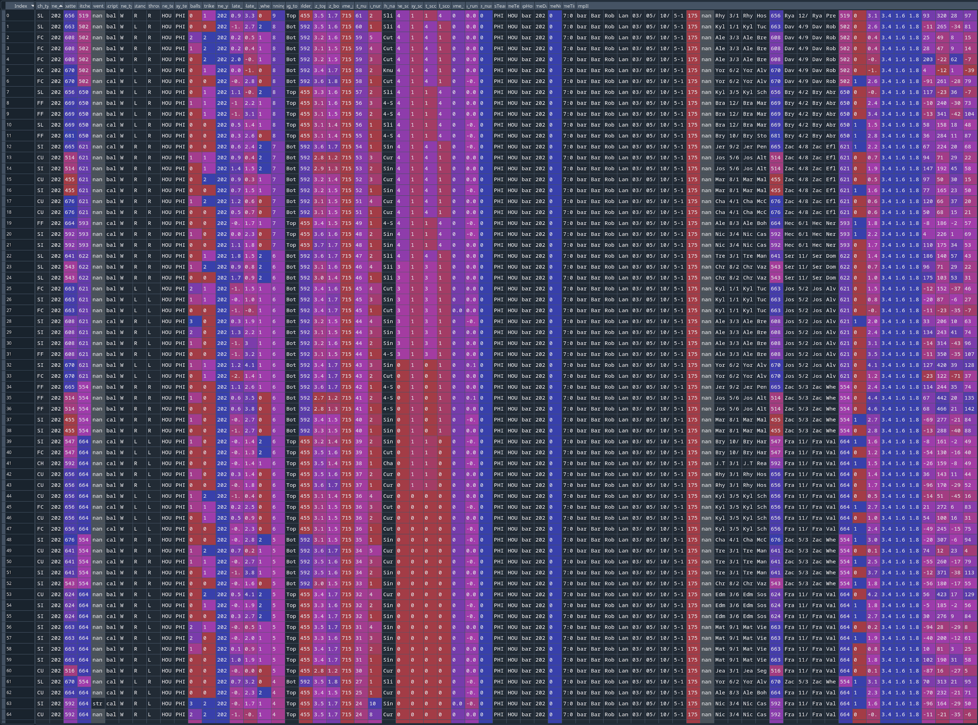
Combined Dataframe
Data Collection
x | z | strikezone(z)_{top} | strikezone(z)_{bottom} | Umpire | Pitcher | Pitcher handedness | Batter | Batter handedness

Slide 29
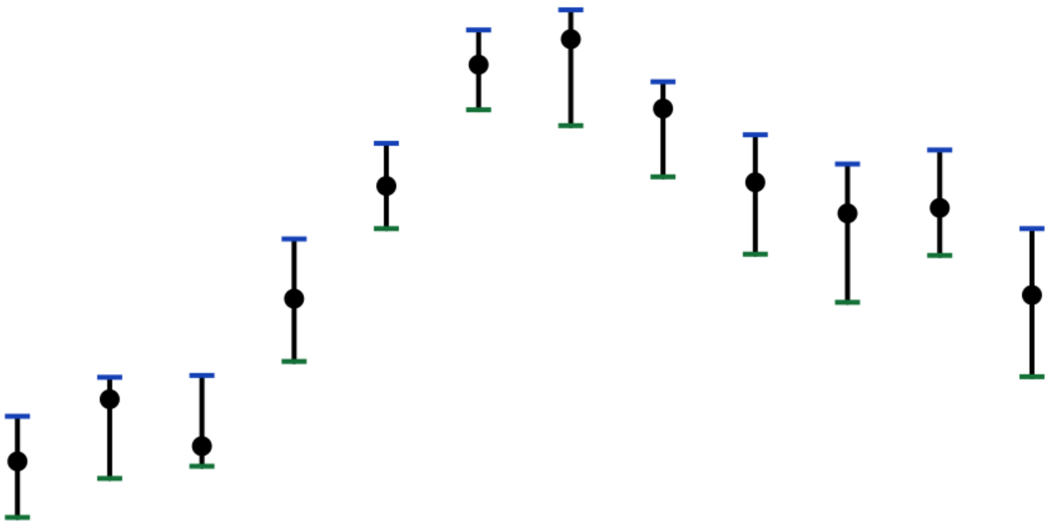
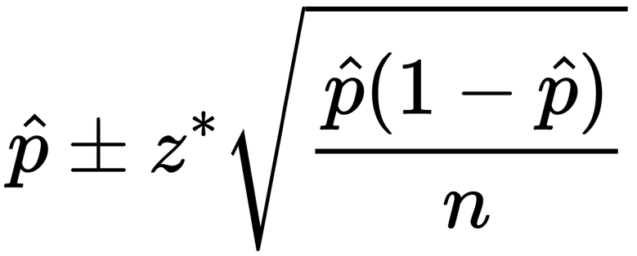
Building a Strike Zone Probability Surface: Step 2
The Useful Kind of Errors
Modeling
The number of pitches falling into each grid cell varies.
The strike percentage in each cell is measured with a different level of confidence.
Sampling and survey statistics when measuring proportions
The pitches in the cell vote on the likelihood a new pitch will be a ball or a strike.
Accounting for measurement errors in the fitting process improves results.
a

Slide 30
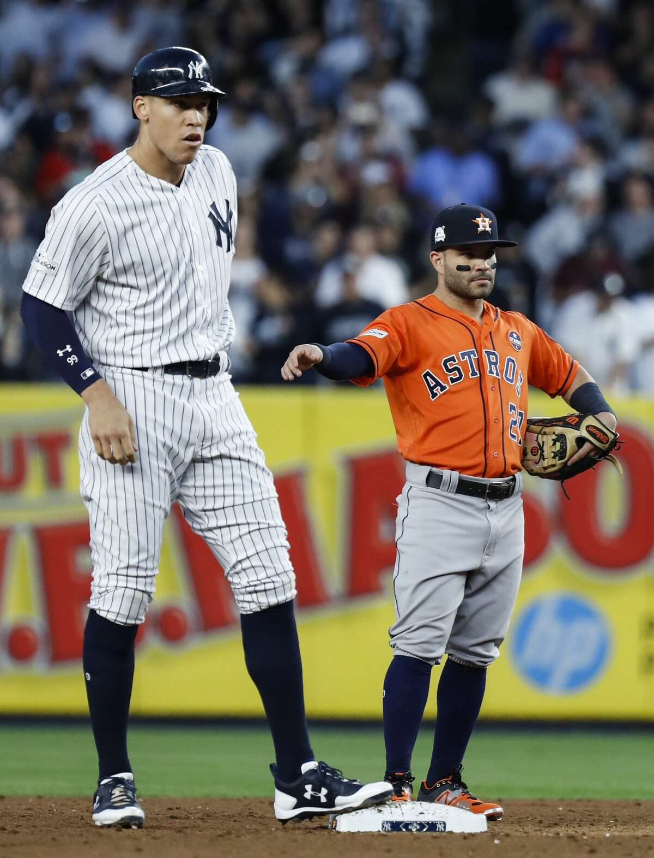
Image credit: Houston Chronicle
Height Normalization
Modeling
Used StatCast reporting of the sz_{top} and sz_{bottom} for every pitch
Averaged (mean) values for each defines a normalized strike zone height
Proportionally scaled each pitch location relative to this standardized size

Slide 31
Key Benefits of the Method
Accounts for sampling errors in the data
Well-tuned underlying functional form matches the shape of the data
The fitting process smooths out noisy data using only a handful of free-parameters
Modeling
Takeaway: The results are reliable to smaller sample sizes than prior efforts, which opens up access to questions about specific matchups and changes over time.

Slide 32
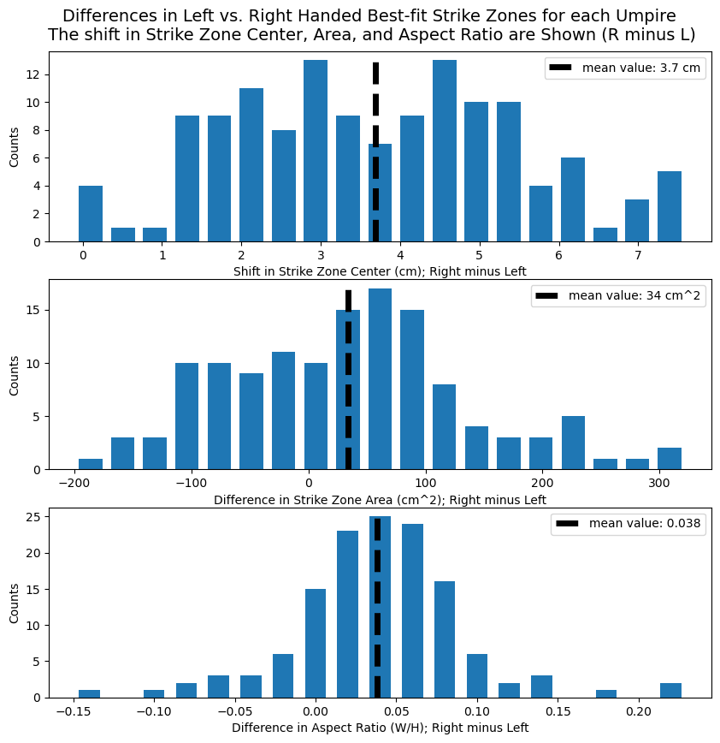
The Lefty Strike
The Presence of the Shift is Uniform across the Umpire Corps
Results
[Top] The shift in the strike zone for left-handed batters holds true across the umpire corps, with the shift measuring between 1 and 7 cm off-center.
[Middle] Centered roughly on zero, the histogram shows the area of umpires’ strike zones generally does not shift between right- and left-handed batters.
[Bottom] We see a clear difference in the aspect ratio, with the lefty strike zone taller and narrower than the right-handed batters’ zone.

Slide 33
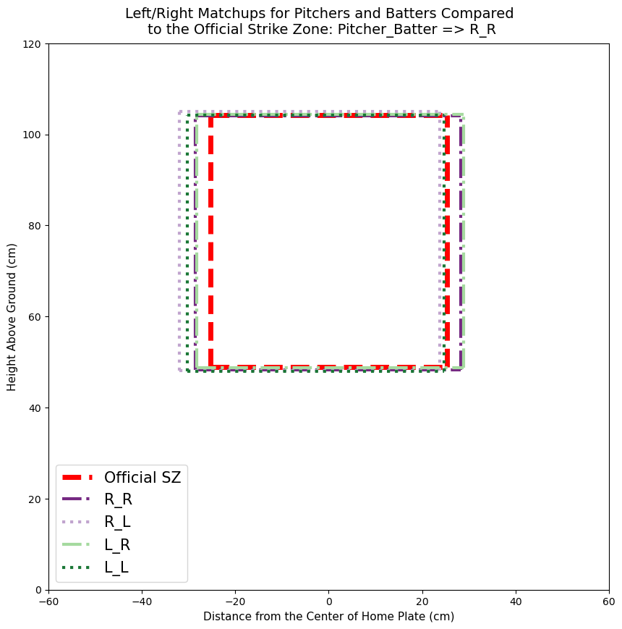
The Lefty Strike
The Lefty Shift More Pronounced for Right-Handed Pitchers
Results
The lefty-strike is even more pronounced when there is a RHP (purple dotted rectangle).
The magnitude of the strike zone shift between left and right-handed batters for right-handed pitchers (purple) is roughly double the shift for left-handed pitchers (green).

Slide 34
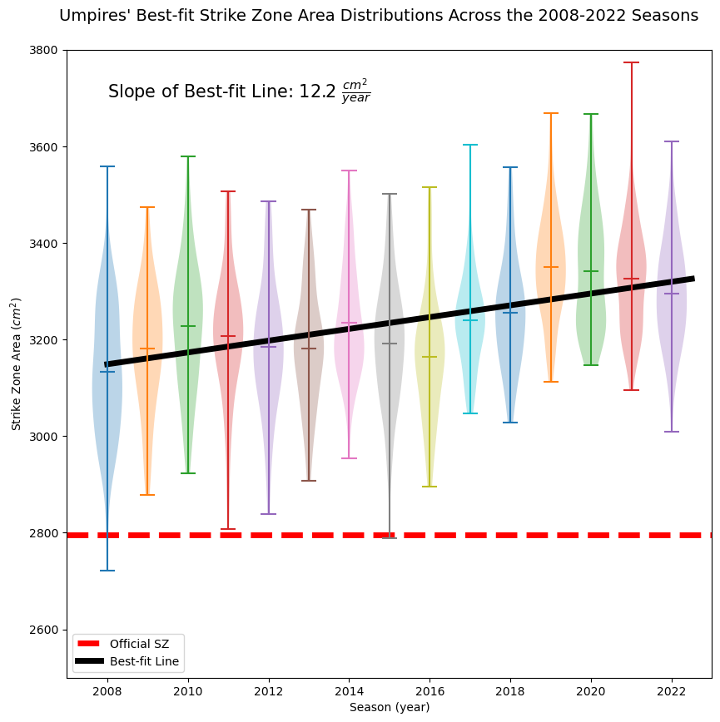
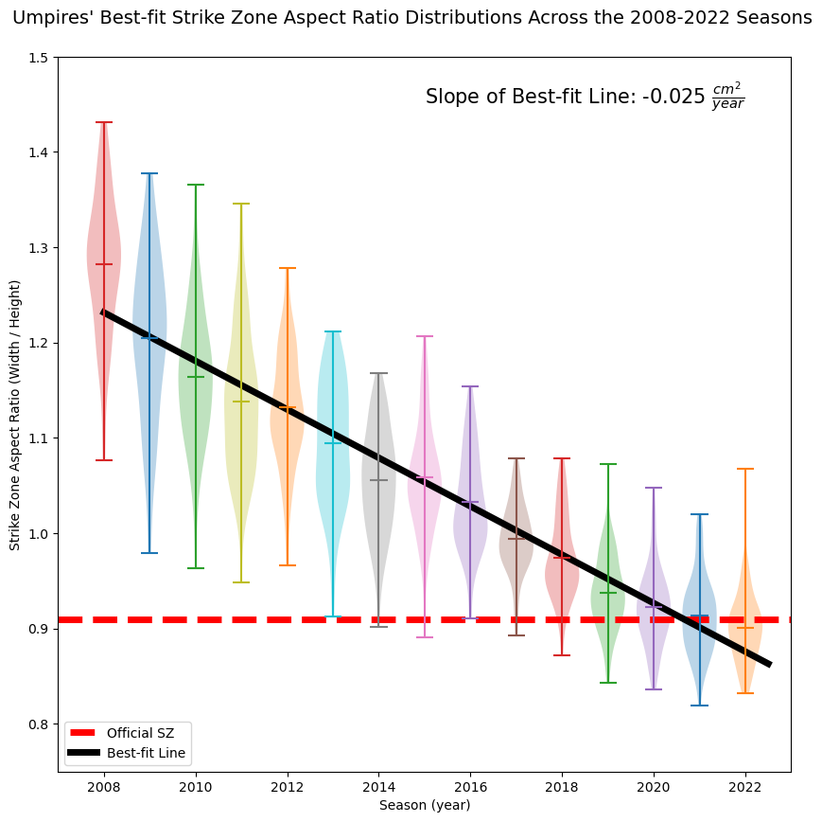
Seasonal Shifts
Results
Takeaway: The area of the strike zone has increased gradually since the 2008 season.
Takeaway: The strike zone has become
narrower and taller since the 2008 season.

Slide 35
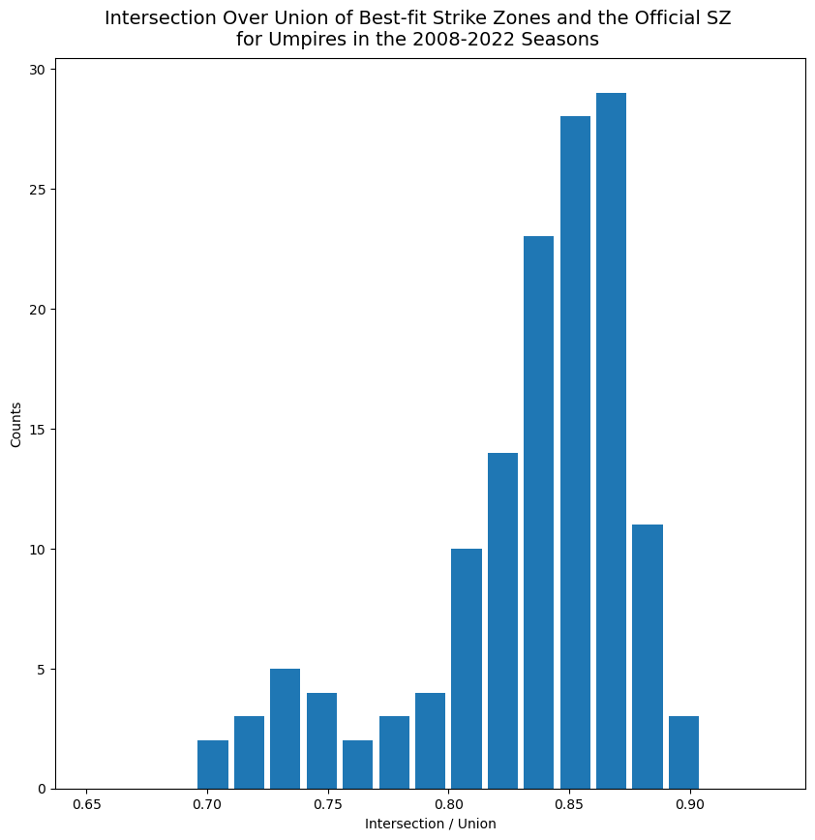
Around the League: Umpire Accuracy
Discussion
Angel Hernandez
IoU =
Area of Intersection
Area of Union
Joe West
Bill Miller
The IoU ratio for the umpire corps ranges from 0.70 to 0.90, with the majority of umpires clustering around the 0.85 mark.
Carlos Torres
Wally Bell

Slide 36
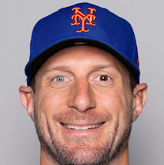
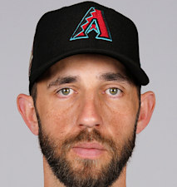
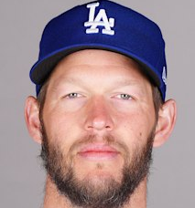
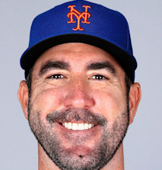
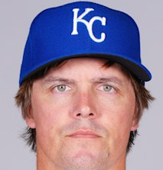
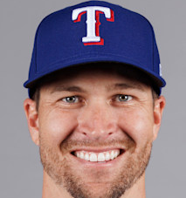
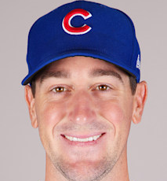
Around the League: Elite Pitchers
3,200
3,400
0.95
1.10
-5.0
1.0
Discussion
Strike Zone Area (cm²)
Strike Zone Aspect Ratio (w/h)
Strike Zone Center Shift (cm)

Slide 37
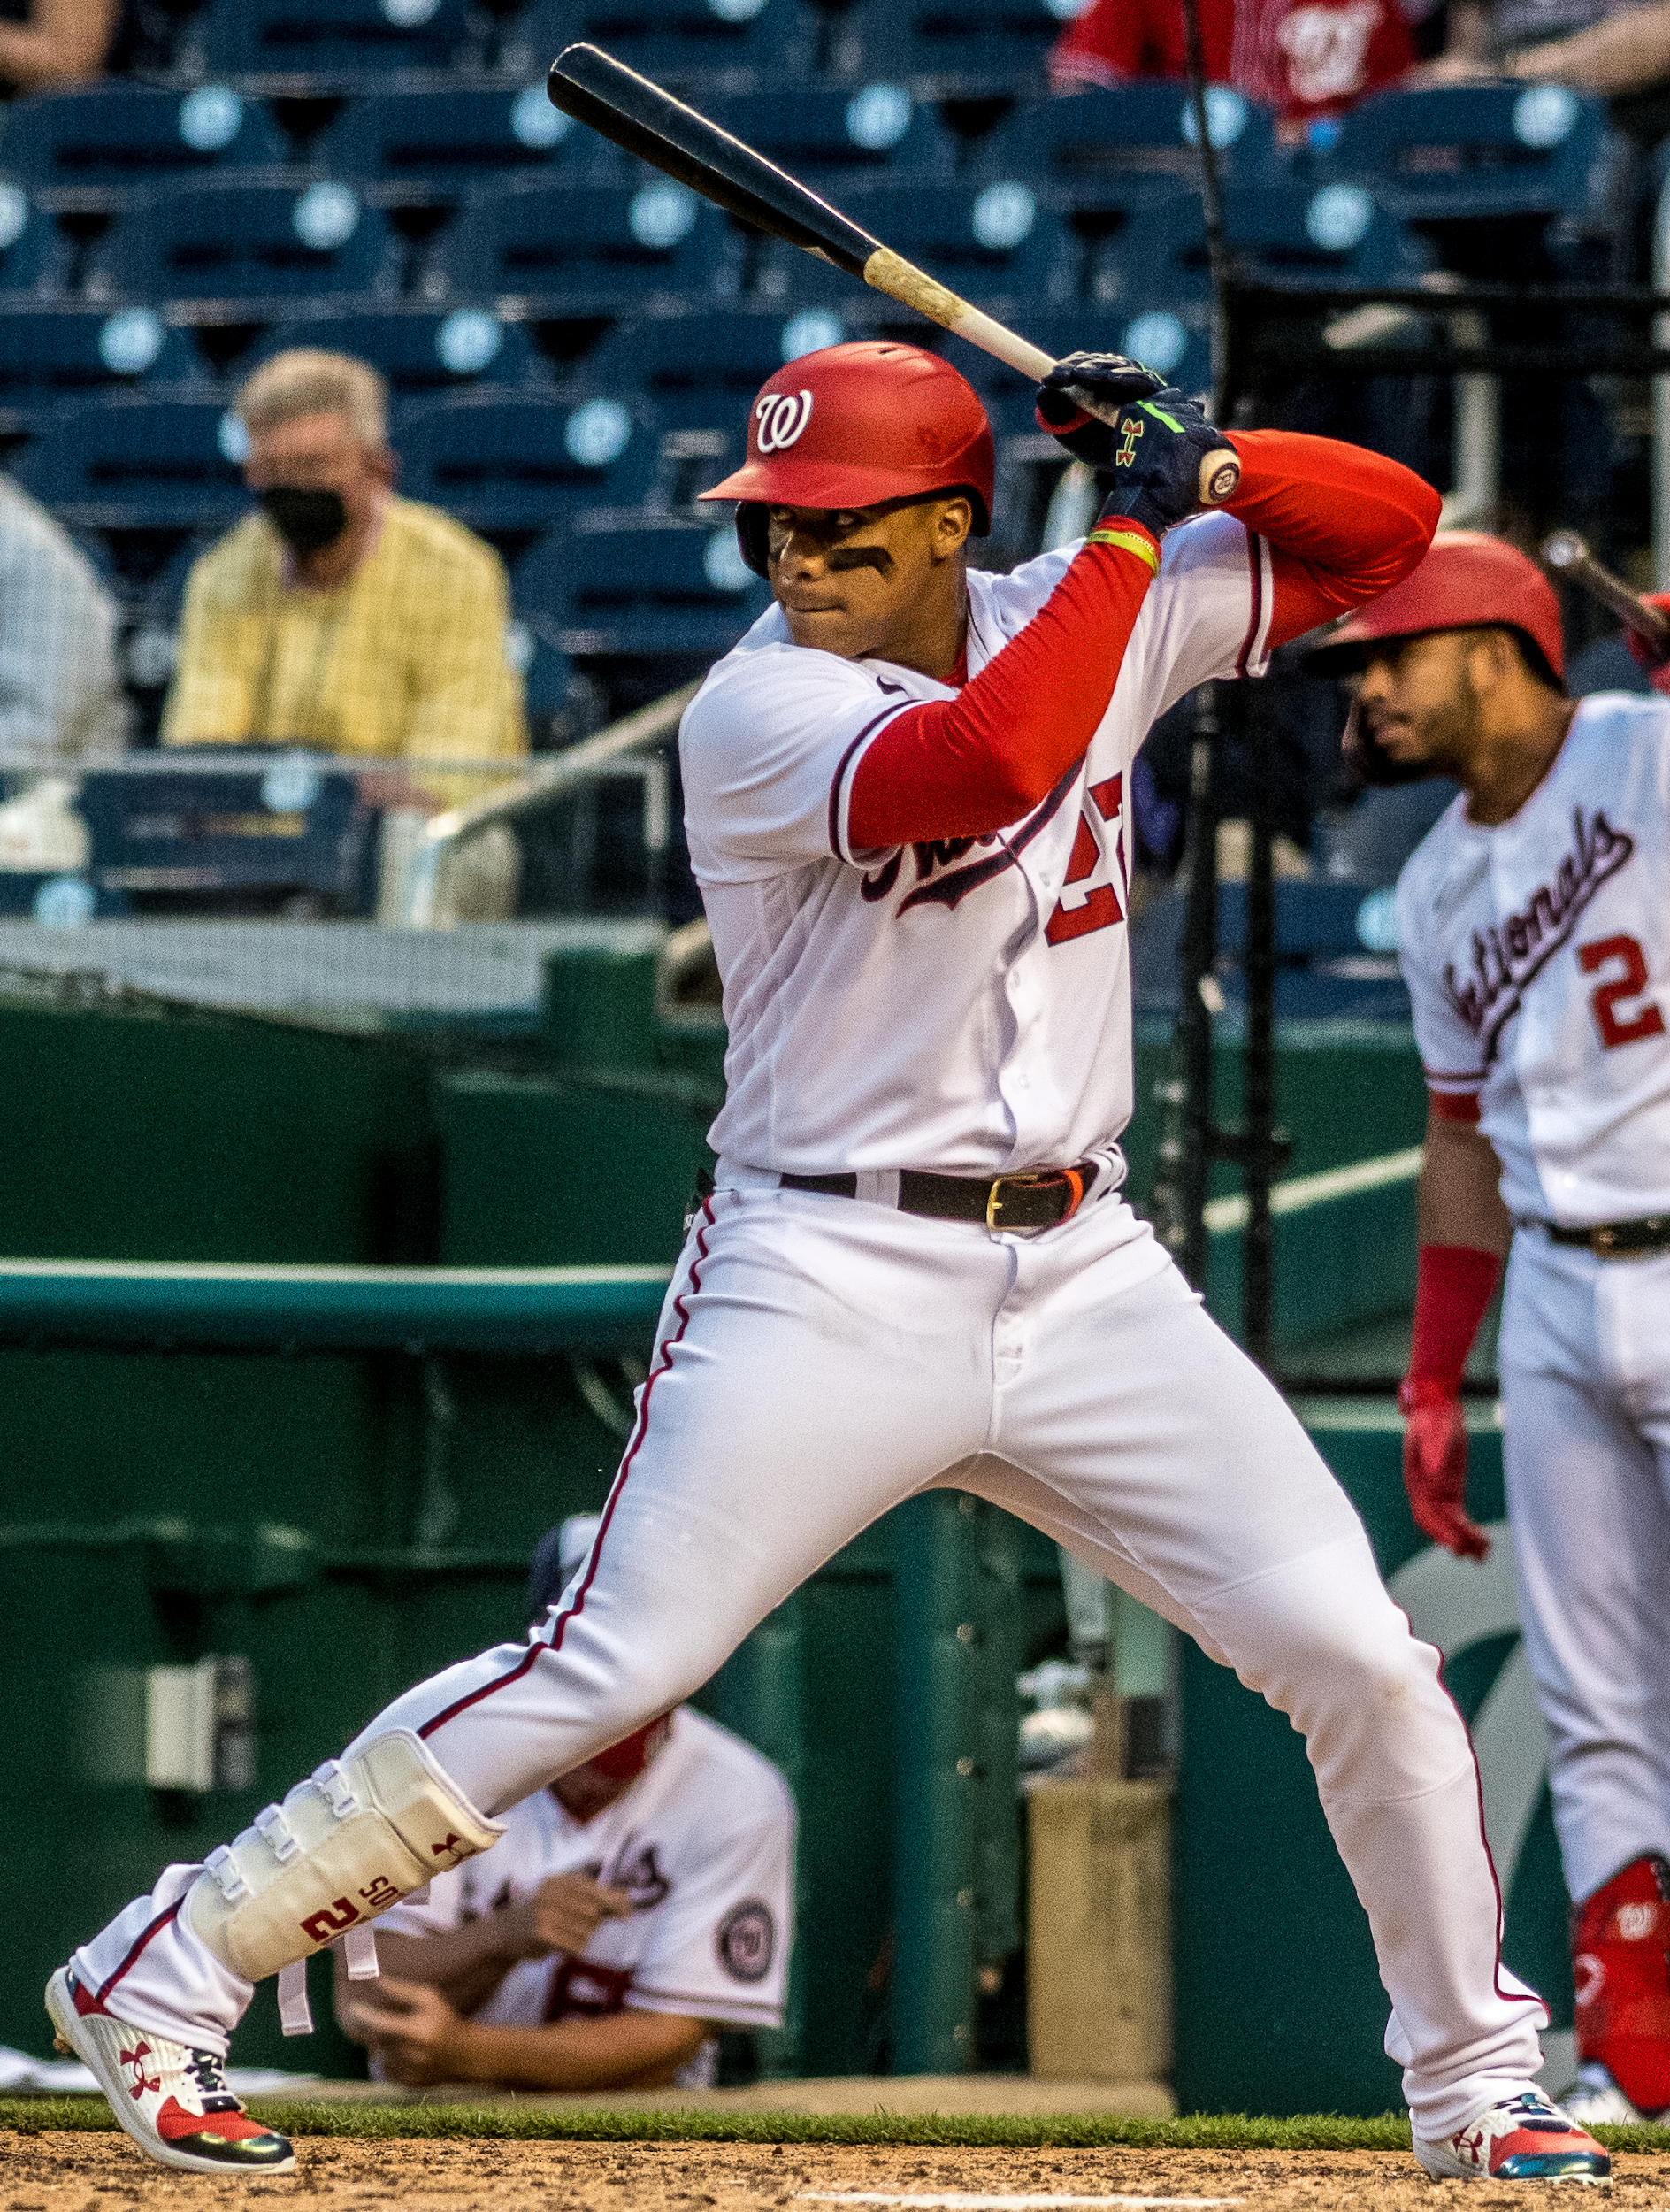
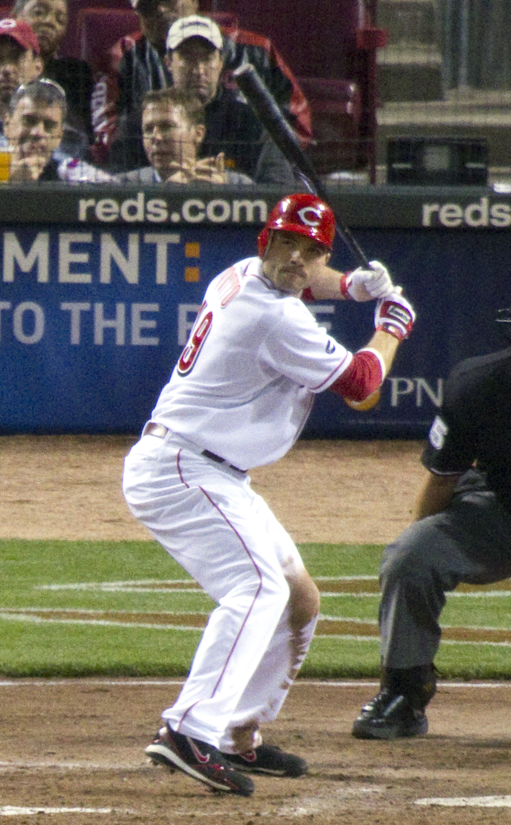
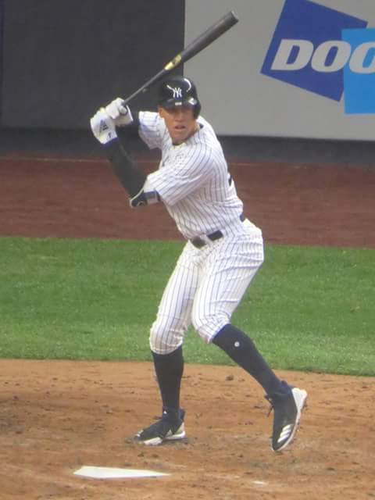
Around the League: Notable Hitters
Discussion
Best Fit Strike Zone
MLB Strike Zone

Slide 38
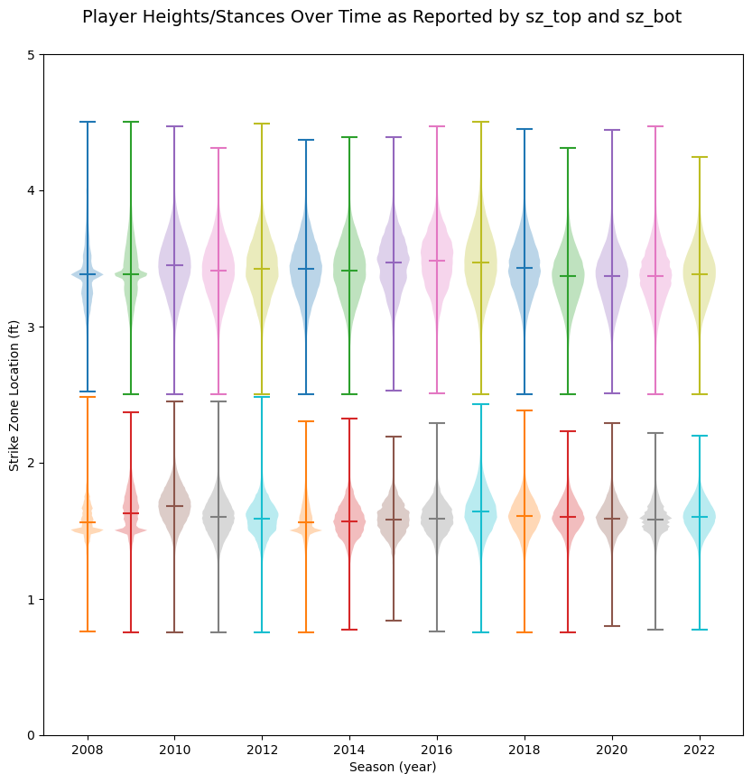
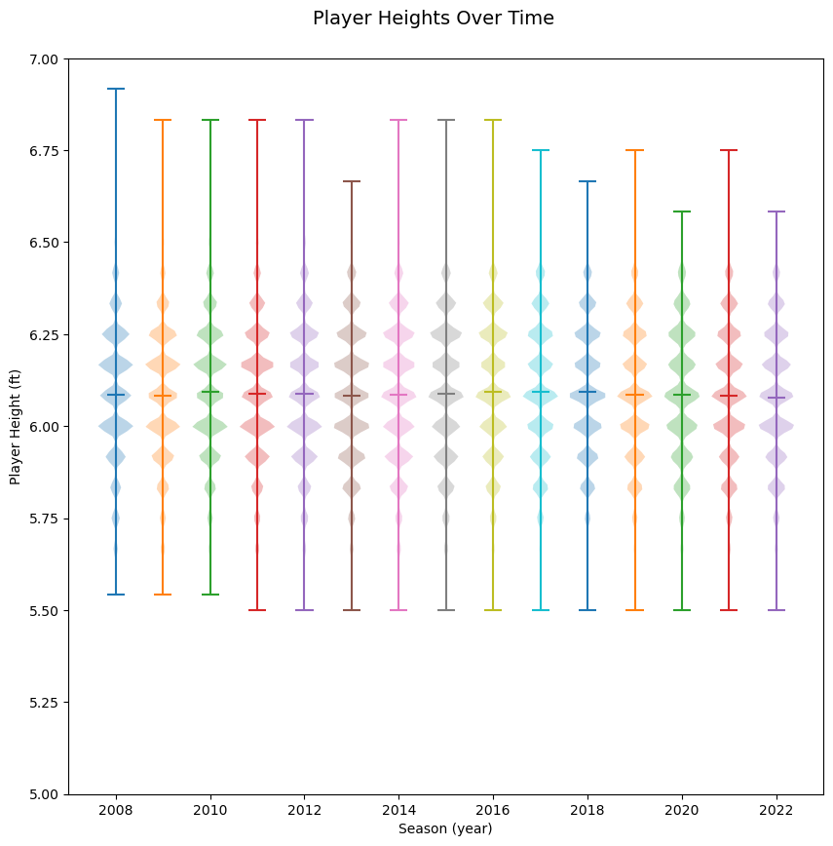
Data Normalizations

Slide 39
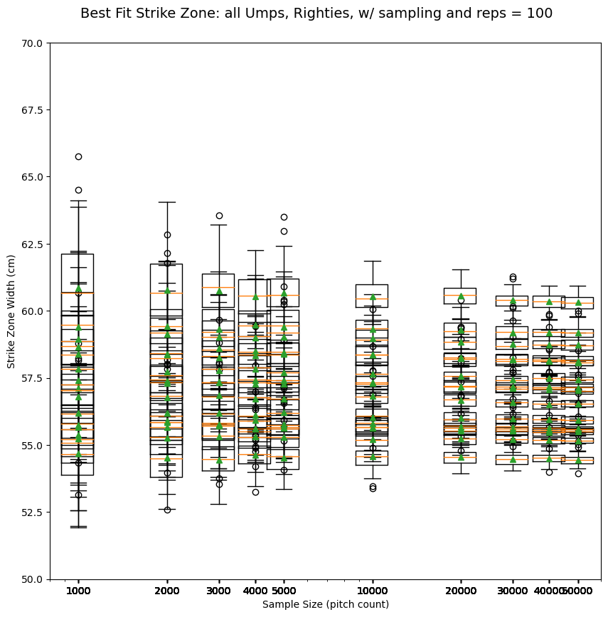
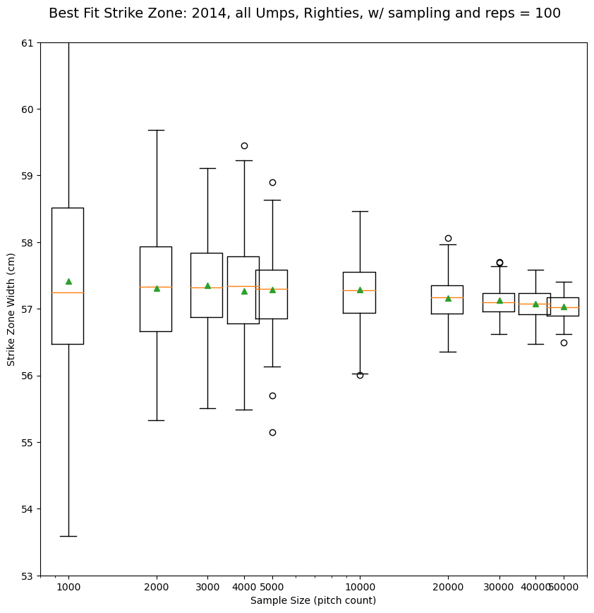
Sensitivity Study

Slide 40
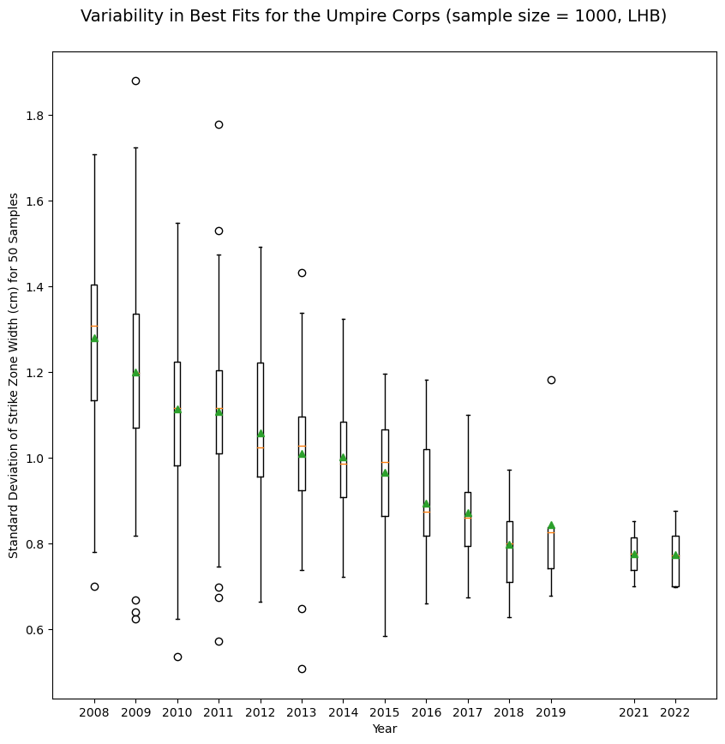
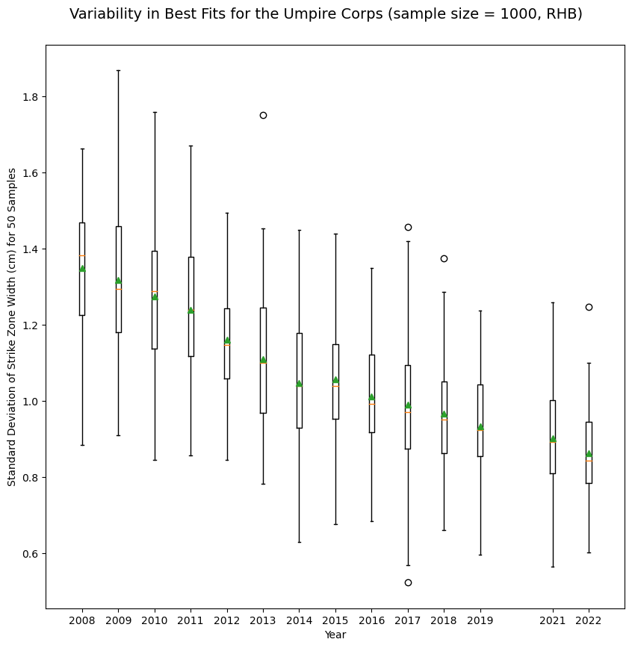
Umpire Variability

Slide 41
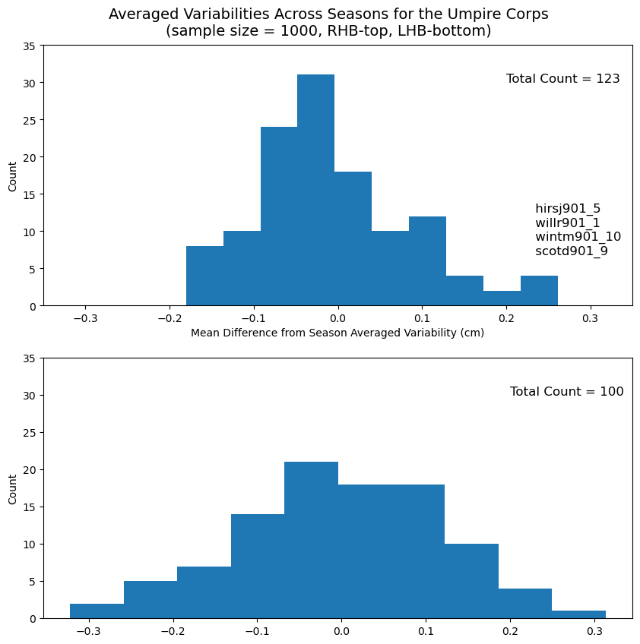
Umpire Variability Over Multiple Seasons

Slide 42
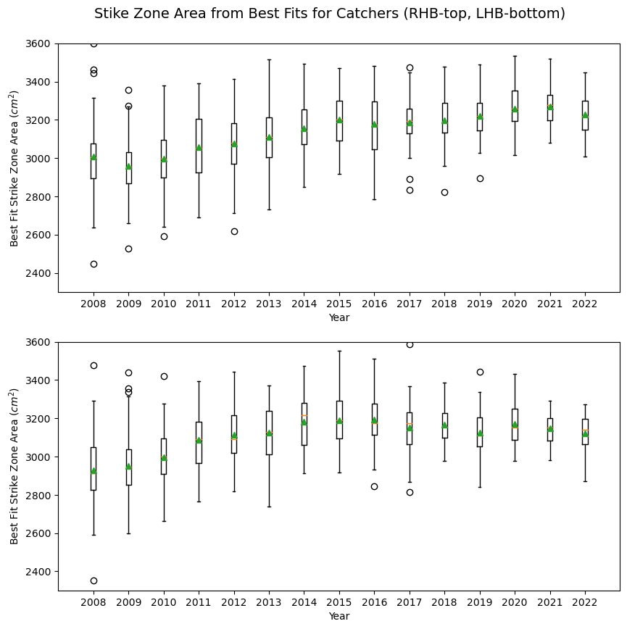
Catcher Framing

