Slide 1
Sweet! 16-Year-Old Players in Major League History
Presented to
The Society for American Baseball Research
by
Chuck Hildebrandt
June 27, 2019
Notes:
Thanks for coming, everyone.

Slide 2
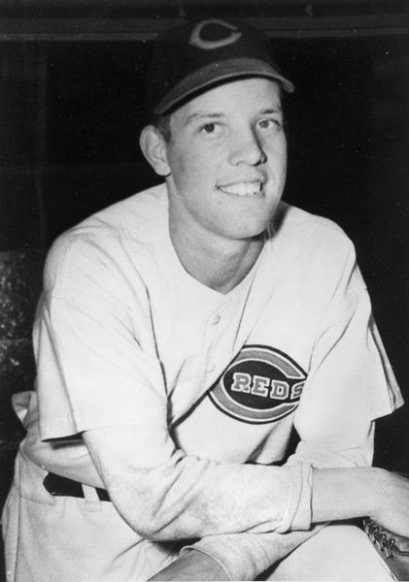
Notes:
You know who this is, right?
Right, Joe Nuxhall. He was not a 16-year-old major leaguer, so we’re not going to talk about him.

Slide 3
The Fifteen 16-Year-Old Major Leaguers
Notes:
These are the guys we’re going to talk about. These are the 16-year-old big leaguers, including two guys I don’t have pictures for, so let’s briefly meet them.

Slide 4
The 16-Year-Old Major Leaguers: Roll Call
Jacob Doyle (age 16-146)
SS, 2B
Nationals of Washington
9 G, 11-for-41, .268 AVG
1
1872
Notes:
Jacob Doyle was the first-ever 16-year-old major leaguer. He played for Washington in their only season in the National Association. He batted .268 which was good for fourth on the team, before they folded after 11 games.

Slide 5
The 16-Year-Old Major Leaguers: Roll Call
Jim Britt (age 16-067)
Pitcher
Atlantics of Brooklyn
37 G, 9-28, 5.06 ERA
2
1872
Notes:
About two weeks later, Jim Britt became the second-ever 16-year-old big leaguer as sole pitcher for Brooklyn, going 9 and 28 and pitching 336 innings, then returning for another 480 innings as a 17-year-old, before disappearing from big league ball. (No wonder.)

Slide 6
The 16-Year-Old Major Leaguers: Roll Call
Frank Pearce (age 16-188)
Pitcher
Louisville Grays
1 G, 4.0 IP, 5 H, 4 R, 2 ER
3
1876
Notes:
Frank Pearce lived every little boy’s dream by coming out of the stands to replace a pitcher who had to leave the game. Frank pitched four innings, then disappeared into the ether whence he came.

Slide 7
The 16-Year-Old Major Leaguers: Roll Call
Leonidas “Lee” (age 16-216)
St. Louis Brown Stockings
OF, SS
4 G, 5-for-18, .278 AVG
4
1877
Notes:
Leonidas Funkhouser was on summer vacation from Princeton when he joined his hometown St Louis Brown Sox. He adopted the alias “Lee”, probably because he wanted to spare his well-connected father grief for having a son who engaged in roughneck activities like “playing base ball”.
Probably why there’s no picture of him.

Slide 8
The 16-Year-Old Major Leaguers: Roll Call
Piggy Ward (age 16-057)
Philadelphia Quakers
3B
1 G, 0-for-5 with 2 K
5
1883
Notes:
Frank Ward, better known as “Piggy” for God knows what reason, became the youngest player in history for six decades when he appeared in one game for the Quakers. He came back to the majors at age 22, then left for good at age 27.

Slide 9
The 16-Year-Old Major Leaguers: Roll Call
Willie McGill (age 16-179)
Cleveland Infants
P
24 G, 11-9, 4.12 ERA, 1.5 fWAR
6
1890
Notes:
Willie McGill had the best career of any Sweet 16 player, racking up more than 14 wins above replacement, (or “WAR”, as the kids like to call it). He left the bigs for good after breaking his hand following his age 22 season.

Slide 10
The 16-Year-Old Major Leaguers: Roll Call
Tom Hess (age 16-296)
Baltimore Orioles
C
1 G, 0-for-2
7
1892
Notes:
Tom Hess is a bit of a mystery—some think it was actually Jack Hess who came into the fifth inning of the Orioles’ blowout win against the Colts. Retrosheet thinks it’s Tom, though, so ... we’ll go with them on this.

Slide 11
The 16-Year-Old Major Leaguers: Roll Call
Joe Stanley (age 16-162)
Washington Senators
P
1 G, 2.0 IP, 5 R, 3 BB, 1 WP, 0-for-2
8
1897
Notes:
Joe Stanley was an outfielder in his real major league career, but his Sweet 16 stint was as a pitcher to finish the first game of a doubleheader against the Reds. Fun fact: when Joe died in 1967, he had been one of the last living ballplayers from the 19th century.

Slide 12
The 16-Year-Old Major Leaguers: Roll Call
“Coonie” Blank (age 16-301)
St. Louis Cardinals
C
1 G, 0-for-2
9
1909
Notes:
Coonie Blank became the 20th Century’s first Sweet 16 player, making his way through the Class C Western Association, before finding himself subbing for the Cardinals in the first game of a late season doubleheader.

Slide 13
The 16-Year-Old Major Leaguers: Roll Call
Roger McKee (age 16-336)
Philadelphia Phillies
P
2 G, 3.1 IP, 16.20 ERA
10
1943
Notes:
The first four batters Roger McKee faced were Cardinal All-Stars: Harry The Hat Walker, Stan Musial, Walker Cooper and Whitey Kurowski, and Roger didn’t give up a run. Alas, he pitched his final big league game at age 18.

Slide 14
The 16-Year-Old Major Leaguers: Roll Call
Carl Scheib (age 16-248)
Philadelphia Athletics
P
6 G, 18.2 IP, 4.43 ERA, -0.4 fWAR
11
1943
Notes:
Carl Scheib, the first Sweet 16 in American League history, quit high school to join the A’s. He faced the Yankees in his debut and was greeted roughly by a Nick Etten triple. Carl hung around the majors all the way to age 27.

Slide 15
The 16-Year-Old Major Leaguers: Roll Call
Tommy Brown (age 16-241)
Brooklyn Dodgers
SS
46 G, 160 PA, .164/.208/.192, -2.0 fWAR
12
1944
Notes:
Tommy Brown was both the youngest 16-year-old player of the 20th century, and the only starting position player on the list. He hit only .164 in 46 games—but did return to the Dodgers the following season, when he became the only 17-year-old in history to hit a big-league home run.
(his world series at bat on 10/9/49: https://youtu.be/JHCQ6Ol09UQ?t=5819)

Slide 16
The 16-Year-Old Major Leaguers: Roll Call
Ralph “Putsy” Caballero (age 16-314)
Philadelphia Phillies
3B
4 G, 0-for-4, 1 K
13
1944
Notes:
“Putsy” Caballero was a two-sport star from New Orleans who spurned an athletic scholarship to join the Phillies. He debuted just one week later in an 11-1 blowout at the hands of the Giants.

Slide 17
The 16-Year-Old Major Leaguers: Roll Call
Alex George (age 16-354)
Kansas City Athletics
SS
5 G, 1-for-10, 1 BB, 7 K
14
1955
Notes:
Alex George was another multi-sport high school star who rejected a college scholarship to join his hometown Kansas City A’s. He was so overwhelmed in his debut, that White Sox catcher Sherm Lollar told him every pitch that was coming, and Alex still struck out.

Slide 18
The 16-Year-Old Major Leaguers: Roll Call
Jim Derrington (age 16-306)
Chicago White Sox
P
1 G (L), 6.0 IP, 9 H, 6 R, 5 ER, 6 BB, 3 K, 1-for-2
15
1956
Notes:
And finally, Jim Derrington’s 16-year-old debut was starting for the White Sox in the final game of 1956, and as you can see here, he pitched a man-sized game. He returned to the Sox in ‘57, pitched another 20 games, and that was it for Jim’s big-league career.
And that is also “it” for 16-year-old players in major league history.

Slide 19
Notes:
Here are the career WAR numbers for our Sweet 16s, and you can see, they’re mostly-y-y not good. There’s [*] Willie McGill, clearly the best of the bunch with a fairly decent career on the level of a Kris Benson or so. A couple [*] other guys, around three wins, but the other twelve? Not good. Six of them, visibly underwater, including Tommy Brown, our 17-year-old home run hitter, while the rest, flatlined around zero.
Now, typically, you expect players good enough to reach the majors at a very young age to have excellent careers. After all, if they’re good enough as young teenagers to play Major League Baseball, the best baseball in the world, they must be very special to compete at that age, and then things would only go up from there, right?

Slide 20
Average Career WAR by Debut Age
Notes:
And you’d be right—to a point.
The average career WAR for a major leaguer debuting at any age [*] is 4.3, that’s the purple dash line in the middle. That’s a decent major league career. Devin Mesoraco, you know that guy, right? Yeah, Mets fans really know that guy. He made almost $30 million as a major leaguer with a 4.3 career WAR, so it’s not nothing. And if you started your big league career as a 17-year-old way back when, like Mel Ott and Bob Feller and Jimmie Foxx did,

Slide 21
Average Career WAR by Debut Age
Notes:
your average career WAR would have been 10.8. That’s second highest to those starting at

Slide 22
Average Career WAR by Debut Age
Notes:
age 19, which is 11.7.

Slide 23
Average Career WAR by Debut Age
Notes:
Age 18 is third best at 10.6,

Slide 24
Average Career WAR by Debut Age
Notes:
20-year-olds fourth best, 9.8, and it goes down from there.
And then: up at the top,

Slide 25
Average Career WAR by Debut Age
Notes:
That little knob, off to the left ... [*] ... those are the 16-year-olds. Their average career WAR is minus, zero, point, two. That’s not even as good, on average, as replacement players. They have, in fact, the worst careers on average of any age group starting out. And that includes 40-year-olds, folded into the 30-plus category—there are five of those guys, their average career WAR is zero point one. So 16-year-olds have worse careers, on average, than that.

Slide 26
Average Career WAR by Debut Age
Notes:
So—how does it make sense that 16-year-olds end up having such bad careers? How can it be that unlike 19- or 18- or even 17-year olds, they couldn’t use their experience playing at the baseball’s highest level to fashion good careers? You’d think debuting at age 16 would give them a leg up, wouldn’t you?

Slide 27
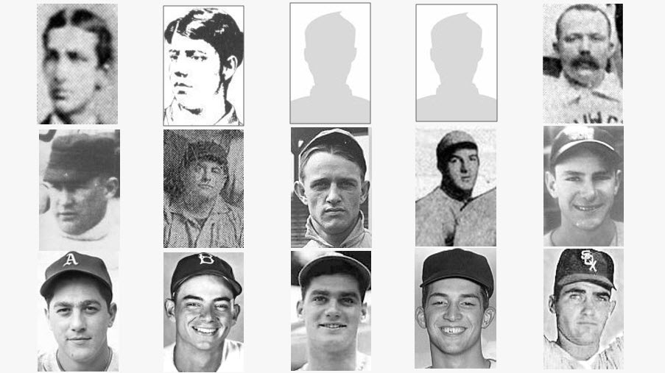
Why Didn’t 16-Year-Old Big Leaguers Go On to Have Good Careers?
Notes:
Well, it didn’t. And there might be some good reasons why it didn’t. For one thing ...

Slide 28
Why Didn’t 16-Year-Old Big Leaguers Go On to Have Good Careers?
They generally did not get regular playing time
Started 43 of final 57 games of season
Team’s only pitcher
Team’s fourth starter
Notes:
With rare exceptions, they didn’t get regular playing time as 16yo, so they couldn’t develop. [*] Tommy Brown was the only position player getting regular playing time, and he was awful. Among pitchers, [*] only Willie McGill and Jim Britt were regulars for their teams, and that was in the 19th Century. The rest got only mop-up duty, or played only a single game. You can't get better if you’re not playing regularly, and you won't play regularly if ...

Slide 29
Why Didn’t 16-Year-Old Big Leaguers Go On to Have Good Careers?
They generally did not get regular playing time
They did not play against talent-appropriate competition
Notes:
You don’t play against talent-appropriate competition. Nearly all these kids were overmatched playing big league ball at 16, and for the most part, a big-league manager’s not going to throw overmatched players out there day after day, no matter what age.
A 16-year-old simply can't play as well as an adult major leaguer, because he’s not an adult yet, which also means ...

Slide 30
Why Didn’t 16-Year-Old Big Leaguers Go On to Have Good Careers?
They generally did not get regular playing time
They did not play against talent-appropriate competition
They may not have been fully accepted by their teammates
Notes:
They may not have been fully accepted by their teammates. Because remember, 16-year-olds played at a time when rookies weren’t well-liked, anyway, remember those days? Plus, what does a full-grown man and a 16-year-old child have in common? Not much, so they probably weren’t hanging out becoming friends, and worse, these kids may have been seen as taking the job of other players their teammates knew and liked—better players who could help the team win. That could lead to resentment, which also ...

Slide 31
Why Didn’t 16-Year-Old Big Leaguers Go On to Have Good Careers?
They generally did not get regular playing time
They did not play against talent-appropriate competition
They may not have been accepted by their teammates
They may not have been able to withstand pressure to be in the major leagues
Notes:
Puts pressure on the child to justify his place on the big-league roster. The majors aren't a place to learn how to play ball—it’s where you’re already an expert at it, and the only benchmarks you’re measured against, are playing well and winning. And one of the key reasons 16-year-olds don’t play well and win in the majors is ...

Slide 32
Why Didn’t 16-Year-Old Big Leaguers Go On to Have Good Careers?
They generally did not get regular playing time
They did not play against talent-appropriate competition
They may not have been accepted by their teammates
They may not have been able to withstand pressure to be in the major leagues
They were too little to play regularly
Notes:
They're too small.

Slide 33
Average size of MLB players
95th-percentile
16-year-old
Notes:
At the 95th percentile, [*] a 16-year-boy is 6’1” and 185 pounds, which sounds big, it’s bigger than I am, but [*] the average major leaguer is now 6’2” and 210. There’s a big difference between 210 pounds and 185 pounds,

Slide 34
95th-percentile
16-year-old
=
9th percentile
major leaguer
Notes:
a weight which would place a 16yo boy [*] at the 9th percentile for weight among all major leaguers.

Slide 35
Why Didn’t 16-Year-Old Big Leaguers Go On to Have Good Careers?
They generally did not get regular playing time
They did not play against talent-appropriate competition
They may not have been accepted by their teammates
They may not have been able to withstand pressure to be in the major leagues
They were too little to play regularly
They missed their mommies
Notes:
And, of course, being a professional baseball player entails a lot of travel, and these boys [*] would definitely miss their mommies while they’re gone and all alone on the road. Just imagine how much fun it would be for the other guys to see a middle-aged lady following the team around on the road so she be can the bulldozer parent clearing the way for her little boy.

Slide 36
Why Didn’t 16-Year-Old Big Leaguers Go On to Have Good Careers?
They generally did not get regular playing time
They did not play against talent-appropriate competition
They may not have been accepted by their teammates
They may not have been able to withstand pressure to be in the major leagues
They were too little to play regularly
They missed their mommies
Notes:
In all seriousness, it should be obvious by now to everyone here that the idea of putting a 16-year-old boy on a major league team is bonkers. Most professional baseball players have been playing the game for more than 16 years, never mind just being alive for 16 years. Experience counts.
BUT ... There are certain unique circumstances under which it might be understandable for a 16-year-old boy to be on a major league team. And first circumstance is:

Slide 37
How could a 16-year-old have ever been allowed to play major league baseball in the first place?
In the 19th Century, the game of baseball was so new, hardly anybody was an expert at playing it.
Notes:
The game of baseball is so new, hardly anybody is an expert at playing it.

Slide 38
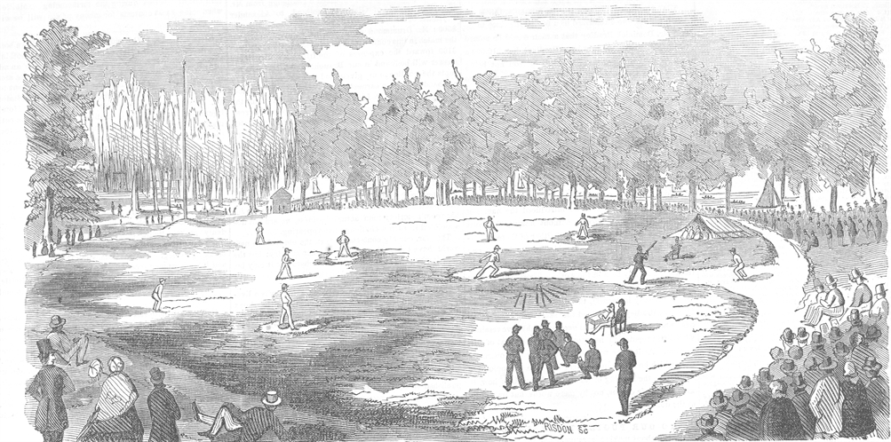
Notes:
Today’s version of baseball, with features like nine men per side, nine innings per game, ninety feet between bases and so on, was finally codified in 1857. That was only fourteen years before the first top professional league,

Slide 39
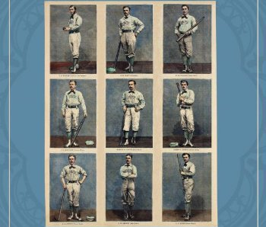
Notes:
the National Association, took the field. For a good part of the country, baseball wasn’t even a thing yet: of all American-born major leaguers in the 1870s, 80% came from northeastern states. That’s four out of every five. And certainly no one grew up playing it, so a lot of the guys you see here? Learned the game as adults. So essentially, just about any reasonably adult-sized white male from New York or Pennsylvania or Maryland, who could learn the game well enough get passably good at it, had a shot at playing in what passed for the major leagues in the 1870s.

Slide 40
Notes:
With a pool so small to draw from, no wonder the first half decade of big-league ball [*] had one of the highest compositions of both teenagers and over-35s in history, and why over half of all 16-year-olds played in the 19th Century.

Slide 41
How could a 16-year-old have ever been allowed to play major league baseball in the first place?
In the 19th Century, the game of baseball was so new, hardly anybody was an expert at playing it.
World War II
Notes:
The second circumstance under which it kinda made sense to put 16-year-olds on your major league roster was: [*] World War II.

Slide 42
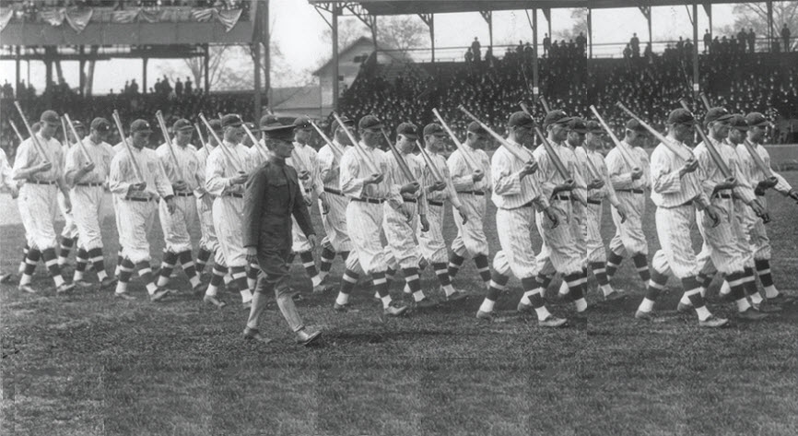
Notes:
Unlike World War I, [*] which affected only two seasons, [*} World War II affected four seasons, and since the war itself was much bigger, [*] mobilizing over four times as many men overall, it really drained the player rolls as 500 major leaguers and 4,000 minor leaguers “swapped flannels for khaki”.

Slide 43
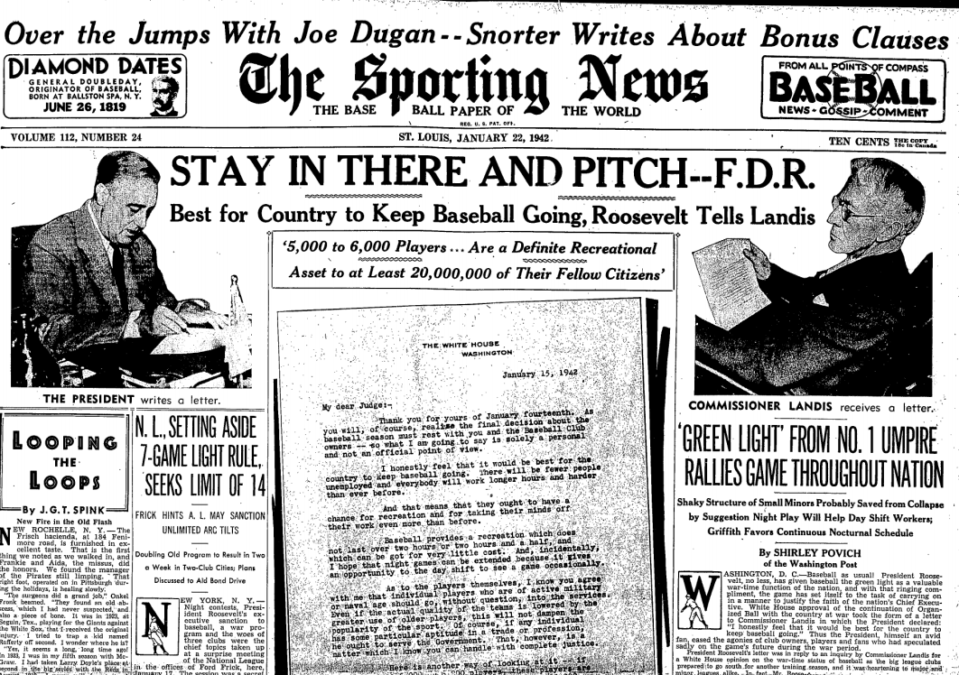
Notes:
And since baseball was given the green light to keep going during the war, players who would never have even sniffed a professional contract before were brought in to keep the game going. This was especially true after Congress widened the draft pool to include ages 18 to 37 after the 1942 season.

Slide 44
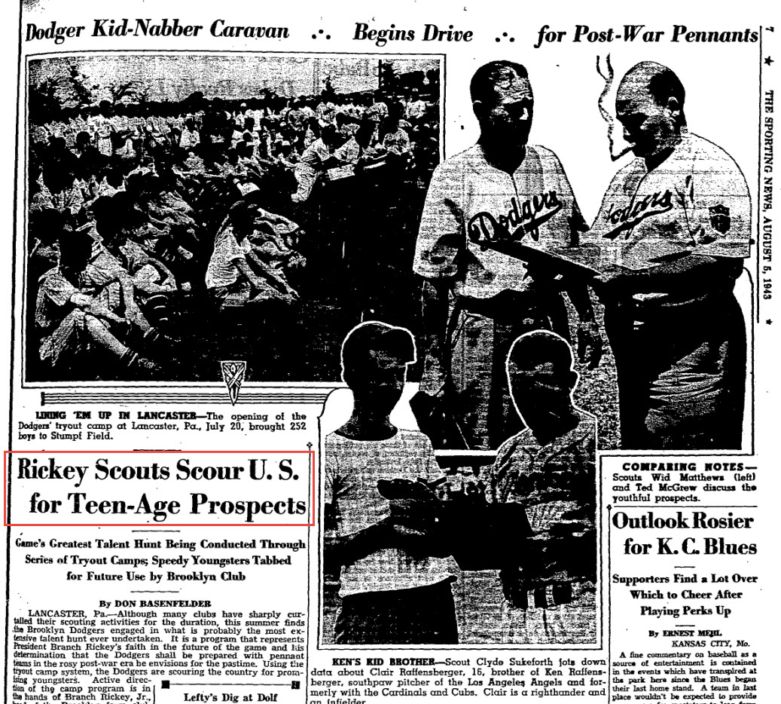
Notes:
As a result several big league teams started actively recruiting minor children for both their farm clubs and big clubs. One Dodgers tryout in Pennsylvania drew 252 underage hopefuls. Dem Bums eventually fielded six minors on their major league squad, while the Phillies fielded five.

Slide 45
Notes:
In all, 15 minor children played 17 seasons worth of big-league baseball [*] between 1943 and 1945. That’s the most of any similar length period in big-league history.

Slide 46
How could a 16-year-old have ever been allowed to play major league baseball in the first place?
In the 19th Century, the game of baseball was so new, hardly anybody was an expert at playing it.
World War II
The Bonus Baby Rule
Notes:
But that wasn't the last time we’d see a lot of minors in the majors. The final circumstance under which a big-league team could possibly defend putting a 16-year-old on its roster was [*]: the Bonus Baby rule.
This rule was passed in 1947 and was intended to

Slide 47
Notes:
prevent rich organizations like the [*] Yankees and Dodgers and Cardinals from signing all the best amateur talent [*] and then stashing them away on their farm clubs. A stronger form of this rule was passed in 1952 that required any player who received

Slide 48
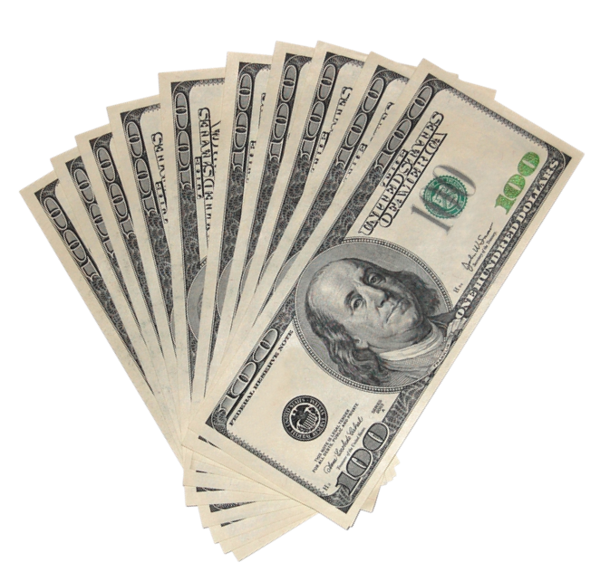
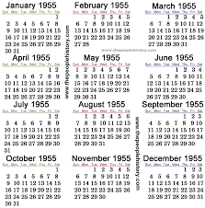
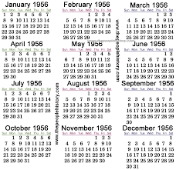
Notes:
a $4,000 bonus or more, to remain on the big-league roster [*] for two years, or risk being exposed to the waiver wire.
This rule led to the signing of incredibly young, barely proven players leading not only to our two sweet 16s of the 1950s, but also a sharp increase in 17- and 18-year-old big leaguers as well.

Slide 49
Notes:
In the years after the war and before the new bonus baby rule, the majors averaged about two 17- and 18-year-olds per year; [*] in 1953 that jumped to eight; [*] in 1955 to eleven; and [*] in 1957 to fifteen. After the Bonus Baby rule [*], that number never reached double digits again.
And, of course, there has not been a 16-year-old major leaguer since.

Slide 50
Why Didn’t 16-Year-Old Big Leaguers Go On to Have Good Careers?
They generally did not get regular playing time
Not against talent-appropriate competition
They may not have been accepted by their teammates
They may not have been able to withstand pressure to be in the major leagues
They were too little
They missed their mommies
They were chosen for ML rosters out of convenience, not for their major league level ability
Notes:
Which points to another reason why 16-year-olds did not have great careers: [*] they were typically chosen for major league rosters based on convenience, rather than for their ability to play baseball at a major league level. Which they can’t.
Now, we all know that baseball is an exceedingly complicated sport to master. It takes more than just strength or speed to excel at baseball, neither of which even 16-year-old outliers have in major league quantities, anyway. It takes years and years of practice to ingrain the instinctual play we take for granted that a major leaguer should be able to do.

Slide 51
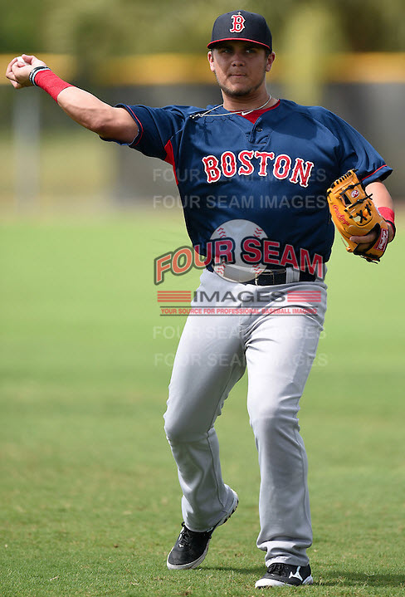
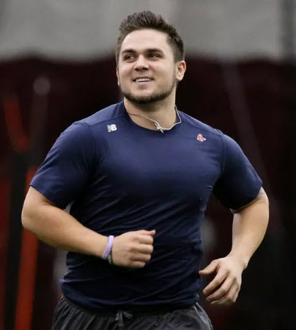
Michael Chavis, 2014
18-year-old minor leaguer
Michael Chavis, 2019
23-year-old major league rookie
Notes:
The average major leaguer logs almost five years in the professional minors, and while he probably gets bigger during that time, he was still adult-sized when he started.

Slide 52
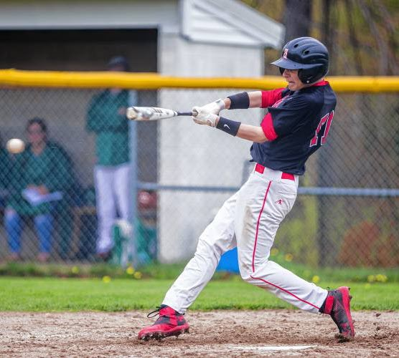
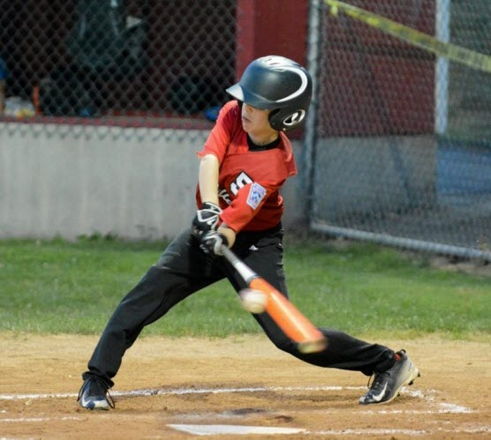
16-year-old baseball player
11-year-old baseball player
Notes:
Five years ago, a 16-year-old baseball player ... [*] was an 11-year-old kid, probably hitting Little League home runs. (See what I did there?) There’s literally no chance he’s going to grow and learn enough in those five years to play the game competitively at the major league level, and history is our proof of that.
Even though it’s now been 63 years since a 16-year-old has been welcome onto a big league roster, you might be thinking, come on, there’s gotta to be some Lotto-level odds that somewhere in the world, there’s at least one 16-year-old who can and will play major league baseball. Right? It’s a big world, and after all, it’s already happened 15 times before.

Slide 53
Is it possible that a 16-year-old could ever play in the major leagues again?
Could it happen? Technically, yes.
Will it happen?
Notes:
So, this leads to the obvious question: [*] Is it possible that a 16-year-old could ever play in the major leagues ever again?
There is no specific rule against it, so, [*] technically: yes, it could happen.
[*] Will it ever happen again? [*]Nope. No way.
Why not? How can I be so confident about this? I can be confident about this because the system has been effectively designed to prevent 16-year-olds from playing in a major league game ever again.

Slide 54
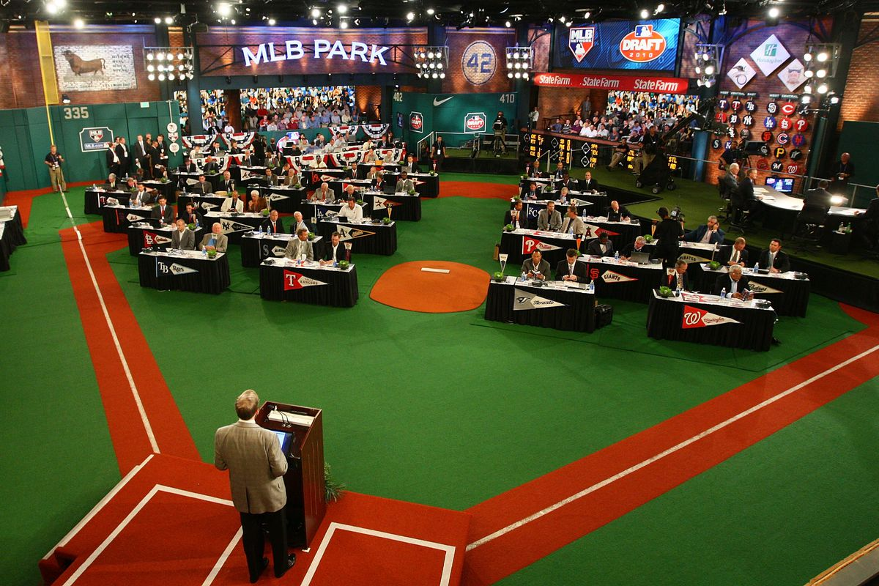
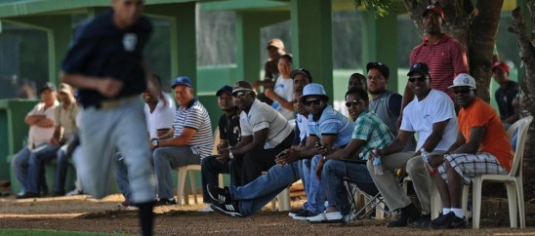
How Young Amateur Talent Enters Organized Baseball
MLB Rule 4 (Amateur) Draft
Amateur Free Agency
Notes:
There are two ways for young amateur talent to enter Organized Baseball: [*] one is the draft, and the other is [*] the international amateur free agent market. Let’s talk about the draft first.

Slide 55
Eligibility for the Amateur Draft
US and Canadian players only
Completion of four years of high school OR one year of junior college
Also eligible: Three-year high school graduates
Must turn seventeen within 45 days after draft
Notes:
This is practically the one way [*} the best young talent only in the US and Canada can enter Organized Ball. To be drafted, a player [*] must complete four years of HS or, complete one year of junior college. But, in an unusual twist, [*] three-year HS grads can be drafted [*] as long as they turn 17 within 45 days after the draft.
So technically, a player can be drafted at age 16, and unfortunately, my article was wrong in stating that the youngest draftee was Alfredo Escalera at age 17 years 114 days. That appeared in a Baseball America article, so it seemed unimpeachable. But combing through the history of the draft myself I was able to identify at least one 16-year-old who was drafted

Slide 56
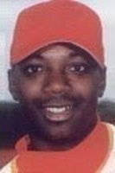
Johnny Ruffin
Drafted 1988 by White Sox (4th Round)
Age 16-308
Notes:
[*] Johnny Ruffin, who was 16 years 308 days when he was drafted out of high school [*] by the White Sox in 1988.
You’ve heard of Johnny Ruffin, right? You’ve probably also heard that he was not a 16-year-old major leaguer. You knew that, right? Yep, it’s true, he did not go direct to the majors—he made his debut at 22.
It’s very unusual for anyone drafted out of high school to go direct to the majors.

Slide 57
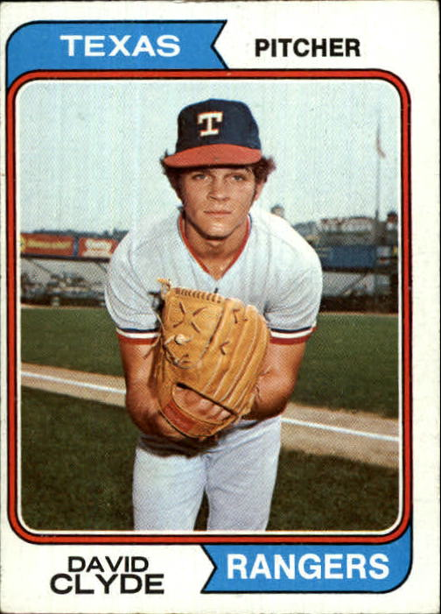
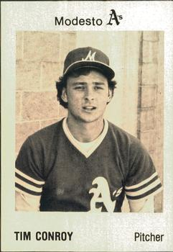
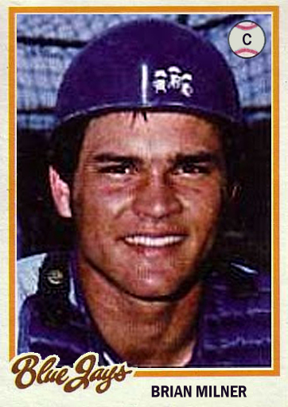
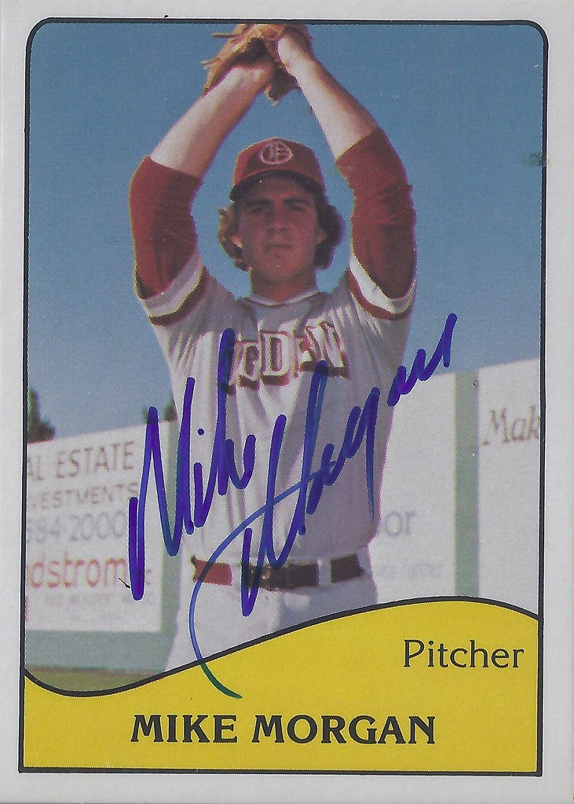
Every Player Drafted out of High School Who Has Gone Straight to the Majors
1973
1978
1978
1978
Notes:
In fact, it’s happened to only four players in the history of the draft: [*] David Clyde in 1973; and [*] Tim Conroy, Brian Milner, and Mike Morgan in 1978. All of them, already 18 years old.
So because of the way the draft has been set up, it’s nearly impossible for American or Canadian resident players to make a big-league team at age 16.

Slide 58
Amateur Free Agency
Undrafted US/Canadian players can go this route, but ... you know ... they didn’t get drafted ... so ... no chance
International Amateur Free Agent: all “foreign” (non-US/Canada) players
Can be signed and play professionally at 16, but must turn 17 by September 1 of first season under contract
HOWEVER: Almost all 16-year-old AFAs play exclusively in Latin American summer leagues
Notes:
The second way a good young player can break into Organized Ball is to sign as an [*] amateur free agent. Undrafted Americans and Canadians [*] can go this route, but only if they’ve been passed over for the draft, which, you know, would mean they’re not very good players, so they’re not going to be 16-year-old big leaguers. Case closed on that.
Not the case for [*] international free agents. The very best foreign players [*] can and do sign contracts and undertake their professional careers at the age of 16. By rule they must turn 17 by September 1 to be eligible, but nevertheless, a young foreign player can play an entire season of Organized Ball at the age of 16. However: [*] almost all of these guys end up playing exclusively in Latin American summer leagues.

Slide 59
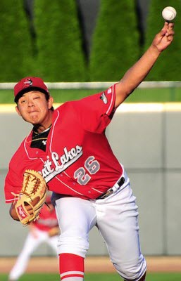
Notes:
Since 2006, according to Baseball Reference, 449 sixteen-year olds have played in Organized Ball. 92% of them played in foreign summer leagues exclusively. Only 7.8% got to play on North American soil, and that 0.2% at the top? That’s [*] Julio Urias, the only 16-year-old in the past thirteen seasons to make it as high as A ball. He made his big-league debut at age 19 years, 289 days.

Slide 60
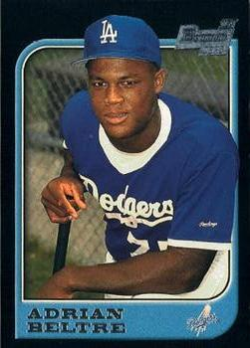
Youngest International Big Leaguer in the DSL Era
Debut Age: 19 years, 78 days
Notes:
In fact, the youngest-ever international major leaguer since the founding of the DSL 34 years ago was [*] future Hall of Famer Adrian Beltre at age 19 years and 78 days.
No 18-year-olds, no 17-year-olds, and definitely no 16-year-olds.
To illustrate just how unlikely it is that another 16-year-old major leaguer will ever appear again, let’s consider the case of

Slide 61
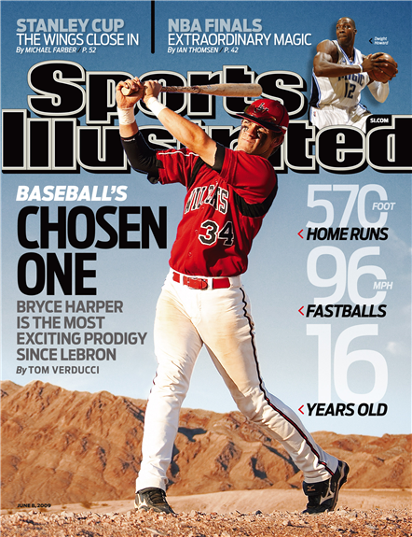
The Case of Bryce Harper
SI Cover Boy at age 16 in June, 2009 as greatest teenage hitter in recent memory
Got high school GED as a soph, enrolled in JC to accelerate arrival in the majors
Slashed .443/.526/.987 in 272 PAs
Drafted #1 overall in 2010
Age: 17 years, 224 days
Still, the Nationals sent him to the minors for 164 games
Debuted in 2012 at age 19 years, 195 days
Notes:
the best and most-hyped young player [*] of our time: Bryce Harper. America met Bryce when he was a [*] Sports Illustrated cover boy ten years ago this month. He [*} earned his GED as a sophomore and enrolled in junior college specifically so he could front-burner his arrival to the majors. He put up [*] an insane slash line at JC and the Nationals did indeed select him [*] #1 overall in the 2010 draft. At that point he was already aged 17 years, 224 days. And rather than place the greatest teenage hitter of our generation directly onto their big-league roster, the Nationals instead [*] sent him to the minors to play a big-league season’s worth of games before he debuted in 2012, [*] age 19 years 195 days.

Slide 62
The Case of Bryce Harper
SI Cover Boy at age 16 in June, 2009 as greatest teenage hitter in recent memory
Got high school GED as a soph, enrolled in JC to accelerate arrival in the majors
Slashed .443/.526/.987 in 272 PAs
Drafted #1 overall in 2010
Age: 17 years, 224 days
Still, the Nationals sent him to the minors for 164 games
Debuted in 2012 at age 19 years, 195 days
Notes:
So, not even an obviously transcendent talent who tried as hard as he could to get into the majors as young as possible could crack a roster closer to his 19th birthday than his 20th birthday. And even once he did, he was still the youngest player to play in the big leagues in almost 14 years.
The conclusion is inescapable: the major league system has been rigged against 16-year-olds—not to mention 17-year-olds and, really, 18-year-olds, too. If the greatest young talent of recent memory couldn’t make a roster younger than 19, what chance does a 16-year-old have?

Slide 63
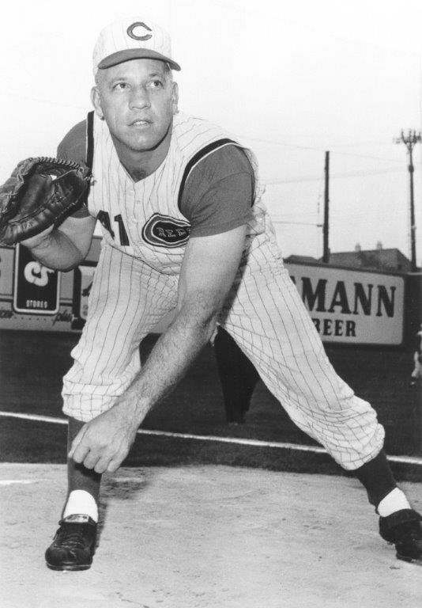
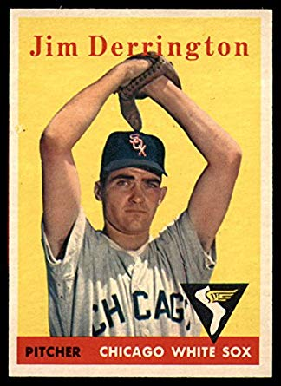
Most Recent Players at Xteen
Joe Nuxhall
Age: 15-316
Debut: 6/10/44
Jim Derrington
Age: 16-306
Debut: 9/30/56
Notes:
So we know that [*] Joe Nuxhall was the only 15-year-old to appear in a big league game, and [*] Jim Derrington was the most recent 16-year-old to appear. Does anybody know who the most recent 17-year-old was?

Slide 64
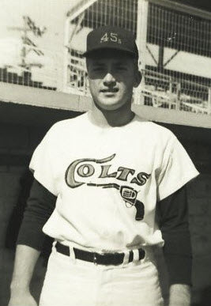
Most Recent Players at Xteen
Joe Nuxhall
Age: 15-316
Debut: 6/10/44
Jim Derrington
Age: 16-306
Debut: 9/30/56
Jay Dahl
Age: 17-295
Debut: 9/27/63
Notes:
Jay Dahl. He was last actual 17-yo to enter a major league game. He pitched two and two-thirds innings and gave up seven runs, five earned. He also died at age 19 in a car crash. He was, coincidentally, the second Colton, California High School baseball star in 16 months to die of a fatal injury while under baseball contract. The other one was Ken Hubbs.
Willie Crawford (18-009) and Larry Dierker (18-000) played in 1964 in what was considered their age 17 seasons, but both had turned 18 by their debuts. Dierker’s debut was his 18th birthday.
Who’s the most recent 18-year-old?

Slide 65
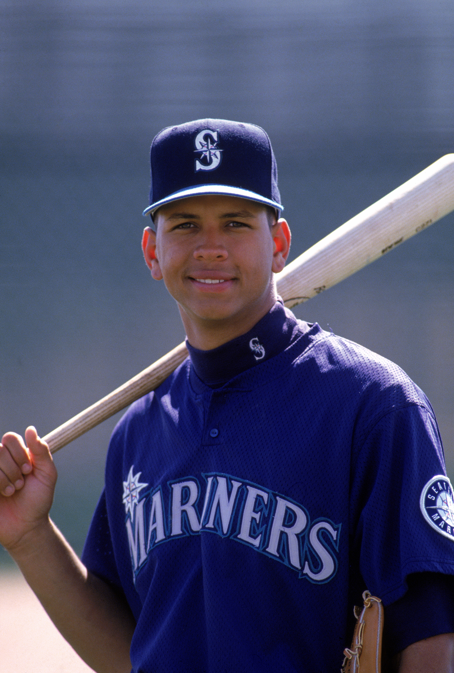
Most Recent Players at Xteen
Joe Nuxhall
Age: 15-316
Debut: 6/10/44
Jim Derrington
Age: 16-306
Debut: 9/30/56
Jay Dahl
Age: 17-295
Debut: 9/27/63
Alex Rodriguez
Age: 18-346
Debut: 7/8/94
Notes:
Alex Rodriguez was the first and only 18-year-old in the majors since the Conroy-Milner-Morgan troika of 1978. And he was only 19 days short of his 19th birthday, so it wasn’t by much, and he turned 19 during his stint before going back down to the minors after hitting .204 with no homers and 20 strikeouts in 59 plate trips.
Teenagers, amirite?

